Slide 1
  Introducing Arduino-programming to Vg2-students using an adaptation of the PRIMM-model from Kings College London.
  Sofie Aarnes, Teknologilinja Kuben vgs

Slide 2

Background
Arduino-programming in Teknologilinja vg1/vg2 and Elektrofag vg1
Top-down-approach (follow the teacher or tutorial step by step)
A lot of doing, little understanding →Variable outcome for the pupils

Slide 3

Can research show me how to teach programming so my pupils learn more?

Slide 4
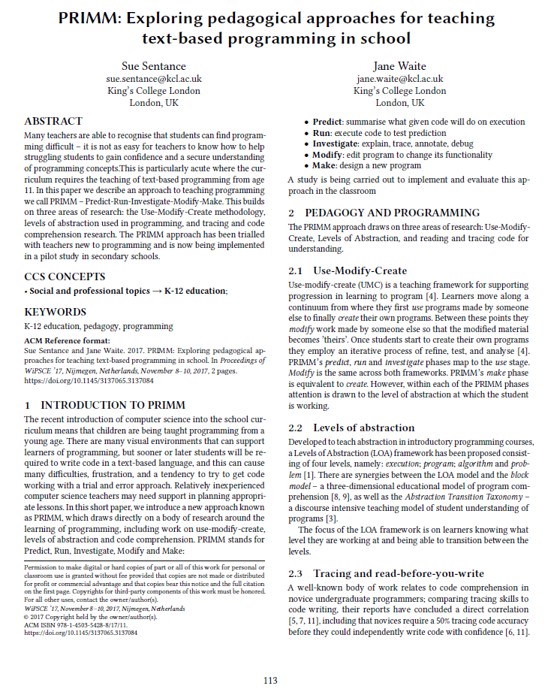

Slide 5
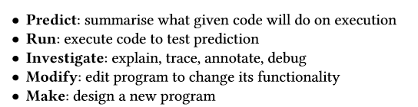

The PRIMM-method (Sue Sentance and Jane Waite, 2017)

Slide 6
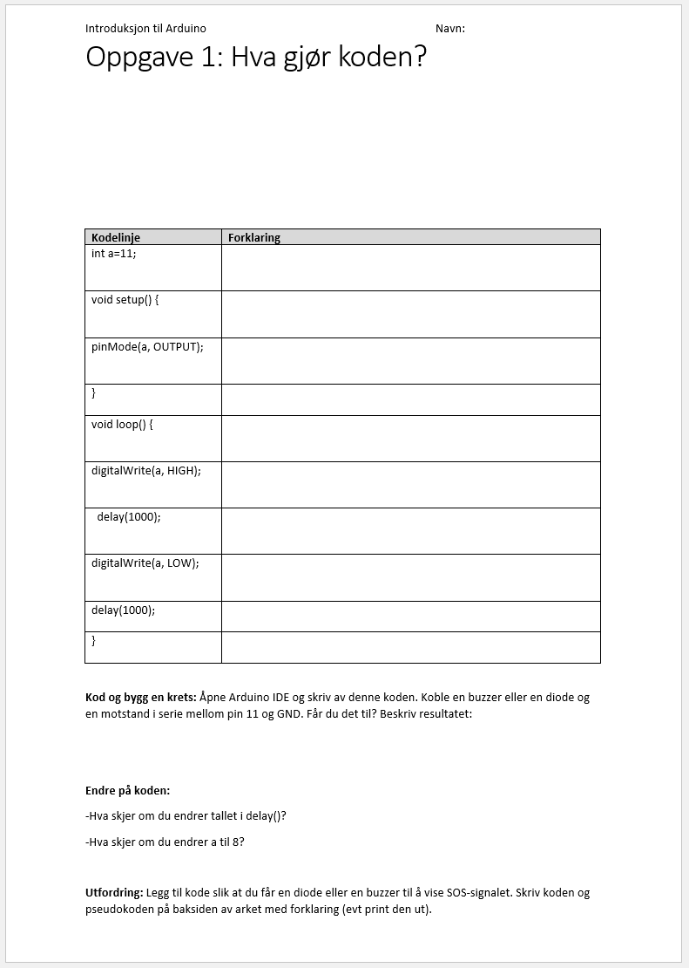
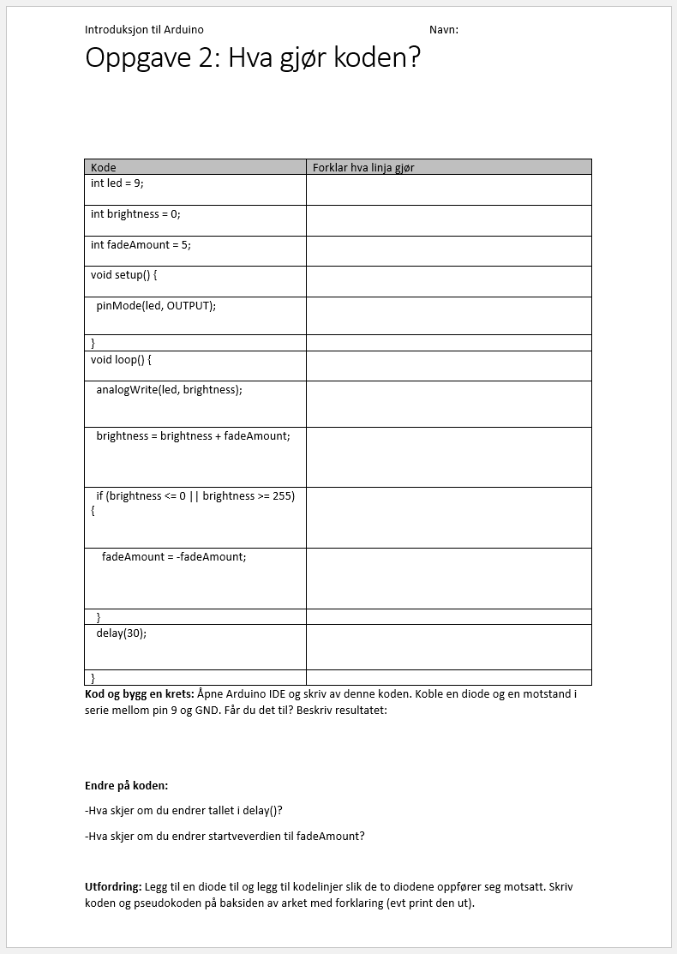
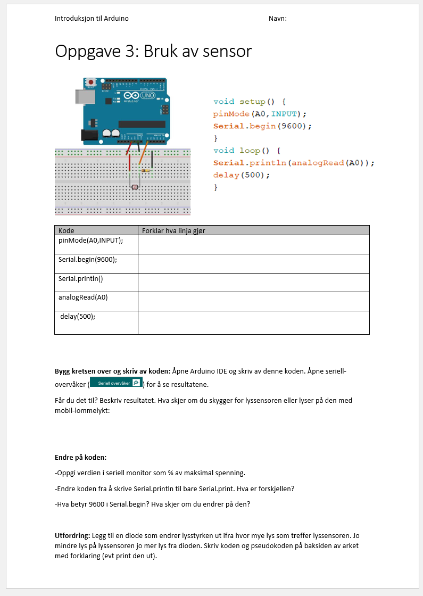
Arduino-programming for vg2 teknologilinja, 3 lessons with introduction-worksheets

Slide 7
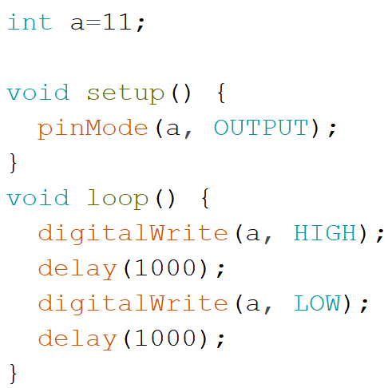
Example from the first lesson
Task 1: Guess what the code does? Discuss with your buddy.

Slide 8
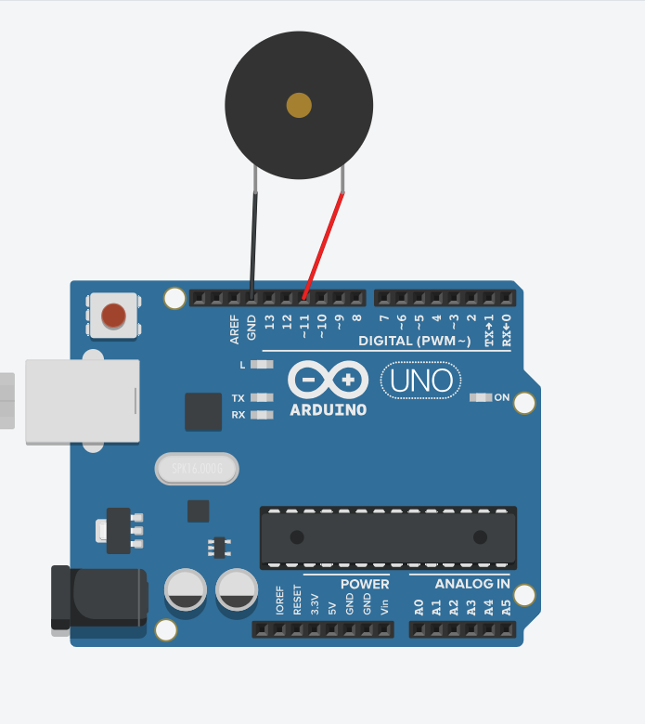
Example from the first lesson
Task 2: Connect a buzzer to pin 11 and GND on your Arduino UNO and run this code. What do you observe? Was your prediction right?

Slide 9
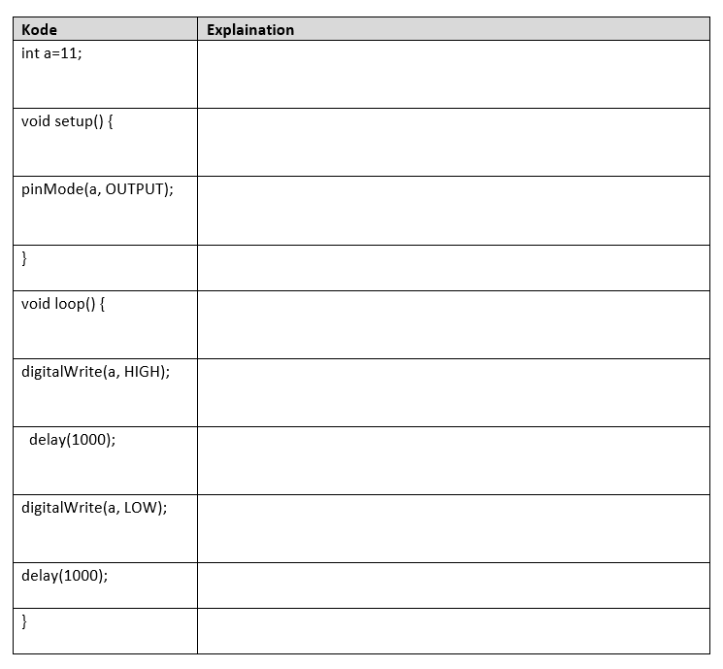
Example from the first lesson
Task 3: Fill out the worksheet.

Slide 10
Example from the first lesson
Task 4:Change the code:
- What happens if you change the number in delay()?
- What happens if you change a to 8?
Task 5: Challenge:
Add code so your buzzer buzz the S.O.S-signal.

Slide 11
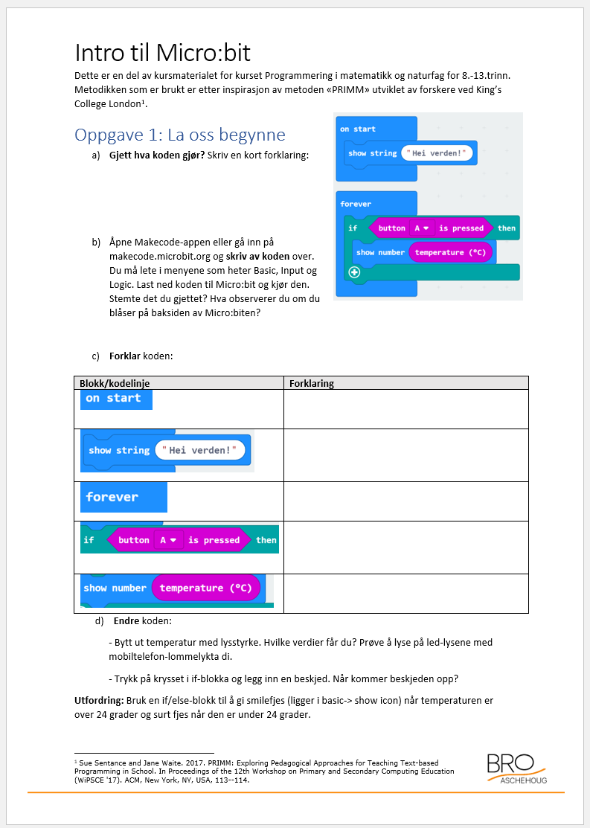

I have tried the PRIMM-approach in teacher courses as well

Slide 12


My experiences so far
The method makes pupils stop and think and not brainless copying code from a tutorial
The lessons hade a good balance between the teacher-led parts and individual/pair work
The worksheets makes the pupils self going
Differentiation in the challenge-task

Slide 13

  Takk for meg!

