Slide 1


Markus Sydenham
PhD-student
The Norwegian University of Life Sciences
Start-up Workshop PolliClim
Community ecology and bees
Markus Sydenham

Slide 2
Introduction
Name: Markus Sydenham
Nationality: Danish/English
Academic background:
  2010 Bsc biology NMBU
  2012 Msc Ecology NMBU
  PhD-student NMBU
Bee taxonomy
Community ecology of bees
Markus Sydenham
PhD-student
The Norwegian University of Life Sciences

Slide 3
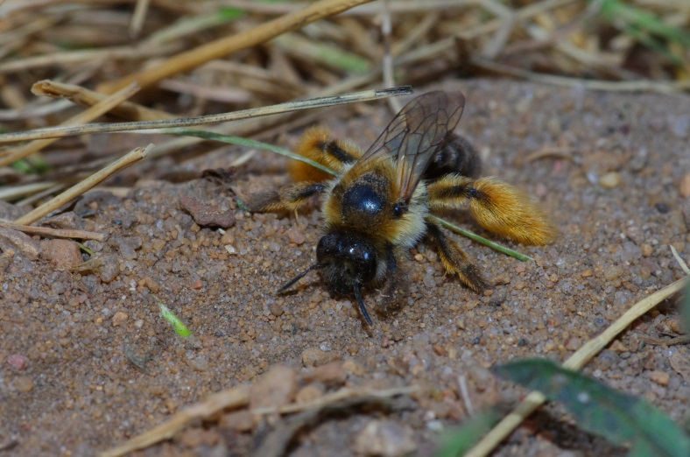
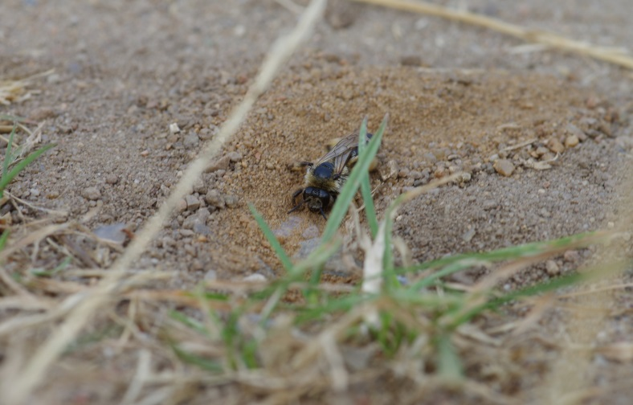
Which, When, Where and Why?
The Norwegian bee fauna
  Roughly 205 species
  Bombus: the most frequently encountered
  Andrena: The most species rich.
Life history traits
  Phenology
  Pollen collection
  Sociality
Markus Sydenham
PhD-student
The Norwegian University of Life Sciences

Slide 4
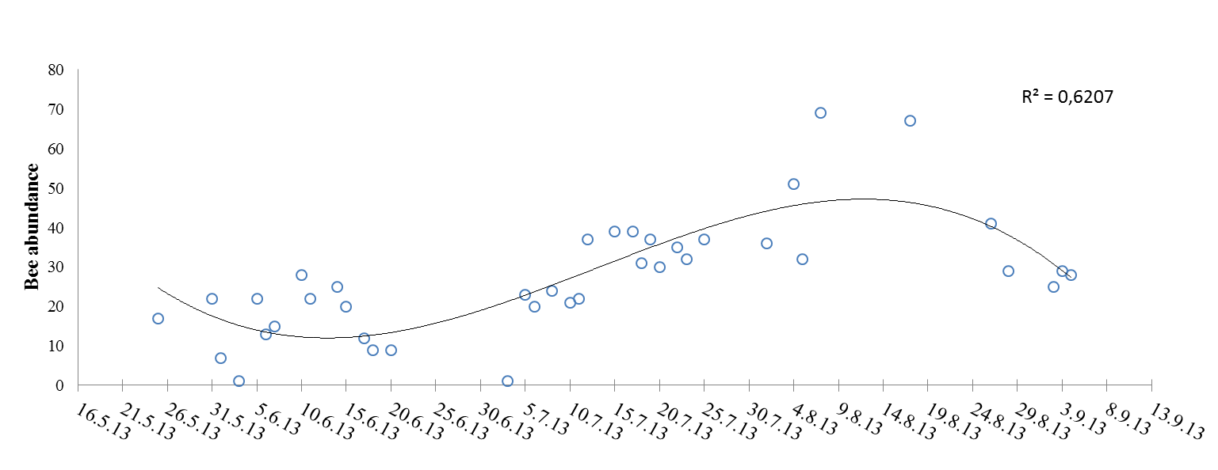
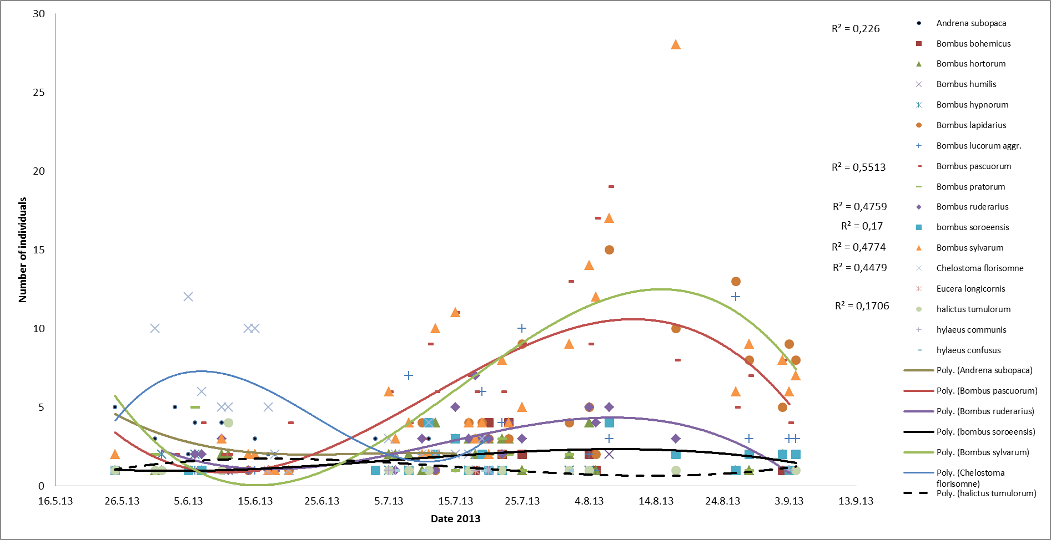
Which, When, Where and Why?
Phenology
Flowering time of raspberry 20.06 (Oslo)
  Bumble bee colonies not fully developed
  Both Solitary and Bumble bees may be relevant?
Markus Sydenham
PhD-student
The Norwegian University of Life Sciences

Slide 5
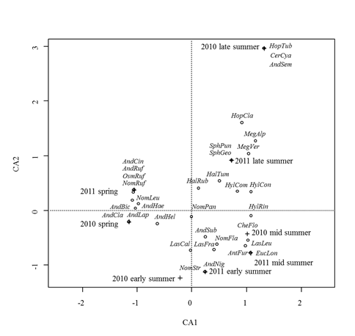
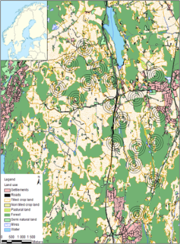
Which, When, Where and Why?
Phenology
  Seasonal Diversity in solitary bees
Climate change?
  Phenological mismatch between plants and bees?
Markus Sydenham
PhD-student
The Norwegian University of Life Sciences

Slide 6
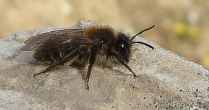
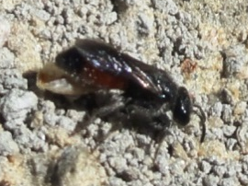
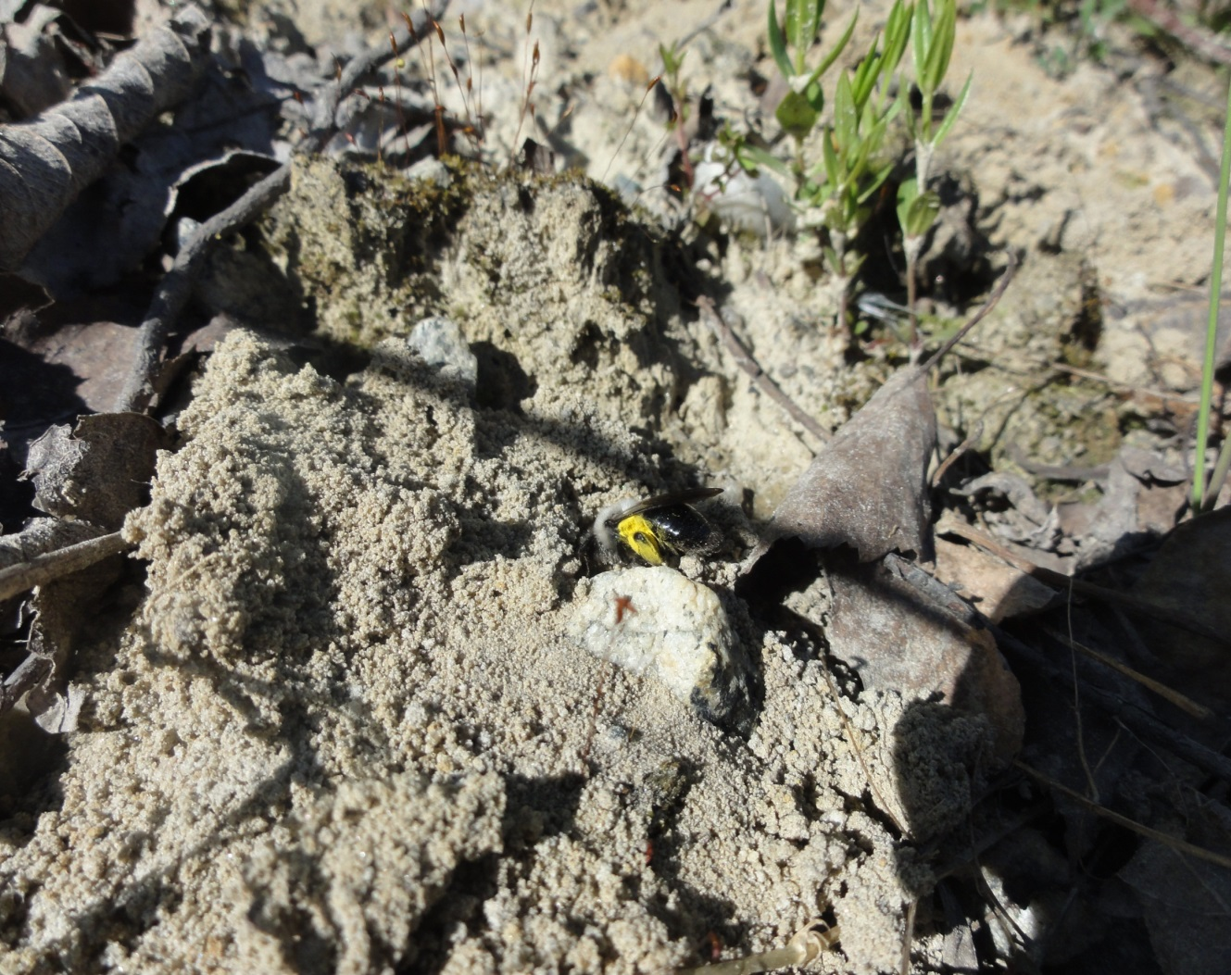
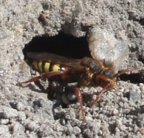
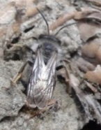
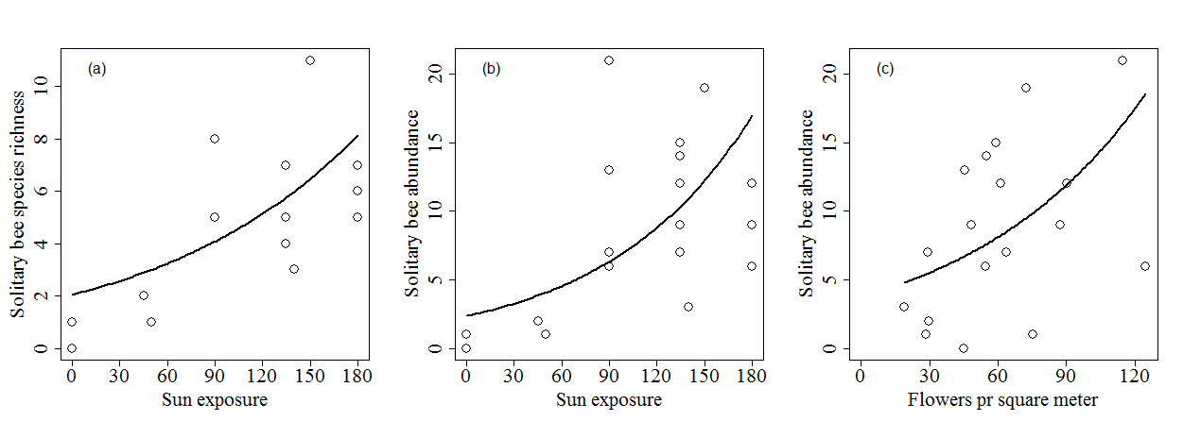
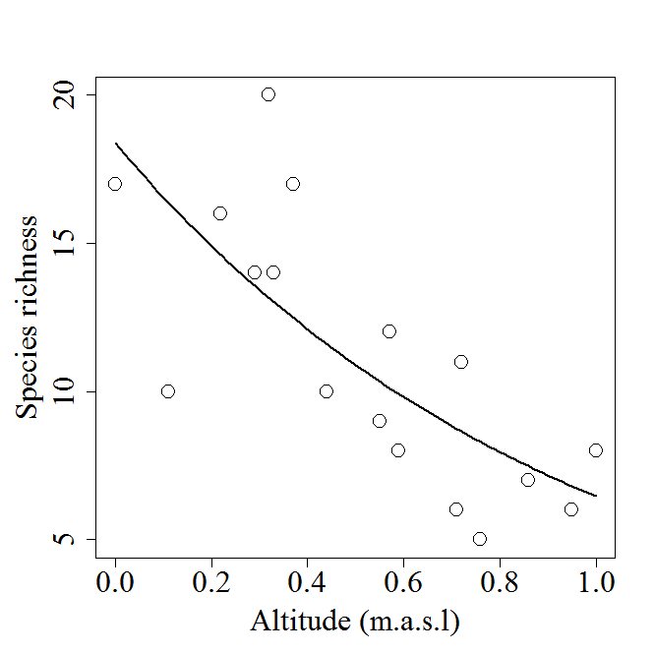
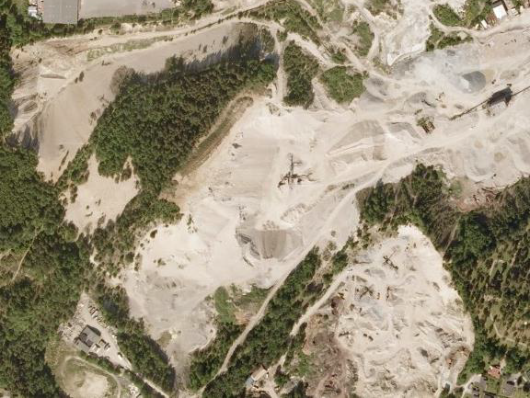
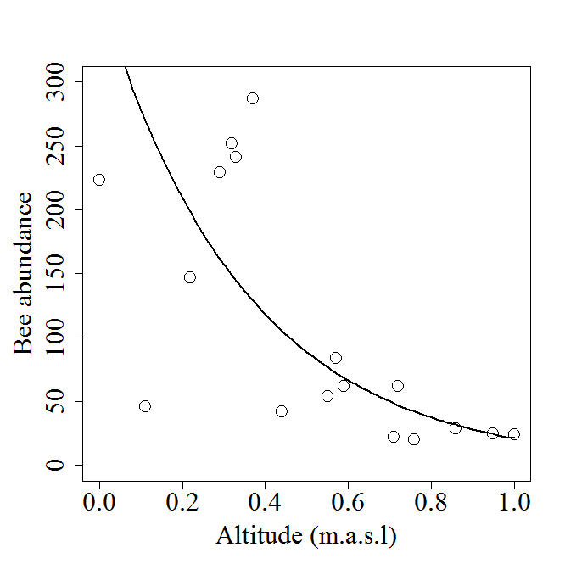
Which, When, Where and Why?
Drivers of species richness in Norway
  Nest site availability
  Sun exposure
  Altitude/latitude
Markus Sydenham
PhD-student
The Norwegian University of Life Sciences
a
b

Slide 7
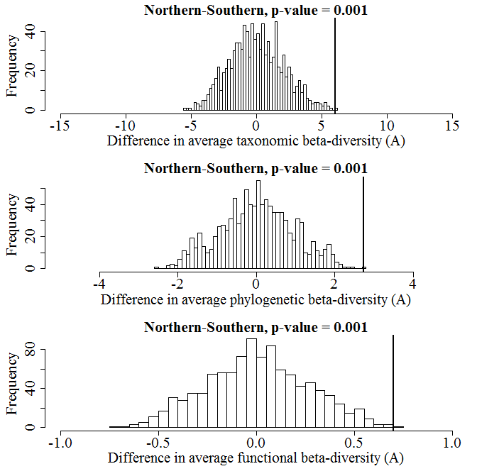
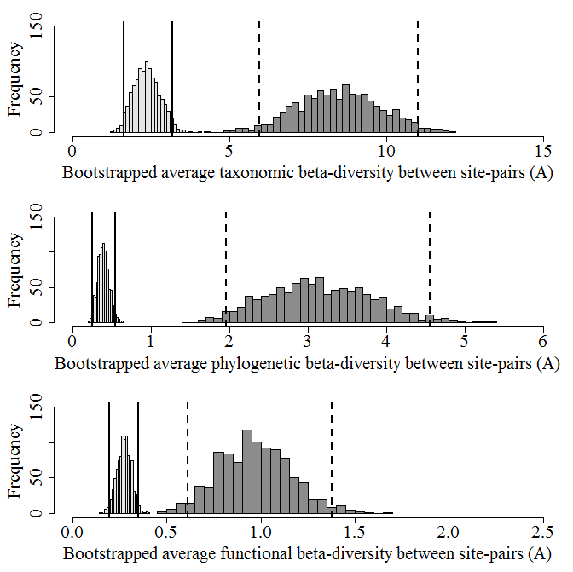
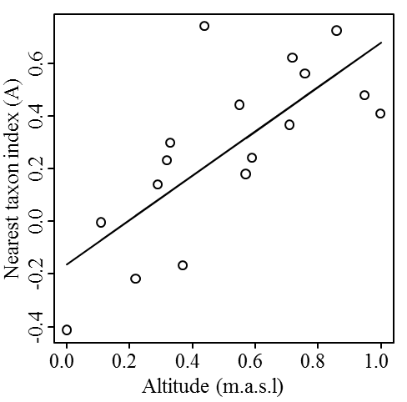
Which, When, Where and Why?
Phylogeny
  Bumble bees tolerate cold climates
More predictable communities at low latitudes/altitudes
Markus Sydenham
PhD-student
The Norwegian University of Life Sciences

Slide 8
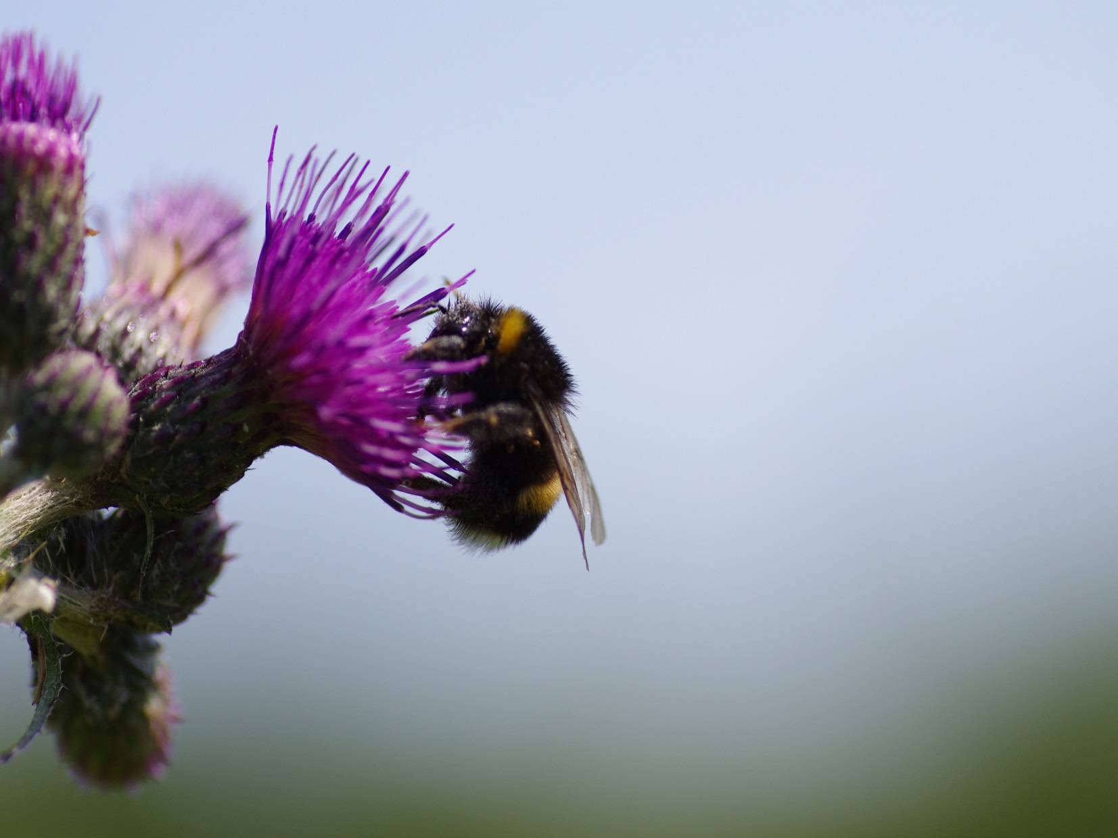
Thank you for listening
Markus Sydenham
PhD-student
The Norwegian University of Life Sciences

