Slide 1
Polliclim meeting
2014 04 08
Some considerations about spatial scale in the context of pollination ecology
Rune Halvorsen

Slide 2
The gradient analytic perspective
The gradient analytic perspective: explanations of natural variation based upon knowledge about environmental gradients and speciesʼ responses to these gradients

Slide 3
The gradient analytic perspective
Three fundamental insights:
  External ‘factors’ do not influence the species one by one, but act on the species in concert
  A few major complex-gradients normally account for most of the variation in species composition that can be explained environmentally
  Species occur within a restricted interval along each major complex-gradient

Slide 4
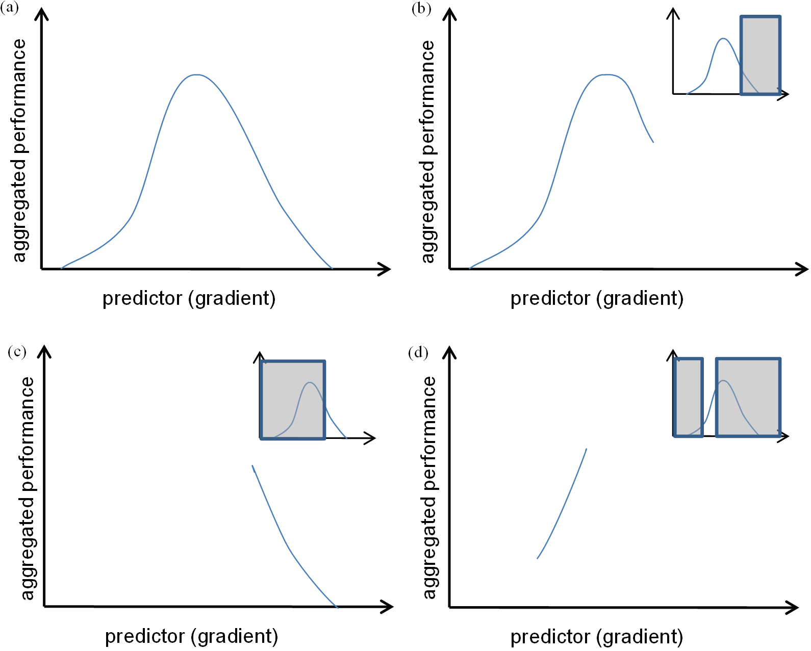

Slide 5
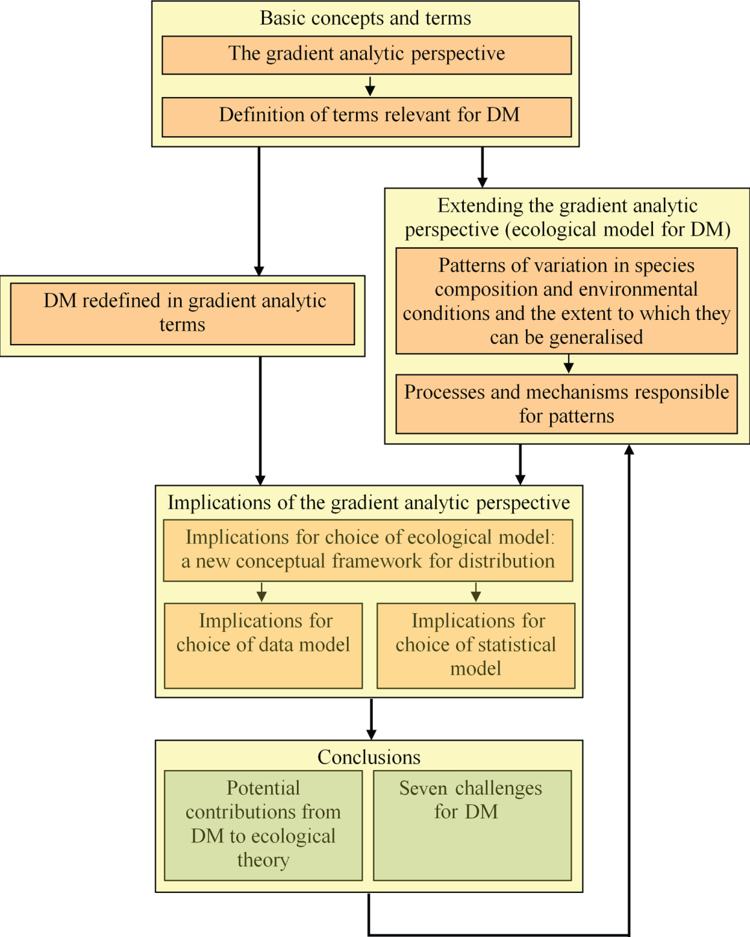
Relevance of the GAP for PolliClim

Slide 6
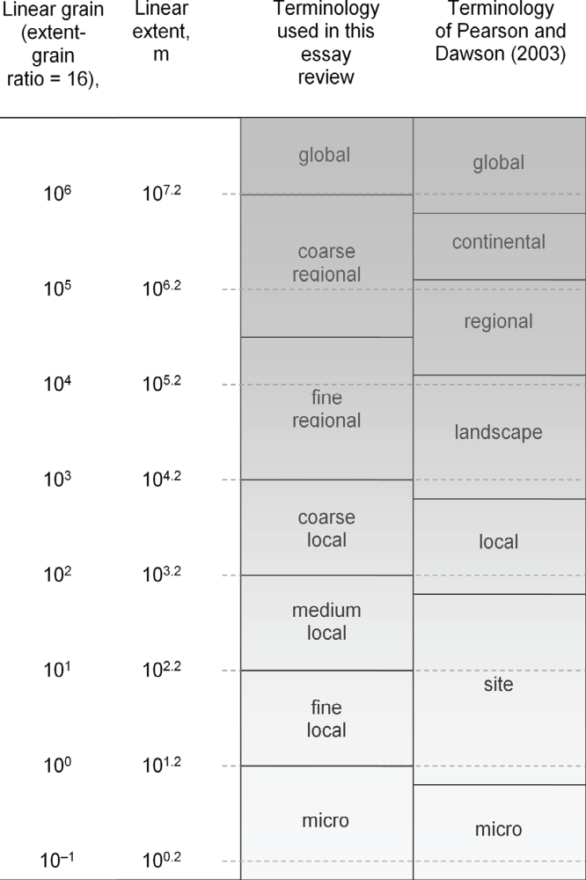
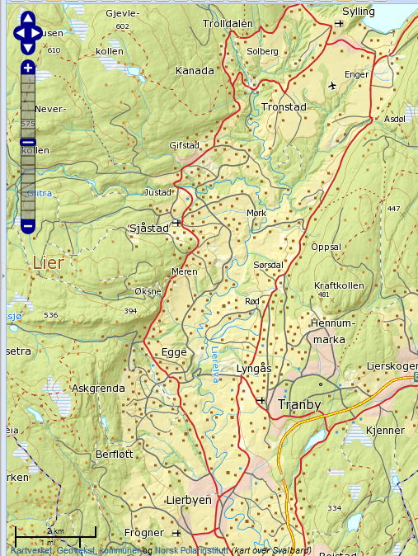
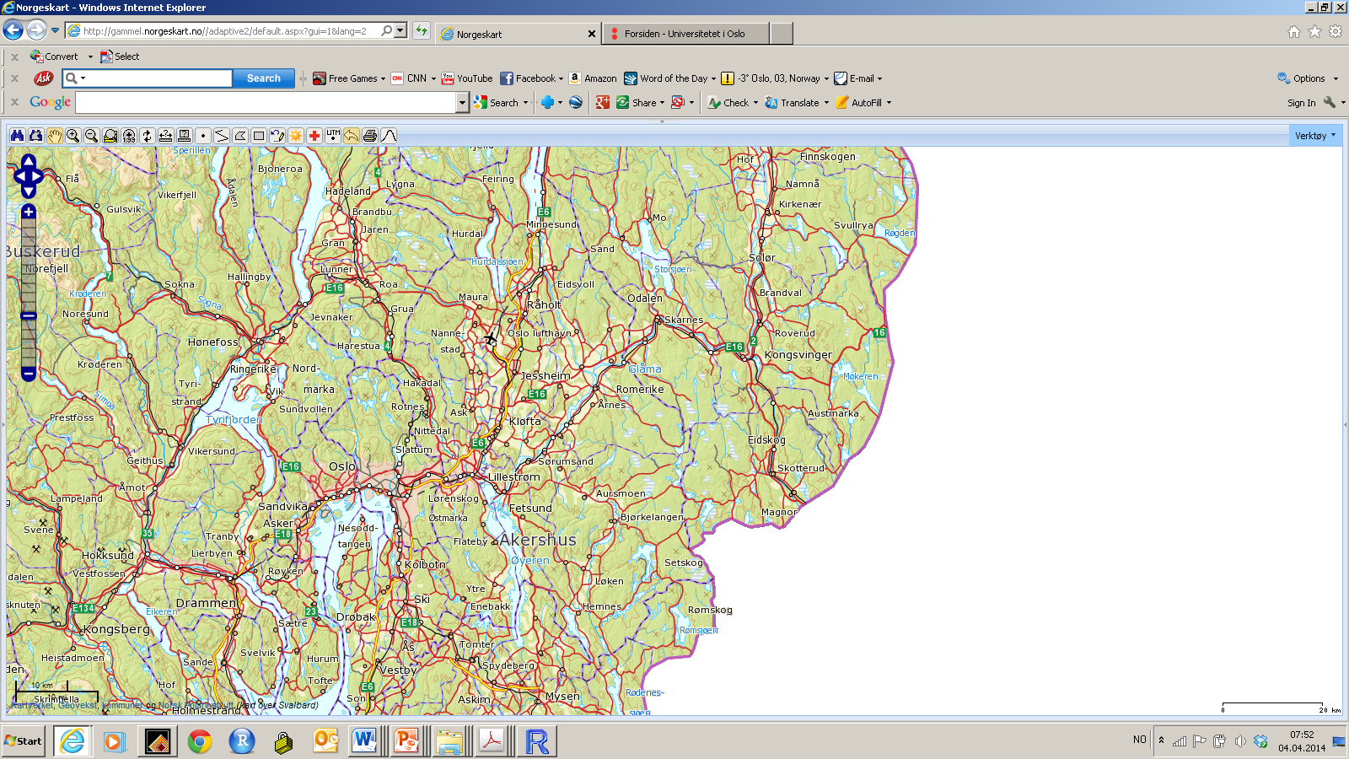
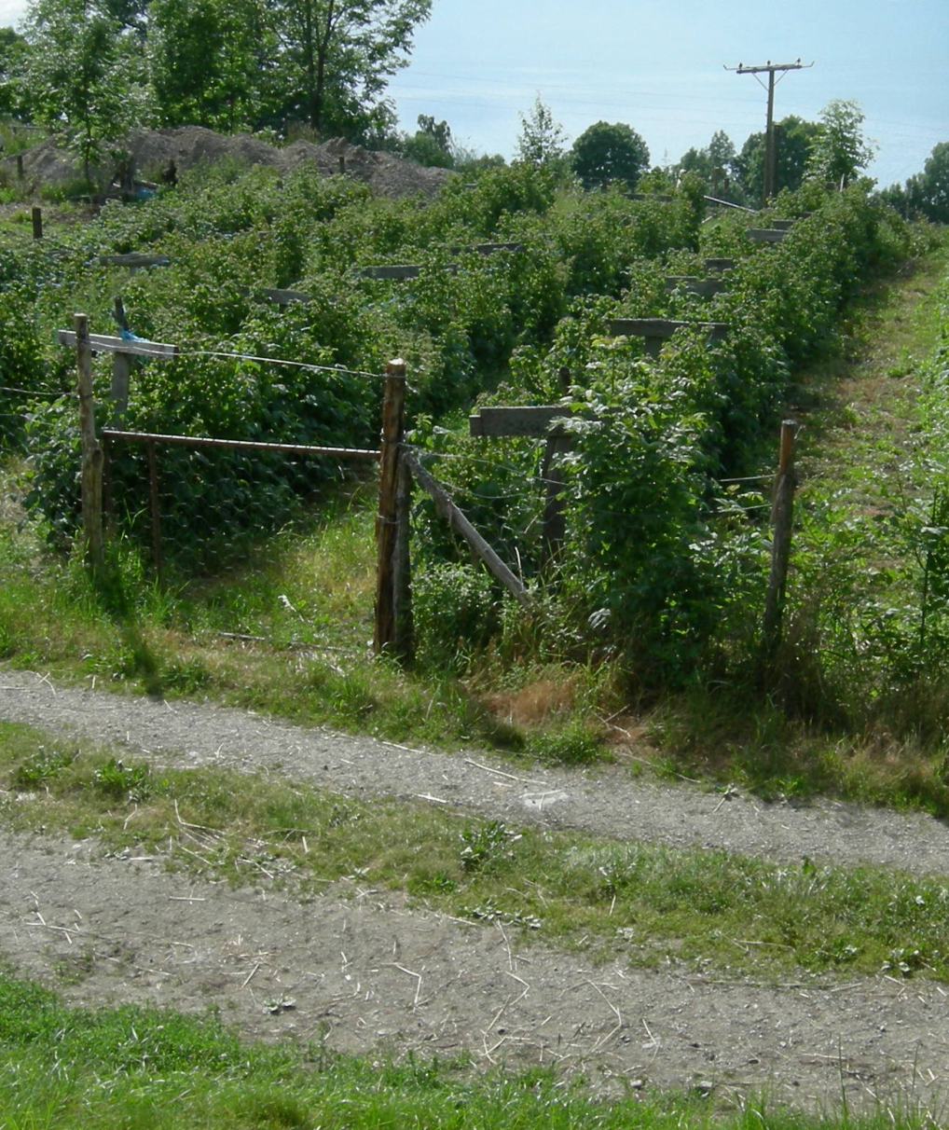
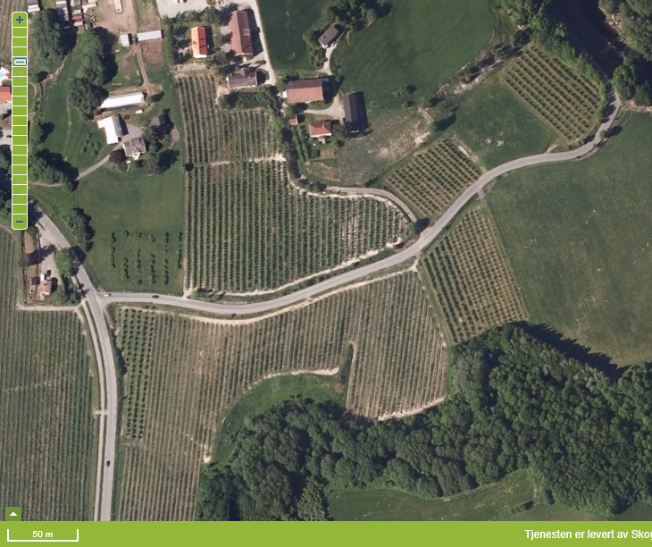
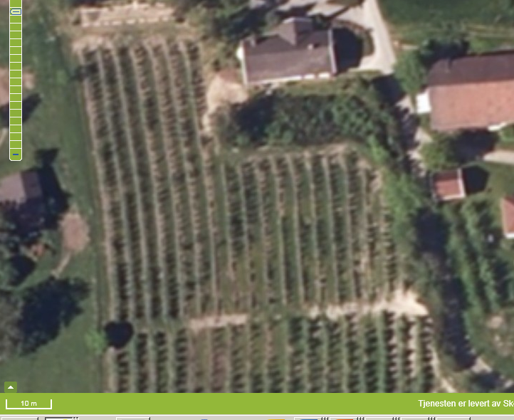
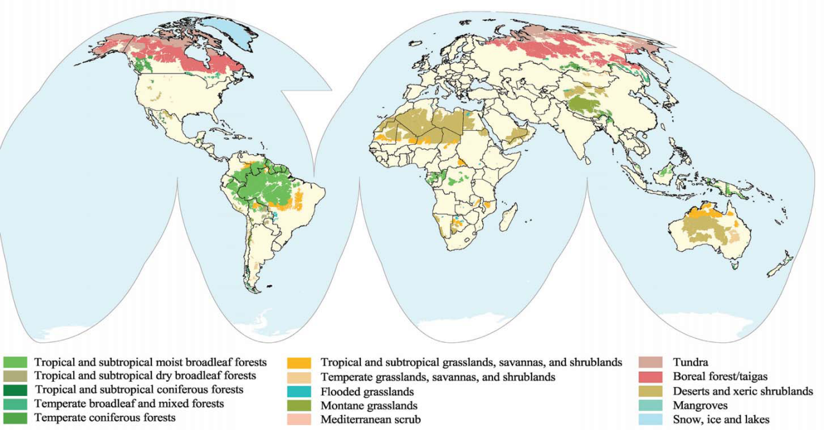
Spatial scales
(sub-) continent
region
municipality
farm
field
patch
individual plants

Slide 7
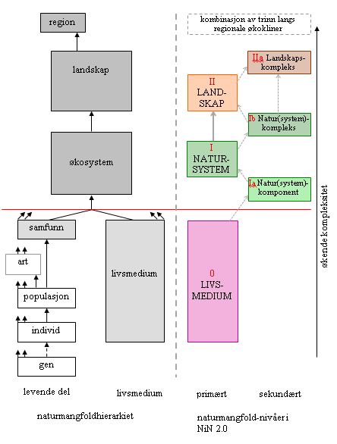
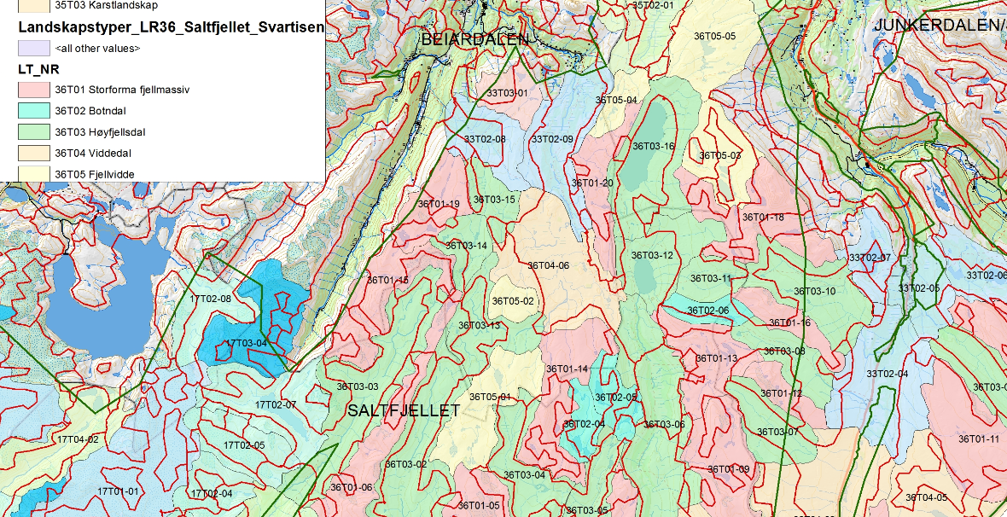
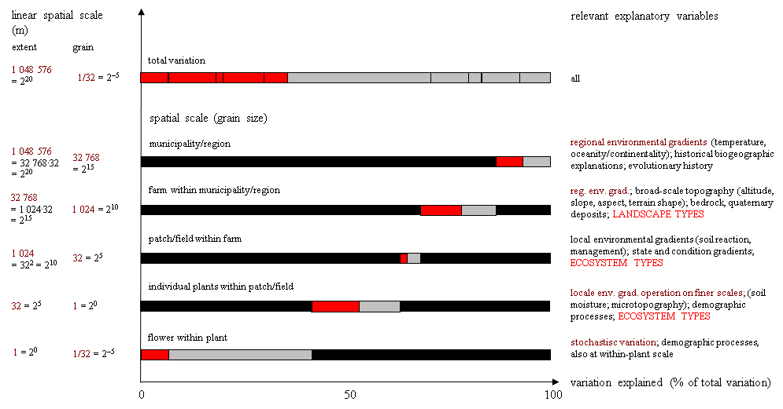
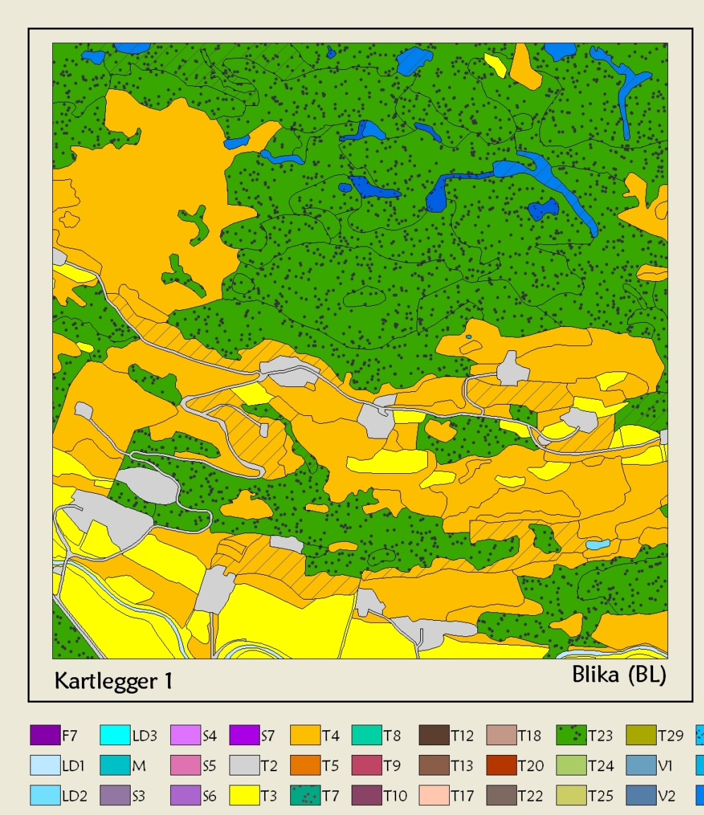
A variation partitioning perspective

Slide 8
Statistical considerations
Mixed models for hierarchical (nested) sampling designs
level a (sub-) continent mod1 <- glm(y ~ β₁x1 + β₂x2 + ... )
level b region mod2 <- lmer(y ~ β₁x1 + β₂x2 + ... + (1|a))
level c municipality mod3 <- lmer(y ~ β₁x1 + β₂x2 + ... + (1|a) + (1|a:b))
level d farm mod4 <- lmer(y ~ β₁x1 + β₂x2 + ... + (1|a) + (1|a:b)
+ (1|a:b:c))
level e field mod5 <- lmer(y ~ β₁x1 + β₂x2 + ... + (1|a) + (1|a:b)
+ (1|a:b:c) + (1|a:b:c:d))
level f patch mod6 <- lmer(y ~ β₁x1 + β₂x2 + ... + (1|a) + (1|a:b)
+ (1|a:b:c) + (1|a:b:c:d) + (1|a:b:c:d:e))
level g individual plants mod7 <- lmer(y ~ β₁x1 + β₂x2 + ... + (1|a) + (1|a:b)
+ (1|a:b:c) + (1|a:b:c:d) + (1|a:b:c:d:e)
+ (1|a:b:c:d:e:f))

