Slide 1
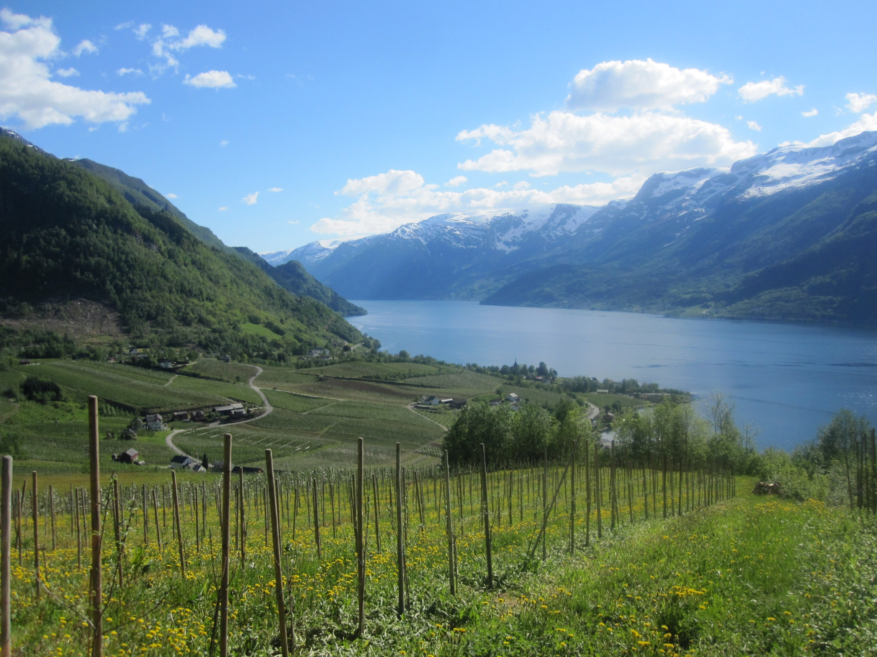
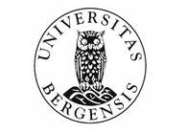

Pollination on applecrops in Norway
Av Ynghild Storhaug
Advisors: Sandra Bosch, Vigdis Vandvik og Bjørn Arild Hatteland

Slide 2
Master thesis
Pollination as an ecosystem service on applecrops in Hardanger, Norway
Which factors affect the abundance of pollinators and the yield

Slide 3
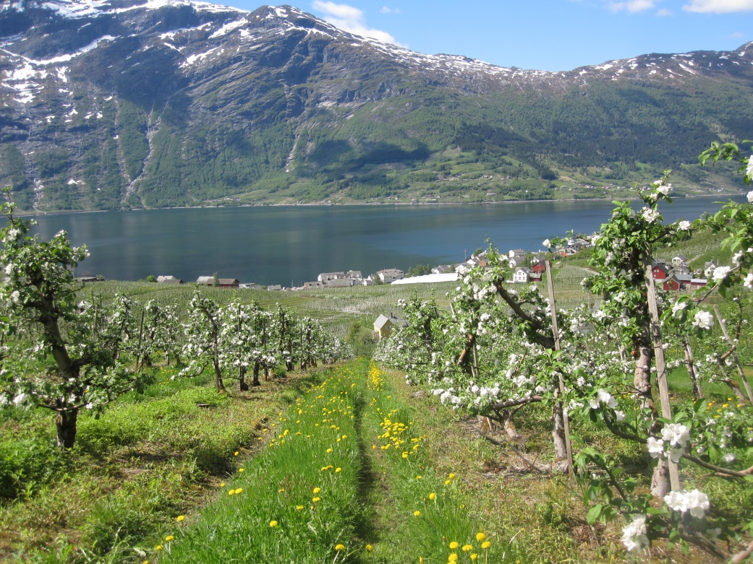
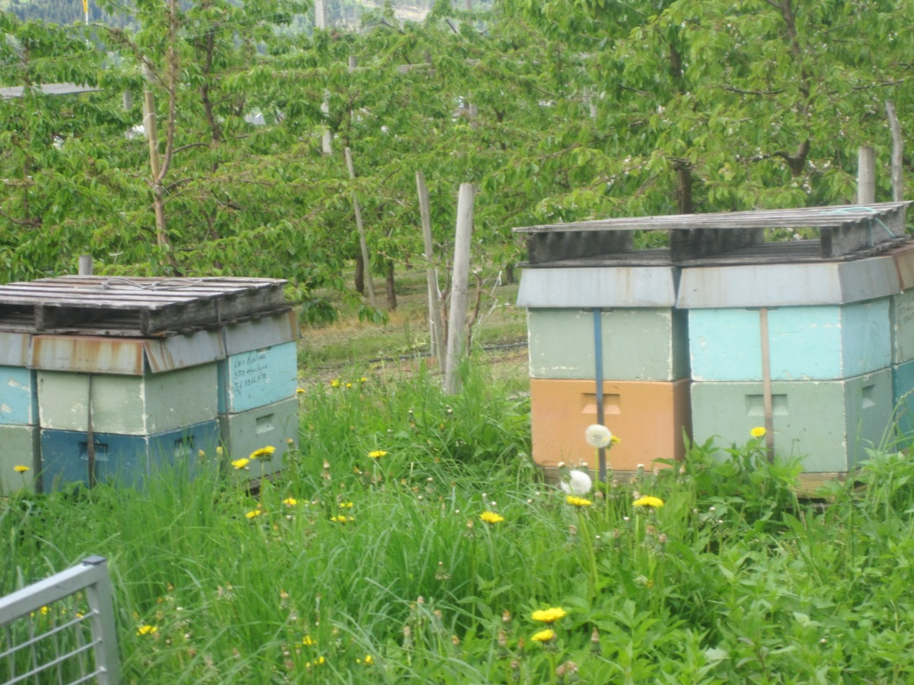
Apples
Crop rows
Warm areas, good climate, soil and seasonal variability
Hordaland, Telemark, Buskerud, Sogn og Fjordande, Vestfold and Rogaland
Few wild insects →hives
Notes:
How to work with farmers. Interaction before and during fieldwork

Slide 4
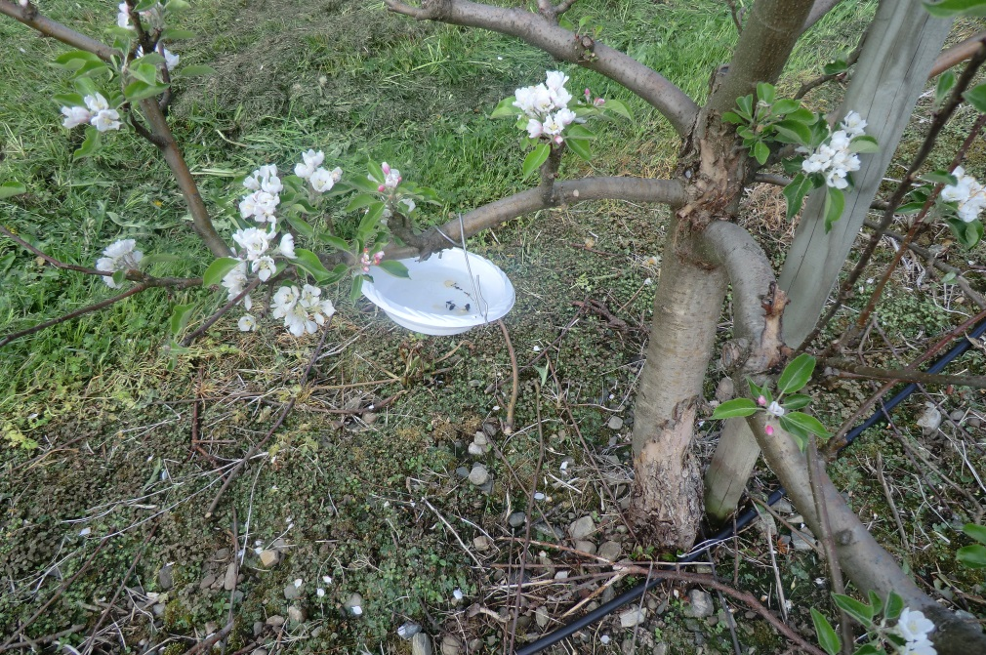
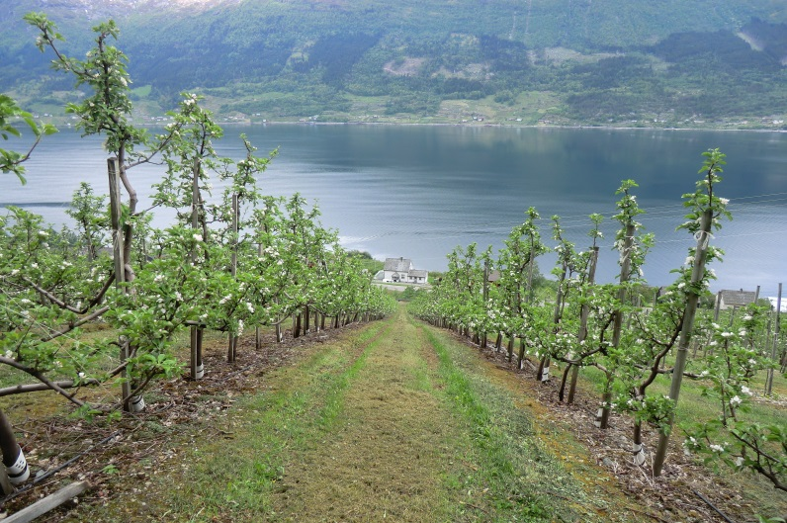
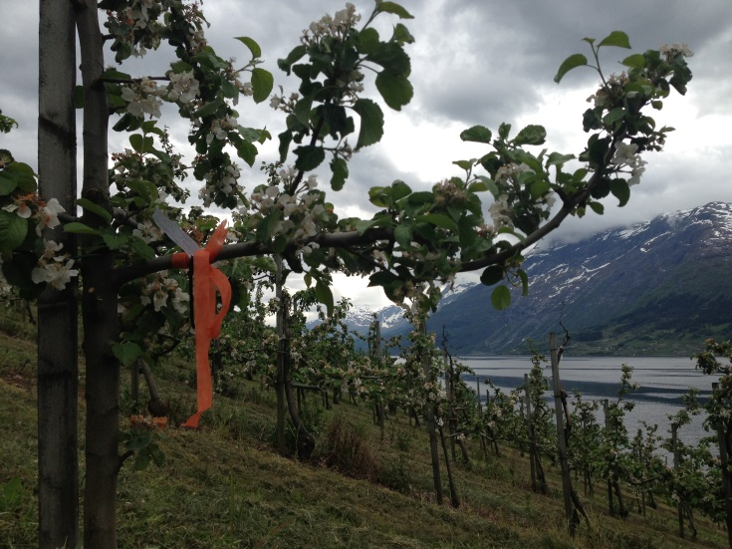
Fieldwork
22 farms, 2 weeks
Transect walks
Observations
Pan traps

Slide 5
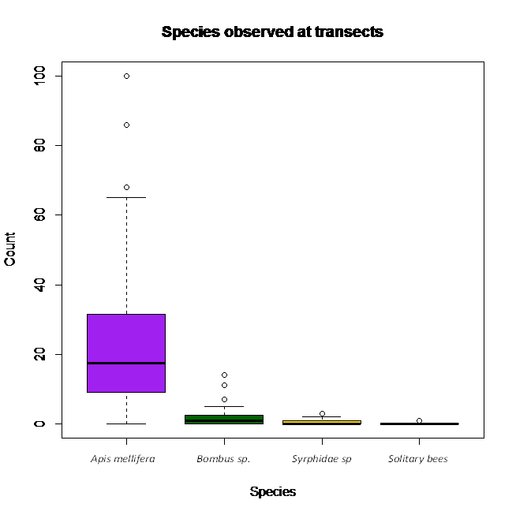
Results

Slide 6
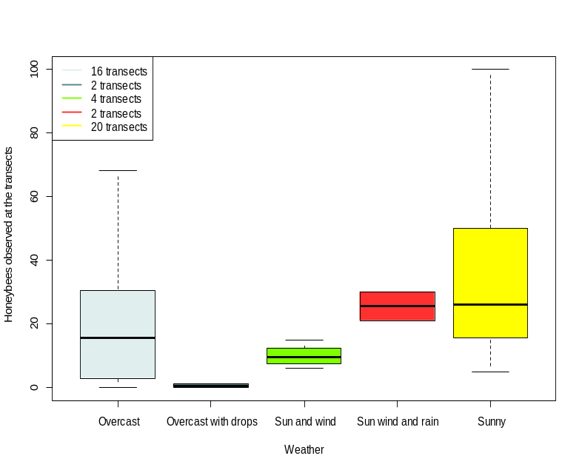
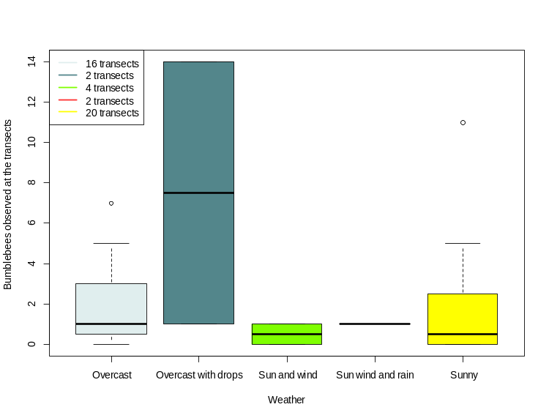
Weather and presence of pollinators

Slide 7
Challenges
Getting information from farmers
Few wild species
markings
Cold march→ late season for flowers and bees
Variyng yield – «resting years»
Not done before

Slide 8
What this experience taught me
Be prepared in a short blooming season
Contacting farmers
How to improve the same fieldwork
- repetitions in stead of so many different farms
- 5 min observation at branches does not work
- improve traps
-different weather and times of day to check for optimal time of day and weather for the species
- marking branches clearly
Need hives to ensure sufficient pollination of apple crops in Norway or a change in agricultural land.

Slide 9
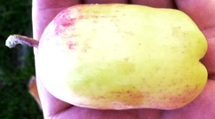
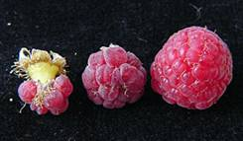
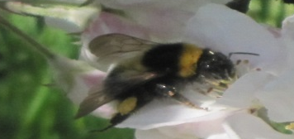
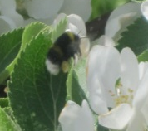
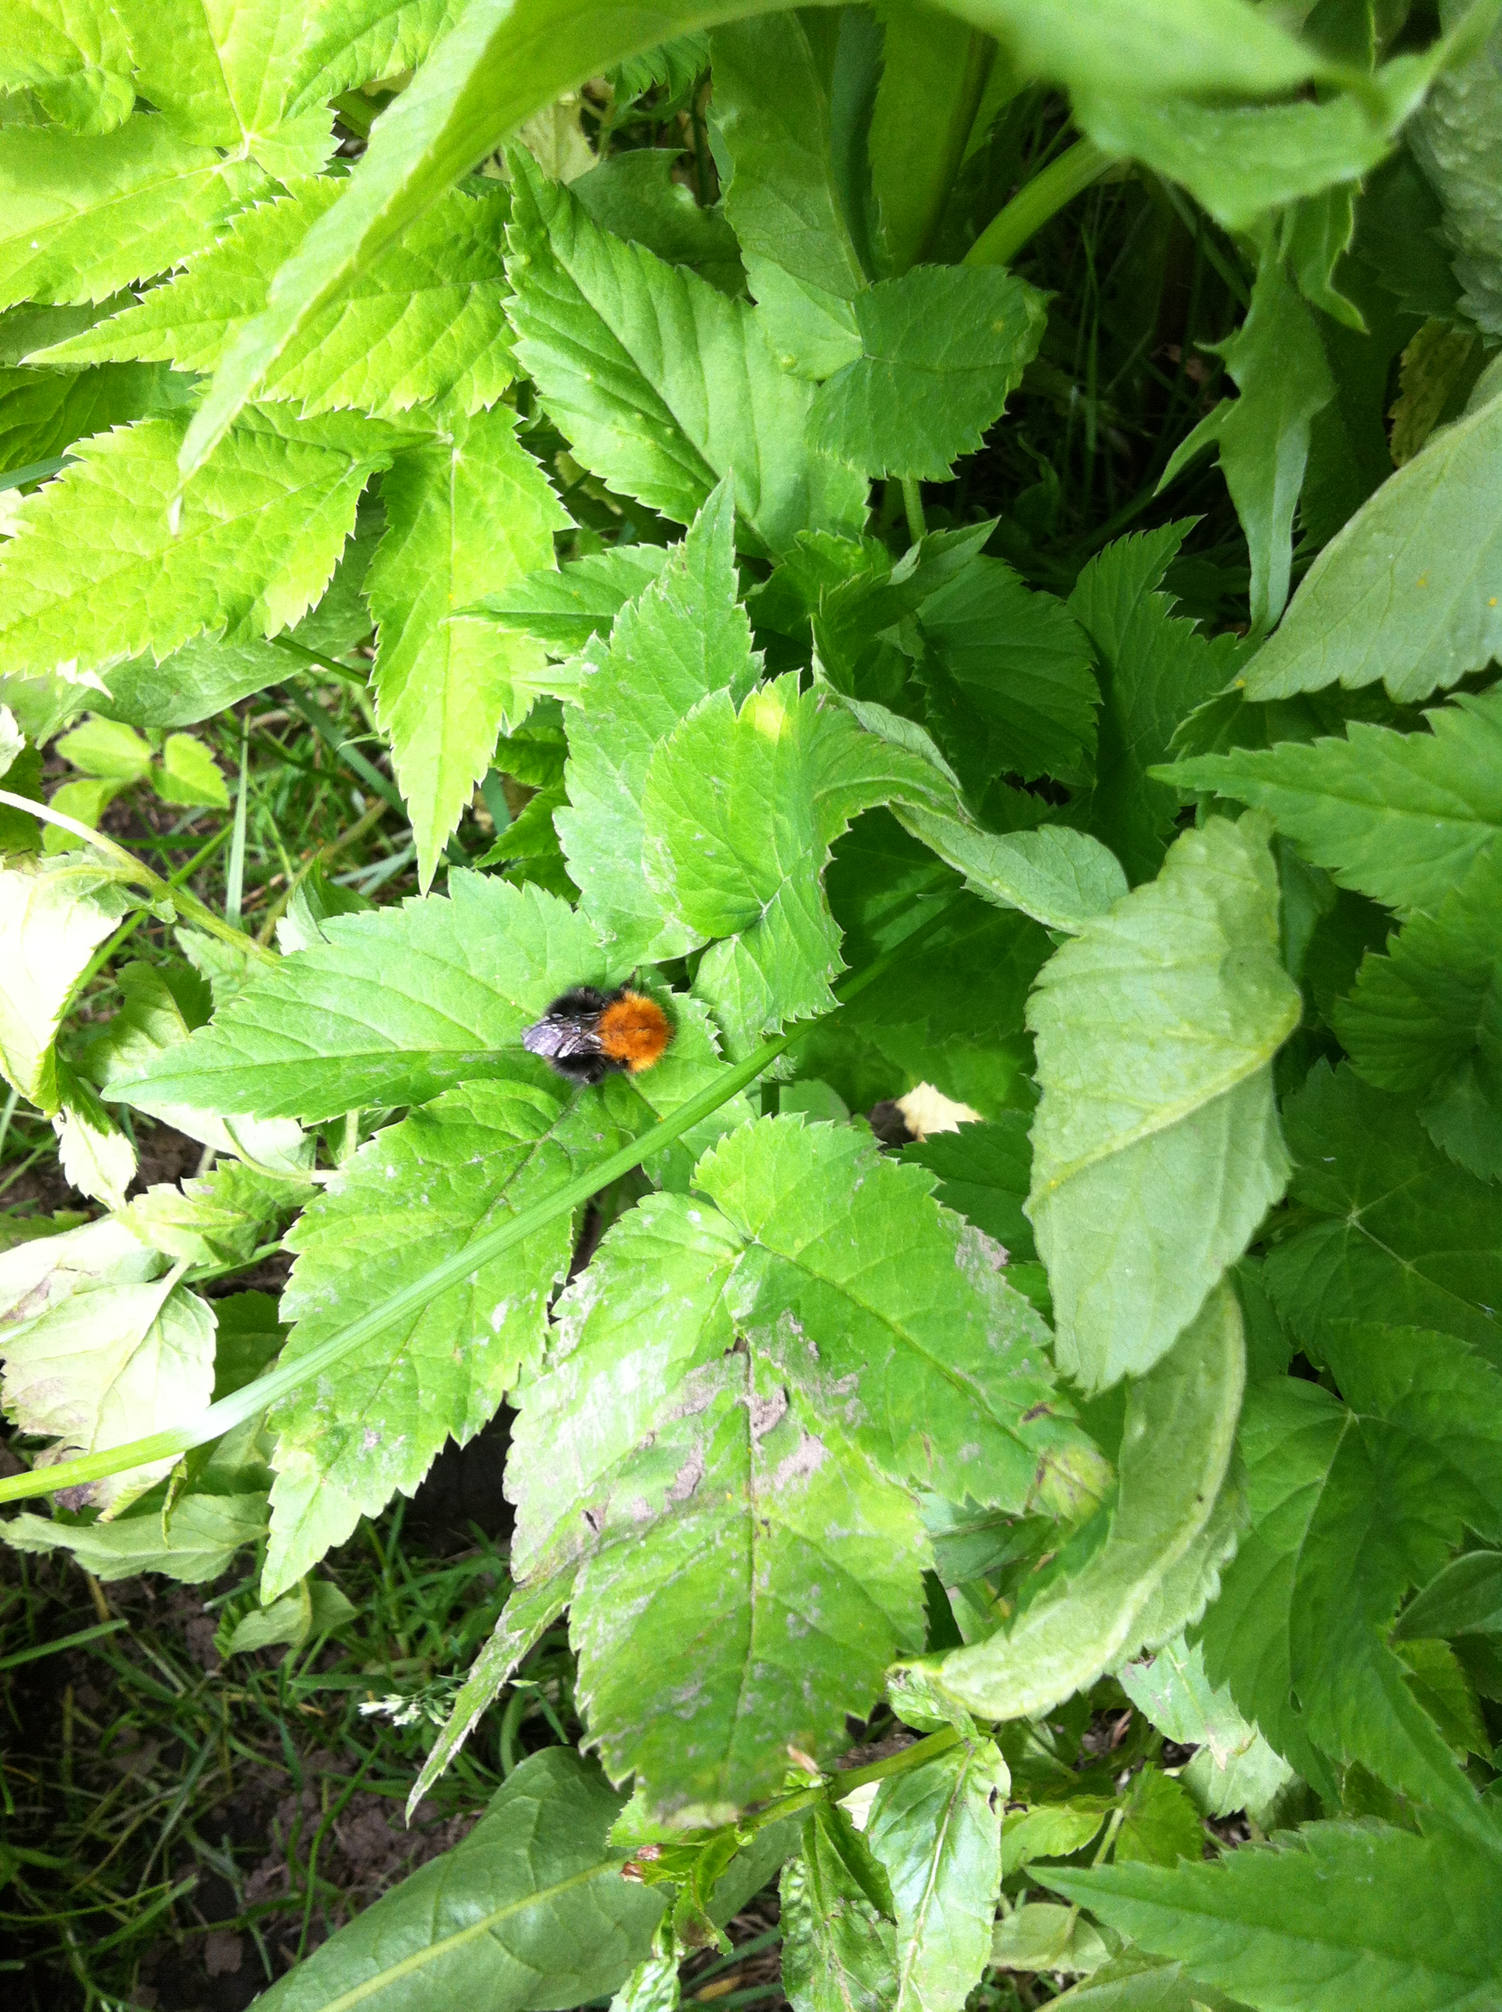
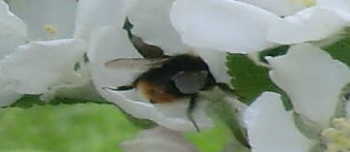
Thank you

Slide 10
Sources
http://www.frukt.no/kun-sokbare/epler-i-hardanger/
http://www.xn--miljdirektoratet-oxb.no/old/dirnat/attachment/1594/Notat_2010_3_3008.pdf
http://www.regjeringen.no/nb/dokumentarkiv/stoltenberg-ii/md/Nyheter-og-pressemeldinger/nyheter/2013/bli-med-pa-a-redde-humlene.html?id=726928
http://www.holtskog-nyhuus.no/gard/

