Slide 1
A Bayesian framework for optimal utilization of plant-pollinator interaction data
Getting the most out of insect-related data

Slide 2
Background
A major issue for pollinator studies is to find out what affects the number of various insects.
Example from own experience: Finding out how the presence of various other flying insects affect the number of honey bees in various flower patches.
The data we studied, was that we were presented with densities (number of an insect type per plant in the course of a time period).
Suspicion: Number of each insect type plus number of plants would yield better analysis. This is needed to get densities, so those gathering the data must have had them.

Slide 3
Experiences from the study of dr. Anders Nielsen
Studied the effects of static factors like the plant species, plant density, patch area on honey bee density. Also dynamic factors like temperature and density of other insect types.
Wanted a wide variety of models in order to test not only for fixed effects. Other insect types were however also deemed stochastic outcome. Their affect on honey bees were considered a random effect, possibly plant-specific.
Bayesian inferences gave the necessary freedom to express and analyze the set of models we wanted to examine. Also, the application is practical enough that informative prior distributions can be made.
Prior distribution for all parameters needed => want biologically informative models.
Support for one model versus another is summarized in the Bayes factor, B=P(data|model1)/P(data|model2), where P is the prediction probability for each model.
Bayes factors favor parsimonious models. Over-complicated models give poorer predictions.

Slide 4
The problem with densities
Density data instead of count data turned out to be a major complicating factor:
Densities are continuous data, but in this case constructed from natural numbers. There’s little intuition of what distribution to expect. (We went for the gamma distribution, since it is a fairly standard distribution for positively definite outcomes.)
Counts can be however zero, which means the densities can be zero. Yet typical continuous-valued probability distributions give zero probability for any fixed outcome.
Zero-inflation, i.e. giving a non-zero probability for the outcome “zero” for continuous value distributions, is tricky.

Slide 5
Solution(?)
We resolved the statistical issue by using a zero-inflated gamma-distribution.
We allowed the zero-inflation, as well as the expectancy to be affected by fixed effects.
Zero-inflation was set as a function that was decreasing with increasing expectancy.
Zero-inflation was achieved by giving a finite probability for the insect density to be very close to zero.
With these issues solved, we went ahead with the analysis. But I think it would have been better for the analysis if we had count data. We’d need fewer statistical assumptions and would have had fewer numerical problems to resolve.
But more importantly, I think we would be better able to find effects with count data. => Simulation study.

Slide 6
Other potential problems
Time dependency: If more than one measurement is done per site then there could be dependencies in the measurements. Could be due to the behavior of the insects or to time-dependent unmeasured covariates. Could lead to false positives.
All effects of other insect species on the pollinator species might not be identifiable. Honey bees might avoid patches when the conditions are so that they expect many bumble bees. But how to tell if the conditions are directly to blame for a lack of honey bees or this expectancy explains it? (Experiments could resolve this, though.)
The direction of causality might not be resolvable. Are there few honey bees because there’s many bumble bees or many bumble bees because there’s few honey bees? Apart from experimentation, time series could perhaps resolve this.

Slide 7
Why do I expect count data to be better?
Densities are processed quantities. They hide the original counts. The more processed the data, the more difficult to assess what was going on, I expect.
Since this is processed data, we don’t have a clear idea why we should expect one distribution family over another.
Statistics have clearly defined count data distribution (Poisson, binomial, negatively binomial), ready for use and with clearly defined assumptions.
General experience is that the closer the statistical modeling describes what we know of reality, the better the analysis.
Complicated non-intuitive distributions will have parameters for which it’s difficult to make an informative prior.

Slide 8
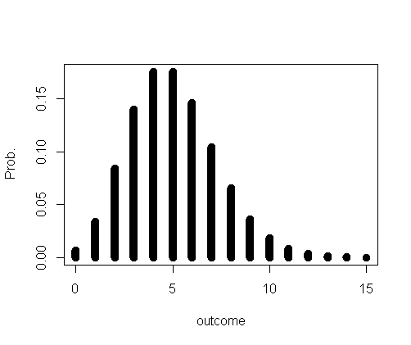
Count data distributions – Poisson
Poisson – A distribution for the counting of events happening independently. A (the?) standard distribution for count data that do not have a fixed upper limit.
One parameter; expectancy.
If we could account for all relevant effects, I would expect the counts to be Poisson-distributed. (Big “if”, though.)
Variance=expectancy.
Distributions for which variance>expectancy are called over-dispersed.
Under-dispersed: variance<expectancy.
Poisson, expectancy=5

Slide 9
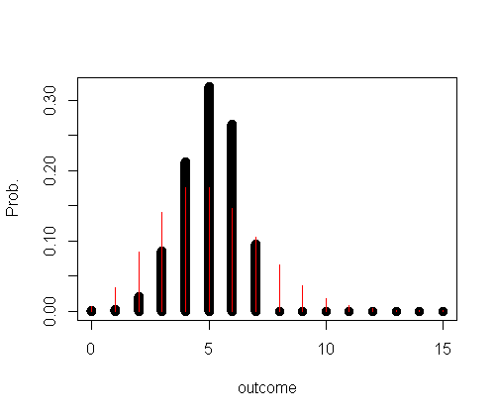
Count data distributions –
Binomial distribution
Binomial – Number of events belonging to a given category from a fixed total number of events.
With there being a finite number of pollinators in the vicinity, maybe a binomial distribution is good. Still, as long as most bees in the vicinity is somewhere else, Binomial→Poisson.
Two parameters, number of available pollinators (n) and probability of finding any one in the study field (p).
Under-dispersed.
PS: Number of available pollinators will be different for different sites!
Binomial, n=7, p=5/7
Red is Poisson (for comparison)

Slide 10
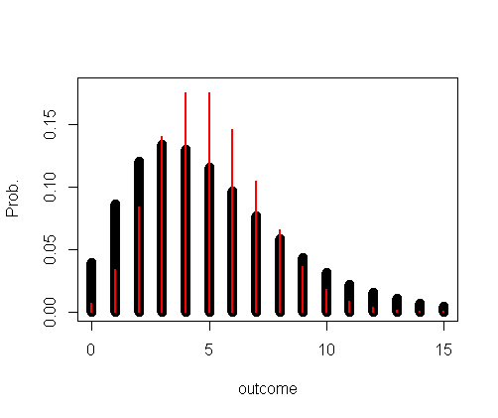
Count data distributions –
Negative binomial distribution
The negative binomial distribution counts the number of failures until a given number of successes or vice versa.
More interestingly, when the Poisson-parameter varies according to the gamma distribution, the result is negative binomial.
Over-dispersed.
If there are unresolved effects, that will create a variation in the Poisson-parameter that can result in the negative binomial distribution. (PS: Social insects)
Parameters: Expectancy, but also one hard to interpret parameter, inherited from the gamma distribution.
Negative binomial, expectancy=5, shape=4.
Red: Poisson

Slide 11
Still zero-inflation?
Might there be events that increases the probability for no bees beyond what one can expect from the standard distributions?
Suggestions: Freak weather, attack on a hive, migration and other “all hands on deck” type of events.
Zero-inflation might still be necessary. Easier than in the continuous case, though.

Slide 12
Simulation study
To assess the effect of collecting insect/plant counts rather than densities:
Simulate a small set of count-data (various models) containing a small effect many times.
Analyze each dataset, testing (Bayes-factor) for effect when the data is modeled as:
    Count data (various models)
    Densities (zero-inflated gamma)
Check for each model how many datasets gave indication of there being an effect.

Slide 13
Preliminary study
Have made 100 datasets.
Each dataset consists of 30 measurements, each in a different “field”.
Plants are negatively binomially distributed so that 95% of the fields will have between 10 and 1000 plants.
The insect counts are Poisson distributed, with expectancy proportional to the number of plants.
There’s a binary covariate, either with
    No effect
    An effect on the edge of being detectable when using count data and the generating distribution (10% false negatives).

Slide 14
Preliminary results
For no effect:
Count data:
    The Poisson model indicates no effect in about 99.7% of the datasets.
Density data:
    Zero-inflated gamma indicates no effect about 97.5% (so slightly smaller “confidence”).
For small effect:
Count data:
    Poisson model on indicates no effect in about 10% (“test strength”) of the cases (by design).
    Negative binomial model ≈11-12%.
    Zero-inflated negative binomial distribution ≈ 12%.
Density data:
    Zero-inflated gamma distribution (expectancy dependency): about ≈ 38%.
    Zero-inflated gamma distribution (also zero-infl. dependency): about ≈ 47%.

Slide 15
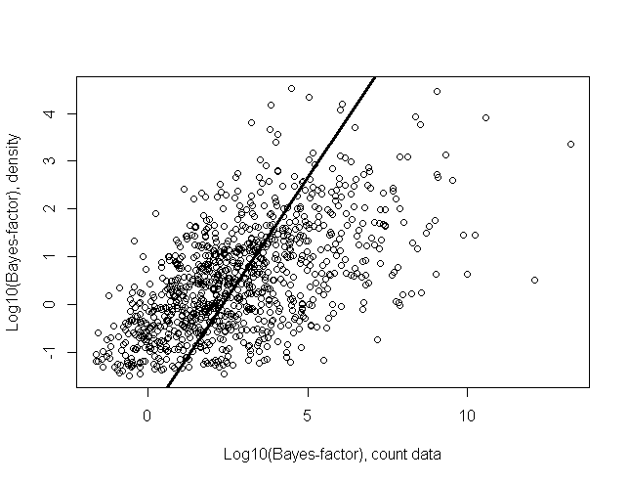
Why do more datasets slip through the cracks for density data?
Short answer: Less evidence (smaller Bayes-factor for effect vs no effect).
Assuming proportionality between the Bayes-factors, the one from count data is on average (on the log-scale) 200 times larger than the one from the density data. I.e. 200 more evidence for an effect with count data than with densities!

Slide 16
Plan for simulation study article
Get more realistic settings for the study design (number of data, patch size).
Repeat study with different count-data models, to see the effect of more complicated generating models.
Repeat for non-binary covariates (continuous or count data).
Repeat for random effects like the presence of other insect types.

Slide 17
What more should be done in a simulation study?
Time series?
Imaginary experiments?
Comments are welcome!

