Slide 1
Course information and MN Faculty meeting for exchange students autumn 2025
Faculty of Mathematics and Natural Sciences

Slide 2
Welcome to the MN Faculty!
MN International Office​:
Anne Aaen-Stockdale​
Ellen Kristine Grøholt​
Ida Marie Gillerstedt​
​
Buddy coordinator​:
Anam Amar and Heidi Rognhaugen

Slide 3
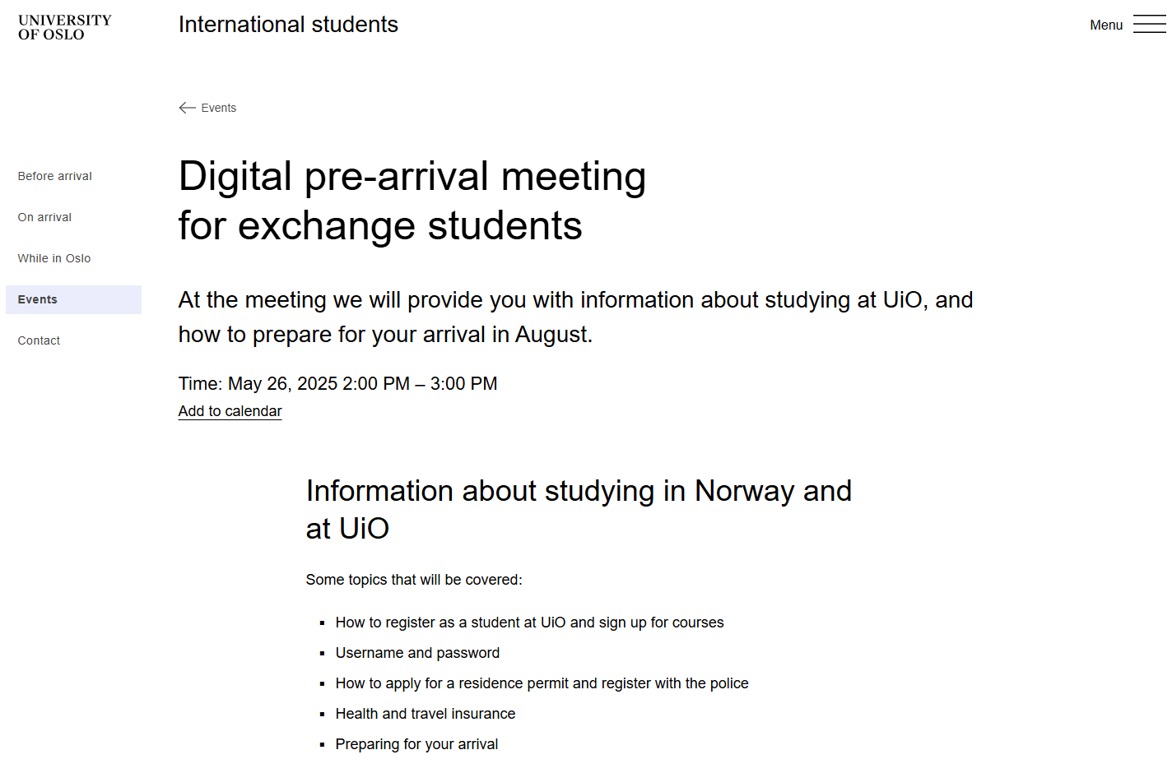
General pre-arrival information meeting is next week
This meeting covers registering as a student, applying for residency permit, housing, insurance, bank card, etc.
Slides from this meeting will afterwards be found on the events page, which will include links to relevant pages.

Slide 4

The Faculty of Mathematics and Natural Sciences
Illustration is AI-generated with Microsoft Copilot
Department of Biosciences ​
Department of Pharmacy ​
Institute of Theoretical Astrophysics ​
Department of Physics ​
Department of Informatics ​
Department of Geosciences ​
Department of Chemistry ​
Department of Mathematics​
Department of Technology Systems

Slide 5

Course registration for exchange students at the MN Faculty
Illustration is AI-generated with Microsoft Copilot
The courses you listed in your application will be assessed (also for non-MN faculty courses)
Check against the formal prerequisite requirements
Notify you where you fulfill the requirements, however you are not guaranteed a place
Courses are NOT on a first-come-first-serve basis
Course admission happens in August for all MN courses
Email if the course might be full or you do not qualify

Slide 6
StudentWeb
All course registration happens in StudentWeb
Login with FEIDE and set up a two-factor authentification (2FA)
User name and password are sent to mobile/cell phone
  General pre-arrival meeting next week will cover what to do if you have issues with this
StudentWeb opens on 3 June
Other Faculties have signup from 3 June (IF YOU ARE TAKING COURSES FROM OTHER FACULTIES CHECK WITH THEM)

Slide 7
StudentWeb
Courses with prerequisites will normally not appear in StudentWeb to be searched for, this includes most MN Faculty courses
First round of course admission at MN Faculty: 15-17 August
Courses will available spaces will be open for registration from 18-19 August
You can complete the registration without any or all courses and add/delete later

Slide 8
Courses
Each course will have BOTH course catalogue page and semester page
Course catalogue page will give information on course content, learning outcomes, formal prerequisites, teaching/course type (lecture, seminars, lab) and examinations (including resits) and grading scale
Courses which say Teaching language: English on demand / on request
Semester page will give specific date/times for each semester, e.i. autumn 2025
Late arrival? Must be agreed with Department AND professor in advanced

Slide 9
Courses
30 ECTS is a fulltime load
Compulsory assignment might be a condition for taking the exam​
All courses will have an examination procedure, make sure you know the details and deadlines for all your courses!​
Can make changes up to 1 September, however some courses might have compulsory attendance before this!​

Slide 10
Internship
Not taking any courses because you are doing an internship?
Complete online registration all the way through as soon as possible (latest 1 Sept)
If you did not confirm in your application who you were doing your internship with we will email you and ask

Slide 11
Learning Agreements and signatures
Learning Agreements
Online Learning Agreements (OLA)
Confirmation of Stay / Certificates of Stay
Arrival Certificates
Please note that all documents must have dates that are within our official semesterdates, which for autumn 2025 are August 11th to December 19th 2025
All documents to be sent to MN Student Information (studieinfo@mn.uio.no) or come in to hand them to MN-studieinfo offices

Slide 12
Important deadlines
3 June – StudentWeb opens for sign up for courses for spring 2025
11 August – Start of semester, Orientation/Buddy week
14 August – Closing date for course registration for first admission at the MN Faculty, other Faculties may differ
18 August – student may sign up for courses that still have spaces available, either sign up on StudentWeb or contact the relevant Department
1 September 2025 is the deadline for:
  Semester registration. This is done in StudentWeb
  Application for special examination arrangements at your studies/exams
11 August is the first day in week 33, in Norway we often refer to the weeks with numbers

Slide 13

Student Life
Illustration is AI-generated with Microsoft Copilot
Orientation/Buddy Week
  Various activites for new students, some practical and some social
  Buddy week – facilitated by Buddy Coordinator for you to meet other exchange students
  Updated program will be ready later
Realistforeningen (RF – Science Student Ass.)
Student Committee: MNSU / academic committees
Norwegian language courses
SiO Sports

Slide 14

Life in Oslo
Illustration is AI-generated with Microsoft Copilot
Close to nature – forest and fjord
  Beaches, lakes
  Hiking
  Skiing, skating
  Island hopping
50% of the city area of Oslo is covered by forest and parks
Opera, theatre, live music, shopping
Multicultural city (check out Grønland markets)

Slide 15

Who to contact?
Illustration is AI-generated with Microsoft Copilot
Questions about visa and immigration?
International Student Reception
Questions about courses and course registration?
MN International Office (that's us!)
Question about IT access and username/password
IT Services
Question about housing?
International Student Reception or SiO Housing

Slide 16
Questions? studieinfo@mn.uio.no

