Slide 1
Increased cerebral blood volume in cortical and subcortical brain regions in Glioblastoma patients after EPI distortion correction
Ivar T. Hovden¹, Oliver M. Geier¹, Ingrid Digernes¹, Elies Fuster-Garcia¹, Grethe Løvland², Einar Vik-Mo³, Torstein R. Meling^{3,4} and Kyrre E. Emblem¹
¹Department for Diagnostic Physics, Oslo University Hospital
²The Intervention Centre, Oslo University Hospital
³Department of Neurosurgery, Oslo University Hospital, Oslo, Norway
⁴Department of Neurosurgery, Geneva University Hospitals, Geneva, Switzerland

Slide 2
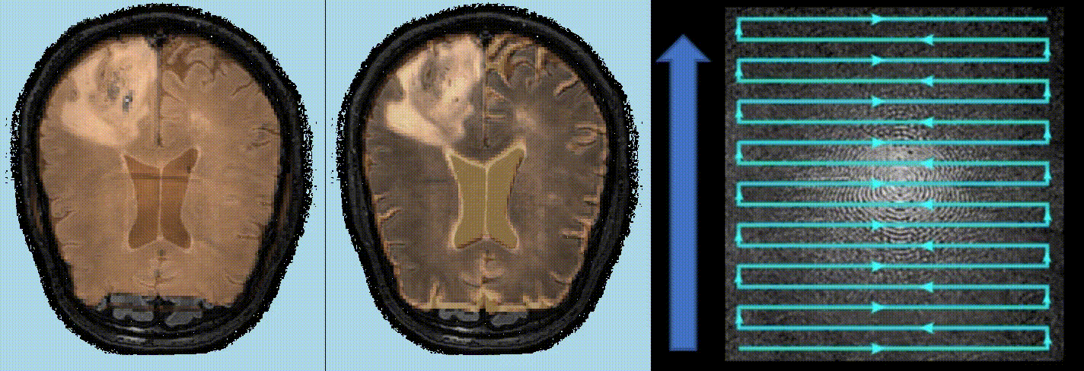
Hypothesis
Gradient-echo and Spin-echo, Echo Planar Images (EPIs) possess severe geometric distortions caused by magnetic susceptibility variations along the phase-encoding direction, when compared with structural MRI
Gradient-echo
Spin-echo
k-space
Voxel displacement
Voxel compression/decompression + signal loss
Voxel compression/decompression

Slide 3
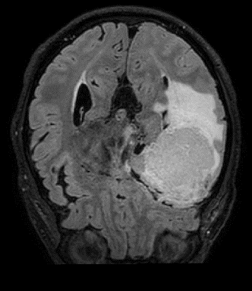
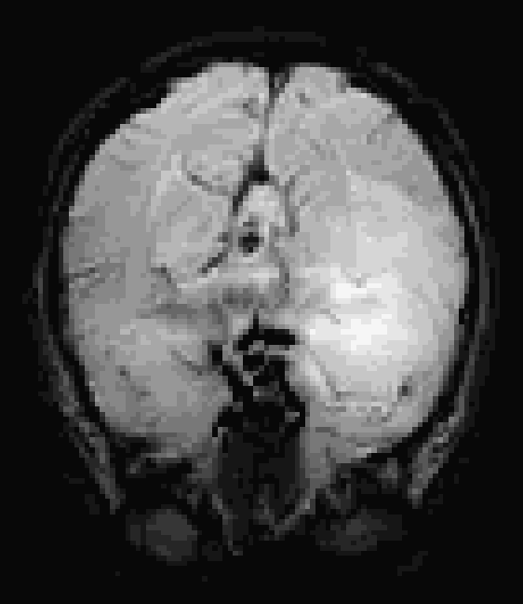
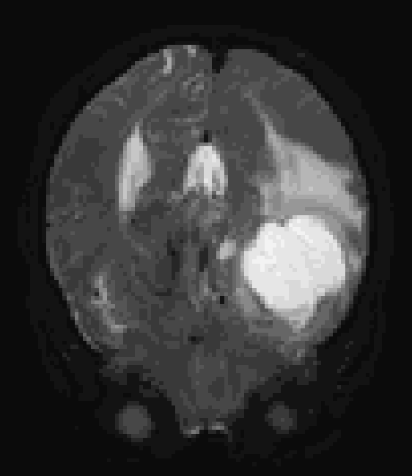
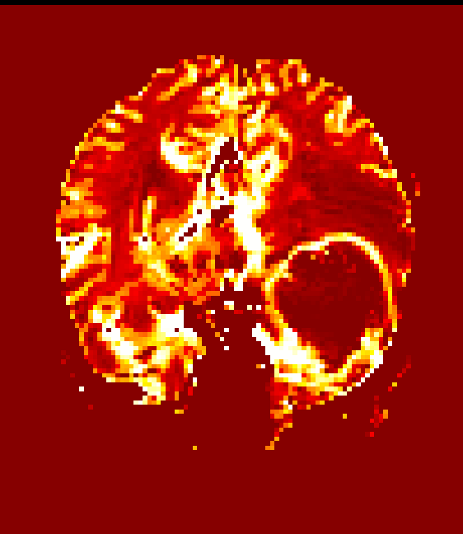
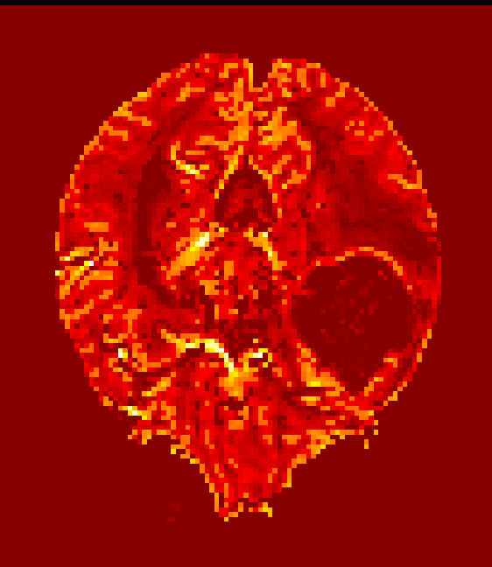
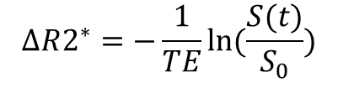
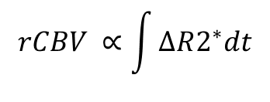
Hypothesis
This should challenge the accuracy of DSC-estimated cerebral blood volume (CBV) for treatment assessment in glioablastoma (GBM) patients
Uncorrected Dynamic Susceptibility Contrast (DSC)
T2 FLAIR
GE DSC (T2*)
SE DSC (T2)
$$ΔR2^{∗}=−\frac{1}{TE}ln⁡(\frac{S(t)}{S_{0}})$$
rCBV
$$rCBV ∝\int{ΔR2^{∗}dt}$$

Slide 4
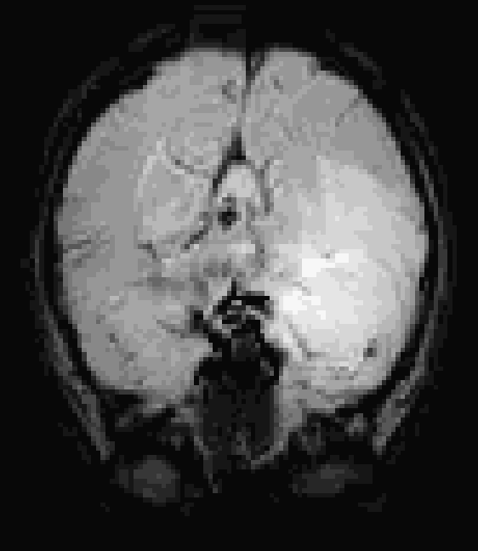
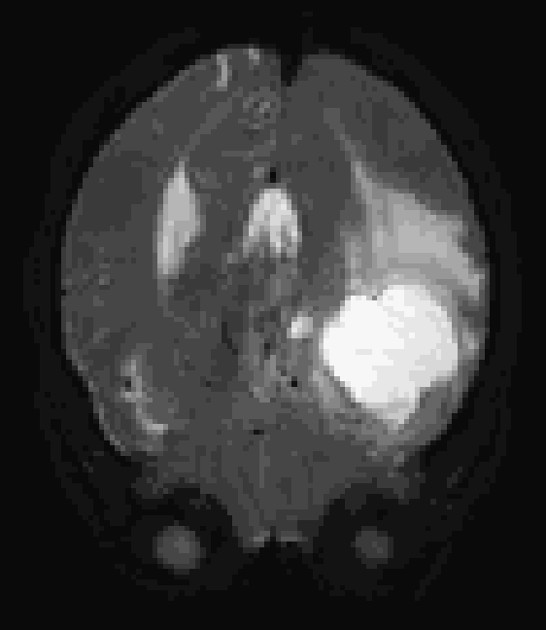
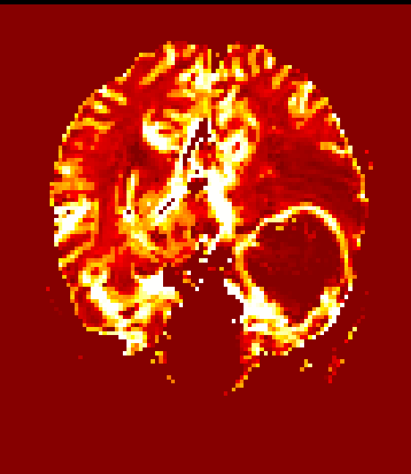
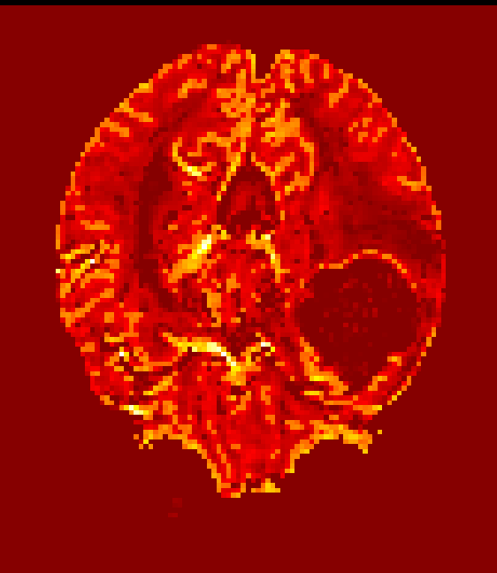
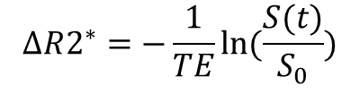
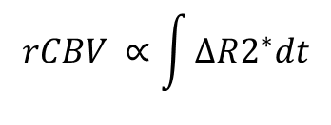
Method
We performed two state-of-the art EPI correction methods on DSC-MR and analyzed the resulting change of estimated rCBV on 45 GBM patients (age range 40-84 years; median 61 years)
Corrected DSC (FSL TOPUP)
1
T2 FLAIR
GE DSC (T2*)
SE DSC (T2)
Andersson et al., 2003
$$ΔR2^{∗}=−\frac{1}{TE}ln⁡(\frac{S(t)}{S_{0}})$$
rCBV
$$rCBV ∝\int{ΔR2^{∗}dt}$$

Slide 5
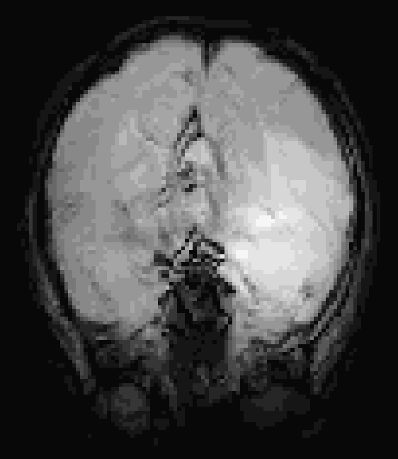
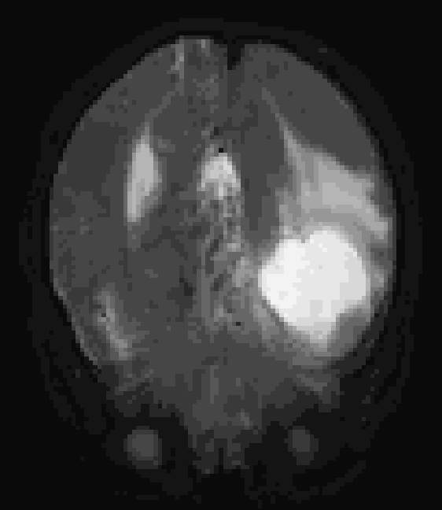
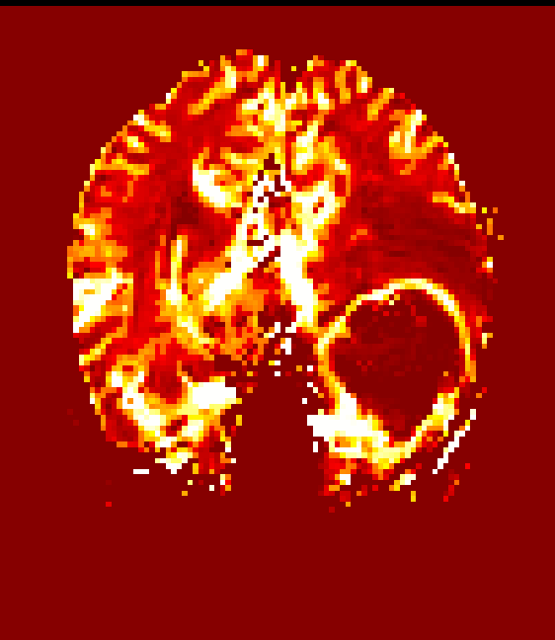
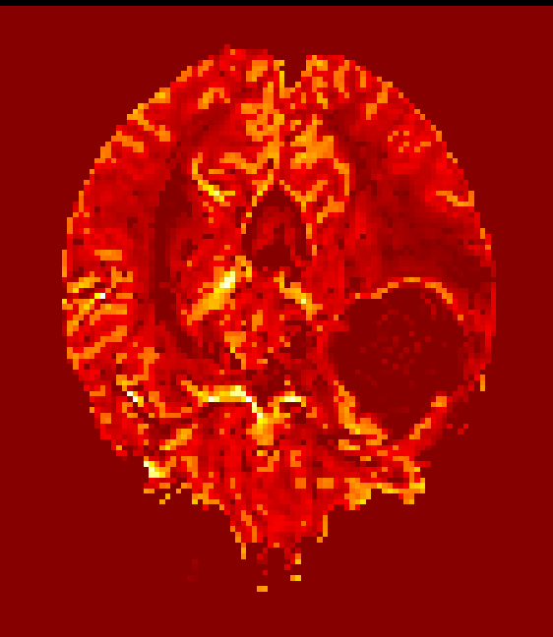
Method
We performed two state-of-the art EPI correction methods on DSC-MR and analyzed the resulting change of estimated rCBV on 45 GBM patients (age range 40-84 years; median 61 years)
Corrected DSC (EPIC)
2
T2 FLAIR
GE DSC (T2*)
SE DSC (T2)
Holland et al., 2010
$$ΔR2^{∗}=−\frac{1}{TE}ln⁡(\frac{S(t)}{S_{0}})$$
rCBV
$$rCBV ∝\int{ΔR2^{∗}dt}$$

Slide 6
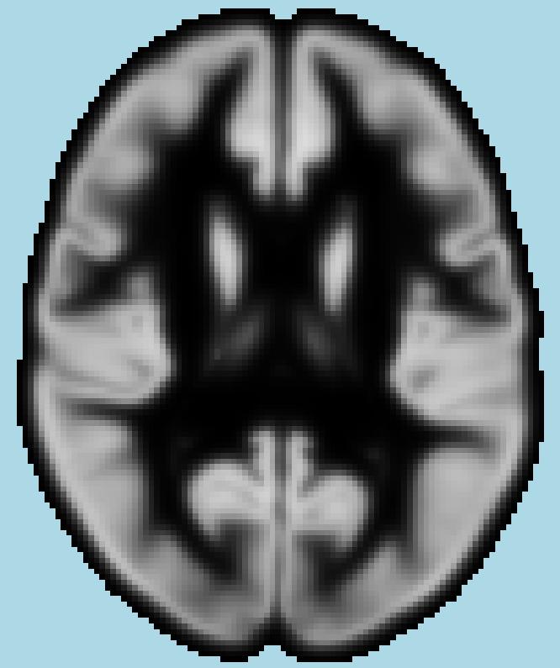
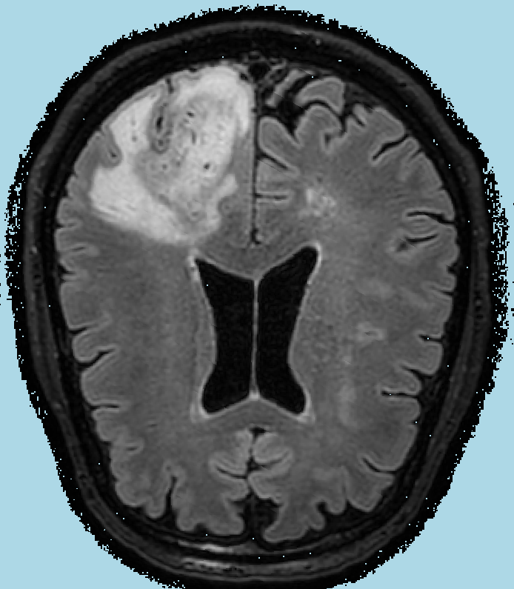
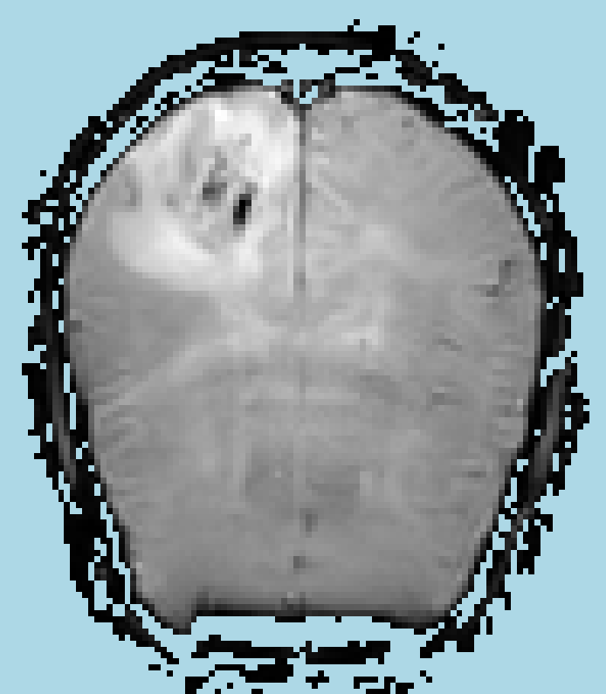
Method
We then for each patient obtained the nonlinear transform between T2-FLAIR and MNI space, and linear transforms between T2-FLAIR and uncorrected, and corrected DSC, respectively
Montreal Neurological Institute (MNI) SPM12 Tissue Probability Map (TPM) (gray matter shown)
R : Nonlinear co-registration
R : Rigid + affine co-registration
D : SPM12 warp
A : Rigid + affine transform
T2-FLAIR
R
D
R
Raw, corr. DSC
2 x A

Slide 7

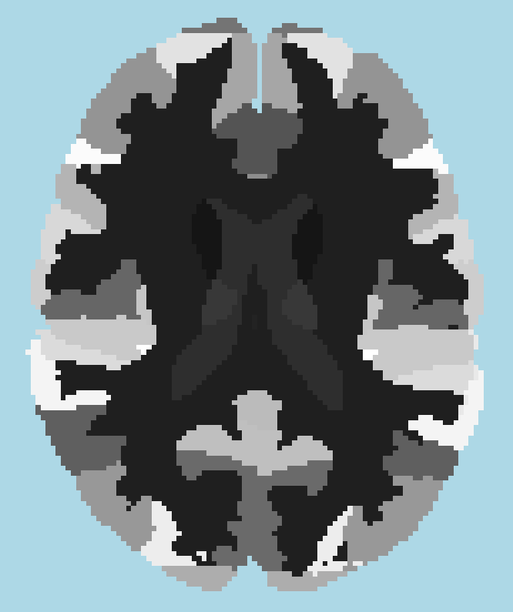
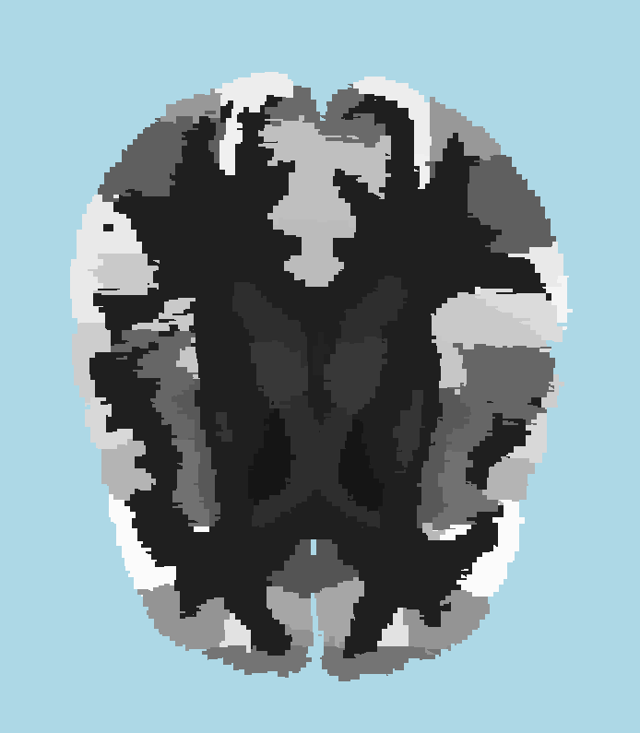
Method
An MNI template of 66 brain regions was then transformed to uncorrected and corrected DSC space using the previous transforms
D⁻¹ : Inverse SPM12 warp
A : Rigid + affine transform
Regions (MNI)
Regions (T2-FLAIR)
Regions (uncorrected and corrected DSC)
D⁻¹
2 x A

Slide 8

Method
We obtained regions with rCBV change (median) using two-sided paired Wilcoxon signed rank tests on these regions
We visualized significant change in rCBV distribution
Regions (uncorrected DSC)
Regions (corrected DSC)
Regional median rCBV change
Wilcoxon

Slide 9
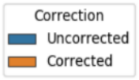
Results
TOPUP and EPIC EPI distortion correction returned rCBV change (p < 0.0008) in multiple cortical and in some subcortical regions. Some notable regions were the middle frontal gyrus, medial frontal cortex and caudate nucleus
All regions with significant rCBV change from correction had rCBV increase in terms of median quartiles
Spin-echo rCBV returned a higher number of regions with rCBV increase than gradient-echo rCBV (28 regions versus 15 regions)
The EPIC distortion correction returned a higher number of regions with rCBV increase compared to the TOPUP distortion correction (27 regions versus 16 regions)

Slide 10
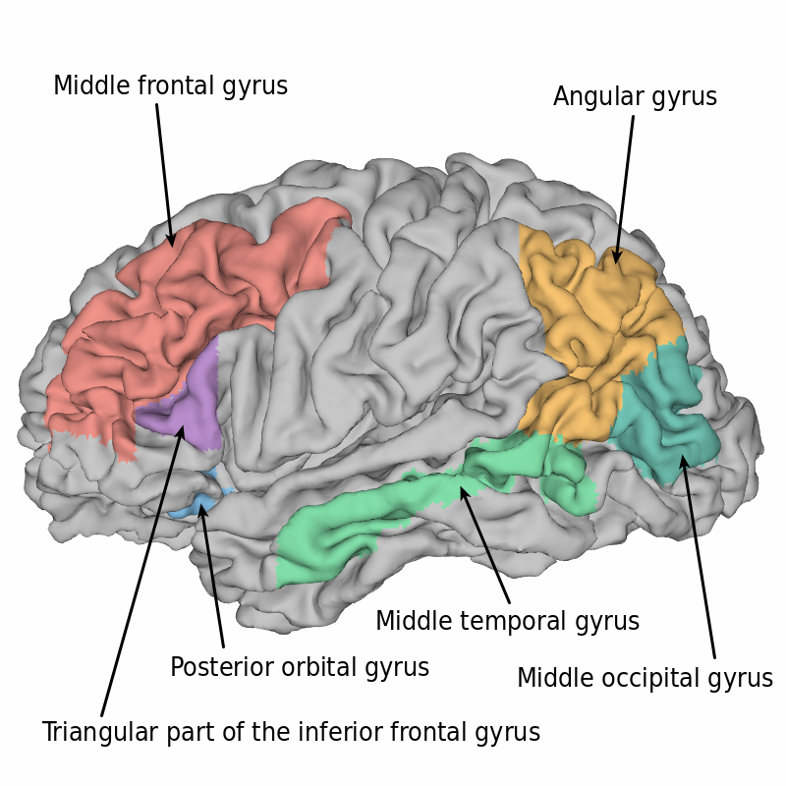
Conclusion
EPI distortion correction is warranted
for correct assessment of CBV values
along with structural images in
glioblastoma treatment assessment
Our data indicate that DSC MRI of
uncorrected EPIs result in
underestimated CBV values in multiple
cortical regions as shown in the figure

Slide 11
Thank you!
Acknowledgements & Funding
Research Council of Norway FRIPRO grant 261984 (KEE)
SouthEastern Norway Regional Health Authority grants 2017073 (KEE) and 2013069 (KEE)
European Research Council (ERC) under the European Union’s Horizon 2020 Programme (ERC Grant Agreement No. 758657-ImPRESS) (KEE)
European Union’s Horizon 2020 research and innovation Programme (EFG) under the Marie Skłodowska-Curie (Grant Agreement No 844646)

