Slide 1
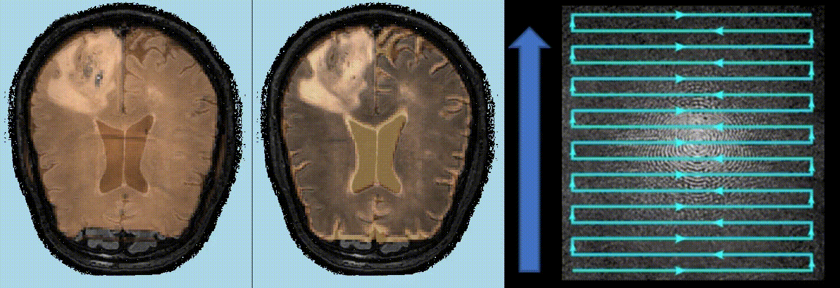
The Impact of EPI-based Distortion Correction of Dynamic Susceptibility Contrast MRI on Cerebral Blood Volume Estimation in Patients with Glioblastoma
European Journal of Radiology
Ivar T. Hovden MS^{1*}, Oliver M. Geier PhD¹, Ingrid Digernes PhD¹, Elies Fuster-Garcia PhD¹, Grethe Løvland BS², Einar Vik-Mo MD PhD³; Torstein R. Meling MD PhD^{3,4} and Kyrre E. Emblem PhD¹
¹⁾Department of Diagnostic Physics, Division of Radiology and Nuclear Medicine, Oslo University Hospital, Oslo, Norway
²⁾The Intervention Centre, Oslo University Hospital, Oslo, Norway
³⁾Department of Neurosurgery, Oslo University Hospital, Oslo, Norway
⁴⁾Department of Neurosurgery, Geneva University Hospitals, Geneva, Switzerland
EPI: Echo-Planar Imaging (brown)
Gradient-echo
Spin-echo
k-space
Voxel displacement
Voxel compression/decompression + signal loss
Voxel compression/decompression

Slide 2
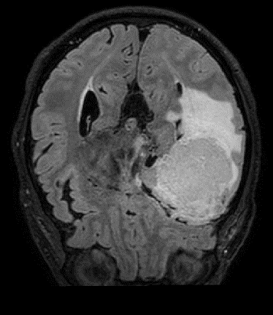
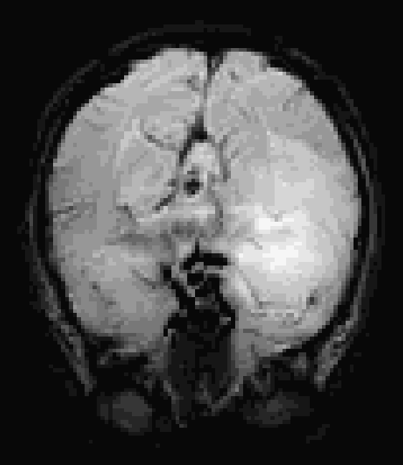
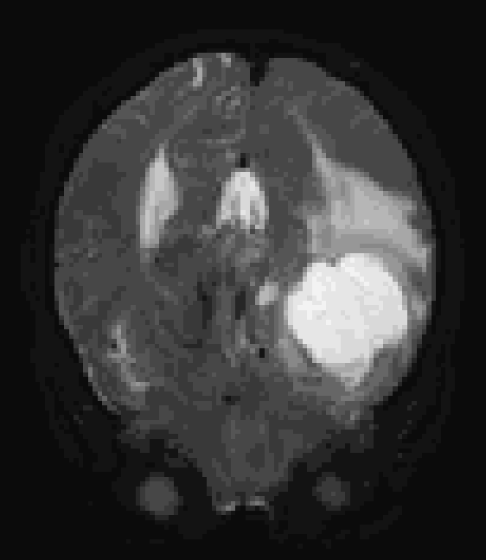
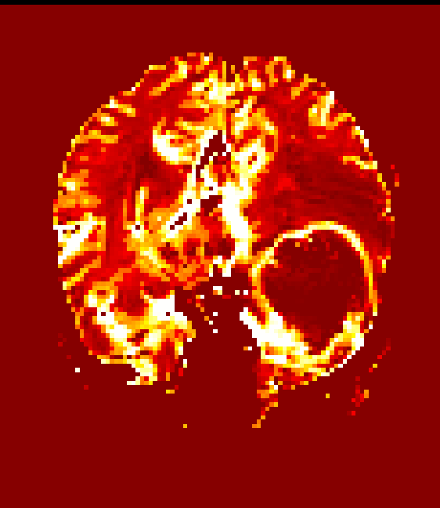
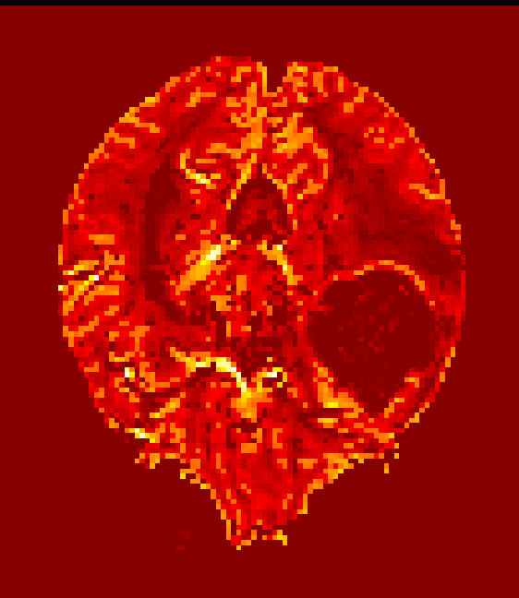
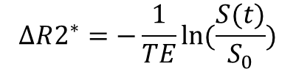
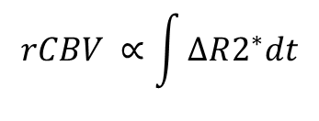
Uncorrected Dynamic Susceptibility Contrast (DSC)
T2 FLAIR
GE DSC (T2*)
SE DSC (T2)
$$ΔR2^{∗}=−\frac{1}{TE}ln⁡(\frac{S(t)}{S_{0}})$$
rCBV
$$rCBV ∝\int{ΔR2^{∗}dt}$$

Slide 3
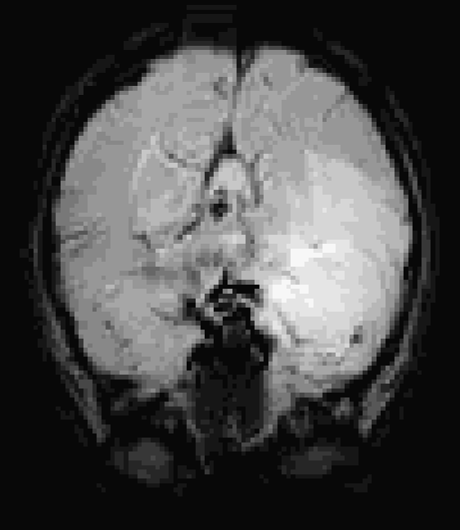
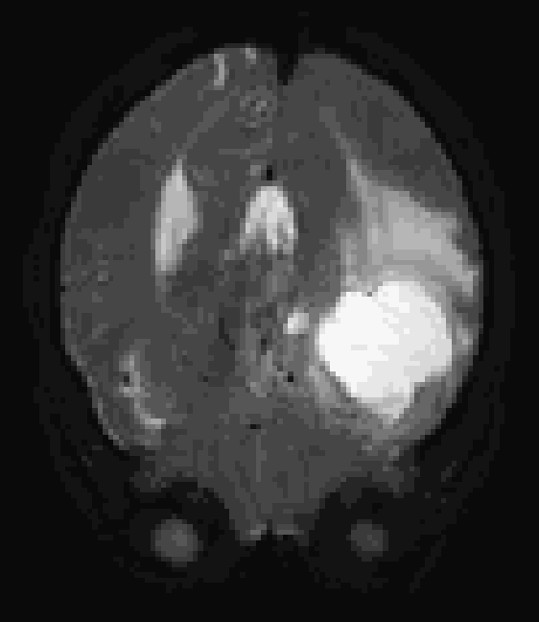
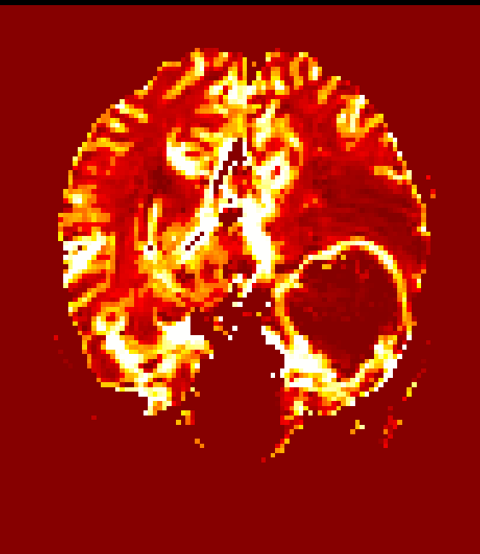
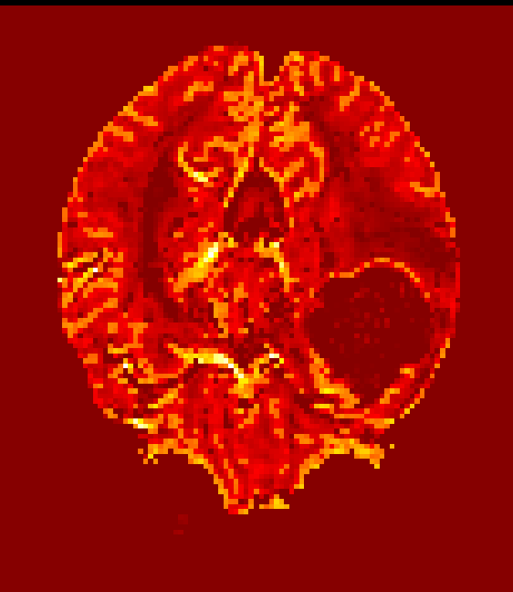
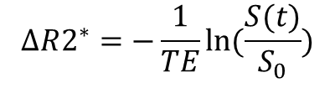
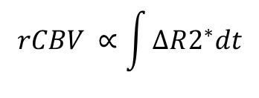
Corrected DSC (FSL TOPUP)
T2 FLAIR
GE DSC (T2*)
SE DSC (T2)
Andersson et al., 2003
$$ΔR2^{∗}=−\frac{1}{TE}ln⁡(\frac{S(t)}{S_{0}})$$
rCBV
$$rCBV ∝\int{ΔR2^{∗}dt}$$

Slide 4
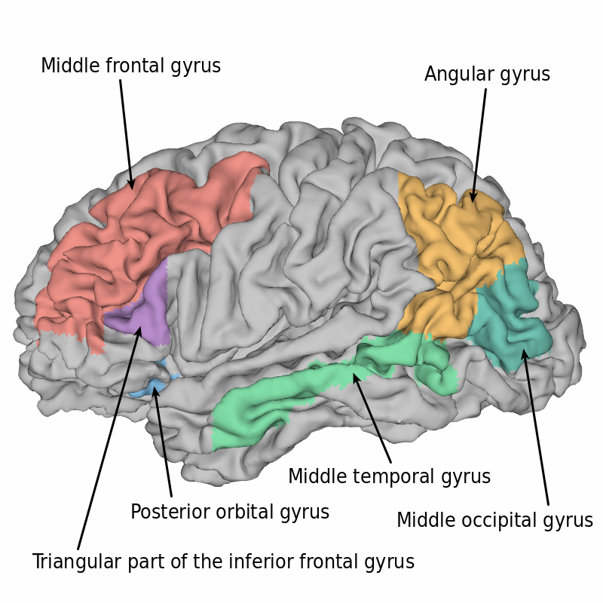
EPI distortion correction is warranted
for correct assessment of CBV values
along with structural images in
glioblastoma treatment assessment
Our data indicate that DSC MRI of
uncorrected EPIs result in
underestimated CBV values in multiple
cortical regions as shown in the figure

