Slide 1
The Impact of EPI-based Distortion Correction of Dynamic Susceptibility Contrast MRI in Patients with Glioblastoma
Ivar Thokle Hovden
Oslo University Hospital

Slide 2
Outline
Motivation: Susceptibility induced distortions
Relevant data
Study Goal
Method
Results
Take home message

Slide 3
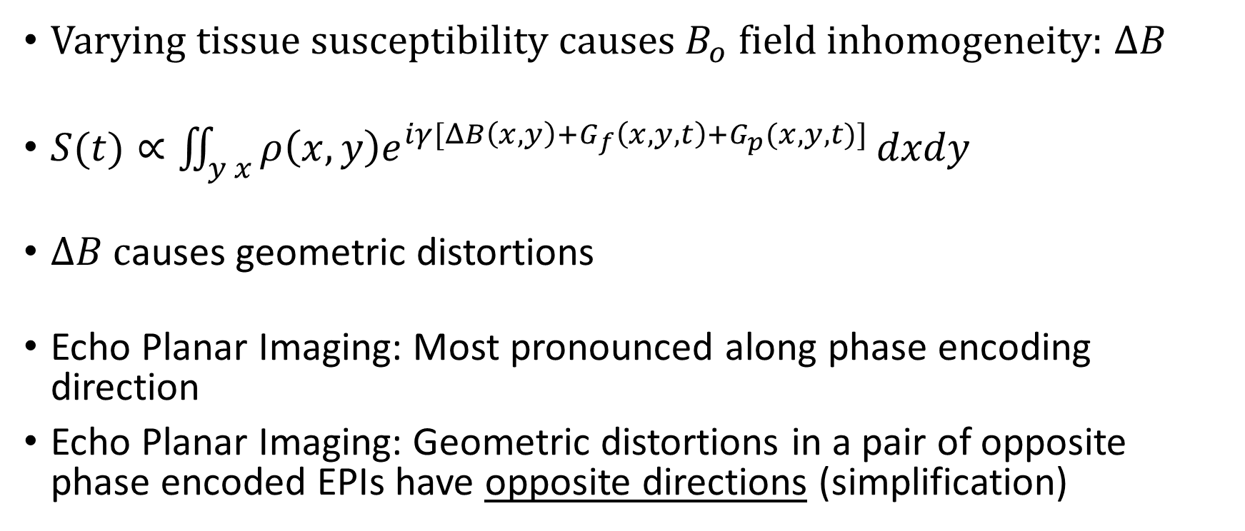
1. Motivation: Susceptibility induced distortions
Varying tissue susceptibility causes $B_{o}$ field inhomogeneity: $ΔB$
$S(t)∝\iint_{y x}{ρ\left(x,y\right)e^{iγ[ΔB\left(x,y\right)+G_{f}\left(x,y,t\right)+G_{p}(x,y,t)]}}dxdy$
$ΔB$ causes geometric distortions
Echo Planar Imaging: Most pronounced along phase encoding direction
Echo Planar Imaging: Geometric distortions in a pair of opposite phase encoded EPIs have opposite directions (simplification)
Andersson et al. 2003

Slide 4
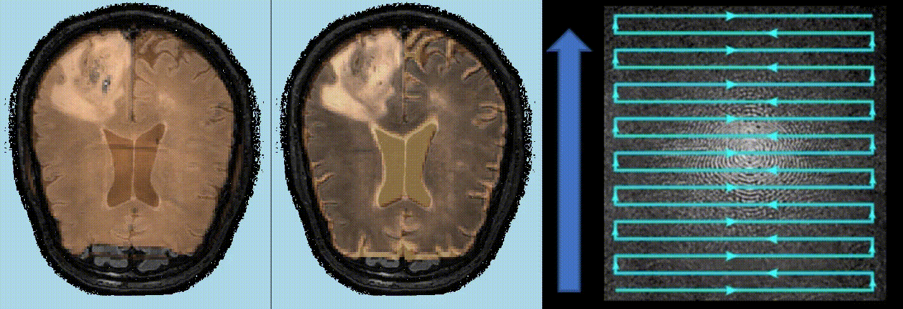
1. EPI susceptibility distortions example (native space)
Gradient-echo
Spin-echo
k-space
Voxel displacement
Voxel compression/decompression + signal loss
Voxel compression/decompression

Slide 5
2. Relevant data
45 newly diagnosed Glioblastoma patients; age 40-84
Pre-scan EPI: Negative phase encoded
Dynamic Susceptibility Contrast (DSC) during contrast injection: Positive phase encoded EPIs
relative Cerebral Blood Volume from DSC
T2 fluid attenuated inversion recovery (FLAIR)
Regions of necrotic, enhancing and edema tumor from Juan-Albarracín et al. 2019
3 Tesla

Slide 6
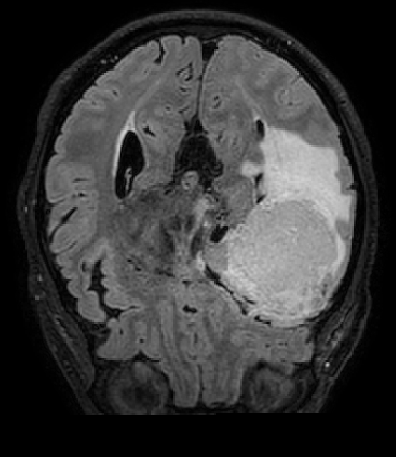
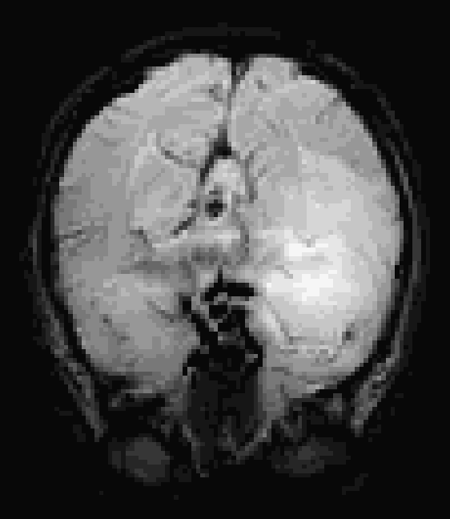
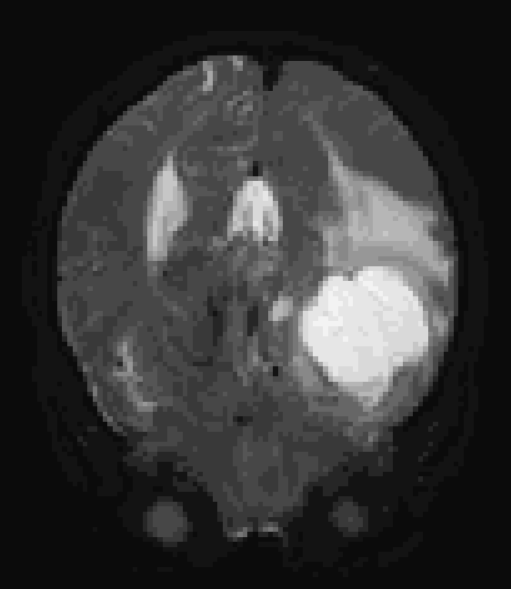
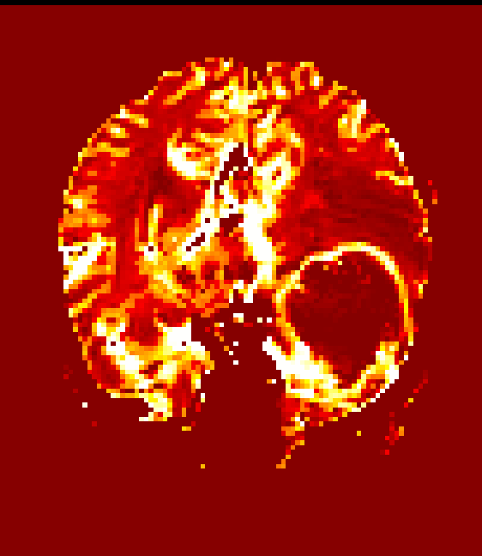
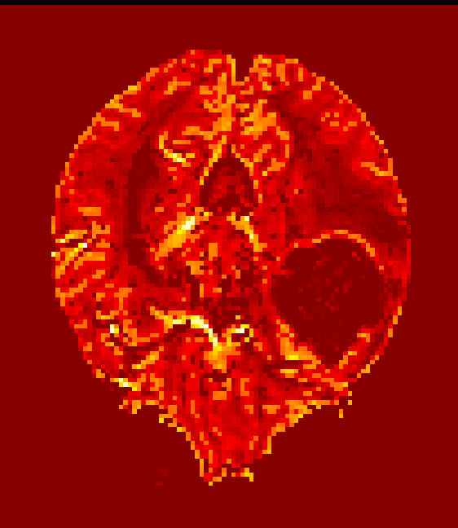
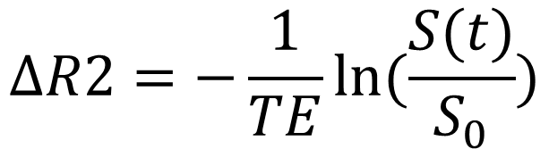
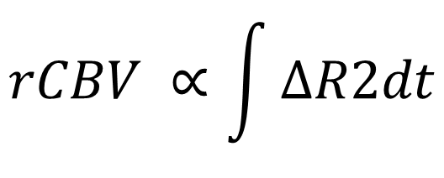
Uncorrected DSC
T2 FLAIR
GE DSC (T2*)
SE DSC (T2)
GE: Gradient echo
$$ΔR2=−\frac{1}{TE}ln⁡(\frac{S(t)}{S_{0}})$$
SE: Spin echo
$$rCBV ∝\int{ΔR2dt}$$

Slide 7
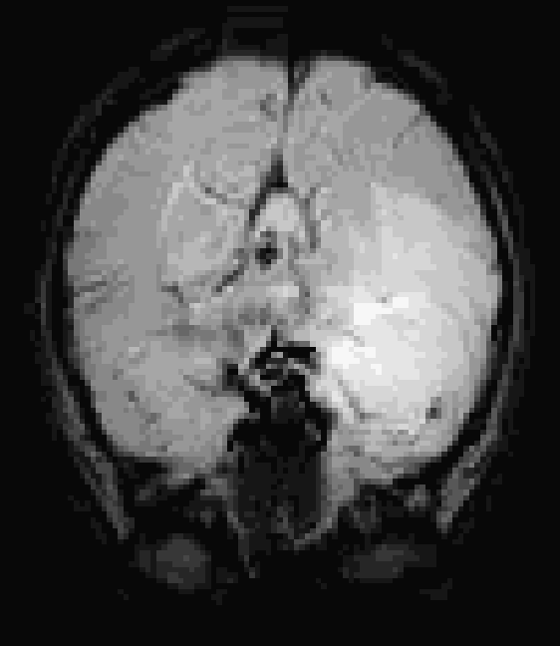
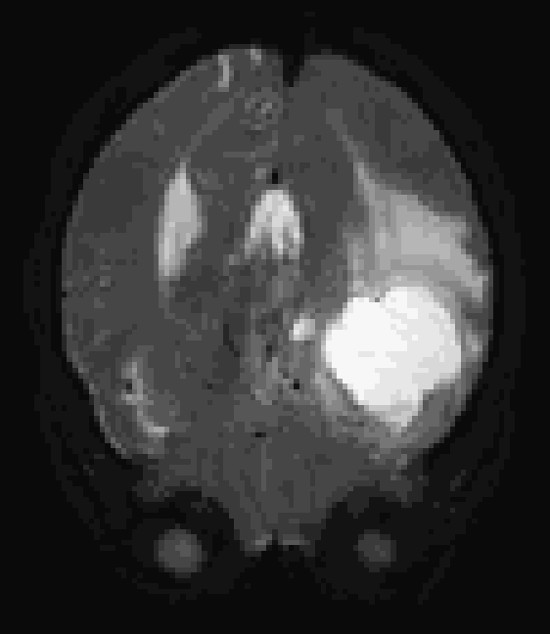
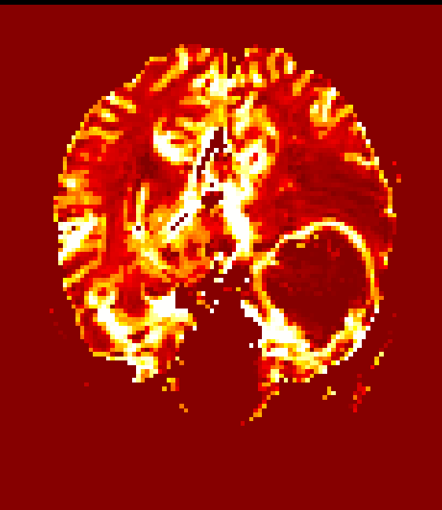
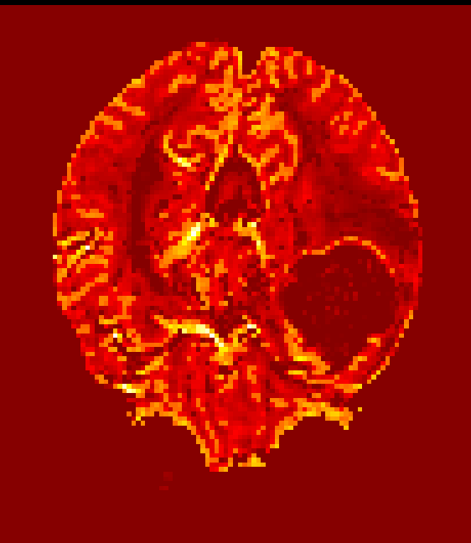
Corrected DSC (FSL TOPUP)
T2 FLAIR
GE DSC (T2*)
SE DSC (T2)
Andersson et al. 2003
$$ΔR2=−\frac{1}{TE}ln⁡(\frac{S(t)}{S_{0}})$$
$$rCBV ∝\int{ΔR2dt}$$

Slide 8
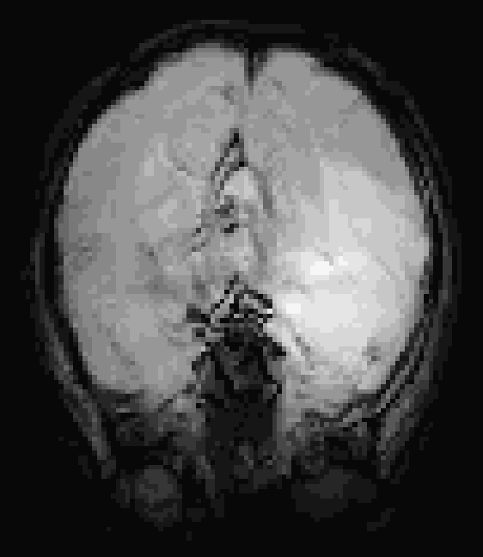
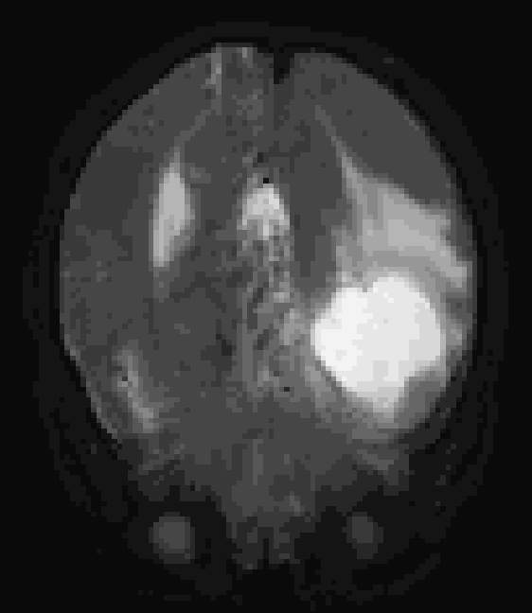
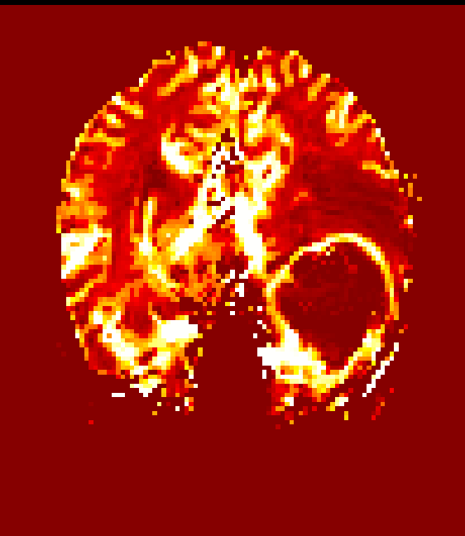
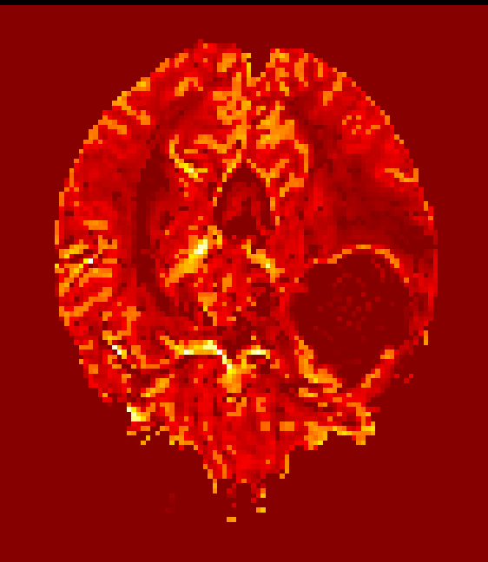
Corrected DSC (EPIC)
T2 FLAIR
GE DSC (T2*)
SE DSC (T2)
Holland et al. 2010
$$ΔR2=−\frac{1}{TE}ln⁡(\frac{S(t)}{S_{0}})$$
$$rCBV ∝\int{ΔR2dt}$$

Slide 9
3. Study Goal
Assess the impact of two EPI correction methods on rCBV
1. FSL TOPUP
2. EPIC
Summarize brain regions with rCBV most affected by correction

Slide 10

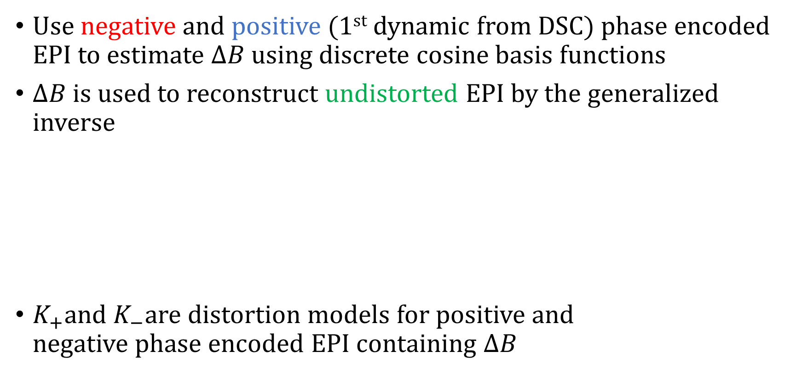
4. Method: Correction method 1: FSL TOPUP
Use negative and positive (1st dynamic from DSC) phase encoded EPI to estimate $ΔB$ using discrete cosine basis functions
$ΔB$ is used to reconstruct undistorted EPI by the generalized inverse
$K_{+}$and $K_{−}$are distortion models for positive and
negative phase encoded EPI containing $ΔB$
Positive EPI
Corrected EPI
Negative EPI
Andersson et al. 2003

Slide 11
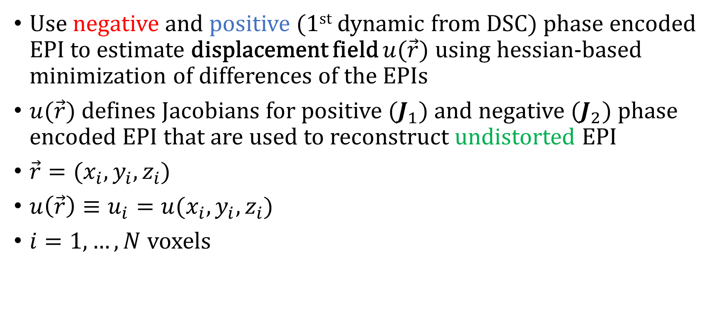
4. Method: Correction method 2: EPIC
Use negative and positive (1st dynamic from DSC) phase encoded EPI to estimate displacement field $u(\vec{r})$ using hessian-based minimization of differences of the EPIs
$u(\vec{r})$defines Jacobians for positive ($J_{1}$) and negative ($J_{2}$) phase encoded EPI that are used to reconstruct undistorted EPI
$\vec{r}=(x_{i},y_{i},z_{i})$
$u\left(\vec{r}\right)≡u_{i}=u(x_{i},y_{i},z_{i})$
$i=1,…,N$ voxels
Positive EPI
Negative EPI
Corrected EPI
Holland et al. 2010

Slide 12
4. Method: Region analysis
Re-align gradient echo and spin echo
1. uncorrected rCBV
2. FSL TOPUP corrected rCBV
3. EPIC corrected rCBV
with T2 FLAIR
based on co-registrating 1st dynamic DSC with T2 FLAIR

Slide 13
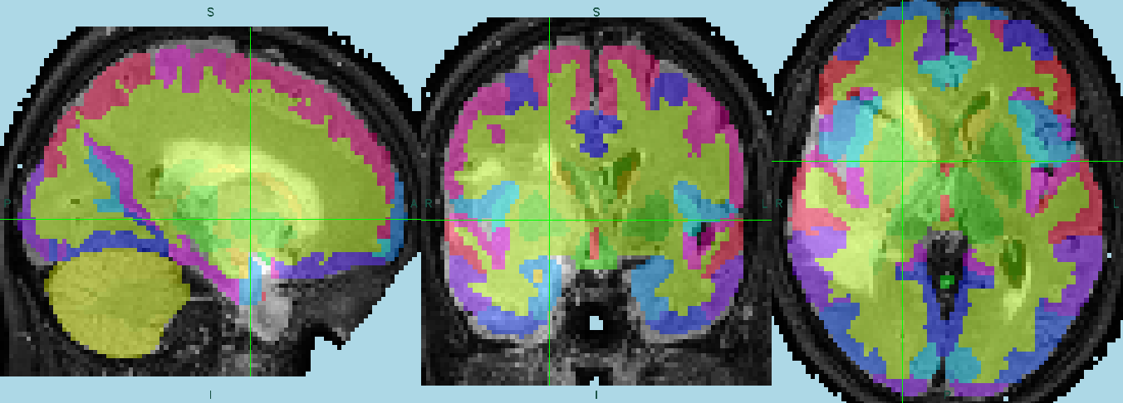
4. Method: Region analysis
Normalize T2 FLAIR to Montreal Neurological Institute (MNI) space using SPM12, store transformation matrix
134 brain regions in MNI space by Neuromorphometrics Inc. (colors)

Slide 14
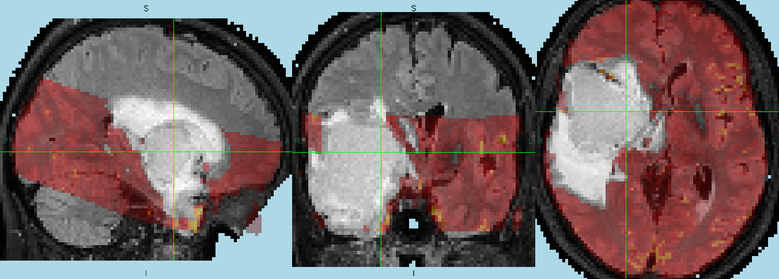
4. Method: Region analysis
Use transformation matrix from T2 FLAIR MNI normalization to transform rCBVs to MNI space
Exclude tumor rCBV from analysis using tumor regions in MNI space from Juan-Albarracín et al. 2019

Slide 15
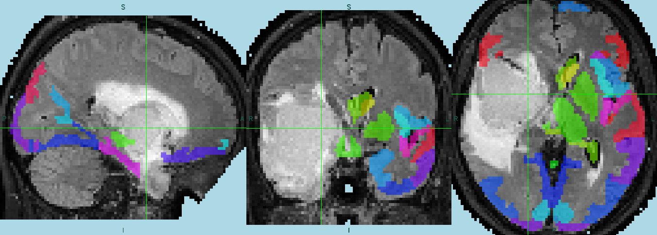
4. Method: Region analysis
Determine brain regions from template that overlap with rCBV minimum 70% and consists of minimum 30 voxels

Slide 16
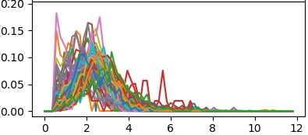


4. Method: Region analysis
Create and normalize rCBV histograms from selected regions
$$\frac{count}{total counts}$$
$$rCBV intensity$$

Slide 17
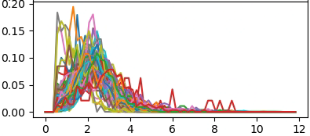

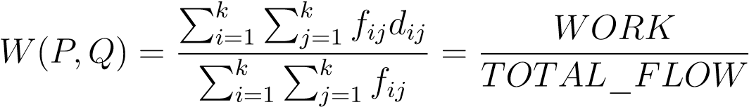







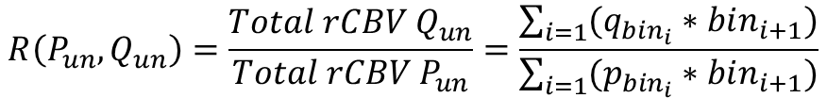


4. Method: Region analysis
Compare histograms across correction using various similarity measures
Hellinger distance
$$P$$
Uncorrected rCBV
$$P$$
$$P$$
$$P$$
$$…$$
Wasserstein distance
Rubner et al. 1998
EPIC corrected rCBV
$$Q$$
$$Q$$
$$Q$$
Relative change of total rCBV
$$Q$$
$$…$$
$$R\left(P_{un}, Q_{un}\right)=\frac{Total rCBV Q_{un}}{Total rCBV P_{un}}=\frac{\sum_{i=1}{(q_{bin_{i}}∗bin_{i+1})}}{\sum_{i=1}{(p_{bin_{i}}∗bin_{i+1})}}$$
$$un:unnormalized$$

Slide 18
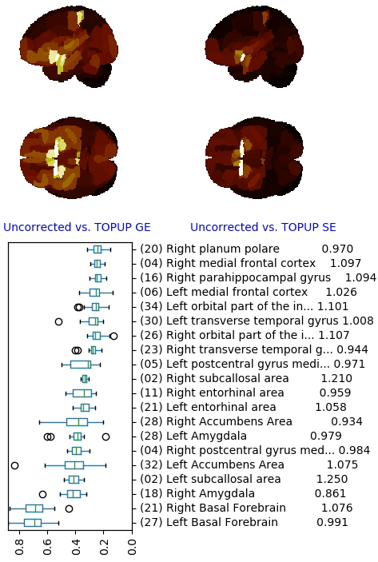

5. Results
Visualized: Median Hellinger distance
1. Difference
in rCBV
caused by
FSL TOPUP
based on
Hellinger distance
EPIC caused
difference in
similar regions
Top 20 regions (bottom-up)
$$n$$
Hellinger distance
Relative change of total rCBV

Slide 19
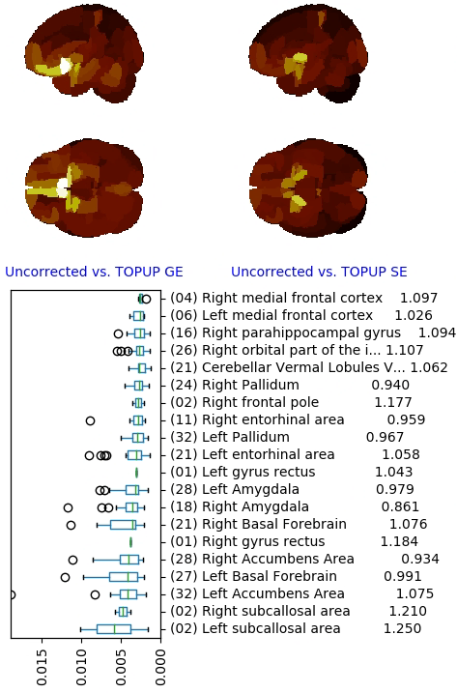
5. Results
Visualized: Median Wasserstein distance
1. Difference
in rCBV
caused by
FSL TOPUP
based on
Wasserstein
distance
EPIC caused
difference in
similar regions
Top 20 regions (bottom-up)
$$n$$
Wasserstein distance
Relative change of total rCBV

Slide 20
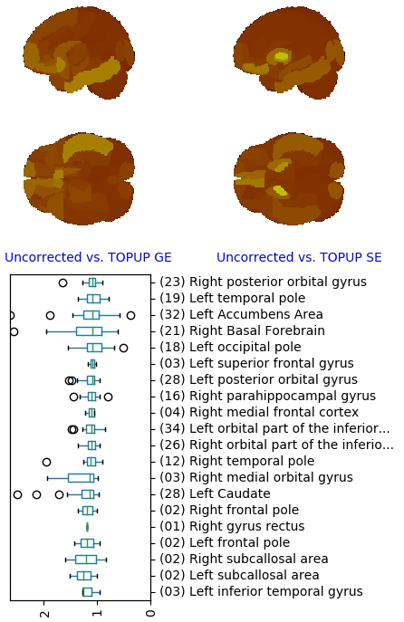

5. Results
Visualized: Median relative total rCBV increase
1. Increase
in relative
total rCBV
caused by
FSL TOPUP
EPIC caused
increase in
similar regions
Top 20 regions (bottom-up)
Relative total rCBV
$$n$$

Slide 21
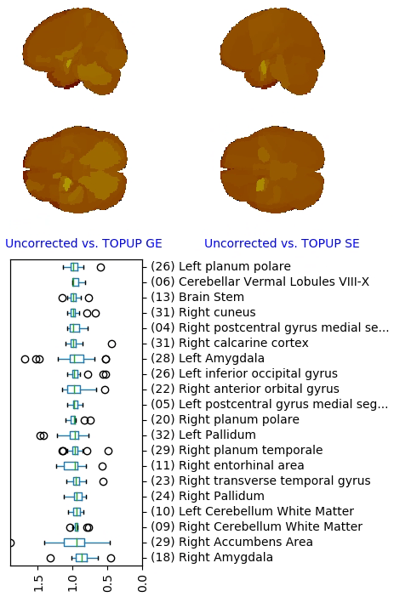
5. Results
Visualized: Median relative total rCBV decrease
1. Decrease
in relative
total rCBV
caused by
FSL TOPUP
EPIC caused
decrease in
similar regions
Top 20 regions (bottom-up)
Relative total rCBV
$$n$$

Slide 22
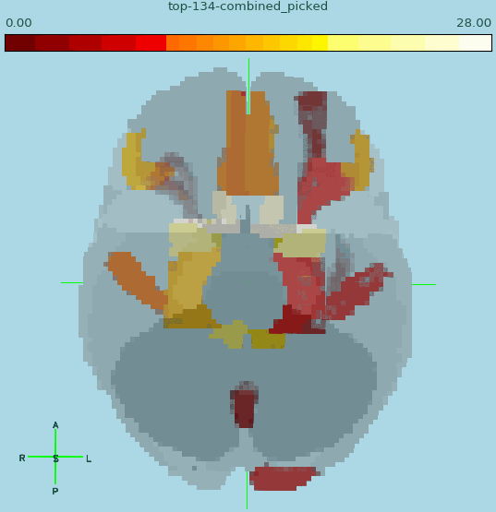
Top regions with large distance ranked high (white, 1.)-low(red, 14.)
Major structural rCBV change (MNI)
Left & right basal forebrain
Left & right accumbens area
Left & right amygdala
Left & right entorhinal area
Left & right Pallidum
Left & right postcentral gyrus medial segment
Left & right orbital part of the inferior frontal gyrus
Left & right medial frontal cortex
Left & right gyrus rectus
Left & right parahippocampal gyrus
Left & right transverse temporal gyrus
Left & right posterior orbital gyrus
Left & right occipital pole
Left anterior orbital gyrus
Based on:
Hellinger distance
&
Wasserstein distance

Slide 23
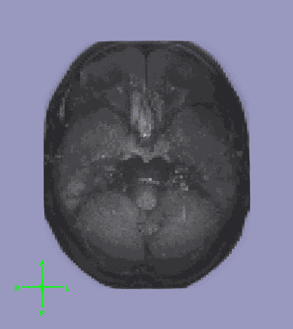
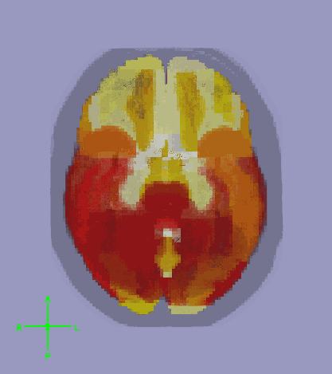
All 134 regions ranked by decreasing distance from corrections (white highest)
Example subject MNI space
Based on:
Hellinger distance
&
Wasserstein distance

Slide 24
5. Take home message
According to Hellinger and Wasserstein distances, EPI distortion correction causes the highest change in rCBV histogram distribution in regions in and around the basal forebrain
Although EPI distortion correction may cause large difference in histogram distribution in a region, it does not necessarily cause large rCBV change in a region

Slide 25
Thank you!

