Slide 1
Quantification of ventricle and tumor volume change in treatment of glioblastoma
Ivar Thokle Hovden
Notes:
I would like that we take the discussion and questions after I have done the presentation
I’m apprechiating to not be interrupted too much, because it makes it more difficult for me to present
And please remember that I have not a clear medical background. I’m perhaps closer to physics, computer science and mathematics
Goal of the presentation: Present motivation and results of comparing tumor and ventricle volume changes in conventional glioblastoma treament, and have discussion for useful input for leading up to a publication about this topic.
Questions: remember it or write it down for asking it after I have finished speaking.

Slide 2
Treatment of glioblastoma
Grade 4 glioma (most aggressive type of the primary glioma brain tumor)
Conventional treatment involving surgery, followed by regularly radiation -and chemotherapy
12-15 months overall survival (15 months ~=450 days, ~62 weeks)
  Most glioblastomas recur despite conventional treatment
Typical observation: ‘shrinkage’ of the tumor volume or volume of surgical resection if successful radiochemotherapy (RCT), then recurrence of new tumor tissue at various places in the brain at later time points (‘expansion’)
Notes:
Radiotherapy plus Concomitant and Adjuvant Temozolomide
‘concomitant’: accompanying, associated, connected -> clinicians' word for concurrent, parallel (?)
‘adjuvant’: drug or collection of drugs that is used to increase the efficacy or potency of certain drugs (ad-hoc treamtment, ‘tilleggsbehandling’ (til kirurgien og strålingen (til kreftbehandlingen))) -> the temozolomide

Slide 3
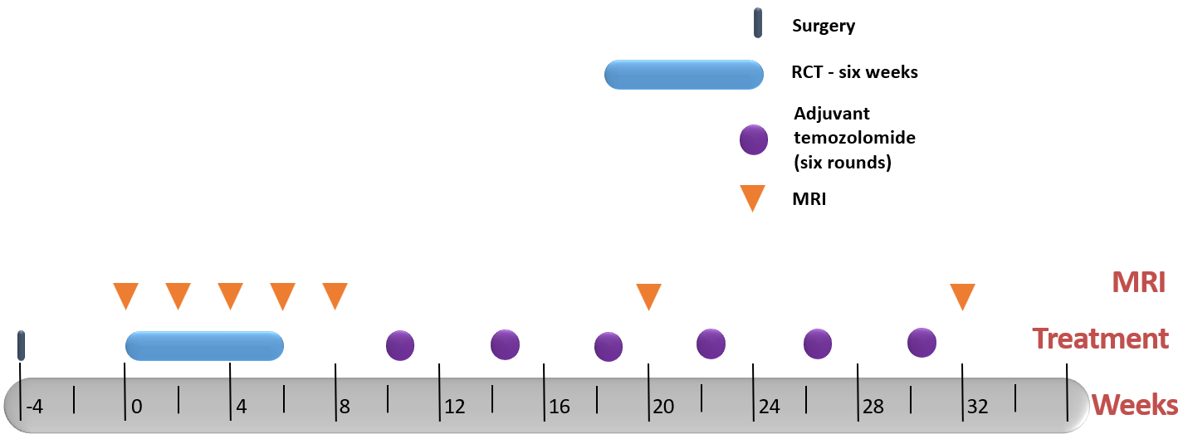
Conventional treatment at OUS (SAILOR)
Fra Magne M. K.
Notes:
From the SAILOR study.
Treatment scheme durating ~half of the documented maximum overall survival
Stupp.
The first MRI is the ‘baseline’ (baseline is post-surgery in the data that I have used)
36 weeks=252 days

Slide 4
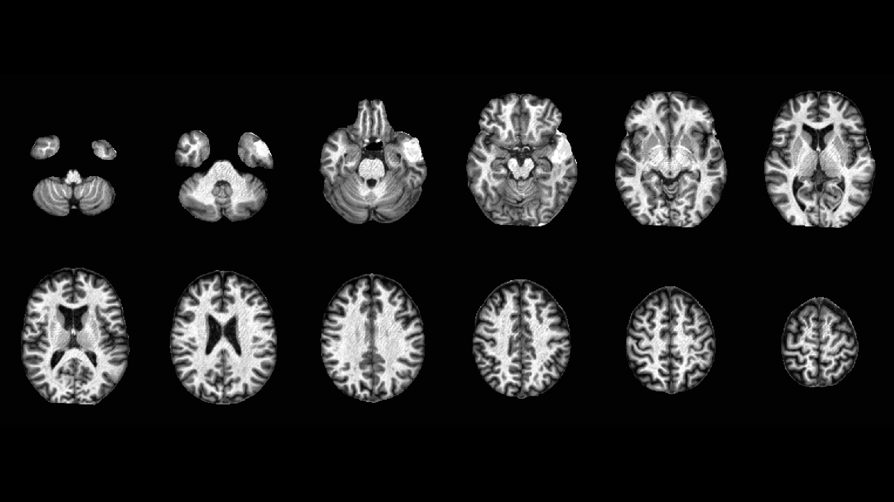
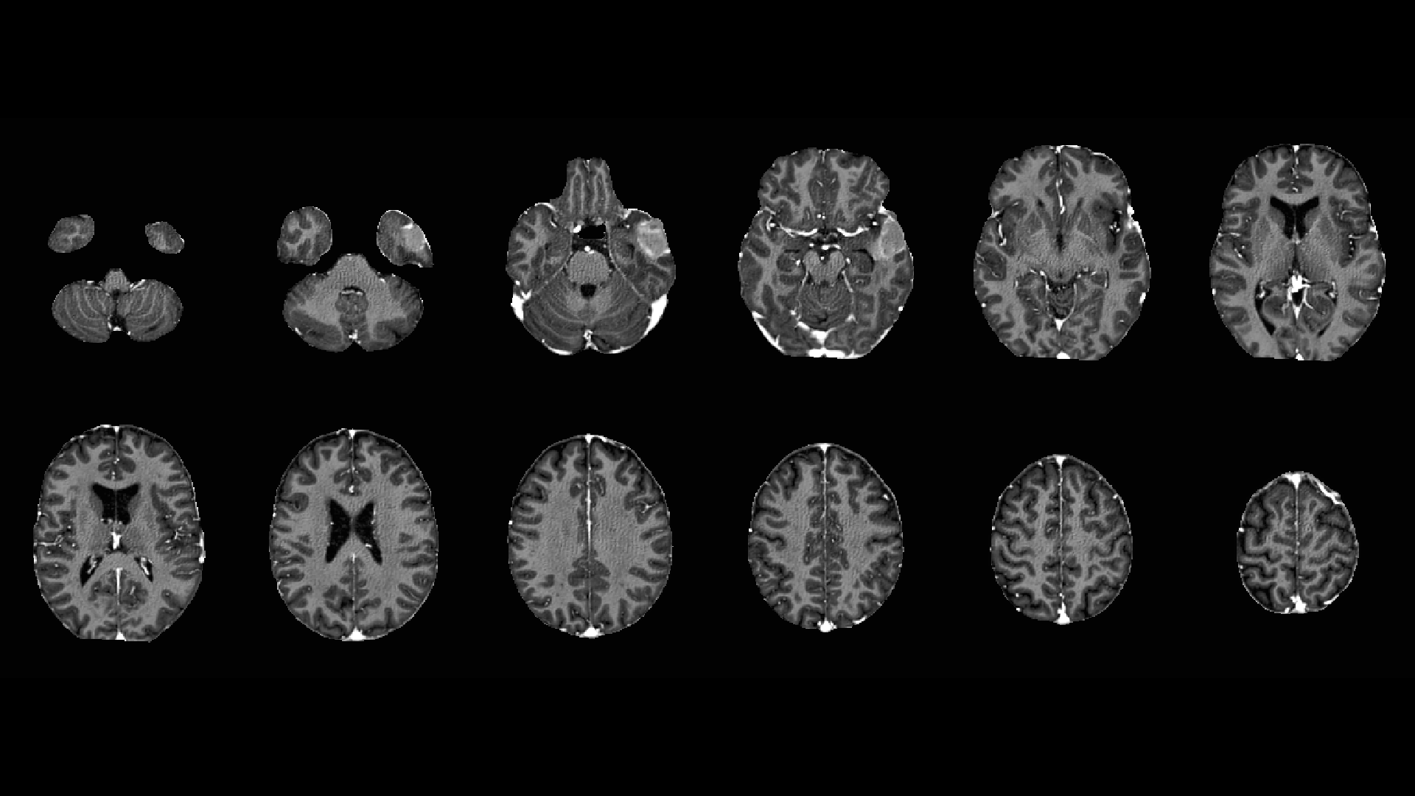
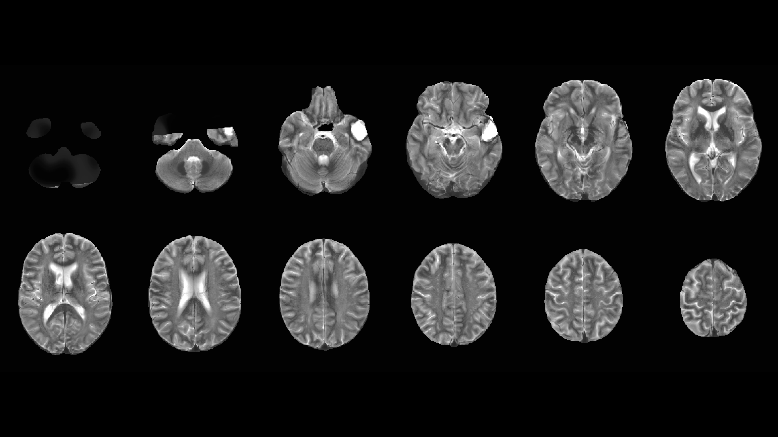
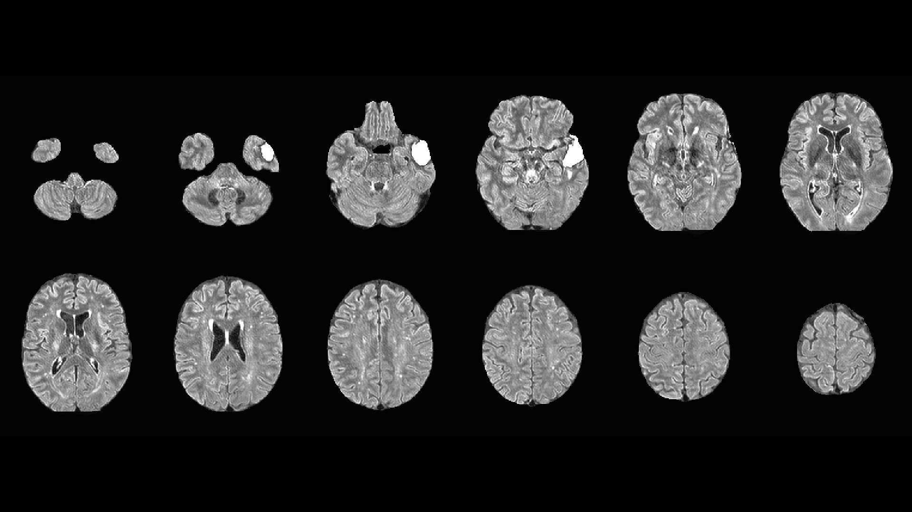
sailor-mni/sub-04
T1
T1c
T2
Flair

Slide 5
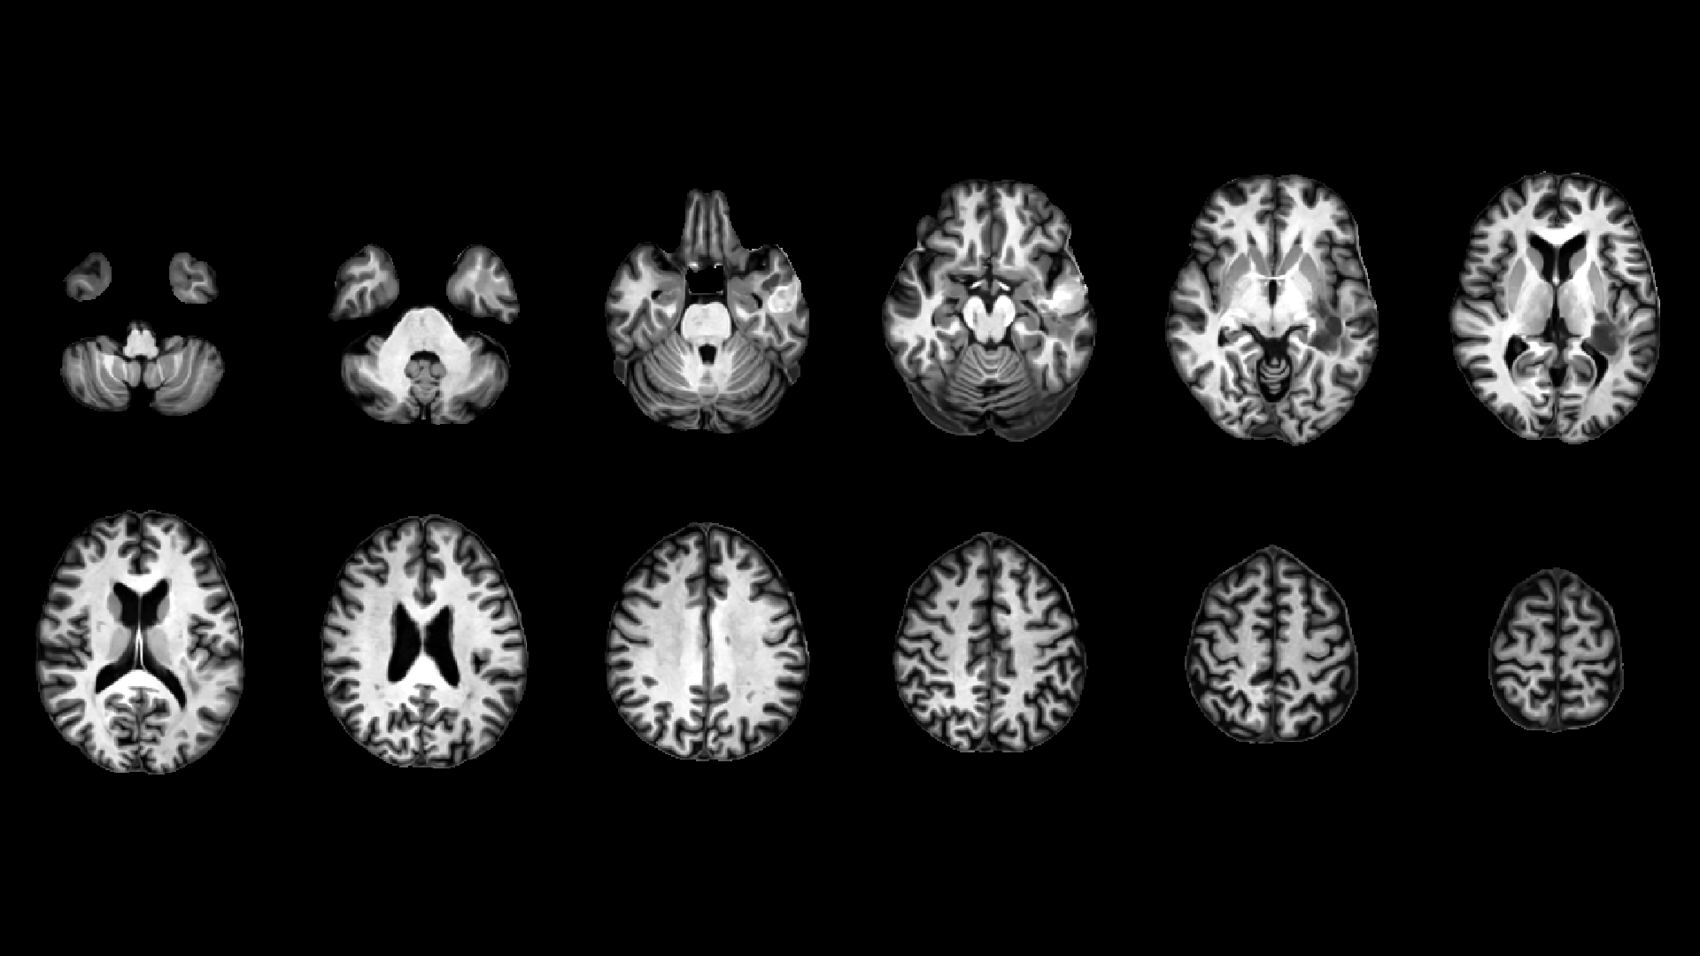
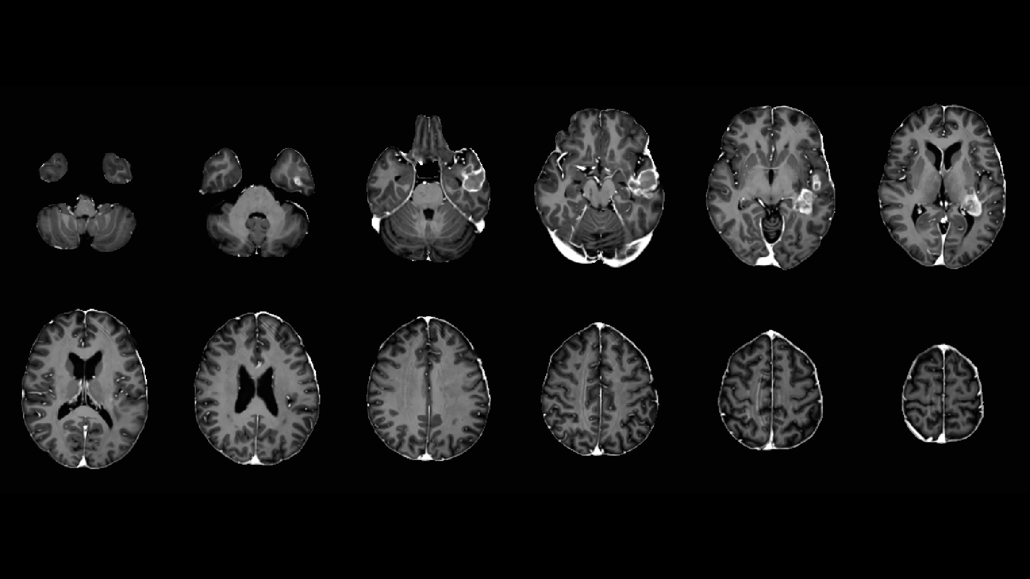
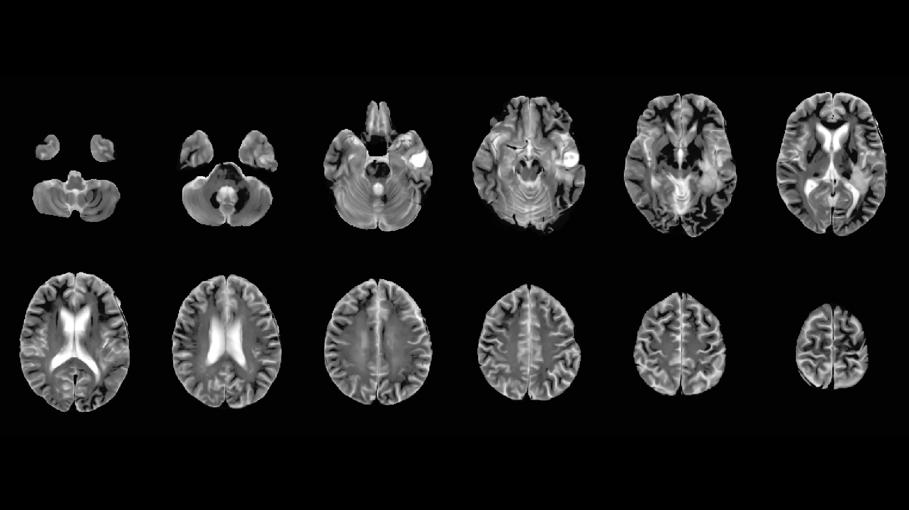
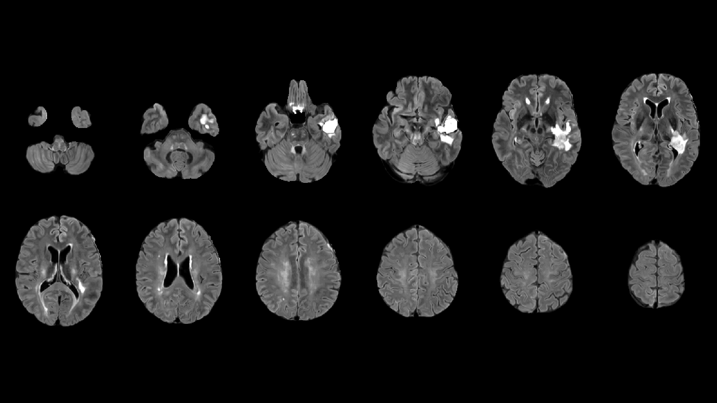
sailor-mni/sub-06
T1
T1c
T2
Flair
Notes:
I would like to perform some analysis that can quantify common reponses to the treatment
The main point is that perhaps such an analysis could lead up to some new knowledge about the conventional treatment
For instance: ventricle expansion is clearly more recognizable than tumor expansion in this treatment

Slide 6
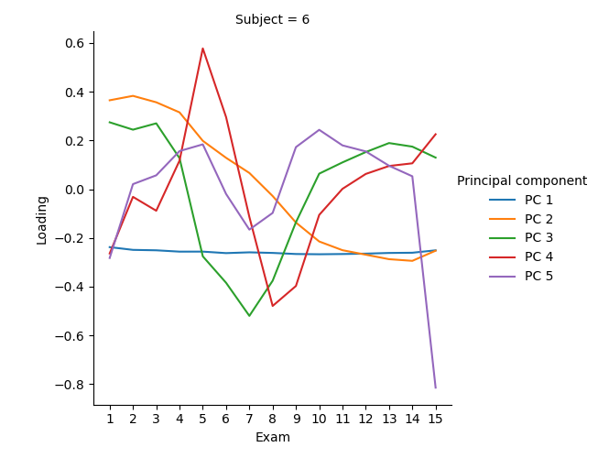
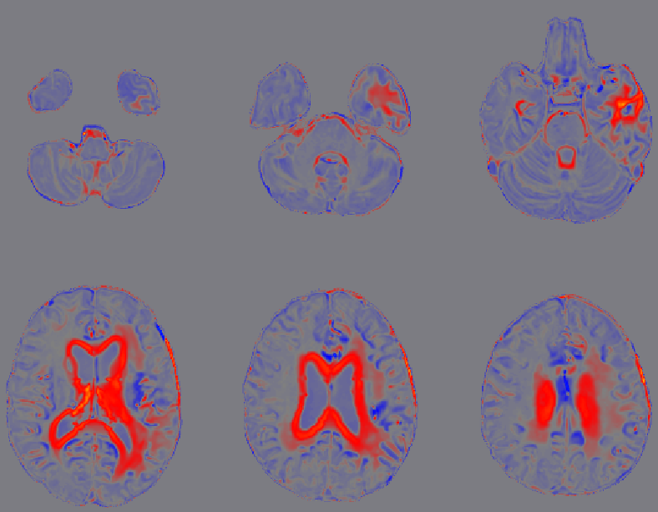
PCA model of subject 6 (all exams)
Loadings: Variable importance (Variable=Exam). First exam is the most important (has highest intensities in red regions) for PC 2
Scores for PC 2. Red regions represent intensity change caused by expanding ventricles. Red and blue represents positive and negative values, respectively
Notes:
Better to be approximately right than precisely wrong
Quantification without segmentation: traditional clustering directly in the image intensities
In PCA, possible to reconstruct an image for a given deconstructed component (from a longitudinal series of T1c MRI for a patient)
Typically, component 2 describes structural changes related to the ventricles
PCA is related to Autoencoder, see link to a previous presentation in the hypothesis slide

Slide 7
Subject (t1c) (SAILOR) | Component describing ventricle change
1 | 2,3,4
4 | 2,3
6 | 2
14 | 2,3
23 | 2,3
24 | 2,3
26 | 2,3
What is component 2?
High intensity change caused by expanding ventricles
Notes:
Component 2 seems to describe/capture ventricle abnormality in glioblastoma

Slide 8
Ventricle change: relevant literature
Evidence of ventricle expansion as part of brain atrophy (shrinkage) as an effect of radiation therapy on glioblastoma (2015)
Atrophy of various brain regions and of the whole brain is associated with radiation therapy (2021 review)
Ventricle dilation as a well-known marker of brain disease and damage
  Dementia, Alzheimer’s
  Hydrocephalus (‘water head’)
  Ageing
  Electroshock therapy
Notes:
Suggestions for references to ventricle change associated with brain disease and damage?

Slide 9
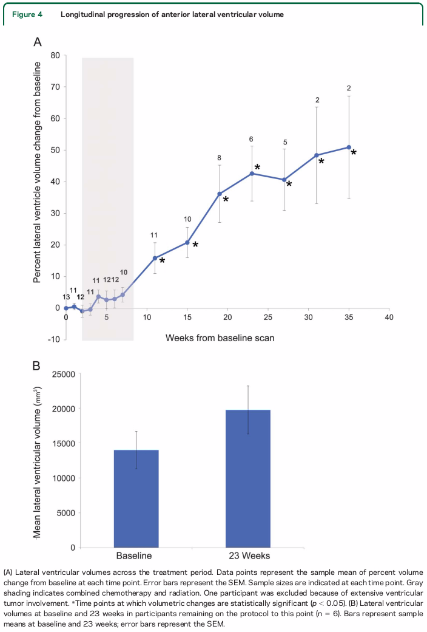
2015 reference
Notes:
Tomas Sakinis
40 weeks=280 days
I would like to perform a similar analysis

Slide 10
Main hypothesis
Ventricle expansion is a stable quantifiable imaging pattern across many glioblastoma patients (my previous presentation)
  More stable than tumor volume measurements?
  Insights into glymphatic aspects of glioblastoma/treatment?
H₀: In standard treatment of glioblastoma, the change of tumor volume is not associated with change of ventricle volume (ventricles 1 and 2)
Notes:
Ventricle change: increase or decrease
Future additions
Stratification between early (RCT) and late (TMZ) treatment
Associating with overall survival

Slide 11
Datagrunnlag
Navn | Sykdom | N | Antall undersøkelser | Valgt anatomisk MR-bilde | Offentlig (j/n) | Kreftsegmentering | Referanse
SAILOR | Gliom (3 grad III, 24 grad IV) | 27 | 3-14 | T1 | n | Ødem, nekrotisk, kontrastforsterkende | 1
BOSTON-NHX | Gliom IV (glioblastom) | 14 | 6-15 | T2 (5), ADC (8), FLAIR (1) | n | kontrastforsterkende | 1
Notes:
Sorry about Norwegian

Slide 12
Data for eksperimenter
sailor-mni + boston-nhx (41 pas *~ 9 intervaller = 369 N)

Slide 13
Eksperiment 0, informasjon
Mål: Segmentering av 1. og 2. ventrikkel
Templat 1: T1 og T2 Montreal Neuroligical Institute (MNI) 152 International Consortium for Brain Mapping (ICBM) 2009c nonlinear symmetric
Templat 2 fra Statistical Parametric Mapping (SPM) 12
  Sannsynslighetstetthetskart for ulike vevstyper (Tissue Probability Map, TPM) :
    Grå materie
    Hvit materie
    Cerebrospinal veske (CSF)
    Skalle
    Utenfor skalle
    Utenfor hode
  136 koregistrerte manuelt segmenterte områder fra Neuromorphometrics, Inc.

Slide 14
Eksperiment 0, metode B
Manuell segmentering av 1. og 2. ventrikkel basert på T1-bilde fra templat 1
MedSeg.ai
Segmenteringen er utført av meg, og de valgte områdene er basert på områdene fra Neuromorphometrics, Inc.
Sammenligning med T1-bilde fra templat 1
Notes:
Alternatives: Using
FastSurfer
MNI152 CSF template

Slide 15
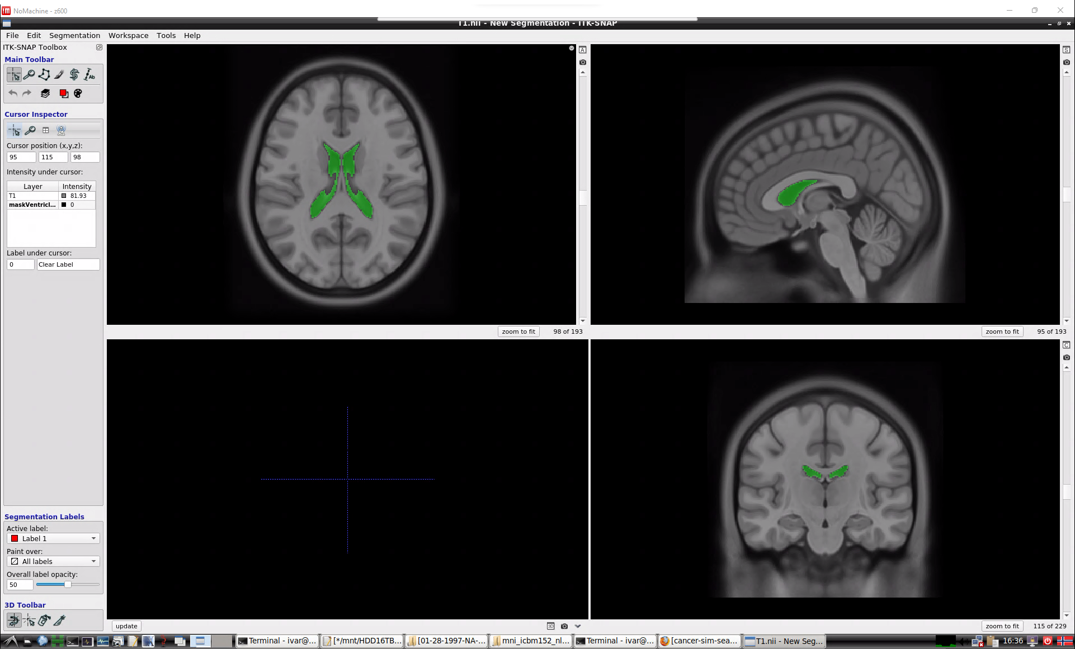
Templat 1 + MedSeg manuelt

Slide 16
Eksperiment 0, metode B
Manuell segmentering av 1. og 2. ventrikkel basert på T1-bilde fra templat 1
MedSeg.ai
Segmenteringen er utført av meg, og de valgte områdene er basert på (lært av) områdene fra Neuromorphometrics, Inc.
Sammenligning med T1-bilde fra templat 1
Konklusjon: Matchende segmentering

Slide 17
Eksperiment 1, informasjon
Mål: ANTs Symmetric diffeomorphic image registratioN (SyN) for å segmentere 1. og 2. ventrikkel i pasient med glioblastom
Templat 1: T1 Montreal Neuroligical Institute (MNI) 152 International Consortium for Brain Mapping (ICBM) 2009c nonlinear symmetric
Segmenterte 1. og 2. ventrikkel for templat 1 med MedSeg
T1-bilde fra SAILOR, pasient 1, første scan postkirurgisk

Slide 18
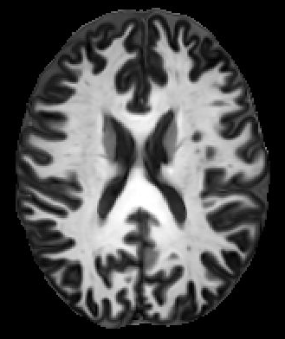
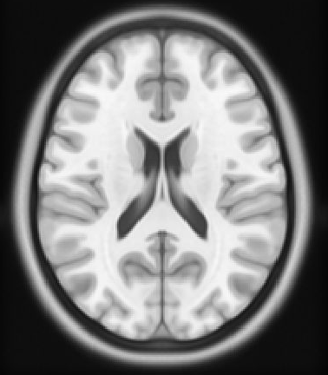
Eksperiment 1, metode
Pasient T1 koregistreres til templat T1
  Fixed: templat T1
  Moving: pasient T1
  command="antsRegistration \
  --dimensionality 3 \
  --float 0 \
  --output $out_prefix \
  --interpolation Linear \
  --winsorize-image-intensities [0.001,0.999] \
  --use-histogram-matching 1 \
  --transform SyN[0.1,3,0] \
  --metric CC[$fixedimg,$movingimg,1,4] \
  --convergence [100x70x50x20,1e-6,10] \
  --shrink-factors 8x4x2x1 \
  --smoothing-sigmas 3x2x1x0vox \
  --verbose 0"
  Gir forflytningfelt for forover og bakover deformasjon av voksler
Pasient
Templat
Notes:
ANTs: Advanced Normalization Tools
Nonrigid (nonlinear, deformable coregistration)

Slide 19



Eksperiment 1, metode
Ventrikkelmaske deformeres til pasient
  Basert på bakover deformasjonsfelt
  k-nærmeste nabo interpolasjon
  antsApplyTransforms --dimensionality 3 \
  --input $ifile \
  --reference-image $ref \
  --output $ofile \
  --interpolation NearestNeighbor \
  --transform $transform \
  --verbose 0
Pasient
Templat

Slide 20
Templat 1 + MedSeg manuelt

Slide 21
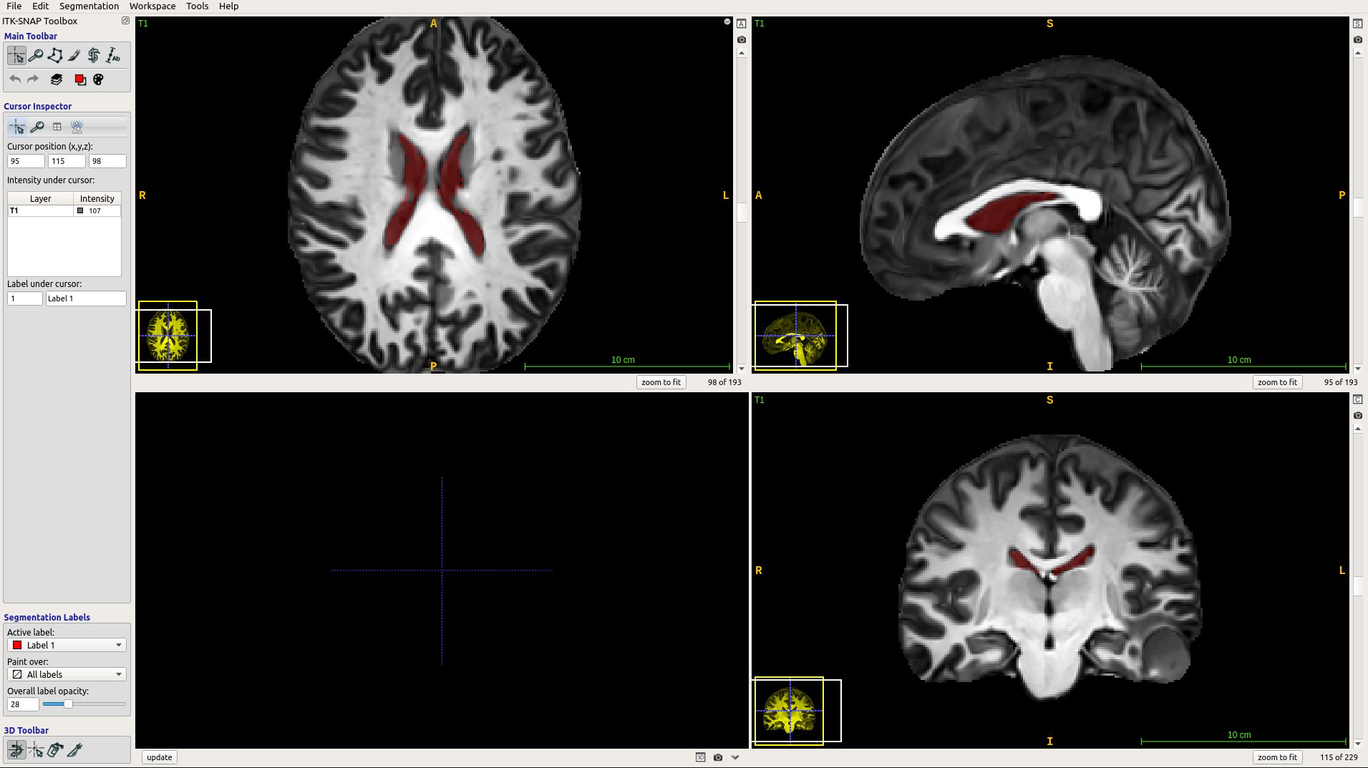
SAILOR pas. 1 + manuell MedSeg + SyN segmentering

Slide 22
Eksperiment 1, konklusjon
ANTs SyN kan brukes til å segmentere ventrikler
Basert på:
  T1 MNI templat 1
  Manuelt segmenterte ventrikler
~4 min kjøretid (64-kjerner AMD Threadripper CPU, miniserver 2)

Slide 23
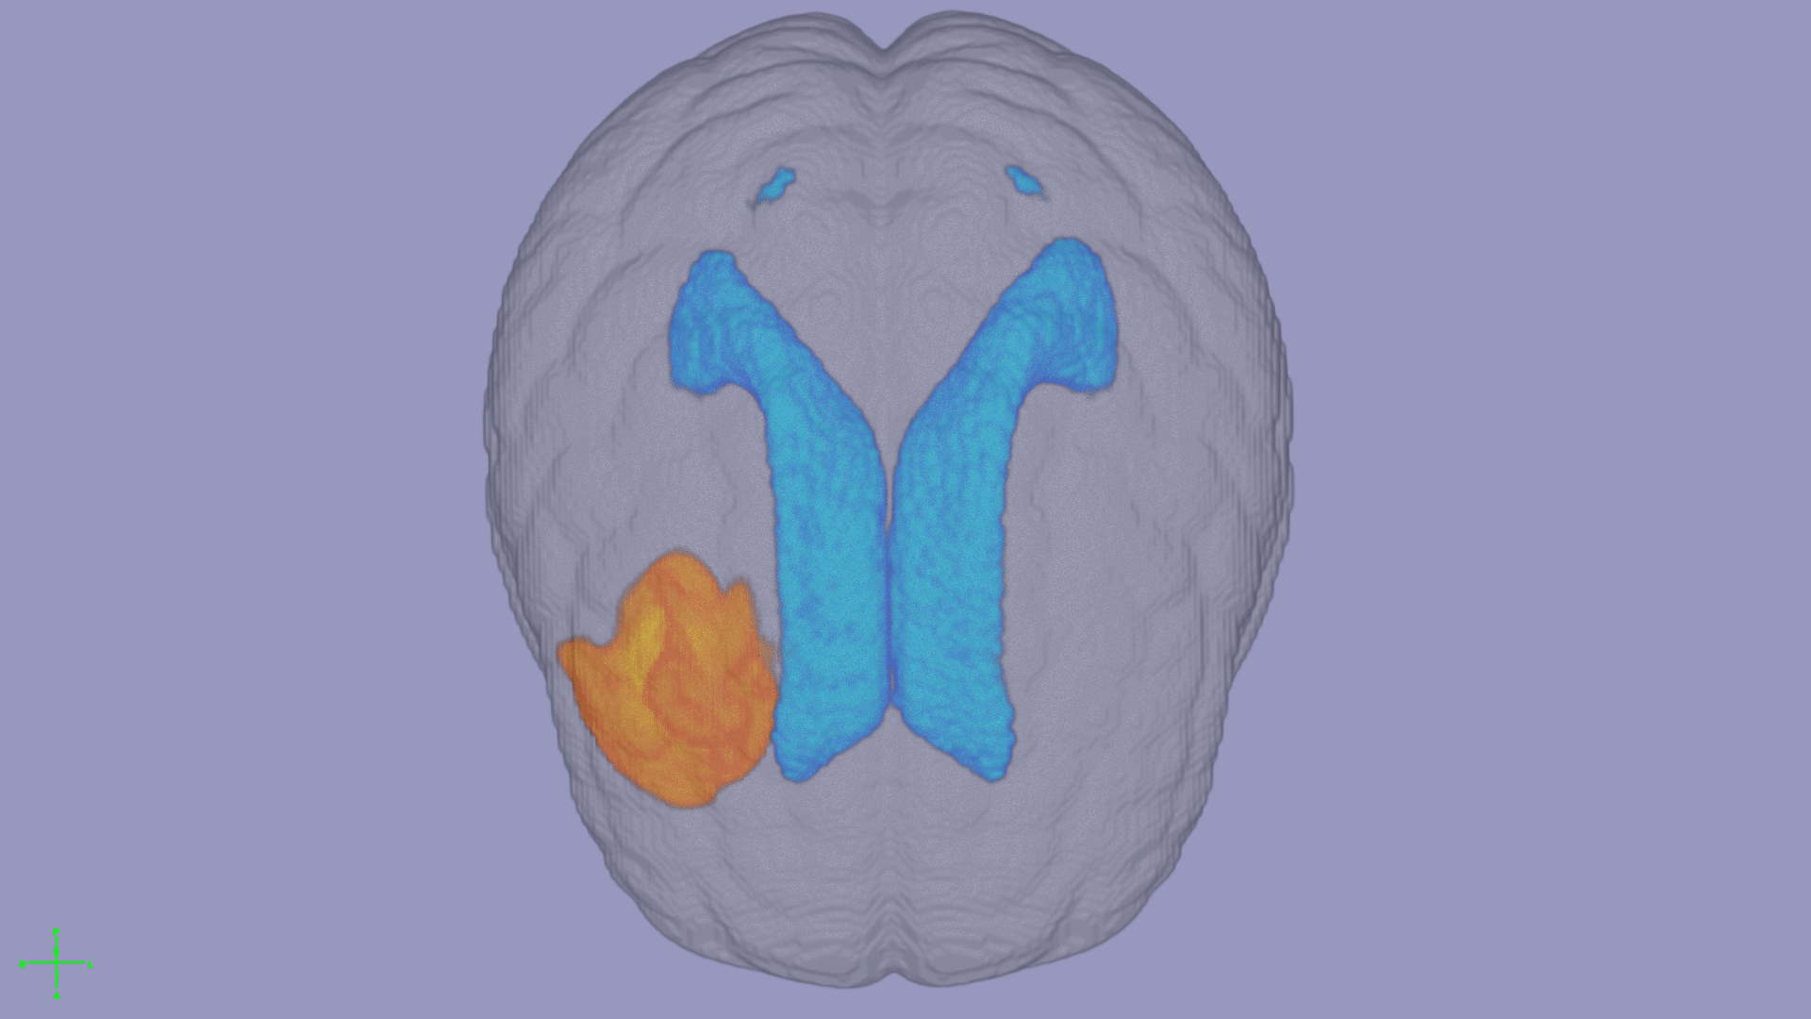
Fra 14 T1-bilder fra SAILOR, pasient 26
Notes:
The behaviour of the volume of the tumor throughout the treatment, is a lot more complex than the behavour of first and second lateral ventricles.

Slide 24
Eksperiment 5, informasjon
Mål: Plått endring av ventrikkelvolum i forhold til baseline scan over tid (to datasett, 41 pasienter, 387 intervaller)
Computation of ventricle volume [mm³] from ventricle masks: compute-vent-vols.sh
Collection of interval measures relative to baseline: print-from-baseline-interval-measures.sh
Notes:
Oslo and Boston dataset

Slide 25
Dataset versions in Experiment 5
Datasett | Git commit | Beskjed
SAILOR | d4c59083a4075191deb6e1e28b77a693501ee3a | modify treatment.txt to re-label a few late time steps where the six cycles of temozolomide were completed, by labeling the treatment to 'unknown'
BOSTON | b2baf585aa80c95ec2c4d7a07b9dbb1371d244e0 | modify treatment.txt to re-label a few late time steps where the six cycles of temozolomide were completed, by labeling the treatment to 'unknown'
https://github.com/CRAI-OUS/bidsdir
Notes:
This is how I envision a more reproducible way of organizing your data for research.
Research community approved Brain Imaging Data Structure (BIDS) file organization + Data science community approved Data Version Control (DVC) + Git + Local (hospital) hosting of the imaging data for full control and security.
Like with Git, possible to ‘checkout’ a specific version of a dataset based on the git commit hash.

Slide 26
Eksperiment 5, metode
A bunch of python and bash scripts on a messy server

Slide 27
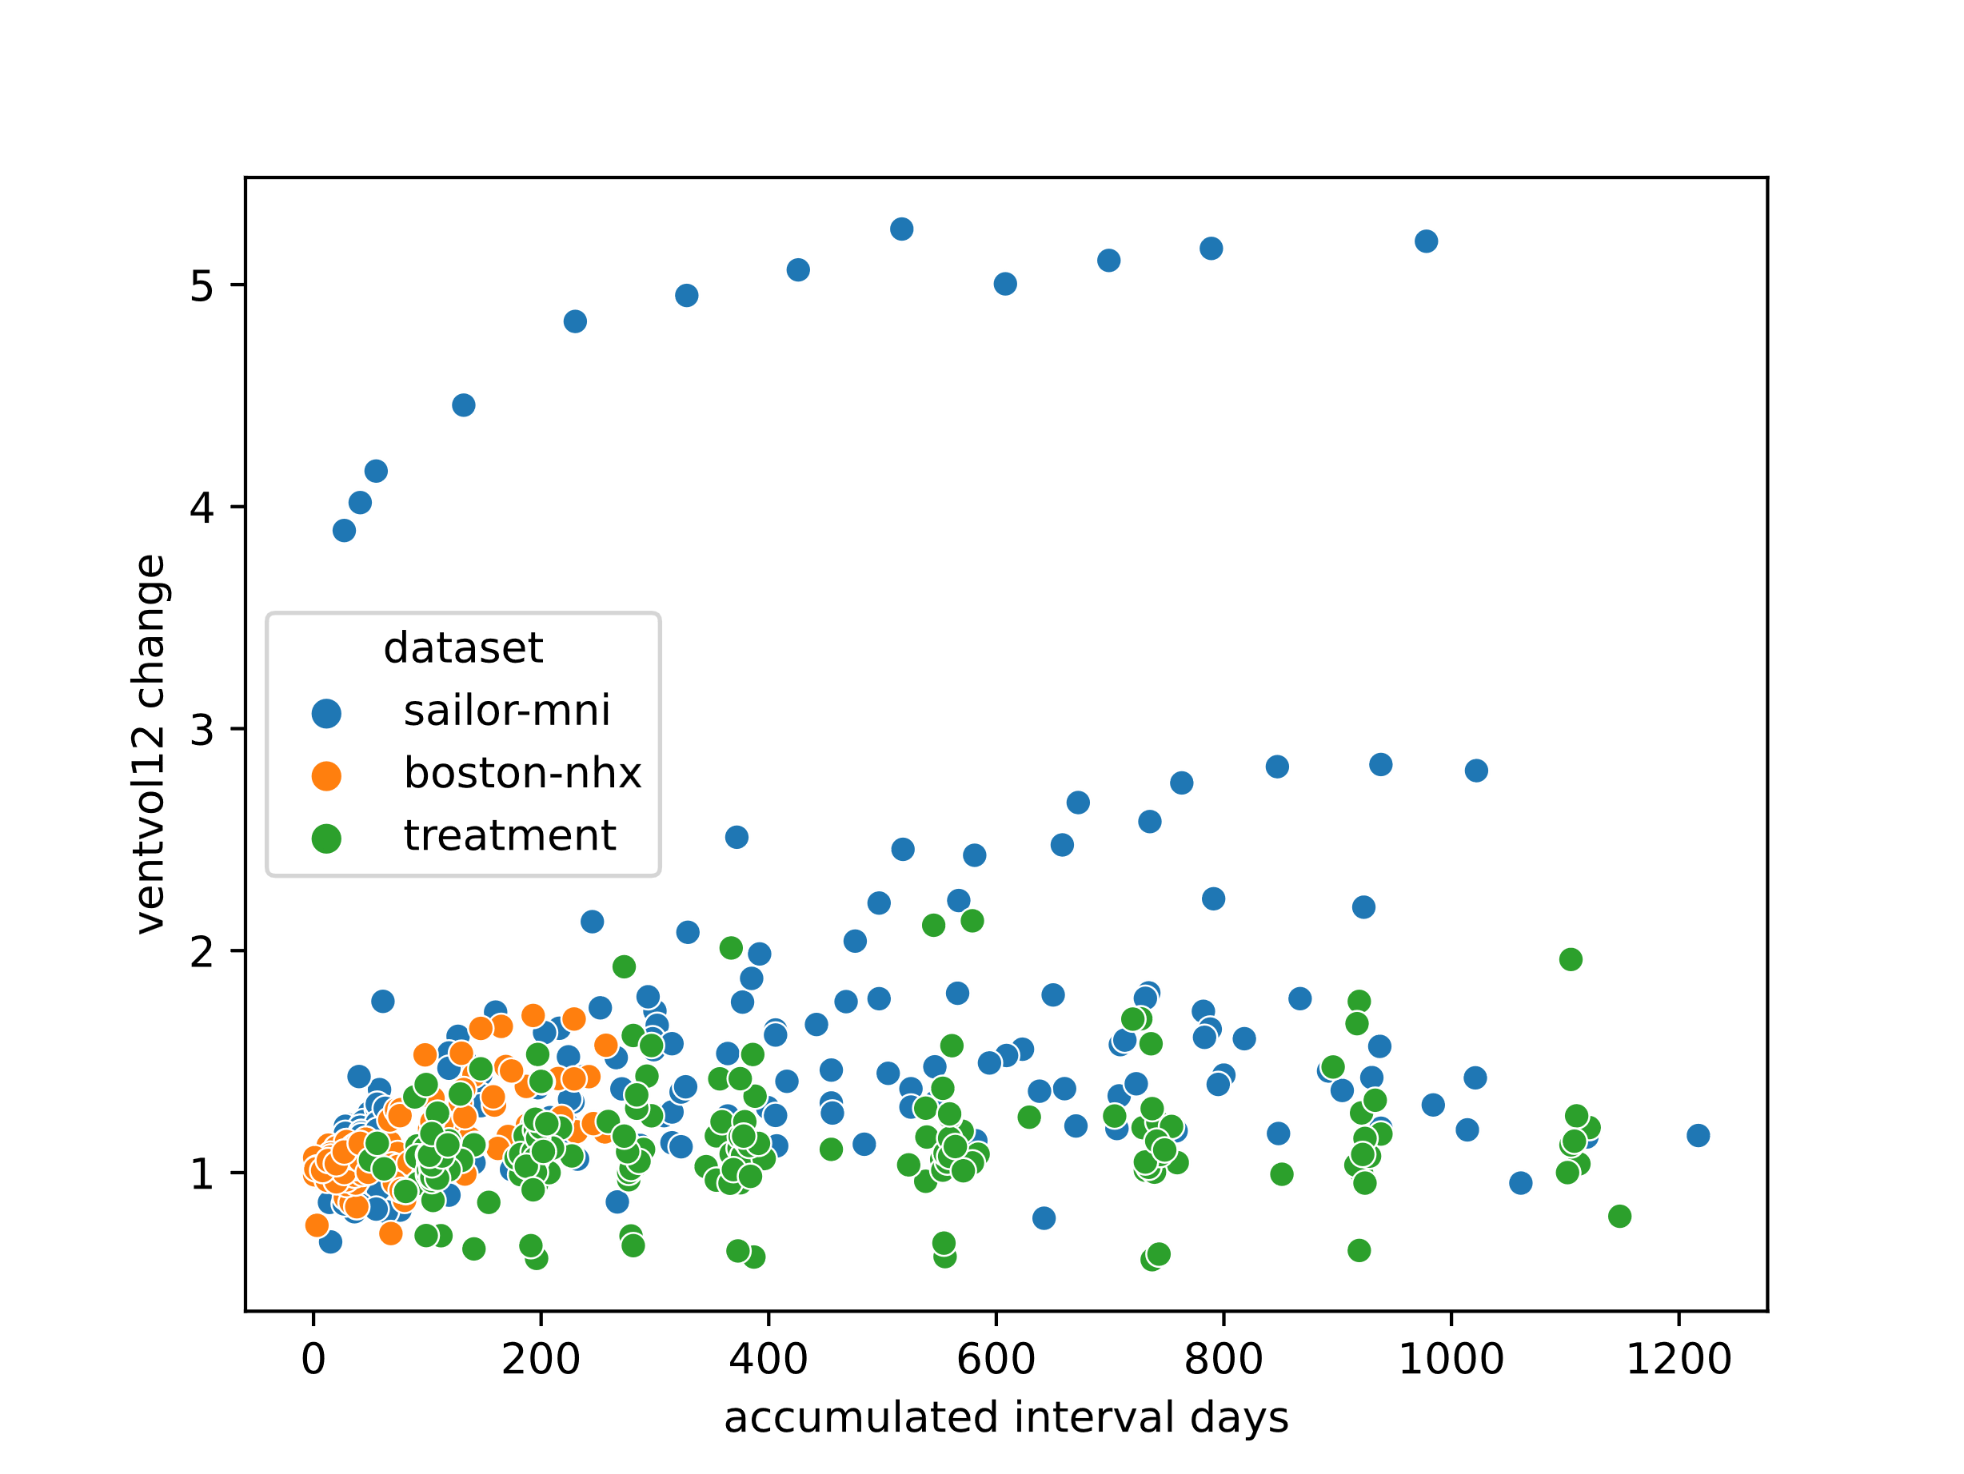
Notes:
1200 days=~171 weeks
Time changed: 1=unchanged, < 1, shrinkage
Most samples describe volume increase
Most data is in the 0-250 (35 weeks) days range
Saillor pas. 23 er en outlier: Veldig rask ekspansjon
A third dataset of brain metastases from lung and skin cancer is also included for comparison, but it is not included in the analysis any further.

Slide 28
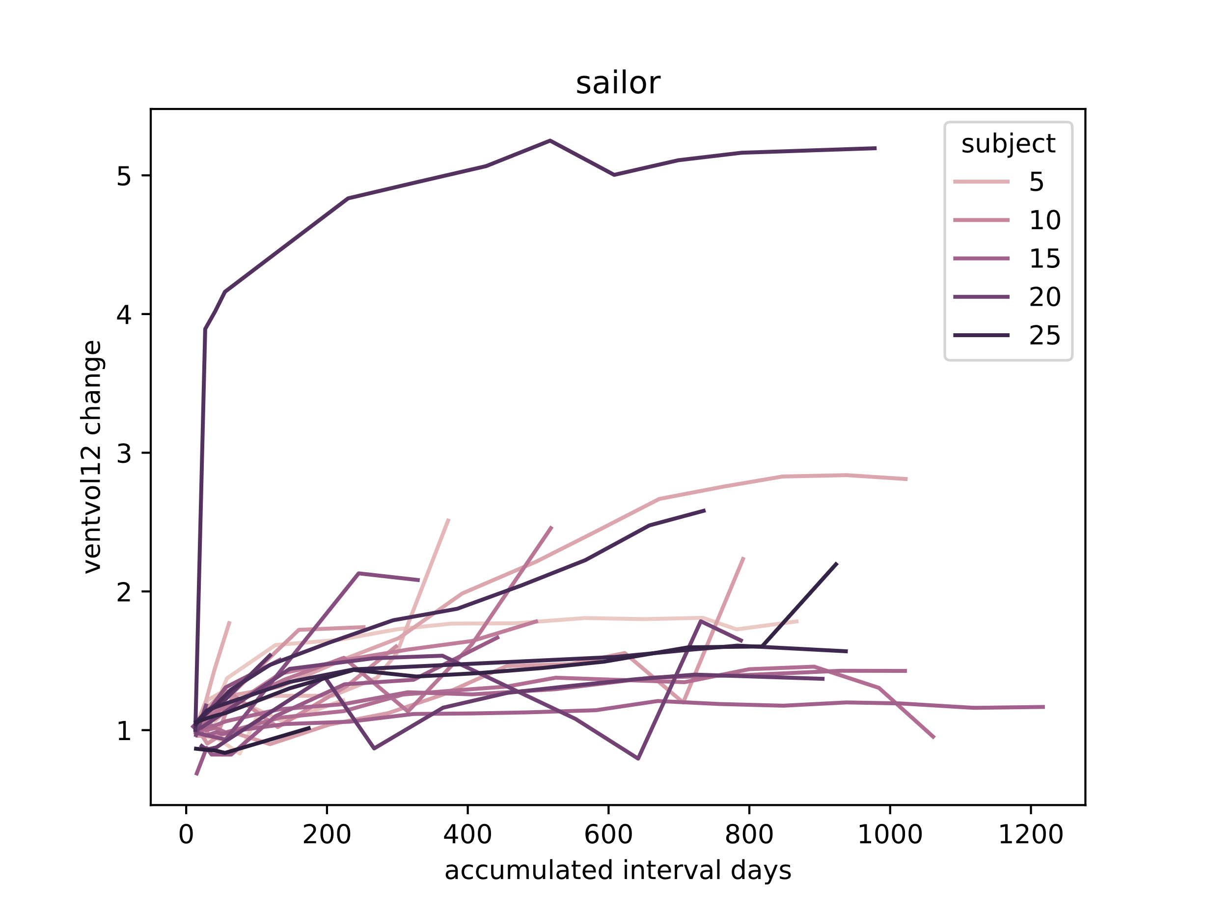

Slide 29
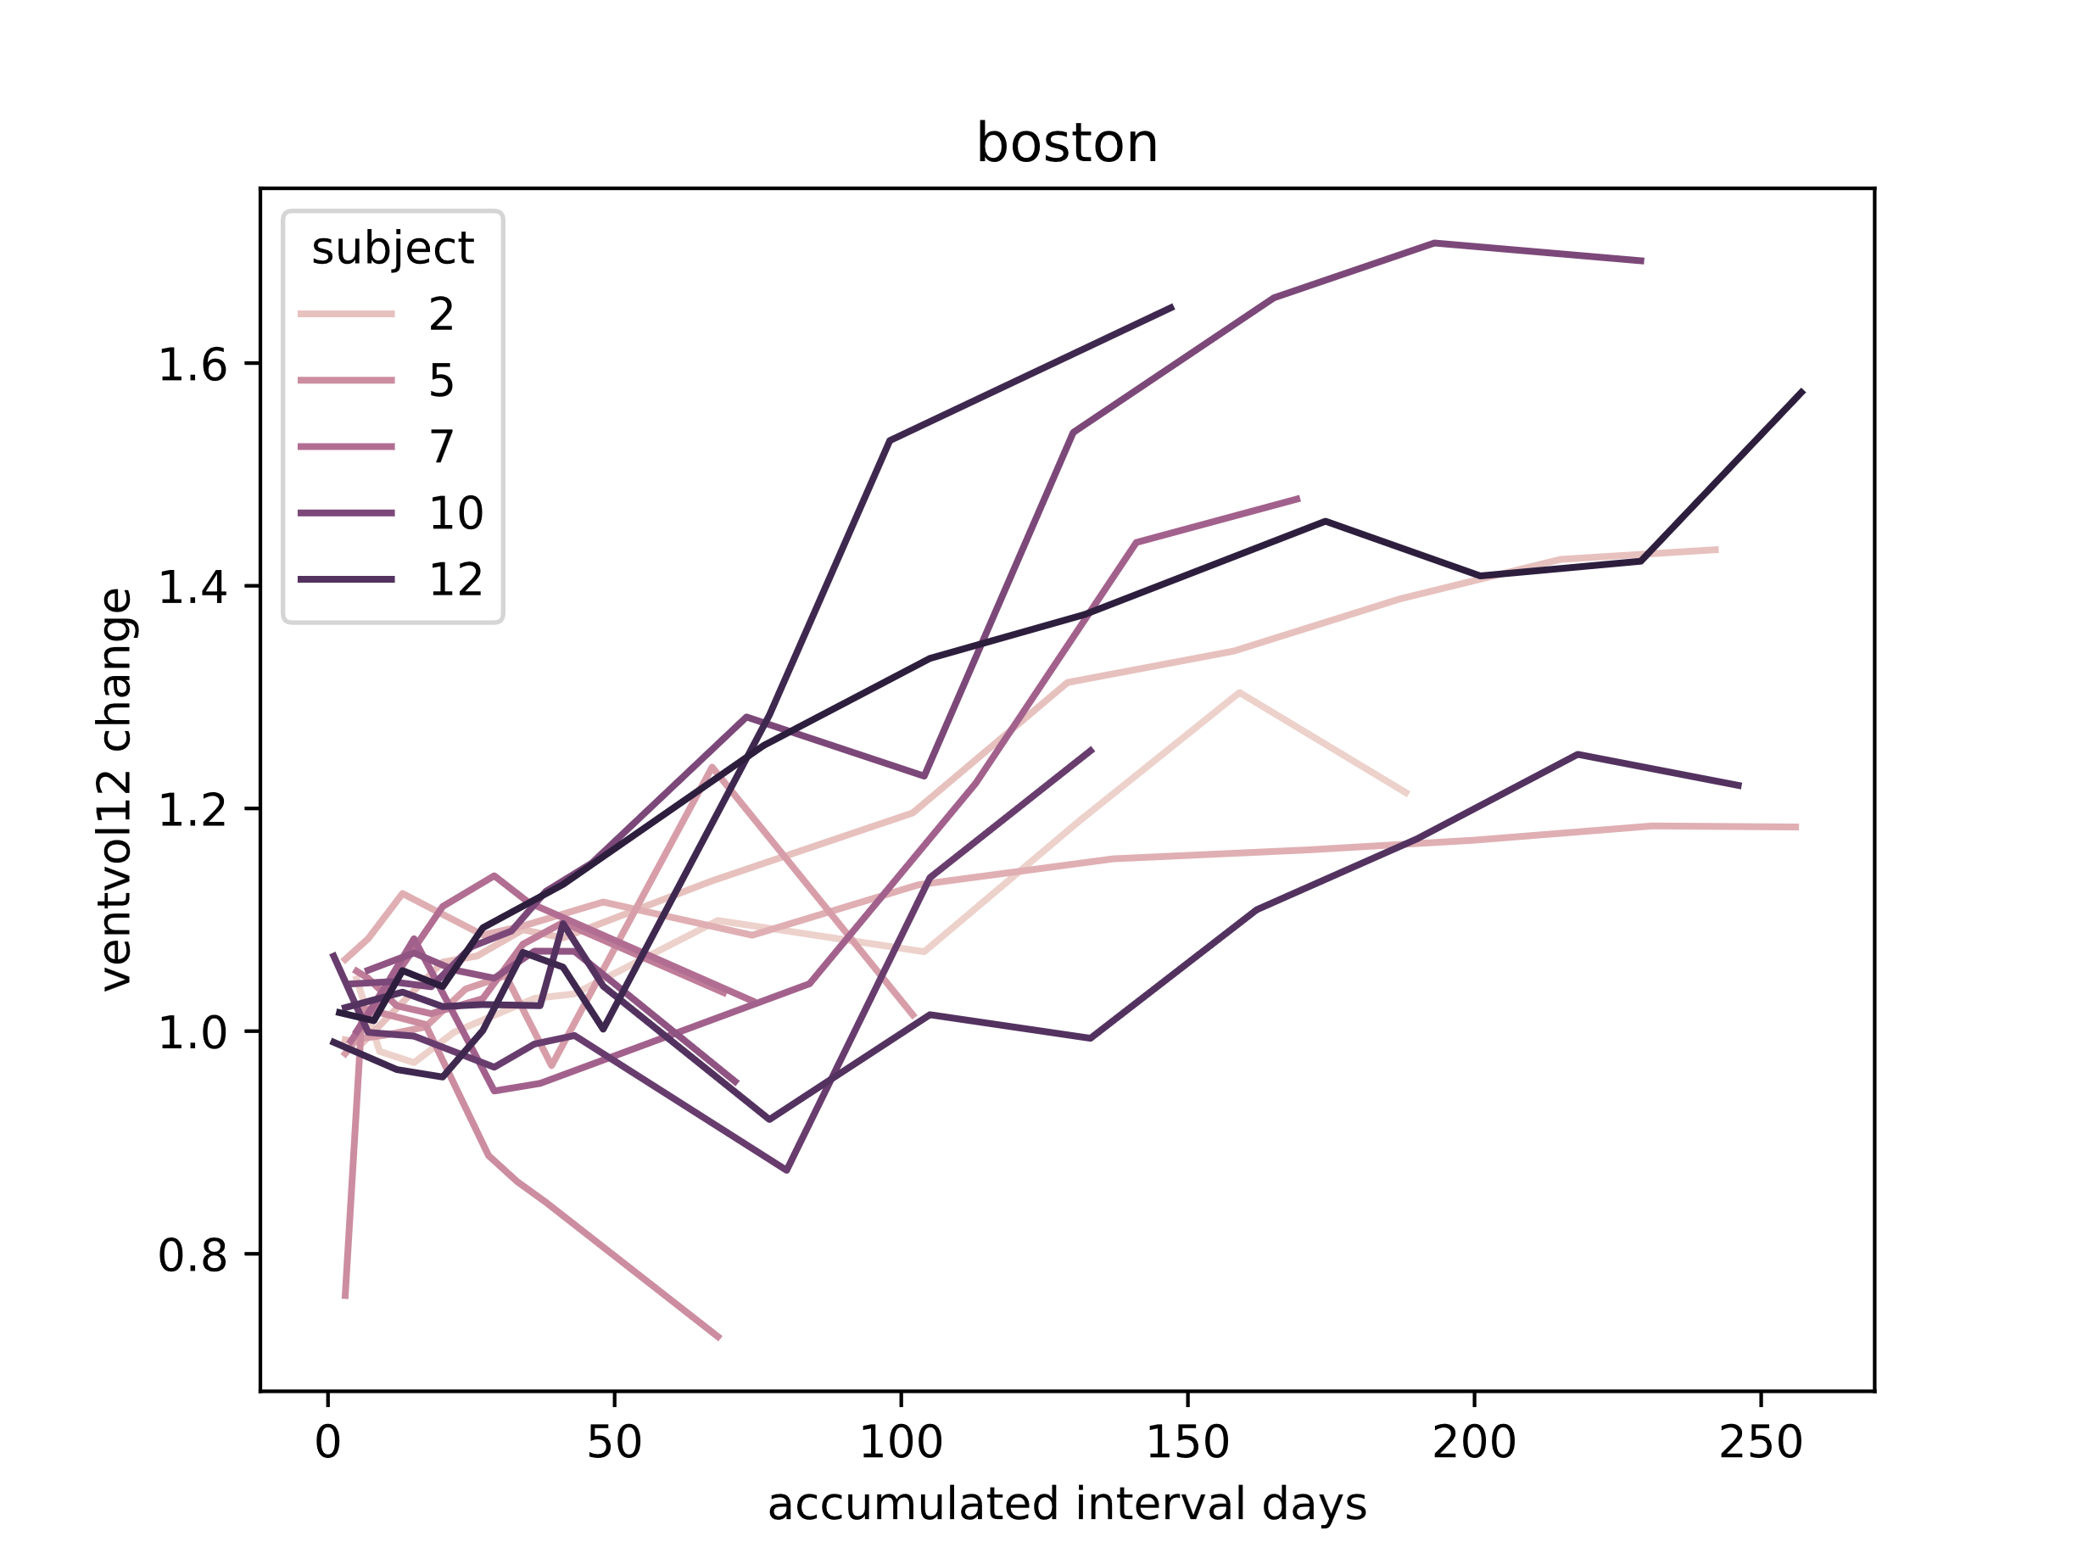
Notes:
A lot longer timespan of patients in the Oslo (sailor) dataset than in the Boston dataset

Slide 30
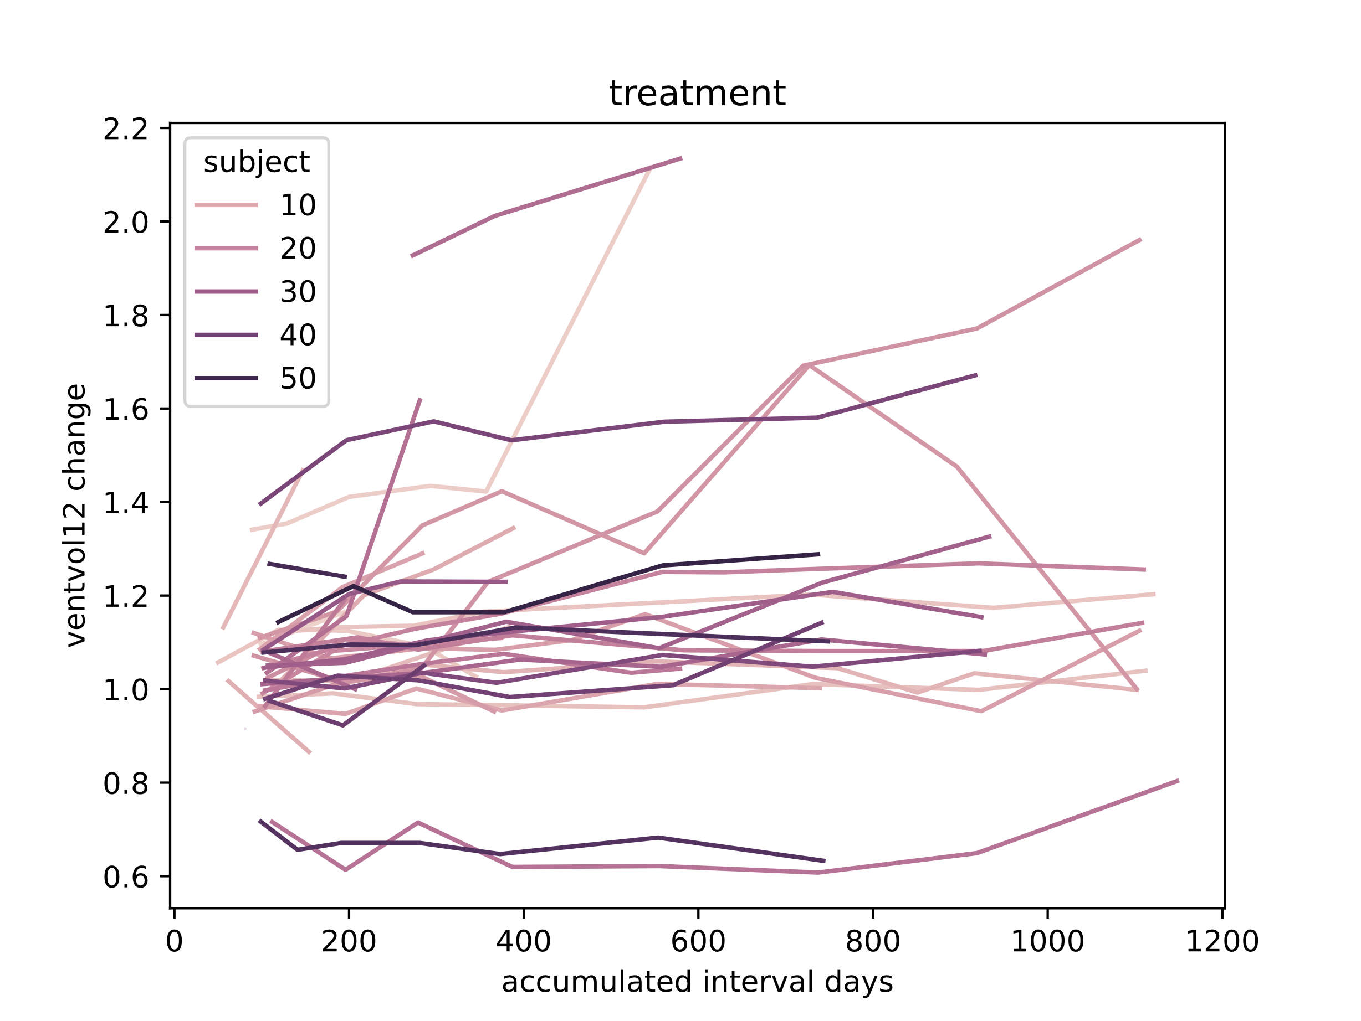
Notes:
This is clearly another pathology, and the treatment is not the same for this type of cancer, than for glioblastoma

Slide 31
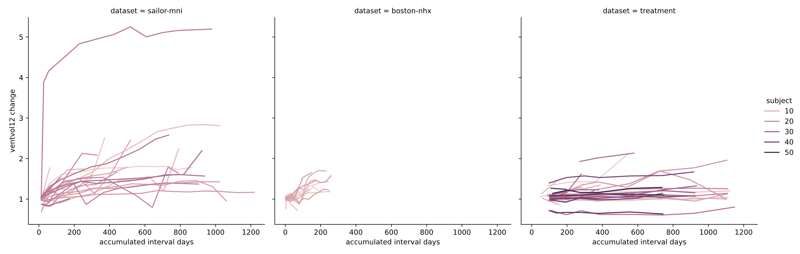

Slide 32
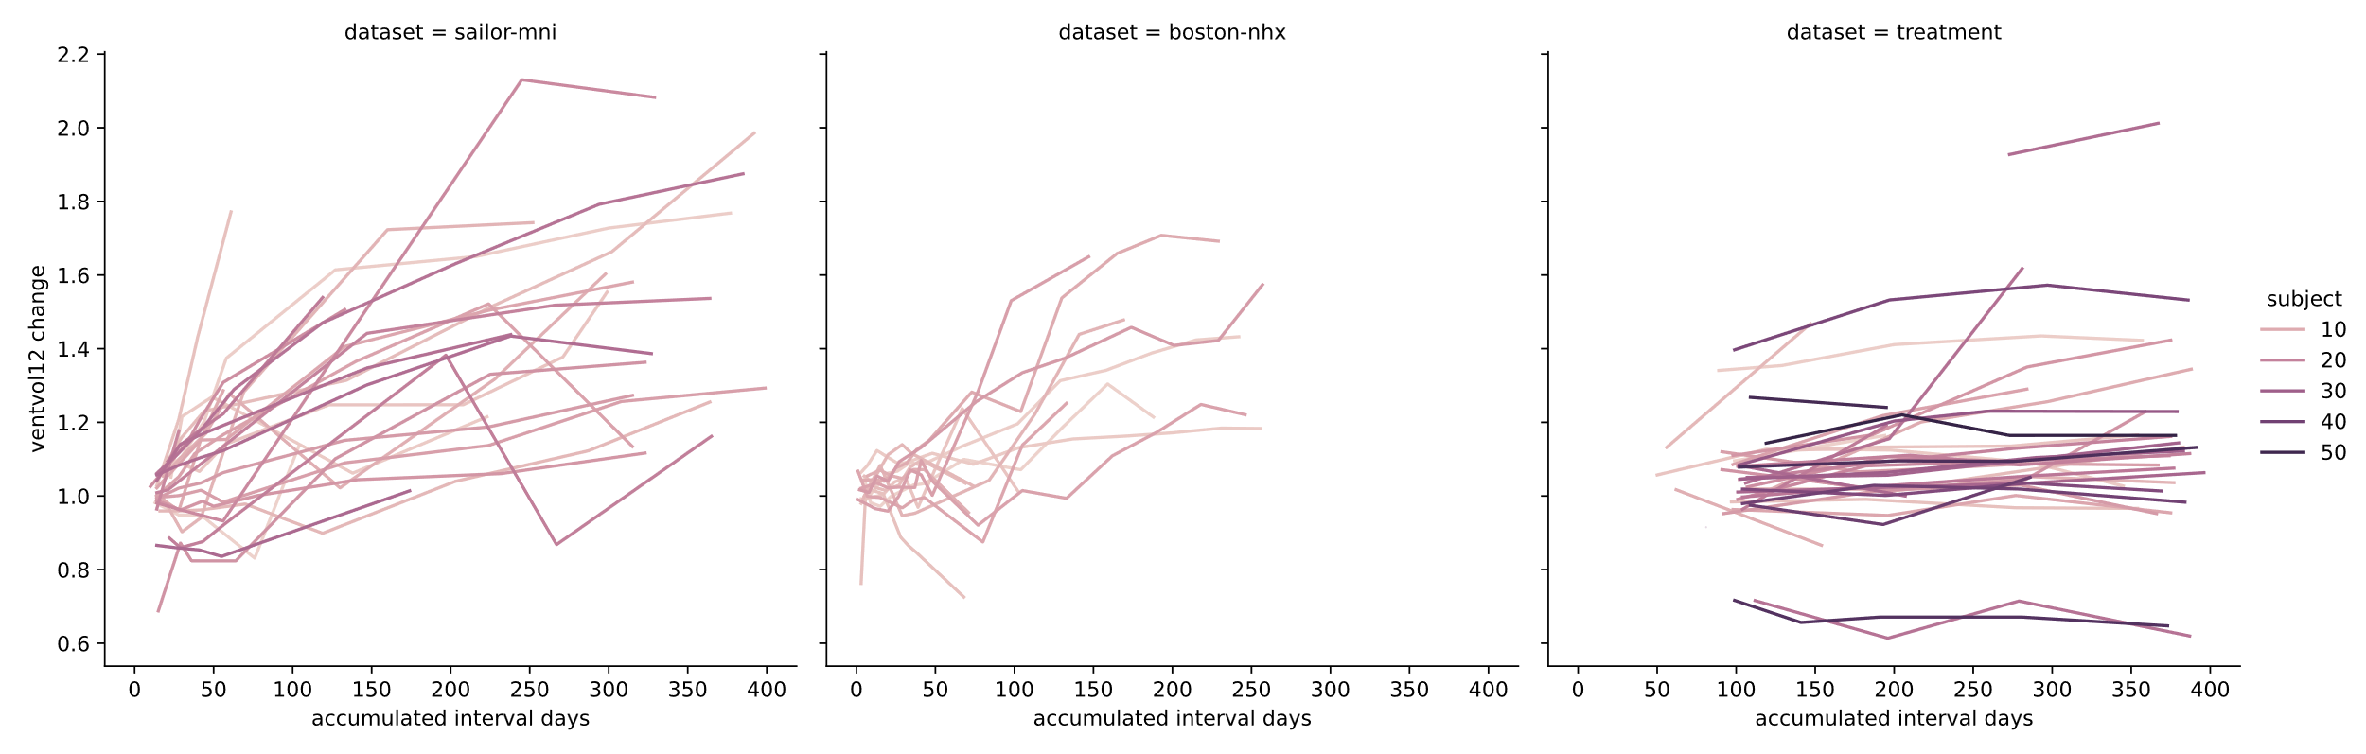
Notes:
Brain metastases dont give that much ventricle dilation compared to glioblastoma

Slide 33
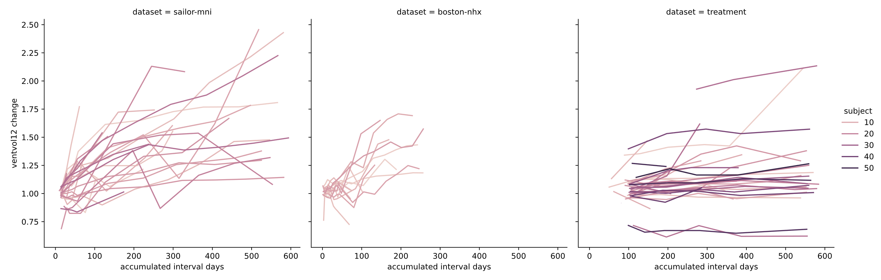

Slide 34
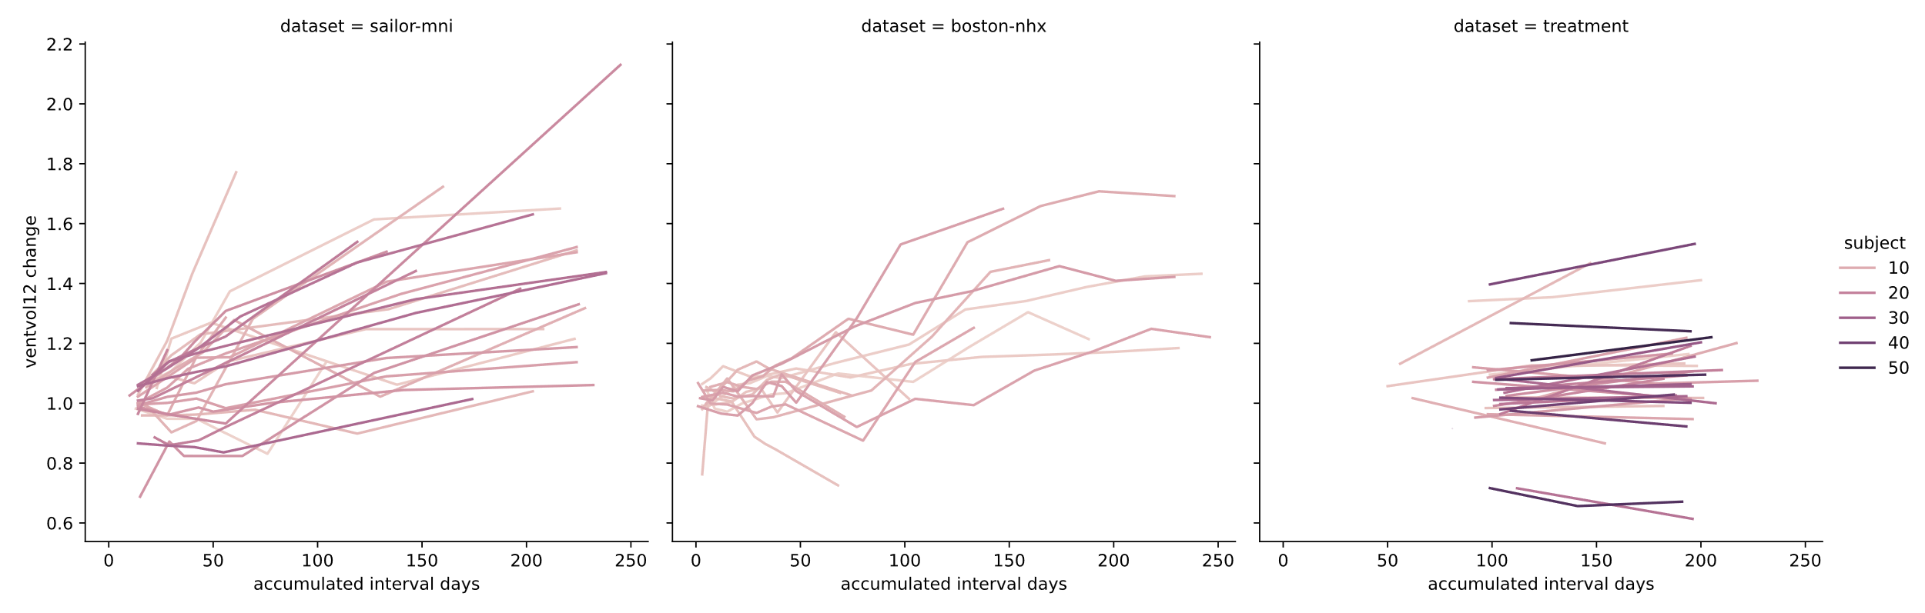

Slide 35
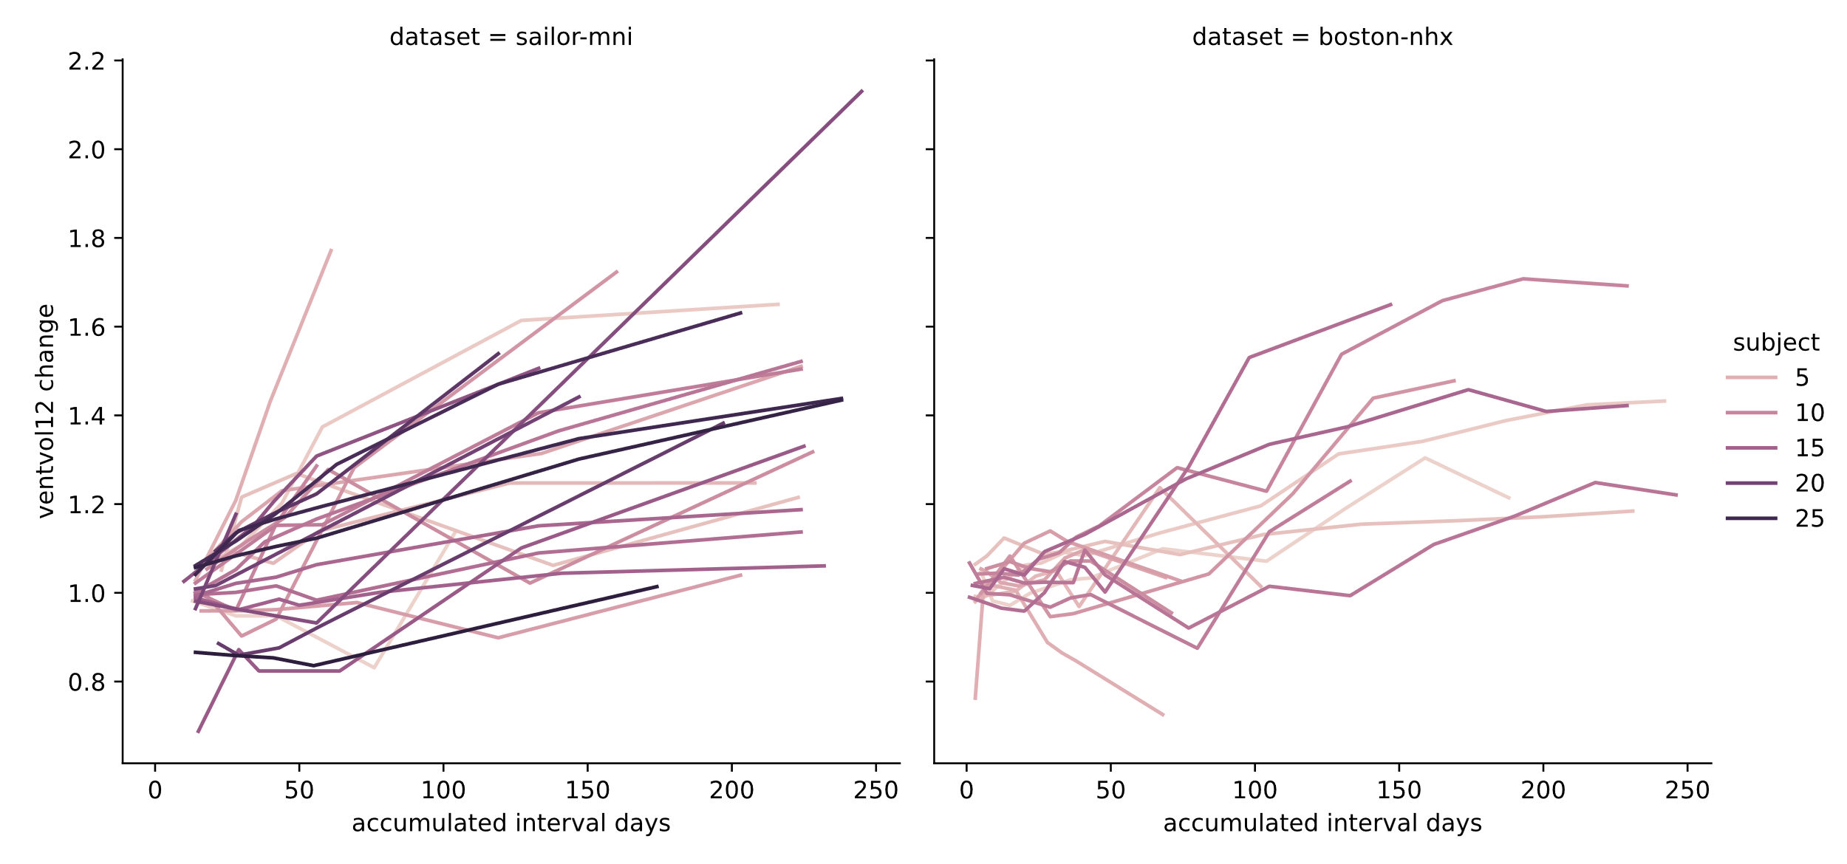
Notes:
250 days = ~35 weeks

Slide 36
2015 reference
Notes:
250 days = ~35 weeks
40 weeks=280 days

Slide 37
Eksperiment 5, observasjoner
Data fra Boston tilsier at behandlingen er kortere, men med tettere oppfølging i starten under kjemostråle

Slide 38
Eksperiment 5, konklusjon
Glioblastoma: Data suggests similar ventricle volume increase (compared to baseline ventricle volume) to Evidence of ventricle expansion as part of brain atrophy (shrinkage) as an effect of radiation therapy on glioblastoma (2015)

Slide 39
Experiment 6
Goal: Analyze correlation between ventricle and tumor volume change from baseline
Two datasets, 41 subjects, 387 volume change measurements (intervals)

Slide 40
Experiment 6, method
Computation of total tumor volume [mm^3] from segmentation (necrosis, contrast enhanced and edema (sailor) or contrast enhanced (boston)): ‘compute-tumor-vols.sh’
Computation of ventricle volume [mm^3] from ventricle masks: compute-vent-vols.sh
Collection of interval measures relative to baseline: print-from-baseline-interval-measures.sh
Joint plot with linear regression and marginal distributions
Pearson correlation
Notes:
Pearson correlation coefficient: ‘bivariate correlation’

Slide 41
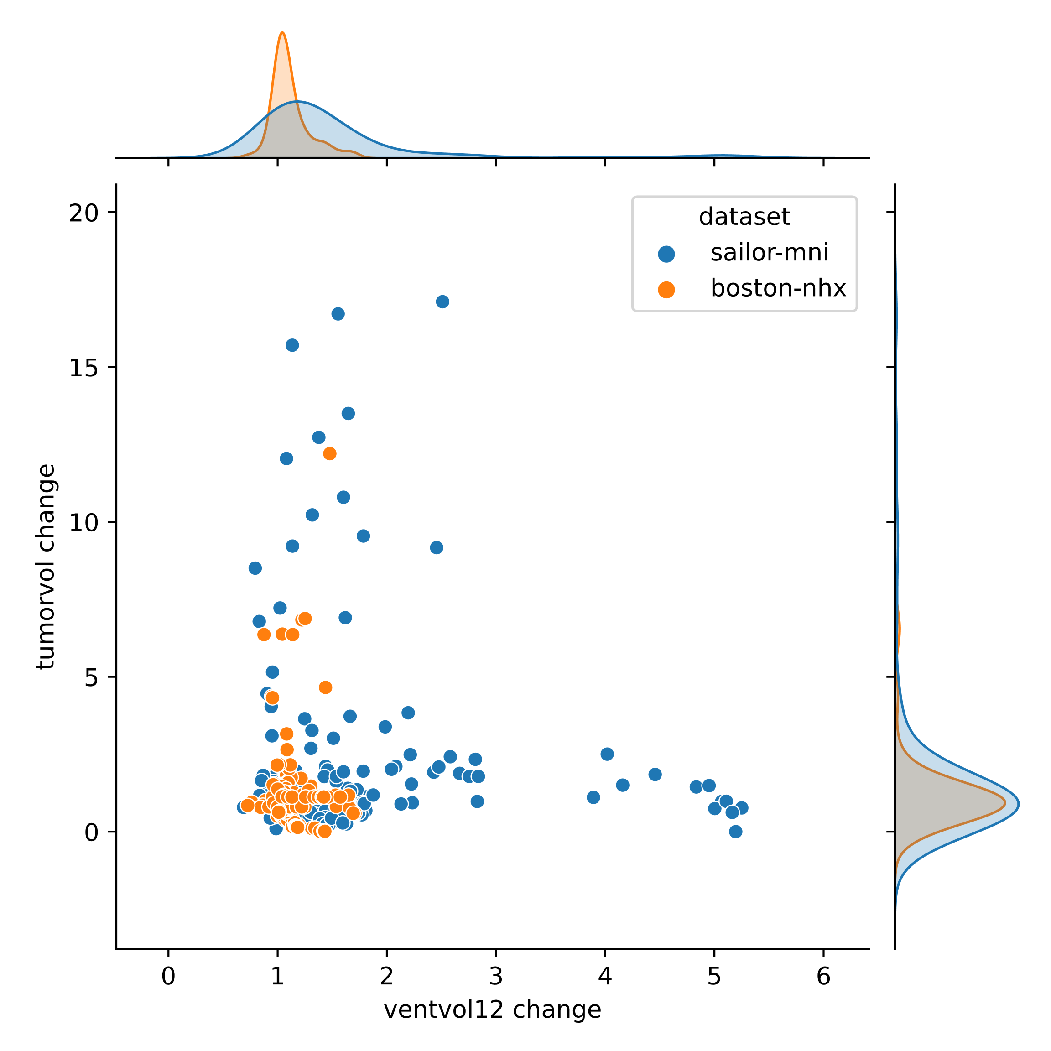

Slide 42
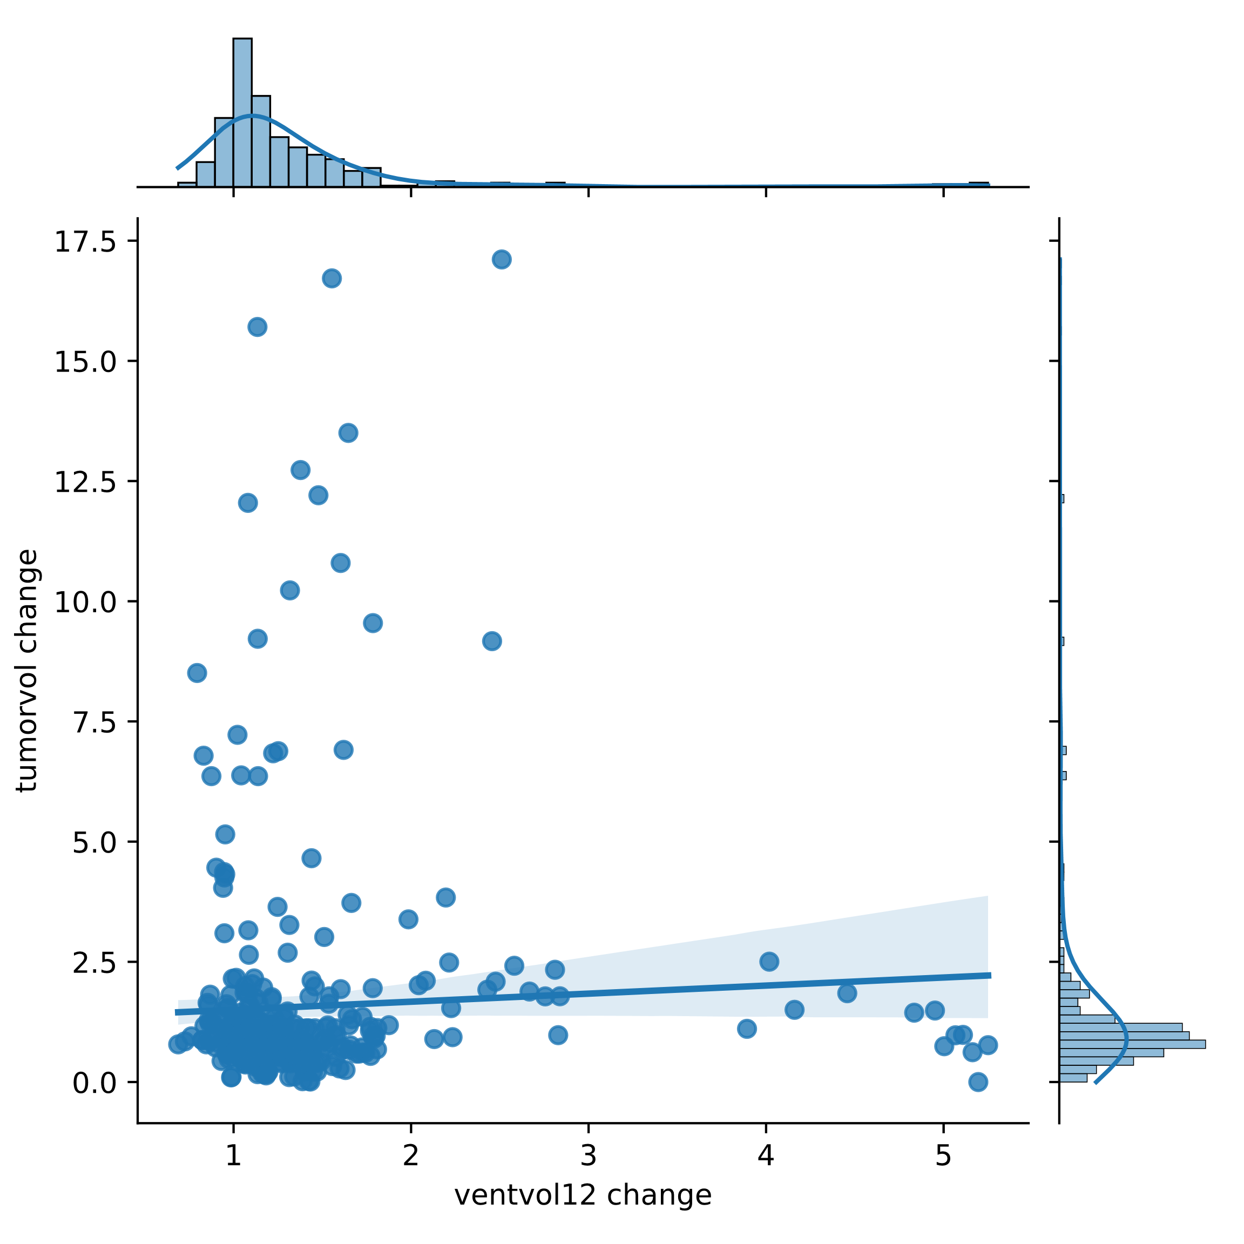
Notes:
Many outliers

Slide 43
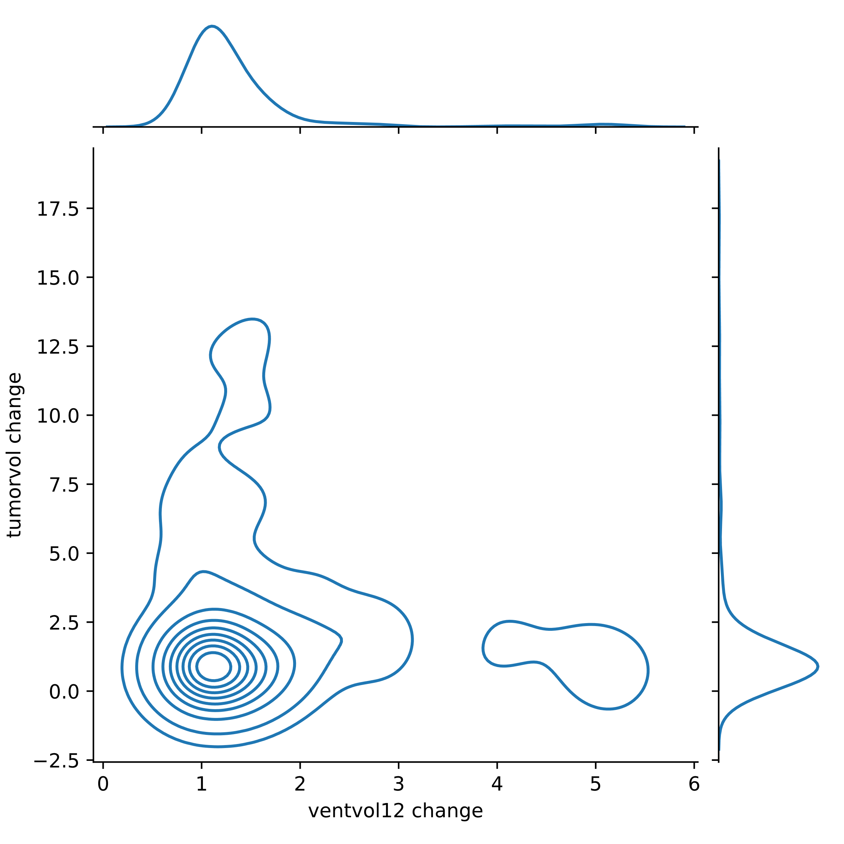

Slide 44
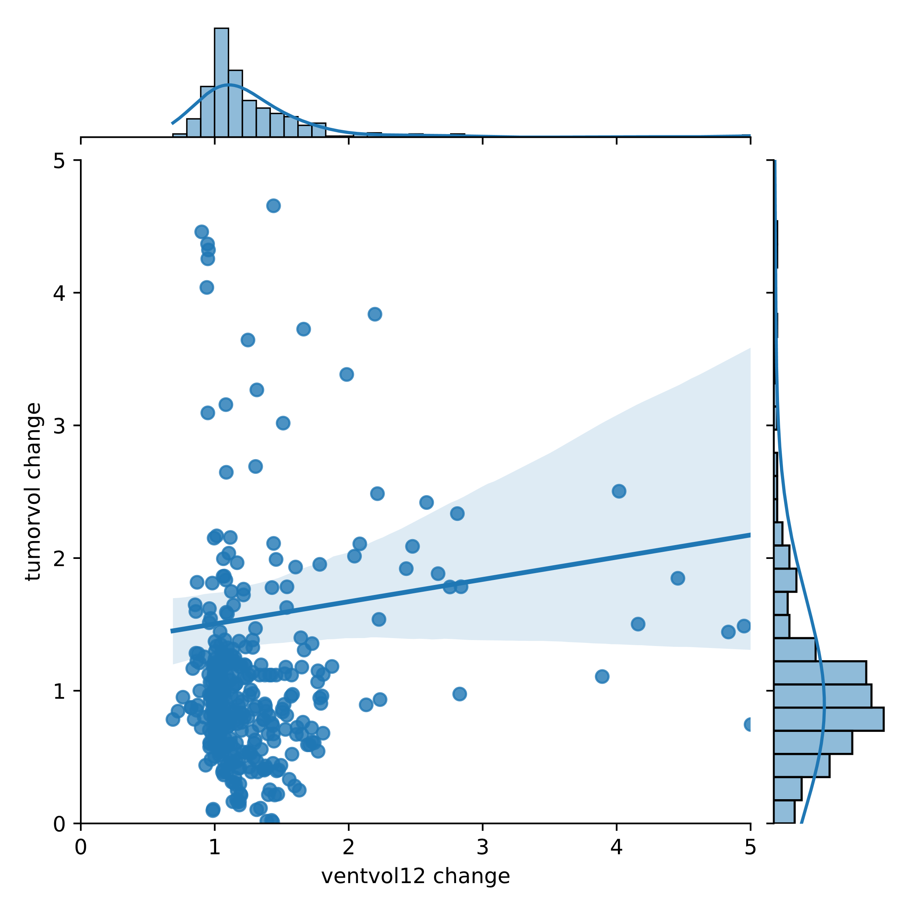

Slide 45
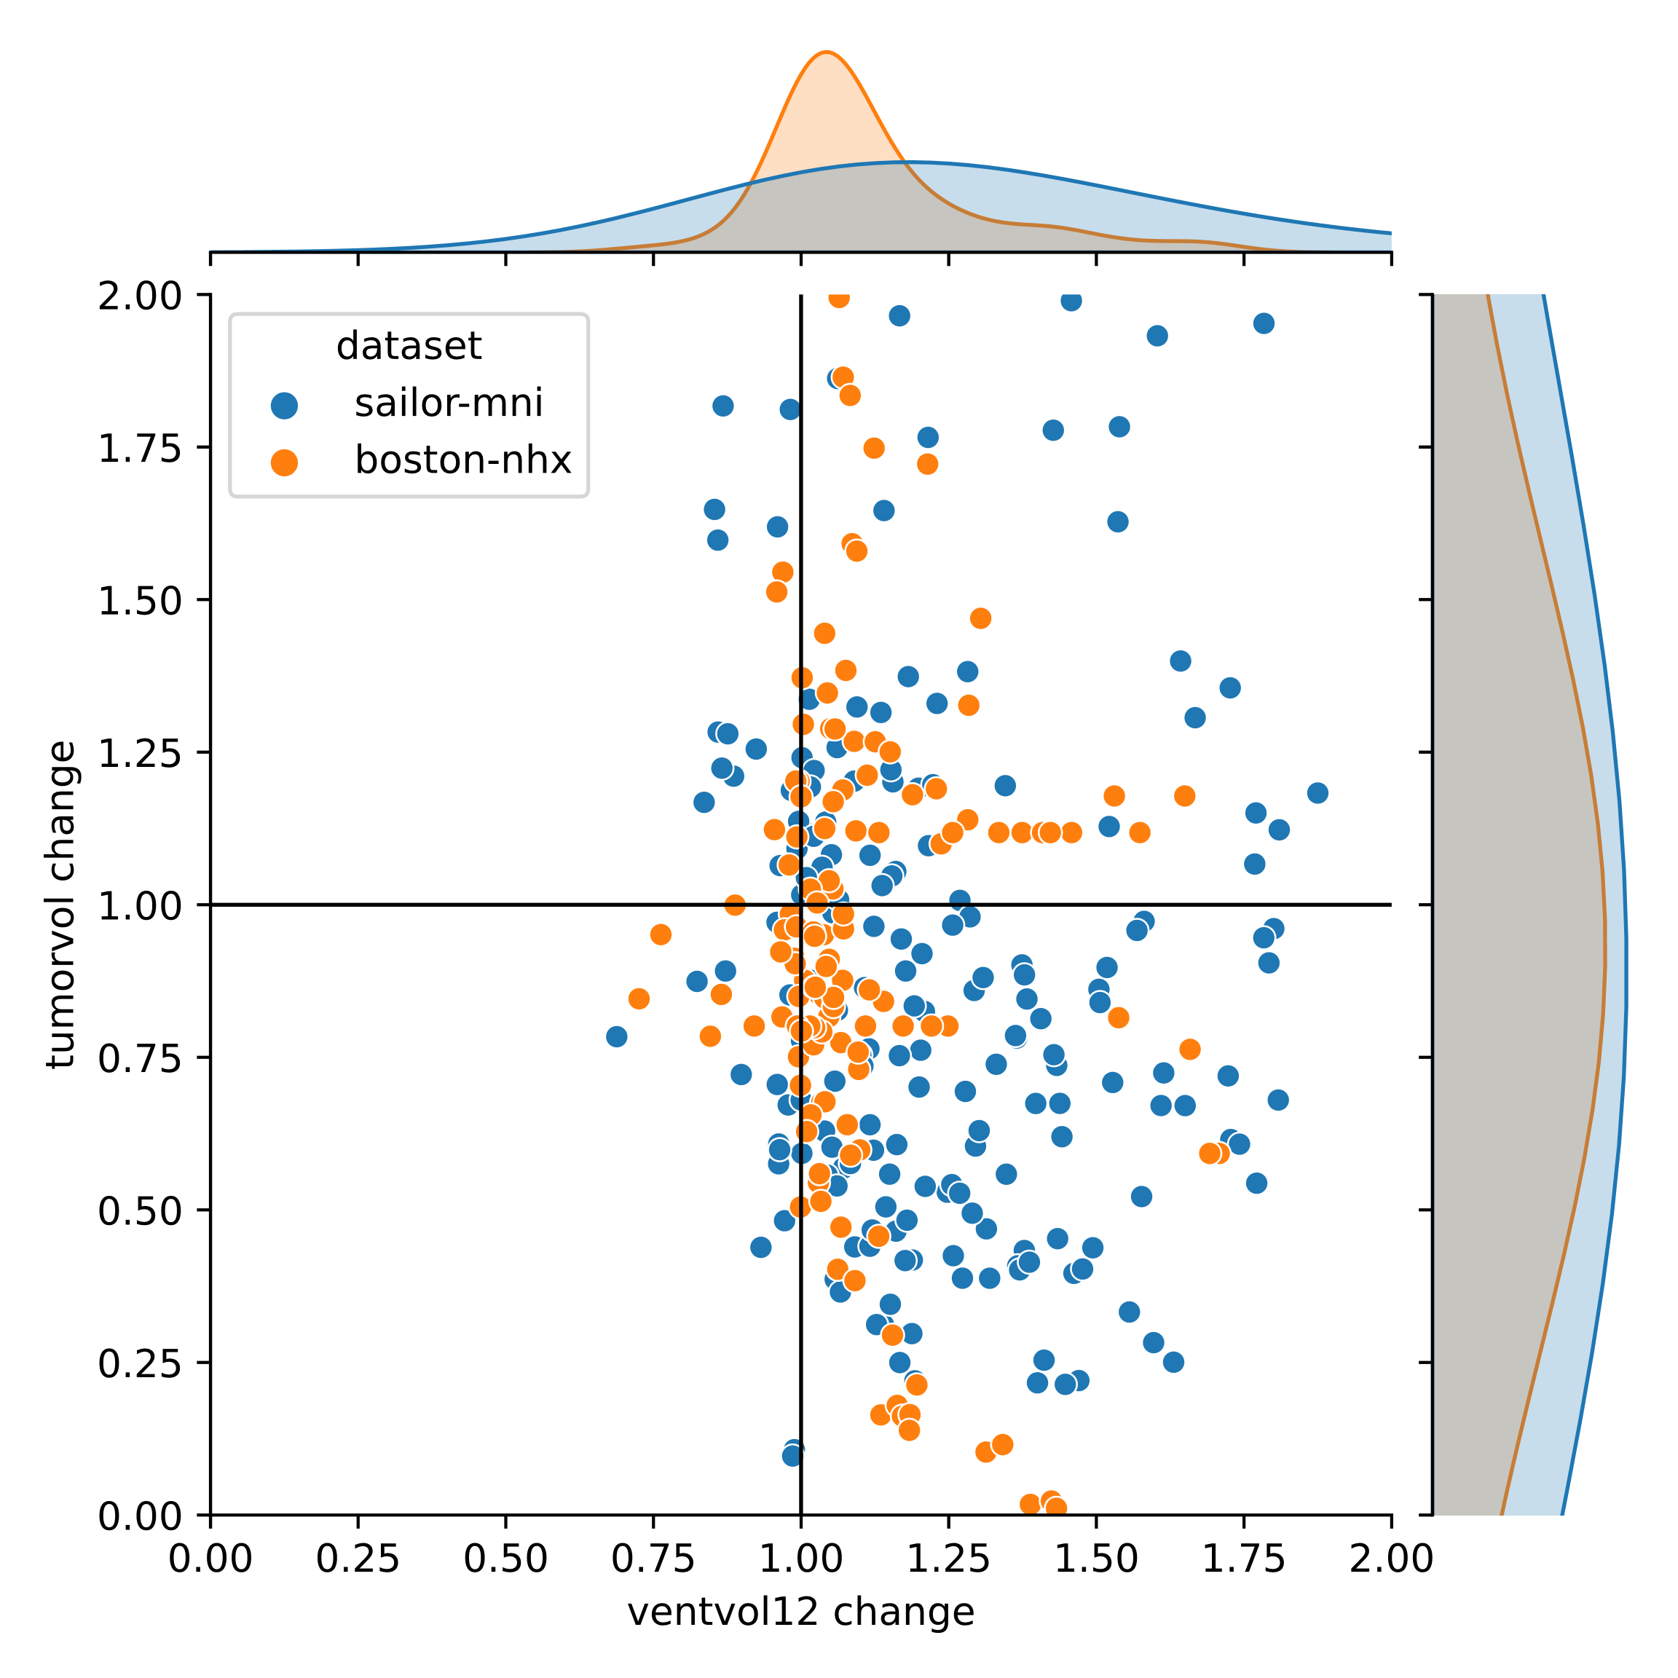
Notes:
What is a dot:
For a single patient
ventvol12 change is volume(a later time point for this patient)/volume(baseline time point for this patient)
Tumor change is volume(a later time point for this patient)/volume(baseline time point for this patient)
Opposed to tumor volume change which is both shrinkage and expansion, ventricle change is almost always expansion

Slide 46
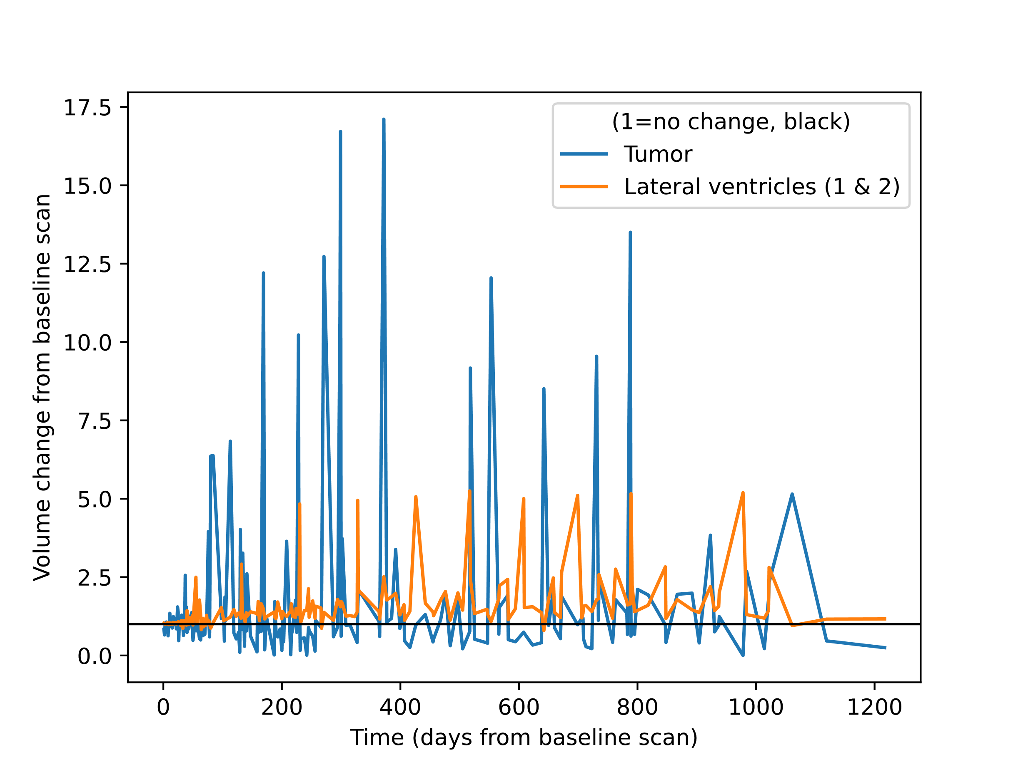

Slide 47
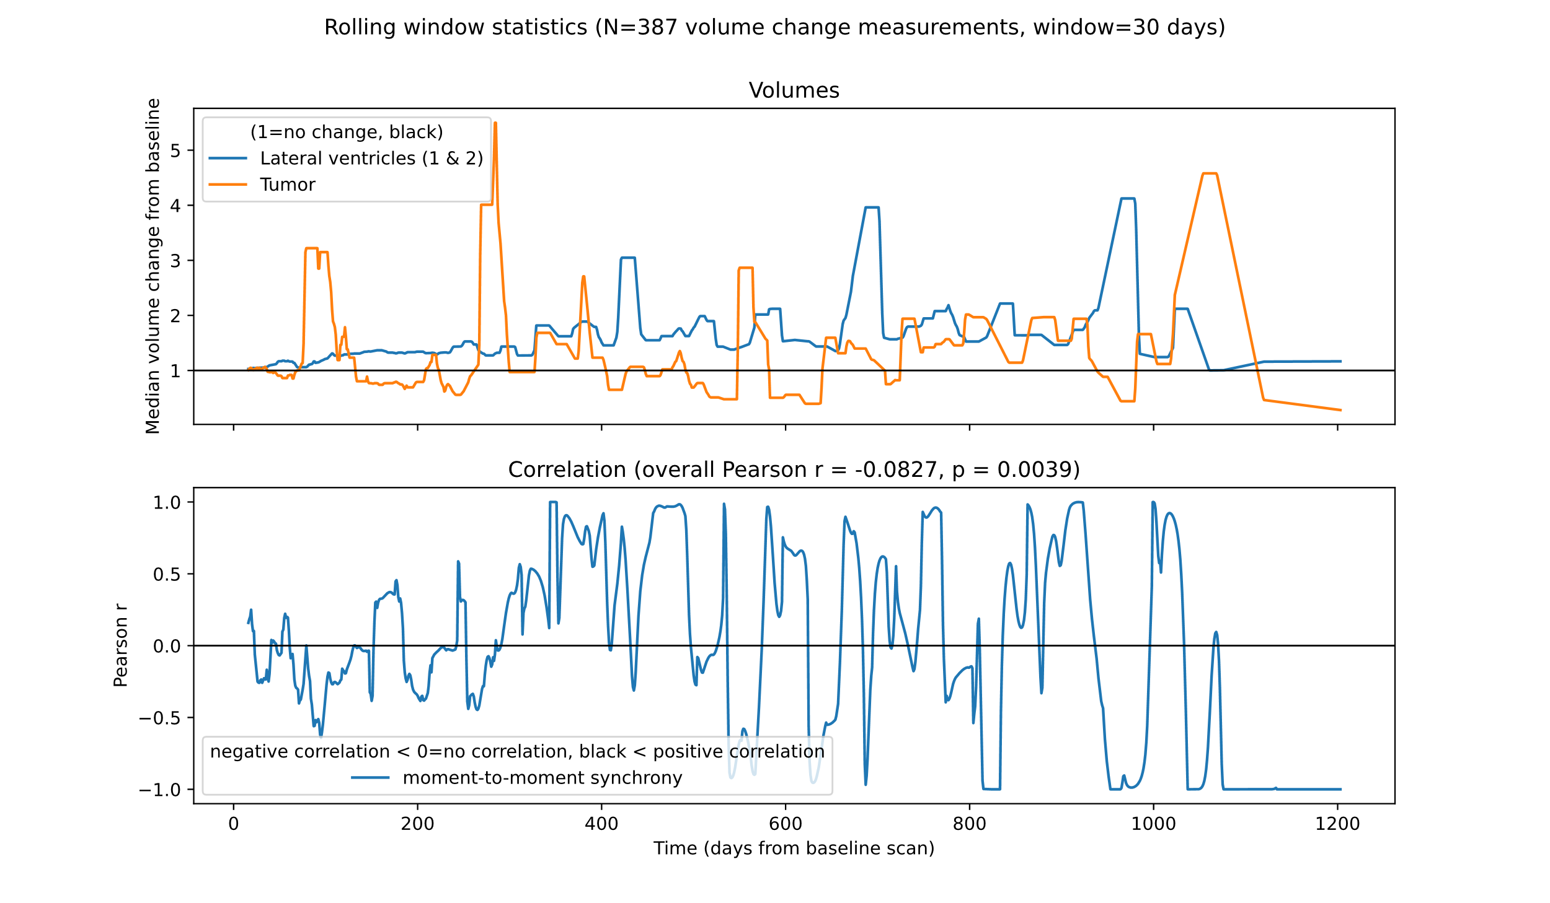
Notes:
Notice that the colors are swapped for tumor and ventricle compared to the previous slide
Overall pearson returns negative correlation
387 volume change measurements
Median of medians
Then linear interpolation

Slide 48
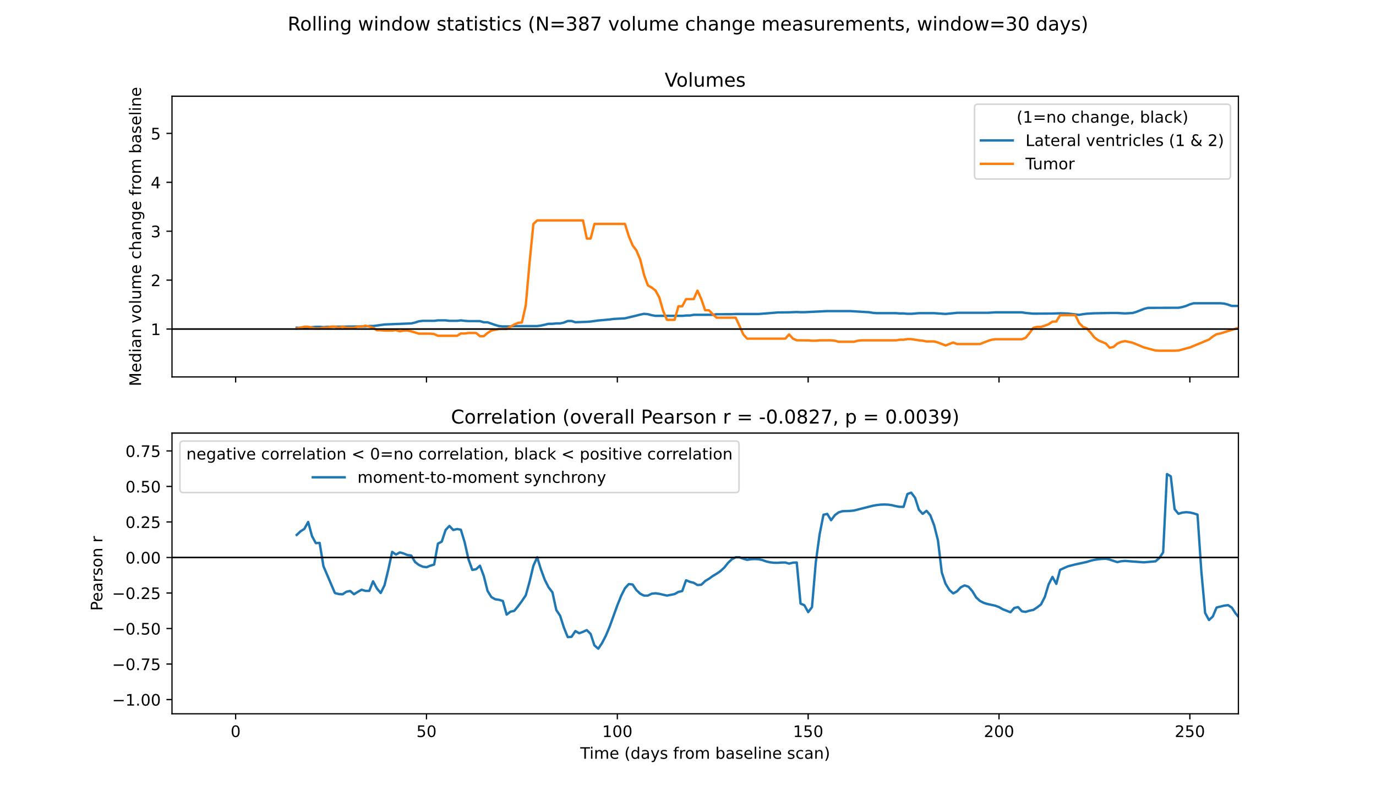
Notes:
Sudden increase of median of median tumor volume around 75 days post baseline scan (~10 weeks)
Analysis start at 15 days post baseline because of a rolling window of 30 days (stride of 1 day)
No window function used (just computing median values with equal weighting)

Slide 49
Experiment 6, conclusion
Overall Pearson: Small, but significant negative correlation between ventricle and tumor volume

Slide 50
Diskusjon
1. Data for både Oslo (SAILOR) og Boston viser klart at ventrikkelvolum øker underveis i behandlingen, i motsetning til tumorvolum som kan både minke og øke.
2. Det er en vesentlig forskjell i ventrikkeløkning mellom glioblastompasienter og metastasepasienter. En forskjell i behandling er om kjemoterapi blir brukt eller ikke. Ellers viser litteratursøk at atrofi, som kan medfølge dilasjon av ventrikler, er en kjent respons på stråleterapi. Begge pasientgrupper mottar strålebehandling, forstår jeg rett.
3. Korrelasjonsanalyse viser en signifikant, men svak negativ korrelasjon mellom endring i ventrikkelvolum og endring i tumorvolum.
4. Alder, overlevelse, bruk av steroider (ja/nei) og tidlig (CRT) vs. sent (kjemo) er mulige oppdelinger i analysen for å markere klinisk relevans.

Slide 51
Thank you!

