Slide 1
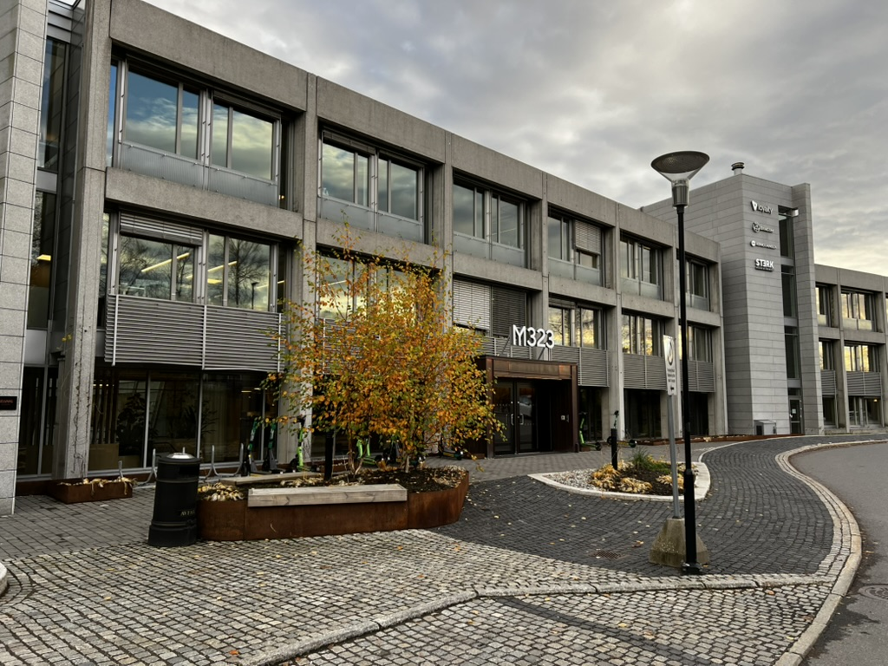

Master project presentations @EliteUiO 18.09.2026
Maridalsveien 323, 0872 Oslo

Slide 2
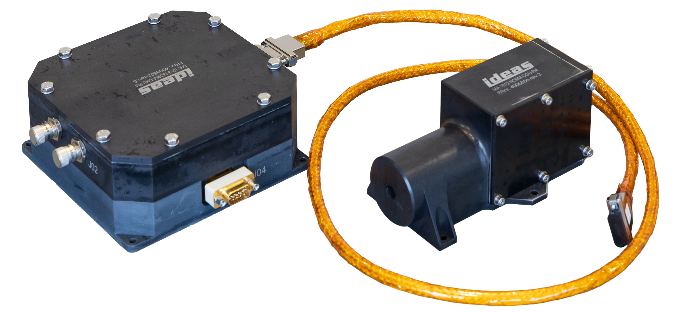
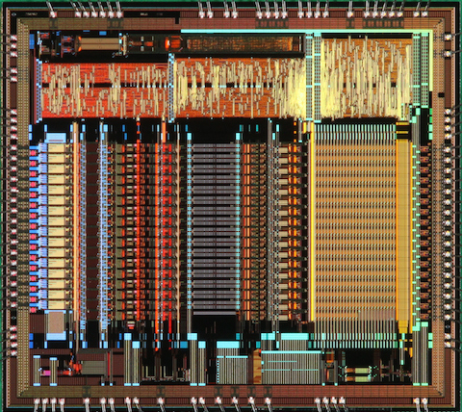
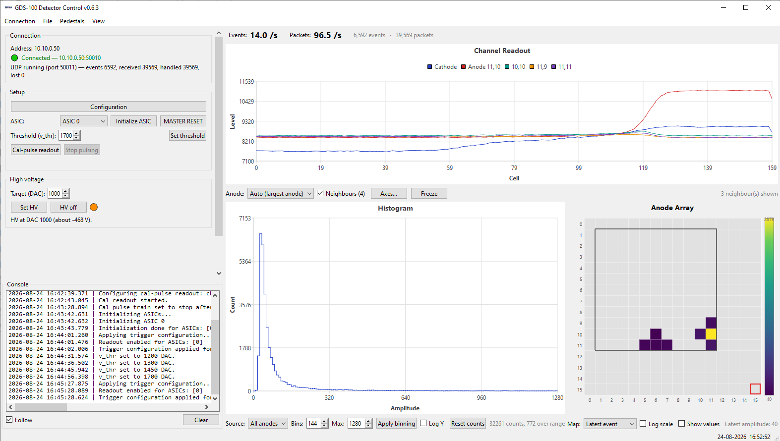
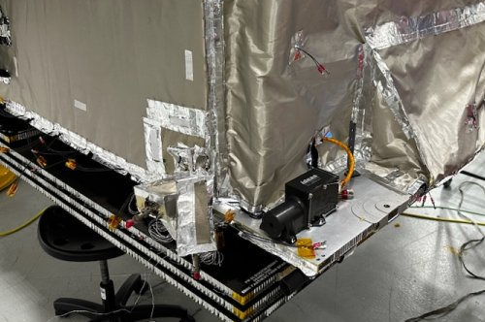





At IDEAS, we make Electronics for Radiation detection and imageing on Earth and in Space

Slide 3
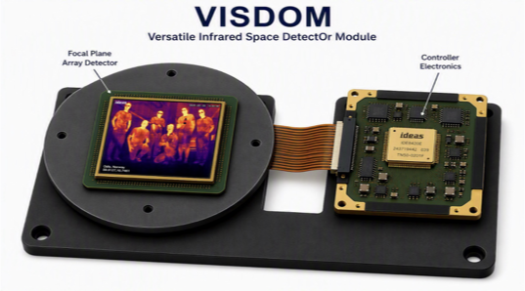
IR Camera System for Autonomous Operations
Develop and demonstrate a “smart” IR camera system based on an IR image detector, the IDEAS NIRCA MkII Front-End Electronics, and an UltraScale+ System-on-Module.
The work may include:
  FPGA development (VHDL)
  Embedded software development
  Image processing
  System integration
  Experimentation
  Wireless communication.
If this is of interest, contact me after
the presentation for a flyer and a chat.

Slide 4
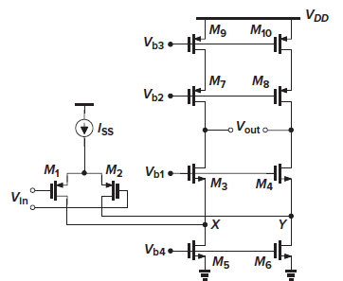
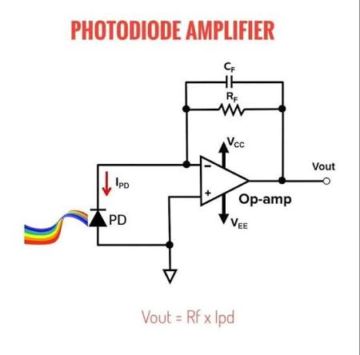
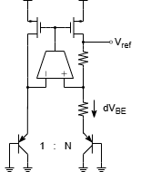
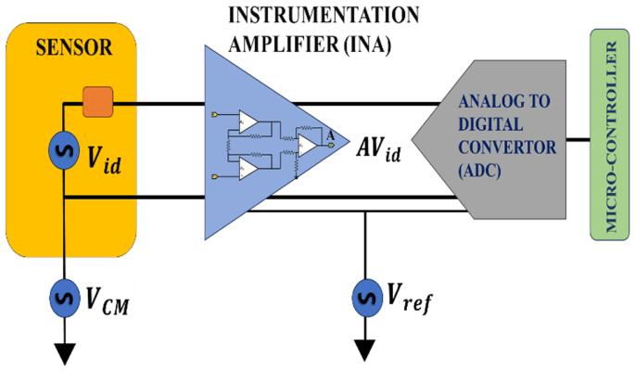
Sub_blocks circuit design in 22nmGF:
Astronomy, earth ovservations and other space applications
Cryogenic operation for space, Quantum computing, data centers, …
Schematic design, layout, possibly chip fabrication and test
Bandgap Reference (BGR)
Instrumentation amplifier to drive detector signal via long cables
Folded cascode amplifier
Charge sensitive amplifier

Slide 5
Thank you for your attention!
Any questions?
Seek us out for a conversation afterwards!

