Slide 1
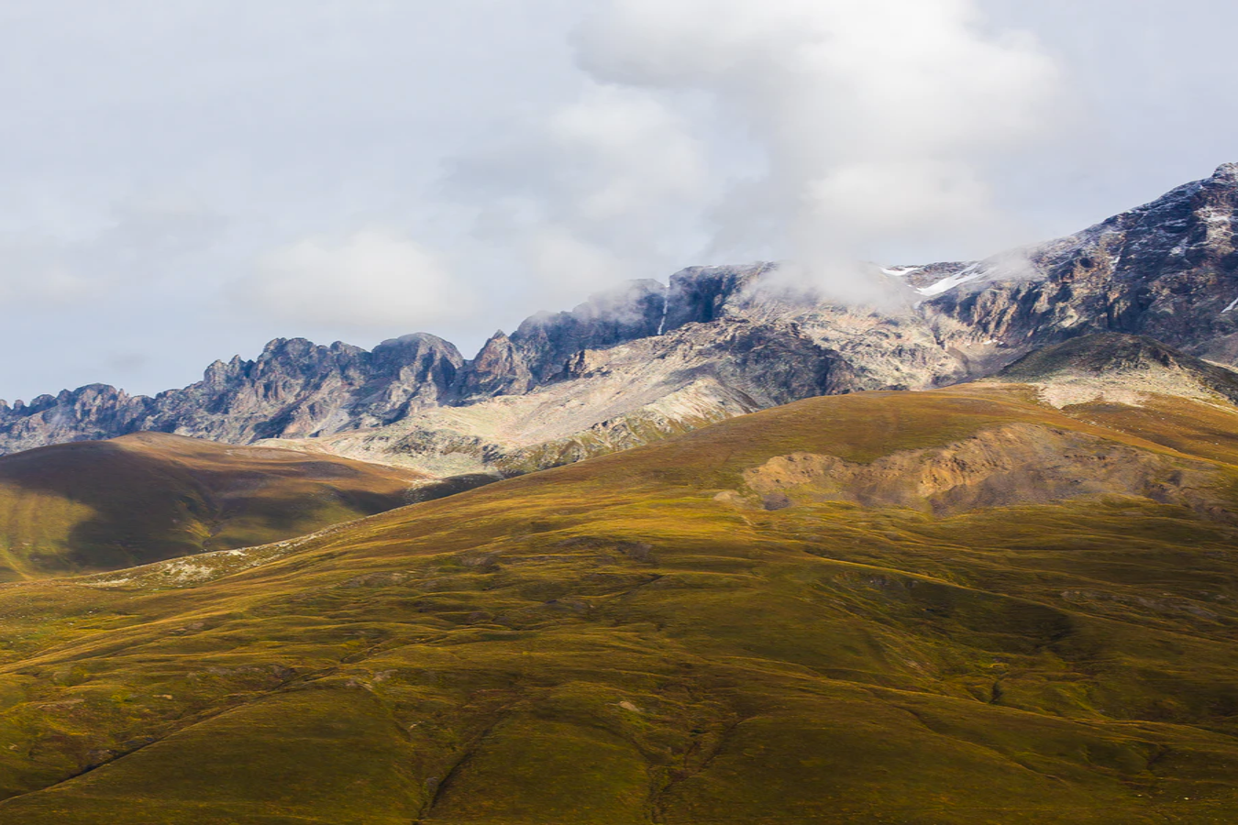

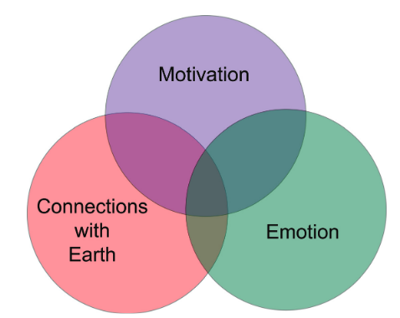


Teaching and Learning Journal Club meeting
28/09, 13:15.
iEarth meeting room (Geology building 217b).
Topic: Interpretations of silence; teaching to motivate and interest.
Journal of Geoscience Education, 59:2, 71-84 (2011)
Contact: Kirsty (kirsty.dunnett@geo.uio.no),
Karianne (k.s.lilleoren@geo.uio.no) or
Mattias (a.m.lundmark@geo.uio.no)

