Slide 1
Dev Science Research
A systematic approach to develop software that provides scientific insights as well as value to stakeholders

Slide 2
Dev Science Research
We have used Design Science Research for several years
  More than 10 master theses
Design Science Research has challenges
  Difficult to relate to Software Engineering
  Uses a jargon that overlaps with Software Engineering but calls similar things in a different way
  The scope is broader and therefore often confusing (tries to cover methods, tools, theories etc.)
  Lacks systematic and concrete guidelines for software engineering
We have adapted DSR to DevSR to help software engineering students
  DevSR is a version of DSR that is specific and adapted to SE

Slide 3
Advantages of DevSR
SE students can reuse what they have learned during the course to carry out the thesis
  Research practices for the thesis are «additions» to a well-known process
Allows flexibility: during iterations students could find issues not known at the beginning of the thesis
Allows incremental and documentable steps of the thesis
It is particularly suitable to conduct an implementation project with industry
  Organizations could also be familiar with such development process
  Although ideas are taken from Agile software development, Agile is used in teams for collaboration, and many practices do not apply for a master thesis

Slide 4
Dev Science Research (simple model)
Iteration
1
Context evaluation
2
Method selection and setup
3
Design and implementations
Refining
4
Temporary Validation
5
Final Evaluation
6
Reporting
Notes:
Add box for the final evaluation and reporting
One high level model + zoomin each and the full one with everything

Slide 5
Dev Science Research
(full model)
Iteration
1
Context evaluation
Constraints and risks
Research requirements
Business requirements
Requirements prioritization
Initial RQs
External knowledge
2
Method selection and setup
Existing Literature
Criteria and Benchmark establishment
Baseline establishment
Experimental design
Refining
Business Stakeholders
3
Design and implementations
4
Temporary Validation
Assessment of temporary solution
Temporary Insights
Theoretical and
Practical insights
Final Evaluation
5
Formal Assessment of final solution
Final Insights
Reporting
6
Notes:
Add box for the final evaluation and reporting
One high level model + zoomin each and the full one with everything

Slide 6
Context evaluation

Slide 7
Constraints and risks
Context constraints might limit feasibility or contributions
  Analyze:
    Collaboration settings
      Who are the stakeholders and what do you need from them? Are they available? Is data available?
    Time available for thesis
    Identify tasks necessary for the rest of the thesis and how long are estimated to take
    Check the writing process and speed. Each student has a different pace and capability
    Technology readiness
      Are you trying to use a technology for which there is not much stable knowledge available?
  Plan:
    Create an initial plan from the beginning of the thesis (after the essay) to the end
    Identify risks
      Data and stakeholders availability
      Techonological uncertainty
      ...
    Create a plan B, C ... According to risks above together with supervisor
    Plans change, it’s important to monitor the constraints and find the best solution
Notes:
Not for reporting

Slide 8
Example
Bjørn and Line want to collaborate with organization X to collect feedback
Manager Vilde from organization X says they might be available to help the students
During the first iteration, other people in organization X don’t reply the emails from the student
What to do?
  Conact Vilde to understand if organization X is still interested
Plan B: find another organization (still risky)
Plan C: use personal network to obtain information (e.g. fellow students, although not recommended for the final evaluation)
Plan D: study a different aspect of the problem for which human evaluation is not necessary
Plan E: ...

Slide 9
Business requirements
Consult with the stakeholders of the study
Elicit requirements that are relevant for the study
  Any requirement technique can be used:
    Example: informal interview with sample stakeholders
    Example: Collection of blog posts, presentations, etc. where such requirements are clearly explained by a stakeholder
Create a set of requirements important for the stakeholders
  It is to start with a list with more than can be addressed, this will be prioritized afterwards
  Identify the important qualities for your solution
    Example: do you want to make an existing solution faster or test if a new solution is feasible at all?
  (optional) Create a set of user stories/tasks to break down the requirements
Notes:
Functional requirements
Normal software development
Report

Slide 10
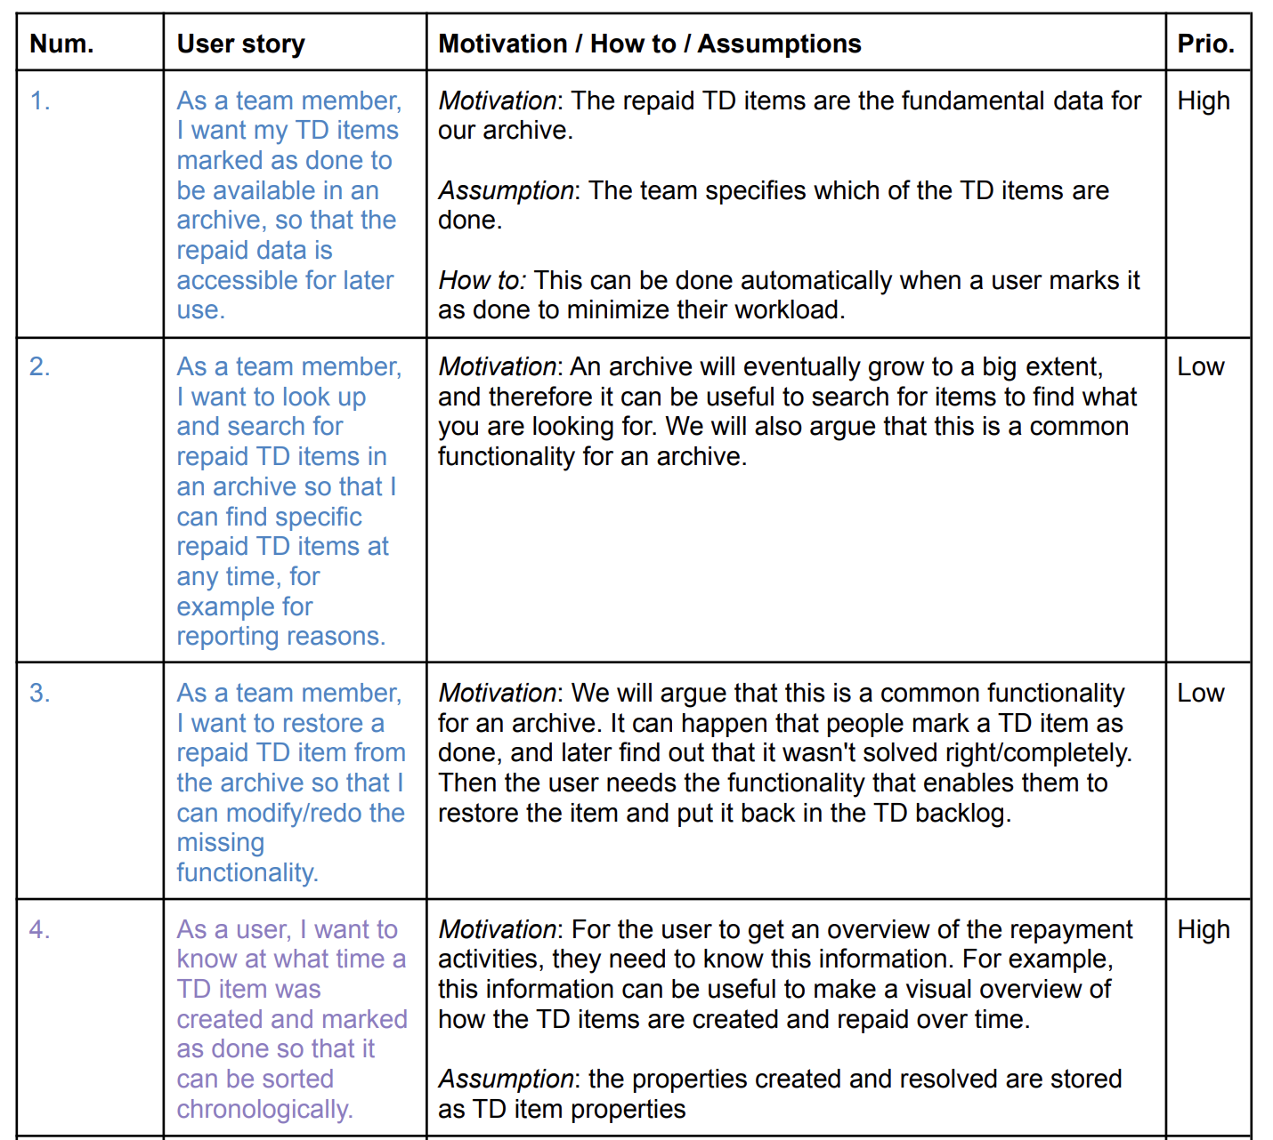
Example
Write some user stories
Motivate, explain assumptions and write how such story can be implemented
Give it an initial prioritization
You want to explain what your solution will be able to do

Slide 11
Research requirements
In a traditional software project, this usually doesn’t exist. In a research project (including a thesis), this is crucial
  Initial literature review
    Select a few very relevant sources
      Majority peer reviewed, but they could also be other sources such as blog posts from renown authors
    One-step forward and backward snowballing literature review
      Check references from the previously selected papers. Select a subset that are relevant
      Check other papers that cite the previously selected papers. Select a relevant subset
  Identify the existing research gaps
    Not many, restrict to 2 max 3 to avoid complexity and too huge scope
  Create a backlog of research gaps (same as for the business requirements)
  Identify initial research theories to be used to build on
    Avoid reinventing the wheel and have a framework to explain the components of your research

Slide 12
Example
A research gap could be a paper containing, in the discussion, phrases such as:
  «More research is needed to understand how a technical debt backlog can be prioritized»
It could also be in the paper introduction, as motivation
  «We have still not understood how AI is perceived by developers»
  Although this is a problem that is being answered in such paper, it doesn’t mean such paper is addressing the whole problem. Some aspects of it could still be relevant
Blog post from a renown practitioner in Linkedin or Medium etc.

Slide 13
Requirements prioritization and RQs
A tricky part is to find a good intersection of business, research requirements and context constraints
  First, prioritize buisiness requirements based on importance for the stakeholders
  Remove or postpone the ones that are not feasible or are risky according to the context analysis
  Remove or postpone the ones that do not provide any contribution for research (unless they might provide a contribution together with other requirements)
  If none are left, start again from scratch
Create initial Research Questions that are relevant for research gaps and aim at addressing the business requirements
  It is ok to have more RQs than the ones that are feasible to address at this point in the process. Prioritize, and start with the ones that are more important according to the requirements analysis

Slide 14
Example
Organization X needs me to create a new interface to integrate two tools
  This is a good high level business requirement
  It’s not a good research requirement
We know how to create an interface. However, such interface needs to communicate not just with a normal API, but it has to be designed in aspecial way (for example to handle data that should be consumed by AI).
  There is no paper or technical solution clearly available for this. Or there is, but it’s suboptimal, or has assumptions that do not hold for organization X
We found a good intersection between business and research requirements
  When implementing and evaluating, it’s important to focus on the AI-specific part of the problem, as that is the relevant research requirement

Slide 15
Method selection and setup

Slide 16
Criteria and benchmark establishment
Based on the requirements elicited earlier:
  Define a set of criteria that need to be fulfilled by the solution
    Create a definition of such concepts
    E.g. The solution is correct (technical requirement)
    E.g. The solution is helpful (user requirement)
  Define how the criteria will be evaluated
    what will be use as proxy for measurement
      Qualitative insights from stakeholders
      Automatically tested with metrics
        Optional: record wanted thresholds to measure against
  Establish a benchmark that can be reused and refined across the iterations
    Any testing techinque, if relevant, can be used
  Here construct validity should be considered

Slide 17
Example
Øyvind would like to study how, giving more information to an LLM, it can better answer questions related to diary production
  What is important? Correctness The LLM needs to be correct, because the stakeholder in company X would like to use the outcome to find past information
    A benchmark was created with questions and correct answers. Every time the LLM is tested with various information available, it will give different answers, which version is closer to the correct answer?
    To test this, one can do it quantitatively (if a specific answer is expected) or use other metrics, or qualitative (which would take more time, but might be more accurate)
  Usefulness
    Is the LLM giving vague answers or detailed ones? Can such information be used in practice?
    This needs to be asked to stakeholders.
    But it’s expensive. So maybe during the first iterations the solution is evaluated by the students, and then it’s evaluated in the final evaluation by someone in organization X

Slide 18
Baseline establishment
Any novel solution that is created during the development phase, needs to be evaluated with respect to another simple solution that can be considered the readlily available state of art/practice solution
  4 types of baseline
    No existing baseline: the whole functionality is new, and the very existing of a solution demonstrates novelty
    Baseline from another study: another study could be describing a state of practice/art solution, which need to include results that can be compared against
    Baseline from practice: the stakeholders provide the description (or the implementation) of their current practical solution, including measurements to be compared against
    Creation of a baseline: if a previous baseline is not available or not measured, a plausible and similar baseline should be create and measured
      This can require quite a lot of time, but it’s a necessary step. The baseline doesn’t need to be the ultimate product but can be a plausible average solution solving the problem
  If a baseline exists but is not measured or cannot be replicated, go to case (1) and give the rationales
  If case (4) is selected, the creation of the baseline can be considered a first iteration, where the following development and evaluation phases are carried out without the experimental design
Notes:
Check Munzner quadrant

Slide 19
Examples
Linn would like to understand if the combination of two metrics gives better results than single metrics. Such combination has not been done before:
  She needs to measure the outcome of both metrics individually and the combination on the same dataset
Bilal would like to visualize a specific metrics. No similar visualizations are available
  A baseline cannot be established. The very existence of the visualization is proof that it can be done. Such solution needs to be evaluated at the end anyways
Demi would like to improve a tool used in organization X
  she need to compare her implementation outcome with the one that is now used at the organization

Slide 20
Experiment design
To understand what determines the positive or negative outcome from the evaluation of a solution, it is important that the solutions implemented during the iterations vary specific variables with respect to the baseline.
  Each time a different solution is created and evaluated, we call it an experiment (but not to be confused with a «controlled experiment» or «quasi experiment»)
  It is important to define which variable(s) will be kept fixed (controlled) and which ones will vary (studied)
  More than one variable can be varied in an iteration if such variables are connected
  Log every experiment for internal validity: how do we know which variable will be responsible for the change in the outcome?
  When comparing to a previous solution, the initial baseline can be replaced by the new solution if it gives better results (usually there is one baseline per iteration)
It is important to design and log the experiments carefully, for each experiment the configuration of the solution should be saved together with the results from the assessment
It si also very important to keep the process creative. One can informally try something on the fly, but if the results seem good, re-run it as an experiment and log the results!

Slide 21
Examples
Alessia would like to see what is the energy effect of using one or another technique to measure technical debt
  The baseline is a known existing tool. She run such tool on project P and she measure the energy consumed
  In the experiment she tries her own tool on the same machine, on the same project P and she measure the energy consumed. The only thing she varies in her experiment is the tool that is used

Slide 22
Design and implementation

Slide 23
Design and implementation
This phase entirely depends on the solution
  Technologies and versions should be logged and should be kept the same across the iterations (unless it is the studied variable)
  Intermediary insights about the implementations should be logged, for example related to decisions that can affect the studied variable
  This phase needs to be correctly estimated or it can cause disruptions for the thesis
  The solution should be uploaded in a versioned system such as git where it can be replicated
    Not necessarily all the stages, but the most significant ones
Notes:
Something more?
Pieces of the solution

Slide 24
Example
Antti wants to see the effect of using two different visualizations with users of a website
  He uses Github for the code of his solution
  He commits a version of his code C1, explaining that in such commit he has implemented visualization V1
  He runs the evaluation with a few fellow students because he doesn’t know yet how good the solution is
  The outcome of the assessment is saved in a folder and called it «assessmen_C1». This way he can compare the results with C2 when visualization V2 is assessed
  In the thesis, Antti just needs to report the text of the commit C1, the rationale, and the results of assessmen_C1.
    NB: a visualization can consists of several «variables». One might need to use a different language, a different web browser etc. Sometimes this is acceptable if such variables are connected (for example the visualization cannot be run in a different browser). Such motivations need to be reported in the thesis

Slide 25
Evaluation

Slide 26
Assessment of temporary solution
Once the solution is implemented, it has to be assessed
  Use the benchmark defined previously to run «tests» and compare the outcome across iterations and with respect to the baseline
  In case of qualitative evaluation, if this is not the final evaluation, consider having a less formal evaluation to keep resources acceptable:
    Identify a proxy for the stakeholder
      Another student
      Another practitioner
      Supervisor
      Self (not recommended unless exceptions)
  Any type of tests or empirical mehtods can be used here as long as they are the right ones to give relevant insights
  The results need to be logged carefully!

Slide 27
Example
Diao needs to assess her novel tool to automatically prioritize two features using AI. She wants to test if such solution is correct and useful
  Correct: she finds some «ground truth»: a real team has logged their feature descriptions together with a priority label. Diao can compare her results with the ground truth and see how accurate they are
  Useful: she wants to see if her tool is useful for the team to prioritize issues
    She ask two teams to participate in a prioritization activity and she ask for feedback afterwards
Diao now wants to compare two tools (one is the baseline from a study she found)
  She set up a controlled experiment
    She ask two different groups of people to rate the usefulness of the tools, one using her tool and one using the baseline

Slide 28
Temporary Insights
During the implementation and the assessment, several insights might emerge from the study
  Some are expected, as when varying the studied variable
  Some might not be expected, but still relevant
  Some might not be directly relevant to the requirements, but could contribute to other parts of knowledge (for example using a specific technology and discovering a interesting use case for it). It is worth logging such insights and report them in the discussion section at the end
  From all the insights logged during the implementation and assessment, some needs to be prioritized
    Give importance based on novelty with respect to business or research requirements, or new constraints emerging for next iterations
  Insights will be used in the next iteration to adjust the other steps
Notes:
Also relevant during implementation? Move?

Slide 29
Refinement iteration

Slide 30
Refinement
The insights and findings gained during implementation and assessment, should be described and used in the next iteration to reflect and update any of the previous steps in each phase
Although it is recommended to not change direction of the study too much, the insights can change our perception of the context. It is therefore acceptable to adjust, add or remove constraints, risks, requirements, baseline, benchmarks, experimental design, assessment methods etc. for the next iteration.
  R: it is recommended to not change too much for only one iteration, unless the results are very negative and the results show evident unfeasibility of the planned approach. In any case, such results are also findings that shuold be reported as negative results and can be as valuable as a successful solution
Notes:
Revise

Slide 31
Example (both for temporary insights and iterations)
Bård wants to implement a tool using a novel technology T. His RQ is «what parameters need technology T to work in Domain D?»
  However, during the first iteration, it is clear that the technology cannot be used in the specific Domain D
    The performance is really poor
  This is a «negative» result, but can still be reported as a contribution in the thesis. Now we know that for that type of Domain D, the novel technology is not suitable
In the next iteration, Bård tries another technology E
  He needs to update the RQs, which were about technology T in Domain D. Now he has a rephrased RQ: «To what extent does technology T work in Domain D?» and a new RQ: «To what extent does technology E work in Domain D?»

Slide 32
Final Evaluation

Slide 33
Formal Assessment
Each study needs a final evaluation that is as formal and rigorous as possible and should use as realistic evaluators (e.g. Users of the system) as possible (if necessary)
  E.g. Controlled experiments
  E.g. Demo with users
The formal assessment needs to be carefully designed and prepared
  Often it cannot be replicated if something goes wrong
If an organization needs to be involved, they need to be contacted well in advance
Before you do the actual evaluation, run a pilot with fellow students or supervisors etc.

Slide 34
Example
Mari needs to understand if her new metrics is able to show useful insights for developers on how to decouple different classes
  She prepares a demo with various phases:
    Show the original solution (where the classes are very coupled) to the developers
    Ask the developers for their solution (so they are not biased by her suggestions)
    Show the metrics and understand if the tool suggests comparable solutions with the developers
    Ask questions to the developers on how useful (on a scale from 1 to 5) the insights were
  She contact various developers at various organizations to try her tool
    After two month, two developers are available to try the demo
    In the meanwhile see below:
  She run the demo with her fellow student Ali
    She discovered that it is better if she asks the developers to explain the original solution, and she updates her demo plan
  Problem: after two weeks no developers are available
    She talks to the supervisors and they find someone using other approaches

Slide 35
Contributions
High level contributions should be identified across the findings obtained during all the iterations.
  What is new that we didn’t know before the study?
  What is new that we could’nt do before the latest implementation?
  Contributions can be related to research or practice
  Deliverying a feature to an organization X is not a contribution, unless it’s something novel (see questions above)
  Research contributions:
    How can researchers use the findings in this study? What are the new implications for their work?
  Practical contributions:
    How can practitioners (in general) use the findings in this study? What are the new implications for their work?
Understanding the contribution is difficult and require time to crystallize the actual few iportant points of a study
Notes:
Rephrase practice with something related to business
Check Hevner contribution (novelty) (applicability) (usefulness)

Slide 36
Example
Daniel has create a huge tool to use Machine Learning to suggest products to customers of an organization X
  The tool is very well implemented and organization X is very happy and deploy the tool
  However, there are 2 papers reporting exactly doing the same thing in a similar settings
  The contribution is very poor
Frances has created a prototype to suggest labels for security using LLMs
  Her tool is a prototype that she can run only on her laptop
  the previous approaches in literature and practice don’t work wel, while her solution gives really accurate results
  The developers finds such input very useful
  Her contribution is very strong: it’s novel and useful

Slide 37
Reporting
Usual reporting of the thesis includes:
  Introduction, background, methodology, results, discussion, conclusion
For DevSR, we recommend a different approach
  Introduction, background are the same
  Research design: here one explains the overall design of steps described so far, with concrete decisions and rationale. This should serve as a bird-eye description of the methodology
  Each iteration is reported, including
    Specific methodology
    Specific results
    Specific insights and discussion
  A final evaluation chapter with the methodology and results
  A chapter with the summary of the most important results, contributions and usual discussion, then conclusions
Notes:
Review this page

Slide 38
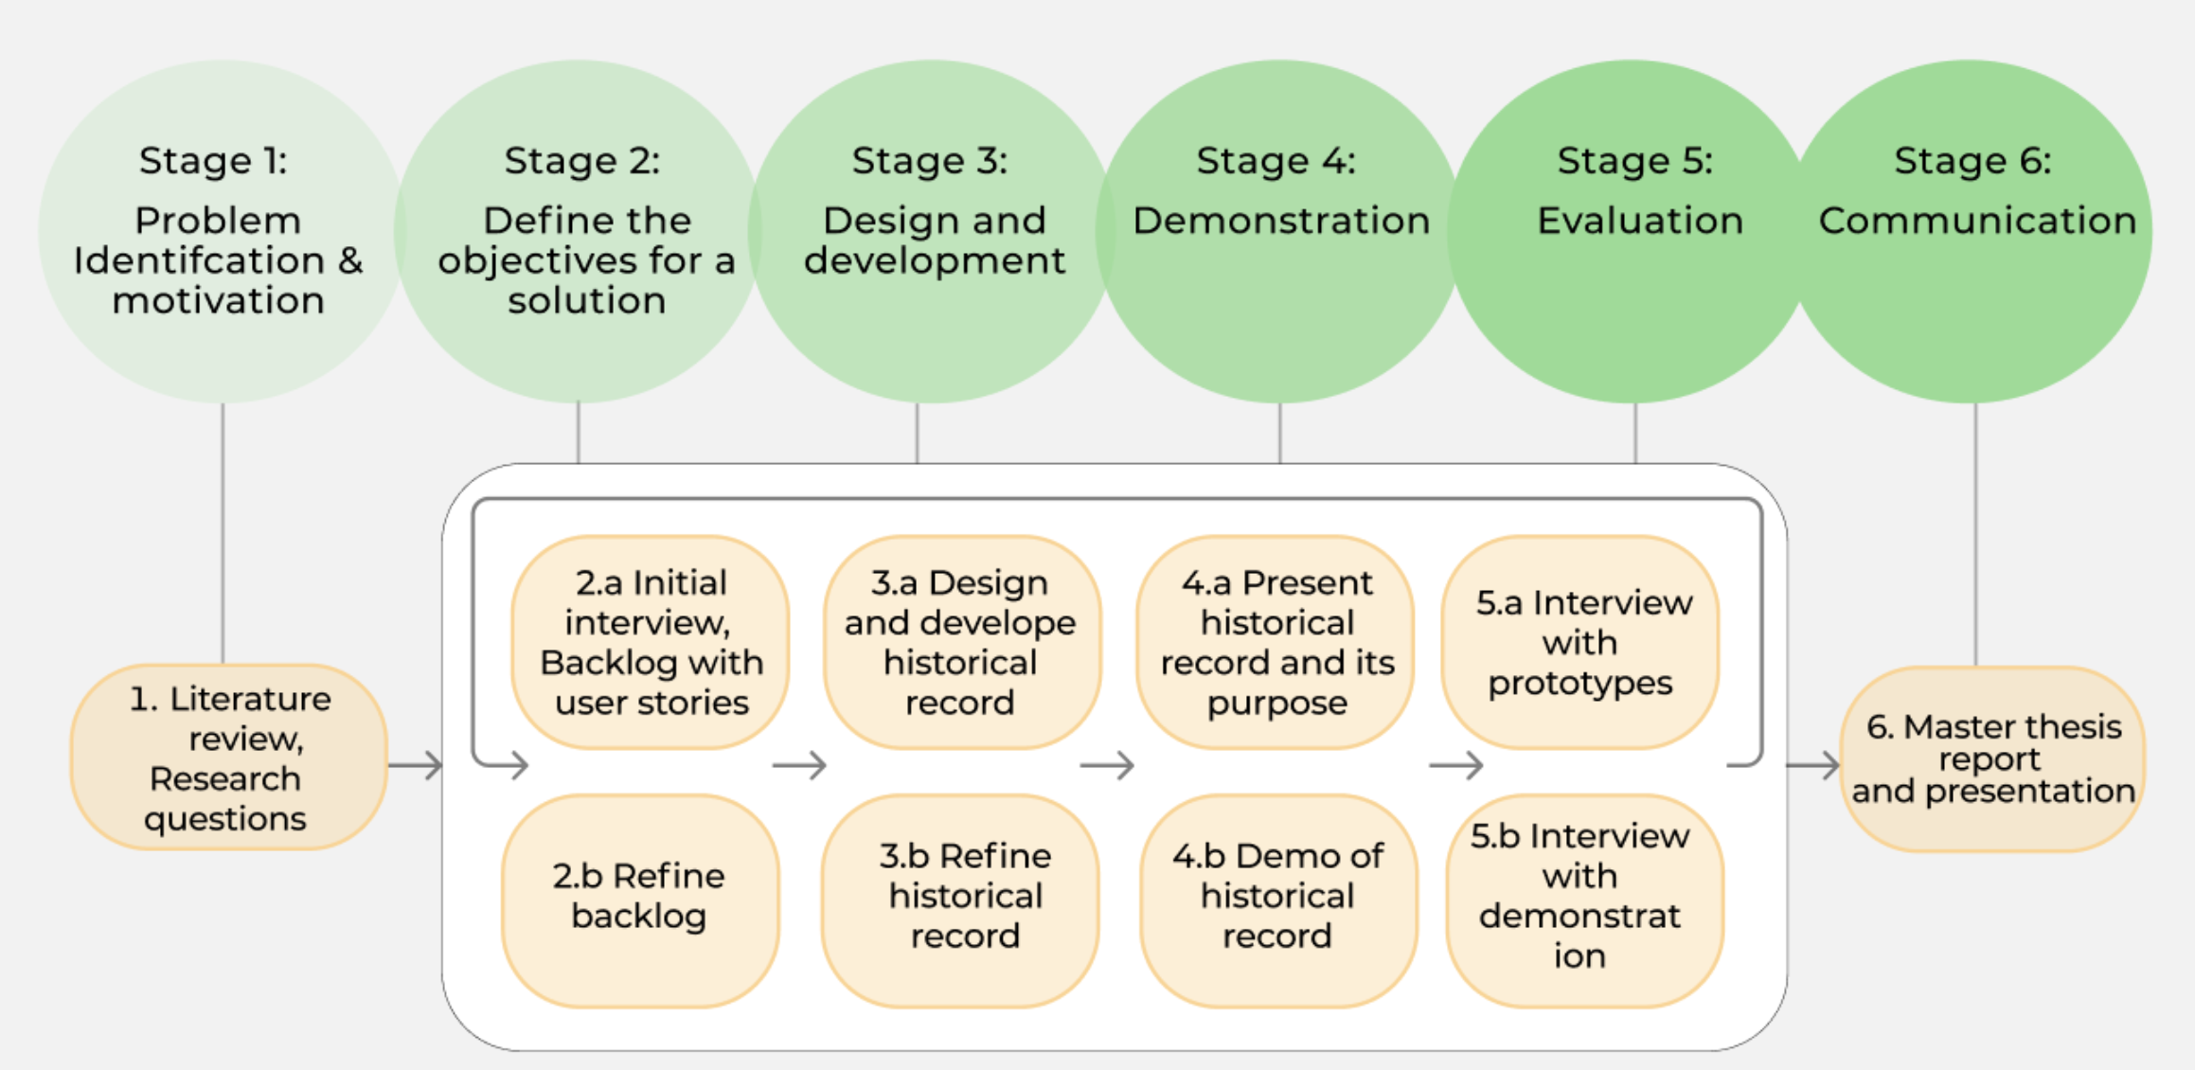
Example
Jay would like to create a visualization for the backlog
  After an initial literature review, she does two iterations
  The first one is focused on various prototypes
  The second one leads to the final evaluation after the backlog is refined
  In her report, she has two chapters, one for «iteration1» and one for «iteration2»

Slide 39
Reporting ++
There are various types of reports that can be created:
  Research content (focused on the contributions for research):
    Technical report, thesis, research paper
      Based on the rigor, novelty and relevance of the contributions, the study can be published in different outlets
      All the phases described in the framwork need to be clearly described reporting decisions, rationales and possibly the various solutions for replicability
    Presentation
      Thesis defence: 25 minutes, tell a good story about your thesis and don’t just copy-paste from it. Focus on the overall meaning of the thesis, not the details
      Conferences, keynotes, etc.
      Remember to convey a message and not report a paper
  Practical content (focused on the contributions for practice)
    Blog, newspaper, etc.
    Presentations for stakeholders
      Participants from the study highly appreciate when the practical insights are shared with them
        This step can be used to further acquire feedback on future work and usefulness of the new solution (e.g. Using mentimeter, etc.)
      Remember to adapt the research part in a way that is understandable for practitioners
Notes:
Review this page

Slide 40
Example
Maren has written a paper on security debt and publish it
  She has also presented her work at sikkerhetfestivalen
  She has travelled to the conference to present her work
Kristian has written a paper on using machine learning to automatically tag prioritiy in textual issues
  It was publish at a conference, and even selected for a journal publication
Daniel has written a paper on using machine learning to tag technical debt and the paper has been accepted, he traveled to Australia!
If a paper is accepted at a good conference based on the student thesis, there is a possibility to (paritally) support financially the participation to such conference

Slide 41
Referencing this methodology
A written document (paper) will be available for this methodology shortly and it will be possible to reference it as a suitable methodology, because based on the Design Science Research paradigm
  It is a good idea to reference the DSR paradigm as well

Slide 42
Feedback
If you are using this methodology, we would like your feedback on how to improve it! ☺
antonima@ifi.uio.no

