Slide 1

8 June 2021
Research Seminar at the University of Oslo
Data and Value:
Digital Data as Technological Artifact
Work in progress…
Aleksi Aaltonen
Fox School of Business
Temple University
Shark illustration: creozavr / pixabay.com

Slide 2
How to understand data-based value creation and innovation?
Data science understands data in way that is not helpful. I call it the ‘standard view’.

Slide 3
The Standard View of Data
Data are “raw facts that describe a particular phenomenon” (Haag and Cummings 2013, p. 508), “a series of facts that have been obtained by observation or research and recorded” (Bocij et al. 2008, p. 794), or “raw facts that can be processed into accurate and relevant information” (Turban et al. 2006, p. G-3).
Seeing data as facts is useful for many purposes and is dominant in much of data science and statistical methods.
However, let’s look at an individual datum – data in singular – and see what the standard view cannot tell us about it.

Slide 4
A Raw Unorganized ‘Fact’ – datum
TIMESTAMP | NS | TITLE | AGE | LEVENSHTEIN | REVISION_ID | CONTRIBUTORS
992632114 | 0 | Aspect ratio | 0 | 1648 | 234503 | 1
992632300 | 0 | Aspect ratio | 186 | 196 | 234504 | 1
1014652275 | 0 | Aspect ratio | 22020161 | 1027 | 100546 | 1
1024579246 | 0 | Aspect ratio | 31947132 | 1033 | 100551 | 2
1024579413 | 0 | Aspect ratio | 31947299 | 3 | 100571 | 2
1024580389 | 0 | Aspect ratio | 31948275 | 64 | 100574 | 3
This is not a ‘fact’ but just a number!
Individual datums presuppose the dataset!

Slide 5
Individual Datums or ‘Data Tokens’
Individual datums become data only as a part of a collection of data, that is, the individual datums (data tokens) presuppose the dataset.
However, a dataset is more than just the datums. It has metadata and structure.
Without metadata and structure, datums lose their referential function and capacity to represent facts. They cease to be data!
…but where does the metadata and structure come from?

Slide 6
The standard view is good for using data but not for studying how data are used.

Slide 7
Eight provocations
Data are not modular components.
There are no unstructured data.
Data are performed through practices.
The materiality of data makes a difference.
Data are intendedly referential but always semantic material.
Data are artificial facts.
New commodities are made from data.
Behavior starts to reflect data.

Slide 8
Data are not modular components.
The idea of recombination of modular components from digital innovation literature is not helpful to understand data.
“Due to their nature as marks, data are by definition cognitive elements that fulfill a different function than that of modules. Data are sign tokens used to describe, index, represent, or stage (perform) reality.”
Alaimo et al. (2020)

Slide 9
There are no unstructured data.
There are no ‘unstructured data’ from computational perspective.
‘Structure’ is understood here as a grammar, that is, a language or a code that allows to interpret data, for instance, character encodings are necessary to have any alphanumerical data.
Data are made by a structure that i) gives data its capacity to represent external entities (events or things) and ii) allows to makes sense of digitally inscribed distinctions.
Aaltonen and Penttinen (2021), Hirschheim et al. (1995)

Slide 10
Data are performed through practices.
Data are not the foundation of knowledge (Tuomi 1999).
“Using the example of temperature measurement, Tuomi argues that it is the knowledge informing the design of thermometers that defines what temperature is.”
Jones (2019, p. 7)
The study of data entails examining how specific data are i) produced and ii) used in practice.
Jones (2019)

Slide 11
The materiality of data makes a difference.
Data are digital material or substance; as such it has certain attributes that distinguish it from earlier records stored on other types of mediums such as paper or analogue tapes.
Data and digital objects in general have been described as: editable, interactive, open, reprogrammable, distributed, granular, modular, homogenous, self-referential, recontextualizable, portable, liquidified, syntactic, non-rival, low cost of reproduction, which makes a difference to how data works.
These attributes fuel new forms of recombinant innovation with data.
Alaimo et al. (2020), Faulkner and Runde (2013), Kallinikos et al. (2013), Monteiro and Parmiggiani (2019), Yoo et al. (2010)

Slide 12
Data are intendedly referential semantic material.
Current data and conceptual modeling research mainly follows representation theory (Burton-jones et al. 2017, Wand and Weber 1995) and so-called fact-based school, which assume one-to-one relationship with real-world entities and data.
However, there used to be a rule-based school to data modeling that was more sensitive to the multiplicity of ways to represent the world, which is still reflected in some data modeling literature.
Data cannot perform its referential function without semantics – it must be possible to makes sense of data.
Alaimo et al. (2020), Hirschheim et al. (1995), Jones (2019), Kallinikos (1999), Kent (2012)

Slide 13
Data are artificial facts.
Data are immutable mobiles (Latour 1999) – they inscribe contextual facts in a form that can travel – or perhaps mutable mobiles (Leonelli 2020):
“More generally, using data journeys as a theoretical framework helps to consider and examine the relationship between different types of data structures (their physical characteristics as mutable objects) and data functions (their prospective use as evidence).”
Leonelli (2020)
Data (artifact) has often unstable and uncertain relationship with facts (function) it performs.
Aaltonen et al. (forthcoming), Alaimo et al. (2020), Latour (1999), Leonelli (2020)

Slide 14
New commodities are made from data.
New things are built from data; for instance, advertising audiences, credit scores or NFTs do not exist outside the industrial ecosystem by which and for which they are produced.
“If data commodities such advertising audiences would simply exist ‘out there’—waiting to be represented by data and analytics—establishing them as commodities would hardly require the kind of interpretive effort and persistent ambiguity management that we find...”
Aaltonen et al. (forthcoming)
This is possible because data fuels comprehension and creation by being amenable for meaningful recombination. This parallels recombination of software/hardware components but follow grammar rather than modularity-based logic.
Aaltonen and Tempini (2014), Aaltonen et al. (forthcoming), Alaimo et al. (2020)

Slide 15
Behavior starts to reflects data.
‘Activity data’ are data that are about the behavior of organizational members who are aware of the data collection and have an interest in how their work is represented through the data.
Employees and their managers perform the activity data in various ways.
The collection of activity data is an intervention to organizational members behavior – their actions start to reflect the data.
Aaltonen and Stelmaszak (under review), Stelmaszak and Aaltonen (under review)

Slide 16
“…analyses that fall upon the standard view consider data exclusively as facts, yet the data must be also seen as artifacts.”
Alaimo and Aaltonen (unpublished manuscript)

Slide 17
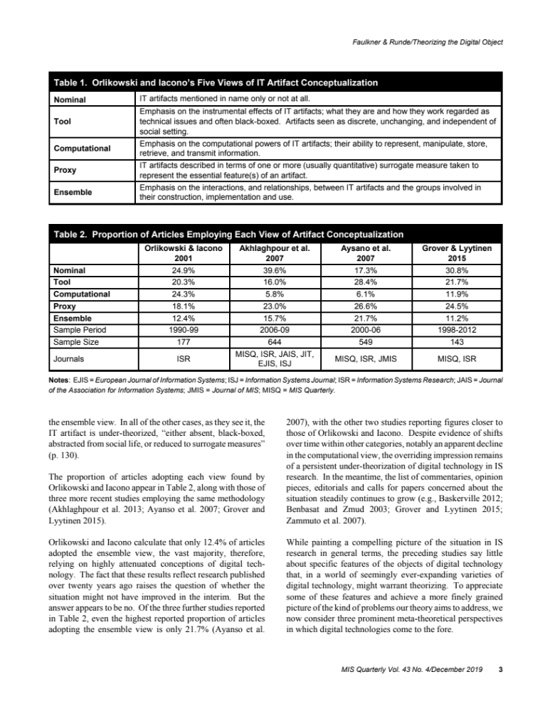
Digital data as IT artifact
Table reproduced from Faulkner and Runde (2019)
The standard view of data matches nominal and tool views.
The seven provocations point to the three latter views: digital data has computational attributes, data are proxies for facts, and data are performed by an ensemble of human and non-human entities.

Slide 18
Some Implications
What does it mean to know things in the industry or science (Monteiro and Parmiggiani 2019, Leonelli 2020)?
Reappraisal of the governance and ownership of data artifacts (e.g. interoperability issues), and their role in strategy.
We need new ways to look at the entire data value chain from data tokens to data-based objects, and data commodities.
Types of questions to drive the study of data

Slide 19
Type of questions to drive the study of data
Data are not a natural or foundational substance (Jones 2019); instead, data are made through practices.
How are specific data produced and used in practice?
Jones (2019) describe the actual practices of producing and using data as important objects of study. These need to be often studied together (Aaltonen and Stelmaszak under review).
What makes specific data possible?
What kind of technologies, organizational conditions and historicial developments have made particular data possible (Aaltonen and Penttinen 2021). Data innovations makes new, valuable datasets possible.

Slide 20
Digital data are no facts. The data are a technological artifact that helps enact facts.

Slide 21
References
Aaltonen, A., Alaimo, C. and Kallinikos, J., (forthcoming). The making of data commodities: data analytics as an embedded process. Journal of Management Information Systems.
Aaltonen, Aleksi, and Esko Penttinen. “What Makes Data Possible? A Sociotechnical View on Structured Data Innovations.” In Proceedings of the 54th Hawaii International Conference on System Sciences. Hawaii, 2021.
Aaltonen, Aleksi, and Niccoló Tempini. “Everything Counts in Large Amounts: A Critical Realist Case Study on Data-Based Production.” Journal of Information Technology 29, no. 1 (2014): 97–110.
Alaimo, Cristina, Jannis Kallinikos, and Aleksi Aaltonen. “Data and Value.” In Handbook of Digital Innovation, edited by Satish Nambisan, Kalle Lyytinen, and Youngjin Yoo, 162–78. Cheltenham, UK: Edward Elgar, 2020.
Faulkner, Philip, and Jochen Runde. “Technological Objects, Social Positions, and the Transformational Model of Social Activity.” MIS Quarterly 37, no. 3 (2013): 803–18.
Hirschheim, Rudy, K. Klein Heinz, and Kalle Lyytinen. Information Systems Development and Data Modeling. Cambridge, UK: Cambridge University Press, 1995.
Jones, Matthew. “What We Talk about When We Talk about (Big) Data.” Journal of Strategic Information Systems 28, no. 1 (2019): 3–16.
Kallinikos, Jannis, Aleksi Aaltonen, and Attila Marton. “The Ambivalent Ontology of Digital Artifacts.” MIS Quarterly 37, no. 2 (2013): 357–70.
Kallinikos, Jannis. “Computer-Based Technology and the Constitution of Work: A Study on the Cognitive Foundations of Work.” Accounting, Management & Information Technology 9, no. 4 (1999): 261–91.
Kent, W. Data & Reality. Third edition.Technics Publications, 2012.
Latour, Bruno. Pandora’s Hope: Essays on the Reality of Science Studies. Cambridge, Massachusetts: Harvard University Press, 1999.
Leonelli, S. “Learning from data journeys.” In Data Journeys in the. Sciences, edited by Sabina Leonelli, and Niccolo Tempini, 1–24. Springer, 2020.
Monteiro, Eric, and Elena Parmiggiani. “Synthetic Knowing: The Politics of the Internet of Things.” MIS Quarterly 43, no. 1 (2019): 167–84.
Tuomi, I. “Data Is More Than Knowledge: Implications of the Reversed Knowledge Hierarchy for Knowledge Management and Organizational Memory.” Journal of Management Information Systems 16, no. 3 (1999): 103–17.
Yoo, Youngjin, Ola Henfridsson, and Kalle Lyytinen. “The New Organizing Logic of Digital Innovation: An Agenda for Information Systems Research.” Information Systems Research 21, no. 4 (2010): 724–35.

Slide 22
The rise of a new form of data value chain
Data tokens are produced by technological conventions that capture facts as socially validated and standardized records.
Data-based objects are compiled (aggregated) from individual data tokens and are often marked by considerable ambiguity as to what the object represents.
Data commodities are data-based objects that are exchanged on the market and thus have market value.

