Slide 1
Ontological Methods for Opinion
Interpretation in Text
Gaurav Negi
PhD Student, 3rd Year
Data Science Institute, University of Galway
Supervisors:
Prof. Paul Buitelaar
Dr. Omnia Zayed

Slide 2
Opinion (Liu et al., 2017)
Opinion is a broad concept that covers sentiment and its associated information such as opinion target and the person who holds the opinion and use the term sentiment to mean only the underlying positive, negative or neutral feelings implied by opinion.
Research Question
How can we effectively and comprehensively represent opinions while capturing fine-grained semantic details?
Notes:
Rephrase research question.
Unifying multiple perspectives on opinion expression and generate one robust ontology which can be effective across a wide range NLP tasks.

Slide 3
Outline
Related Work
Building Blocks of an Opinion
UOC Ontology
Benchmark Dataset
Baselines
Notes:
This presentation has the background, followed by a brief literature review, leading up to the challenges in opinion mining. Then we look at our research questions followed by the work that we did.

Slide 4
Related Work: NLP
Conventional sentiment analysis studies mainly perform prediction at the sentence or document level identifying the overall sentiment towards the whole sentence or document.
E.g. I was not happy with one of the programs on it . Negative
Recent fine-grained sentiment analysis tasks:
      Aspect Opinion Co-extraction (Lie et al., 2019)
      Opinion Triple Extraction (Zhang et al., 2020; Ma et al., 2018)
      Aspect Category Opinion Quadruple Extraction (Cai et al., 2021)
      Structured Sentiment Analysis (Barnes et al., 2019; 2021; 2022)

Slide 5
Related Work: NLP
Conventional sentiment analysis studies mainly perform prediction at the sentence or document level identifying the overall sentiment towards the whole sentence or document.
E.g. I was not happy with one of the programs on it . Negative
Recent fine-grained sentiment analysis tasks:
      Aspect Opinion Co-extraction (Lie et al., 2019)
      Opinion Triple Extraction (Zhang et al., 2020; Ma et al., 2018)
      Aspect Category Opinion Quadruple Extraction (Cai et al., 2021)
      Structured Sentiment Analysis (Barnes et al., 2019; 2021; 2022)
E.g. I was not happy with one of the programs on it .
Opinion
Aspect Term
NEG
LAPTOP#SOFTWARE (Entity # Category)

Slide 6
Related Work: NLP
Conventional sentiment analysis studies mainly perform prediction at the sentence or document level identifying the overall sentiment towards the whole sentence or document.
E.g. I was not happy with one of the programs on it . Negative
Recent fine-grained sentiment analysis tasks:
      Aspect Opinion Co-extraction (Lie et al., 2019)
      Opinion Triple Extraction (Zhang et al., 2020; Ma et al., 2018)
      Aspect Category Opinion Quadruple Extraction (Cai et al., 2021)
      Structured Sentiment Analysis (Barnes et al., 2019; 2021; 2022)
positive
Holder
Sentiment Ex.
Target
E.g. I was not happy with one of the programs on it .
Opinion
Aspect Term
NEG
LAPTOP#SOFTWARE (Entity # Category)

Slide 7
Related Work: Marl Ontology (Semantic Web)
Marl is a standardised data schema (also referred as "ontology" or "vocabulary") designed to annotate and describe subjective opinions expressed on the semantic web and Information Systems.
https://www.gsi.upm.es/ontologies/marl/

Slide 8
Related Work: Marl Ontology (Semantic Web)
Described
Object
Feature
Described
Object
Part
describesObjectFeature
describesObjectPart
Positive
Described
Object
describesObject
Polarity
Negative
hasPolarity
Opinion
Neutral
domain
polarityValue
Domain
extractedFrom
Polarity
Value
algorithmConfidence
opinionText
Source
Text
Opinion
Text
Algorithm
Confidence
https://www.gsi.upm.es/ontologies/marl/

Slide 9
Limitations
Opinion Mining in NLP :
1. The formulations of opinion mining in NLP is based on the theoretical foundation provided by Liu and Zhang (2012); Liu017(2017), yet they do not capture the expressiveness of opinion and all its facets.
2. Semantic relationships between opinion facets are implicitly acknowledged in existing works, ABSA does not utilize them, and structured sentiment analysis only partially leverages them when addressing sentiment-related components of an opinion.
Marl Ontology:
The Marl Ontology attempts to specify structure of opinion for the semantic web. However, it does not utilizes the advancements of opinion mining research in NLP
Contributions*
Specification of the Unified Opinion Concept (UOC) Ontology.
Formulation of semantically structured opinion mining based on the UOC Ontology semantics along with baseline methods and quantitative evaluation metrics.
Test Dataset Creation (5 domain x 20 opinionated sentences)

Slide 10
Unified Opinion Concepts (UOC) Ontology
I think it is a great spot to visit this year, especially for the tourists as it is so close to many restaurants.
spot
has
Attribute
Aspect
embodies
Aspect
Target
has Aspect
Category
hasTargetEntity
Aspect Category
Target Entity
hasAttribute
hasAttribute
General
Location
Extracting target information from the text along with its semantic structure

Slide 11
Unified Opinion Concepts (UOC) Ontology
I think it is a great spot to visit this year, especially for the tourists as it is so close to many restaurants.
Sentiment
Polarity
Positive
hasPolarity
Sentiment
hasIntensity
Sentiment Intensity
Strong
hasAttribute
great
Extracting sentiment information from the text along with its semantic structure

Slide 12
Unified Opinion Concepts (UOC) Ontology
I think it is a great spot to visit this year, especially for the tourists as it is so close to many restaurants.
I
hasAttribute
Author
hasAttribute
Holder
Holder
Entity
hasHolderEntity
Extracting opinion holder information (Liu et al., 2017)

Slide 13
Unified Opinion Concepts (UOC) Ontology
I think it is a great spot to visit this year, especially for the tourists as it is so close to many restaurants.
tourists
so close to many restaurants
hasAttribute
hasAttribute
Qualifier
Reason
hasQualifier
hasReason
Opinion
Extracting qualifiers and reason (Liu et al., 2017) from the text

Slide 14
Unified Opinion Concepts (UOC) Ontology
I think it is a great spot to visit this year, especially for the tourists as it is so close to many restaurants.
tourists
so close to many restaurants
I
hasAttribute
hasAttribute
Author
hasAttribute
hasAttribute
Qualifier
Reason
Holder
Holder
Entity
spot
hasHolderEntity
hasQualifier
hasReason
Sentiment
Polarity
has
Attribute
hasHolderEntity
Positive
hasPolarity
Aspect
embodies
Aspect
Target
isExpressedOn
Target
Opinion
conveys
Sentiment
Sentiment
hasIntensity
Sentiment Intensity
Strong
hasTargetEntity
hasAttribute
has Aspect
Category
great
Aspect Category
Target Entity
hasAttribute
hasAttribute
General
Location

Slide 15
Unified Opinion Concepts (UOC) Ontology
holder_span
qualifier_span
reason_span
hasAttribute
entity_value
hasAttribute
hasAttribute
hasAttribute
Qualifier
Reason
Holder
Holder
Entity
Negative
hasHolderEntity
aspect_term
Positive
hasQualifier
hasReason
isHeldBy
Sentiment
Polarity
Neutral
has
Attribute
hasPolarity
Aspect
embodies
Aspect
Target
isExpressedOn
Target
Opinion
conveys
Sentiment
Sentiment
hasIntensity
Sentiment Intensity
Strong
hasTargetEntity
hasAttribute
has Aspect
Category
Average
expression
Weak
Aspect Category
Target Entity
hasAttribute
hasAttribute
category_name
entity_value

Slide 16
Semantically Structured Opinion Mining
holder_span
Holder
Holder Entity
entity_value
Aspect
Aspect Category
category_name
Target
aspect_term
Opinion
Target Entity
entity_value
Sentiment
Sentiment Polarity
Sentiment Intensity
expression
Qualifier
Reason
Problem def. Given the input text, T_{i} extract an exhaustive set of opinions Oi = {O₁₁, O₁₂, ..., O_{ij}} where each opinion O_{ij} is represented as tuple:
Oij = {aspect_term_{j}, sentiment_expression_{j}, aspect_category_{j}, target_entity_{j},
sentiment_polarity_{j}, sentiment_intensity_{j}, holder_span_{j},
holder_entity_{j}, qualifier_{j}, reason_{j}}

Slide 17
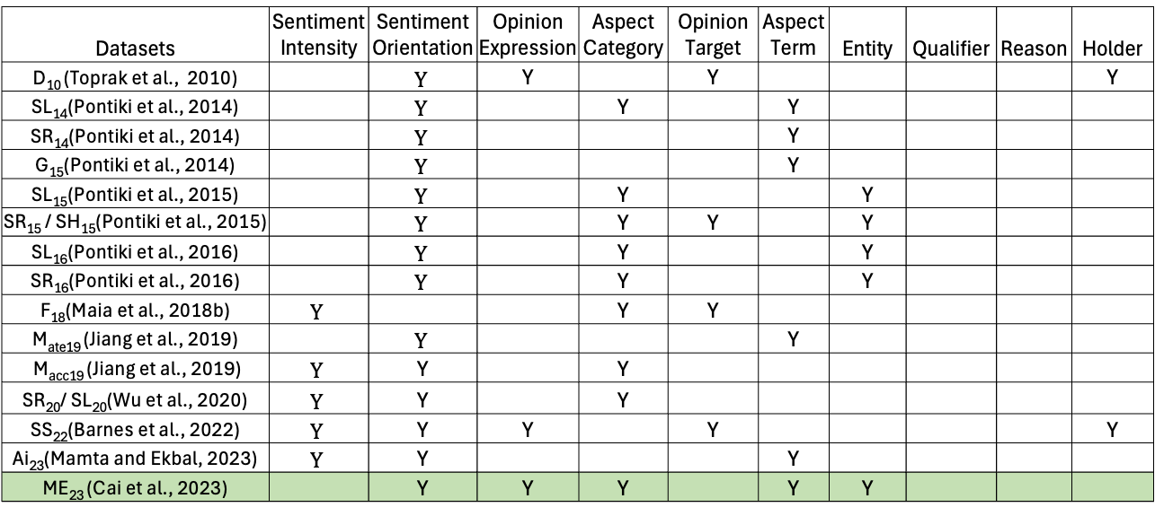
UOC: Dataset Resources
Datasets | Sentiment Intensity | Sentiment Orientation | Opinion Expression | Aspect Category | Opinion Target | Aspect Term | Entity | Qualifier | Reason | Holder
D₁₀ (Toprak et al., 2010) |  | $$Y$$ | Y |  | Y |  |  |  |  | Y
SL₁₄(Pontiki et al., 2014) |  | $$Y$$ |  | Y |  | Y
SR₁₄(Pontiki et al., 2014) |  | $$Y$$ |  |  |  | Y
G₁₅(Pontiki et al., 2014) |  | $$Y$$ |  |  |  | Y
SL₁₅(Pontiki et al., 2015) |  | $$Y$$ |  | Y |  |  | Y
SR₁₅ / SH₁₅(Pontiki et al., 2015) |  | $$Y$$ |  | Y | Y |  | Y
SL₁₆(Pontiki et al., 2016) |  | $$Y$$ |  | Y |  |  | Y
SR₁₆(Pontiki et al., 2016) |  | $$Y$$ |  | Y |  |  | Y
F₁₈(Maia et al., 2018b) | $$Y$$ |  |  | Y | Y
M_{ate19} (Jiang et al., 2019) |  | $$Y$$ |  |  |  | Y
M_{acc19} (Jiang et al., 2019) | $$Y$$ | Y |  | Y
SR₂₀/ SL₂₀(Wu et al., 2020) | $$Y$$ | Y |  | Y
SS₂₂(Barnes et al., 2022) | $$Y$$ | Y | Y |  | Y |  |  |  |  | Y
Ai₂₃(Mamta and Ekbal, 2023) | $$Y$$ | Y |  |  |  | Y
ME₂₃ (Cai et al., 2023) |  | Y | Y | Y |  | Y | Y
We surveyed the dataset resources available for the related task. We evaluated the alignment of the existing annotations with the UOC schematics.
Note: We observe that none of the datasets have all the annotations required to solve the task. So, we extended the annotations of ME23 dataset

Slide 18
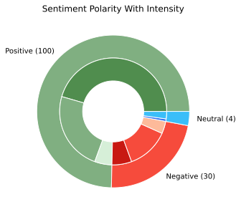
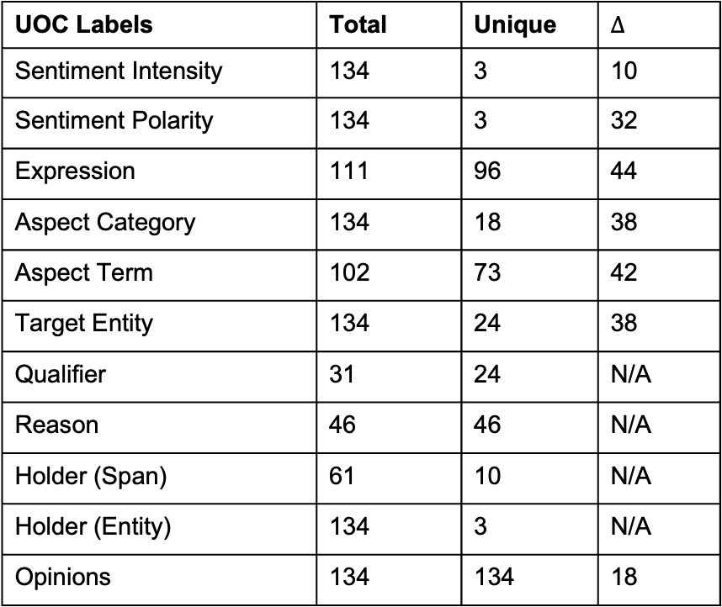
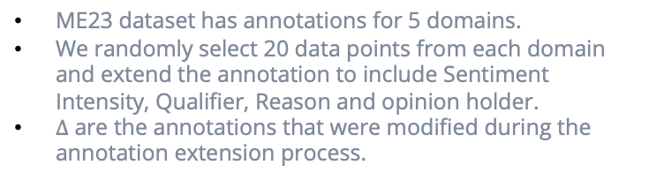
Benchmark Dataset
UOC Labels | Total | Unique | $∆$
Sentiment Intensity | 134 | 3 | 10
Sentiment Polarity | 134 | 3 | 32
Expression | 111 | 96 | 44
Aspect Category | 134 | 18 | 38
Aspect Term | 102 | 73 | 42
Target Entity | 134 | 24 | 38
Qualifier | 31 | 24 | N/A
Reason | 46 | 46 | N/A
Holder (Span) | 61 | 10 | N/A
Holder (Entity) | 134 | 3 | N/A
Opinions | 134 | 134 | 18
ME23 dataset has annotations for 5 domains.
We randomly select 20 data points from each domain and extend the annotation to include Sentiment Intensity, Qualifier, Reason and opinion holder.
$∆$ are the annotations that were modified during the annotation extension process.
Notes:
Planning to submit and we are

Slide 19
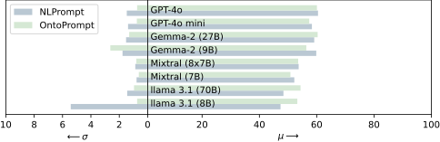
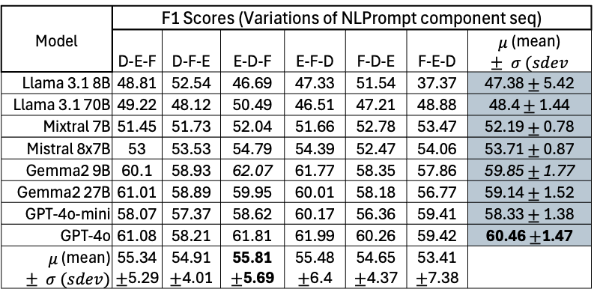
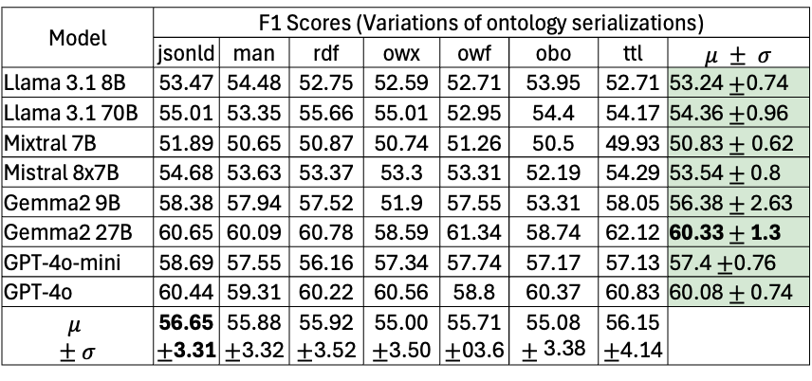
LLM Baselines
Natural Language Prompt (NLPrompt): It has the definitions of opinion concepts (D), in-context examples (E) and format guidelines (F).
Ontology Prompt (OntoPrompt): In this prompt the definitions of concepts (D) is provided as a serialized ontology description rather instead of natural language.
Model | F1 Scores (Variations of NLPrompt component seq)
 | D-E-F | D-F-E | E-D-F | E-F-D | F-D-E | F-E-D | $μ$ (mean) $± σ (sdev$
Llama 3.1 8B | 48.81 | 52.54 | 46.69 | 47.33 | 51.54 | 37.37 | 47.38 $±$ 5.42
Llama 3.1 70B | 49.22 | 48.12 | 50.49 | 46.51 | 47.21 | 48.88 | 48.4 $±$ 1.44
Mixtral 7B | 51.45 | 51.73 | 52.04 | 51.66 | 52.78 | 53.47 | 52.19 $±$ 0.78
Mistral 8x7B | 53 | 53.53 | 54.79 | 54.39 | 52.47 | 54.06 | 53.71 $±$ 0.87
Gemma2 9B | 60.1 | 58.93 | 62.07 | 61.77 | 58.35 | 57.86 | 59.85 $±$ 1.77
Gemma2 27B | 61.01 | 58.89 | 59.95 | 60.01 | 58.18 | 56.77 | 59.14 $±$ 1.52
GPT-4o-mini | 58.07 | 57.37 | 58.62 | 60.17 | 56.36 | 59.41 | 58.33 $±$ 1.38
GPT-4o | 61.08 | 58.21 | 61.81 | 61.99 | 60.26 | 59.42 | 60.46 $±$1.47
$μ$ (mean) $± σ (sdev)$ | 55.34$±$5.29 | 54.91 $±$4.01 | 55.81 $±$5.69 | 55.48 $±$6.4 | 54.65 $±$4.37 | 53.41 $±$7.38
Model | F1 Scores (Variations of ontology serializations)
 | jsonld | man | rdf | owx | owf | obo | ttl | $$μ ± σ$$
Llama 3.1 8B | 53.47 | 54.48 | 52.75 | 52.59 | 52.71 | 53.95 | 52.71 | 53.24 $±$0.74
Llama 3.1 70B | 55.01 | 53.35 | 55.66 | 55.01 | 52.95 | 54.4 | 54.17 | 54.36 $±$0.96
Mixtral 7B | 51.89 | 50.65 | 50.87 | 50.74 | 51.26 | 50.5 | 49.93 | 50.83 $±$0.62
Mistral 8x7B | 54.68 | 53.63 | 53.37 | 53.3 | 53.31 | 52.19 | 54.29 | 53.54 $±$ 0.8
Gemma2 9B | 58.38 | 57.94 | 57.52 | 51.9 | 57.55 | 53.31 | 58.05 | 56.38 $±$ 2.63
Gemma2 27B | 60.65 | 60.09 | 60.78 | 58.59 | 61.34 | 58.74 | 62.12 | 60.33 $±$ 1.3
GPT-4o-mini | 58.69 | 57.55 | 56.16 | 57.34 | 57.74 | 57.17 | 57.13 | 57.4 $±$0.76
GPT-4o | 60.44 | 59.31 | 60.22 | 60.56 | 58.8 | 60.37 | 60.83 | 60.08 $±$ 0.74
$$μ$$ $$± σ$$ | 56.65 $±$3.31 | 55.88 $±$3.32 | 55.92 $±$3.52 | 55.00 $±$3.50 | 55.71 $±$03.6 | 55.08$±\text{3.38}$ | 56.15 $±$4.14
Effect of prompt type
NLPrompts results in a higher individual model scores across different versions however the OntoPrompts exhibits higher average score across models.
OntoPrompt also has a lower standard deviation across models hinting at the robustness of the prompting method.
Notes:
Planning to submit and we are

Slide 20
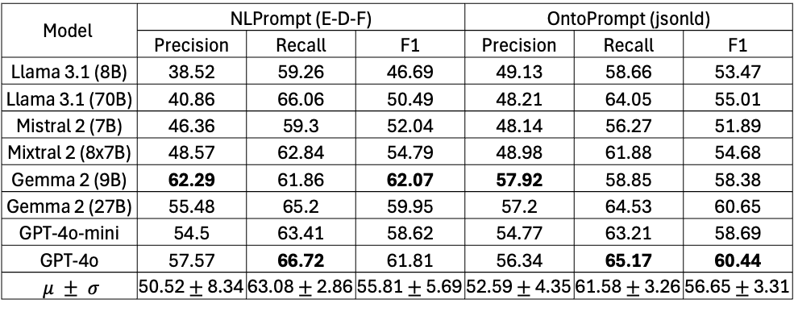
LLM Baselines
Model | NLPrompt (E-D-F) |  |  | OntoPrompt (jsonld)
 | Precision | Recall | F1 | Precision | Recall | F1
Llama 3.1 (8B) | 38.52 | 59.26 | 46.69 | 49.13 | 58.66 | 53.47
Llama 3.1 (70B) | 40.86 | 66.06 | 50.49 | 48.21 | 64.05 | 55.01
Mistral 2 (7B) | 46.36 | 59.3 | 52.04 | 48.14 | 56.27 | 51.89
Mixtral 2 (8x7B) | 48.57 | 62.84 | 54.79 | 48.98 | 61.88 | 54.68
Gemma 2 (9B) | 62.29 | 61.86 | 62.07 | 57.92 | 58.85 | 58.38
Gemma 2 (27B) | 55.48 | 65.2 | 59.95 | 57.2 | 64.53 | 60.65
GPT-4o-mini | 54.5 | 63.41 | 58.62 | 54.77 | 63.21 | 58.69
GPT-4o | 57.57 | 66.72 | 61.81 | 56.34 | 65.17 | 60.44
$μ ± σ$ | 50.52 $±$ 8.34 | 63.08 $±$ 2.86 | 55.81 $±$ 5.69 | 52.59 $±$ 4.35 | 61.58 $±$ 3.26 | 56.65 $±$ 3.31
Observations
The best performing model is Gemma 9B with the NLPrompt. It hints at the fact that parameter size is not the singular factor dictating the extraction of opinion from the text.
In these selected results also we see that the OntoPrompt has a higher average precision and f1 score across the models and lower values of stdev. On manual assessment the improved robustness was found to be due to less hallucinations and fewer extracted opinions when using OntoPrompts.

Slide 21
Limitations and Future Work
Benchmark dataset is limited in size and can only be utilized for evaluation purposes.
Current evaluation metrics do not incorporate semantic measure.
The established baselines leaves a significant scope for exploring effective machine learning techniques to enhance performance.
Notes:
Planning to submit and we are

Slide 22
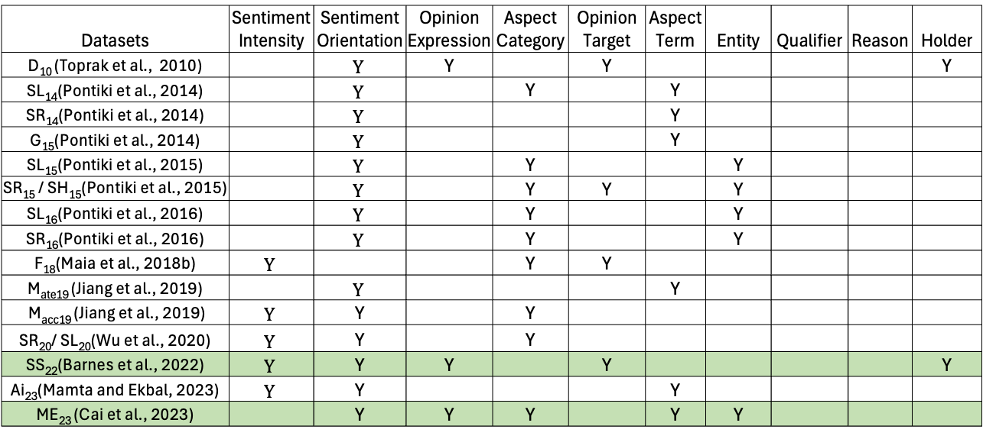
Current Work: Improving Dataset Utilization with MTL
Datasets | Sentiment Intensity | Sentiment Orientation | Opinion Expression | Aspect Category | Opinion Target | Aspect Term | Entity | Qualifier | Reason | Holder
D₁₀ (Toprak et al., 2010) |  | $$Y$$ | Y |  | Y |  |  |  |  | Y
SL₁₄(Pontiki et al., 2014) |  | $$Y$$ |  | Y |  | Y
SR₁₄(Pontiki et al., 2014) |  | $$Y$$ |  |  |  | Y
G₁₅(Pontiki et al., 2014) |  | $$Y$$ |  |  |  | Y
SL₁₅(Pontiki et al., 2015) |  | $$Y$$ |  | Y |  |  | Y
SR₁₅ / SH₁₅(Pontiki et al., 2015) |  | $$Y$$ |  | Y | Y |  | Y
SL₁₆(Pontiki et al., 2016) |  | $$Y$$ |  | Y |  |  | Y
SR₁₆(Pontiki et al., 2016) |  | $$Y$$ |  | Y |  |  | Y
F₁₈(Maia et al., 2018b) | $$Y$$ |  |  | Y | Y
M_{ate19} (Jiang et al., 2019) |  | $$Y$$ |  |  |  | Y
M_{acc19} (Jiang et al., 2019) | $$Y$$ | Y |  | Y
SR₂₀/ SL₂₀(Wu et al., 2020) | $$Y$$ | Y |  | Y
SS₂₂(Barnes et al., 2022) | $$Y$$ | Y | Y |  | Y |  |  |  |  | Y
Ai₂₃(Mamta and Ekbal, 2023) | $$Y$$ | Y |  |  |  | Y
ME₂₃ (Cai et al., 2023) |  | Y | Y | Y |  | Y | Y
Better Utilization of Existing Resources
SS₂₂ and ME₂₃ between themselves have annotations for all the labels except for reason and qualifier. There is an opportunity for their utilization to train opinion extraction systems.

Slide 23
Current Work: Dataset Annotation Semantics
holder_span
qualifier_span
reason_span
hasAttribute
entity_value
hasAttribute
hasAttribute
hasAttribute
Qualifier
Reason
Holder
Holder
Entity
Negative
hasHolderEntity
aspect_term
Positive
hasQualifier
hasReason
isHeldBy
Sentiment
Polarity
Neutral
has
Attribute
hasPolarity
Aspect
embodies
Aspect
Target
isExpressedOn
Target
Opinion
conveys
Sentiment
Sentiment
hasIntensity
Sentiment Intensity
Strong
hasTargetEntity
hasAttribute
has Aspect
Category
Average
expression
Weak
Aspect Category
Target Entity
hasAttribute
hasAttribute
category_name
entity_value

Slide 24
Current Work: Dataset Annotation Semantics
SS₂₂ Dataset
hasAttribute
holder_span
Target
Holder
Holder
Entity
hasHolderEntity
ME₂₃ Dataset
aspect_term
isExpressedOn
Target
isHeldBy
has
Attribute
Strong
Aspect
embodies
Aspect
Opinion
conveys
Sentiment
Sentiment
hasIntensity
Sentiment Intensity
Average
hasTarget
Entity
Weak
has Aspect
Category
Aspect Category
Target Entity
hasAttribute
hasPolarity
Negative
hasAttribute
hasAttribute
Positive
expression
Sentiment
Polarity
category_name
entity_value
Neutral

Slide 25
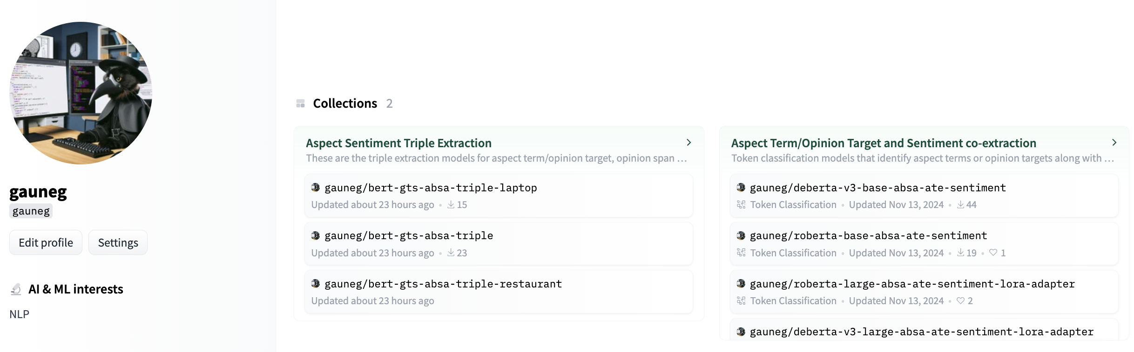
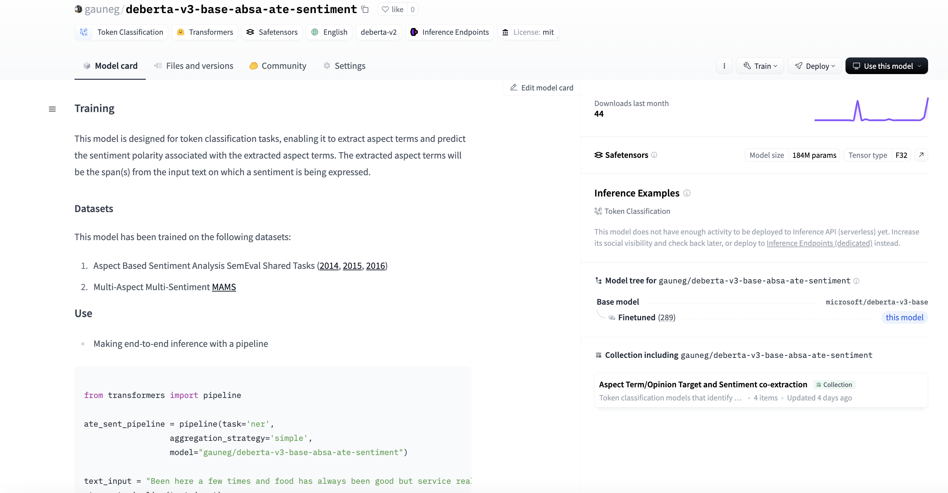
Other Activities
Maintaining easily accessible Hugging Face repository for fine-grained sentiment analyses. Link: https://huggingface.co/gauneg

Slide 26
Questions?

Slide 27
REFERENCES
Hu, Minqing, and Bing Liu. "Mining and summarizing customer reviews." Proceedings of the tenth ACM SIGKDD international conference on Knowledge discovery and data mining. 2004.
Zhuang, Li, Feng Jing, and Xiao-Yan Zhu. "Movie review mining and summarization." Proceedings of the 15th ACM international conference on Information and knowledge management. 2006.
Qiu, Guang, et al. "Opinion word expansion and target extraction through double propagation." Computational linguistics 37.1 (2011): 9-27.
Jie Tao and Lina Zhou. 2020. A Weakly Supervised WordNet-Guided Deep Learning Approach to Extracting Aspect Terms from Online Reviews. ACM Trans. Manage. Inf. Syst. 11, 3, Article 13 (September 2020), 22 pages. https://doi.org/10.1145/339963.
Wu, C., Wu, F., Wu, S., Yuan, Z. and Huang, Y., 2018. A hybrid unsupervised method for aspect term and opinion target extraction. Knowledge-Based Systems, 148, pp.66-73.
Xiaowen Ding, Bing Liu, and Philip S. Yu. 2008. A holistic lexicon-based approach to opinion mining. In Proceedings of the 2008 International Conference on Web Search and Data Mining (WSDM '08). Association for Computing Machinery, New York, NY, USA, 231–240. https://doi.org/10.1145/1341531.1341561
Scaria, K., Gupta, H., Goyal, S., Sawant, S.A., Mishra, S. and Baral, C., 2023. Instructabsa: Instruction learning for aspect based sentiment analysis. arXiv preprint arXiv:2302.08624.
Youwei Song, Jiahai Wang, Tao Jiang, Zhiyue Liu, and Yanghui Rao. 2019. Attentional encoder network for targeted sentiment classification. arXiv preprint arXiv:1902.09314.
Hu Xu, Bing Liu, Lei Shu, and S Yu Philip. 2019a. Bert post-training for review reading comprehension and aspect-based sentiment analysis. In Proceedings of the 2019 Conference of the North American Chapter of the Association for Computational Linguistics: Human Language Technologies, Volume 1 (Long and Short Papers), pages 2324–2335.
Sun, C., Huang, L. and Qiu, X., 2019, June. Utilizing BERT for Aspect-Based Sentiment Analysis via Constructing Auxiliary Sentence. In Proceedings of the 2019 Conference of the North American Chapter of the Association for Computational Linguistics: Human Language Technologies, Volume 1 (Long and Short Papers) (pp. 380-385).
C. Toprak, N. Jakob, and I. Gurevych. Sentence and expression level annotation of opinions in user-generated discourse. In J. Hajic, S. Carberry, and S. Clark, editors, ACL 2010, Proceedings of the 48th Annual Meeting of the Association for Computational Linguistics, July 11-16, 2010, Uppsala, Sweden, pages 575–584. The Association for Computer Linguistics, 2010.
M. Pontiki, D. Galanis, J. Pavlopoulos, H. Papageorgiou, I. Androutsopoulos, and S. Manandhar. Semeval-2014 task 4: Aspect based sentiment analysis. In P. Nakov and T. Zesch, editors, Proceedings of the 8th International Workshop on Semantic Evaluation, SemEval@COLING 2014, Dublin, Ireland, August 23-24, 2014, pages 27–35. The Association for Computer Linguistics, 2014
Q. Liu, Z. Gao, B. Liu, and Y. Zhang. Automated rule selection for aspect extraction in opinion mining. In Q. Yang and M. J. Wooldridge, editors, Proceedings of the Twenty-Fourth International Joint Conference on Artificial Intelligence, IJCAI 2015, Buenos Aires, Argentina, July 25-31, 2015, pages 1291–1297. AAAI Press, 2015.

Slide 28
Q. Jiang, L. Chen, R. Xu, X. Ao, and M. Yang. A challenge dataset and effective models for aspect-based sentiment analysis. In K. Inui, J. Jiang, V. Ng, and X. Wan, editors, Proceedings of the 2019 Conference on Empirical Methods in Natural Language Processing and the 9th International Joint Conference on Natural Language Processing, EMNLP-IJCNLP 2019, Hong Kong, China, November 3-7, 2019, pages 6279–6284. Association for Computational Linguistics, 2019.
J. Barnes, L. Oberl ̈ander, E. Troiano, A. Kutuzov, J. Buchmann, R. Agerri, L. Øvrelid, and E. Velldal. Semeval 2022 task 10: Structured sentiment analysis. In G. Emerson, N. Schluter, G. Stanovsky, R. Kumar, A. Palmer, N. Schneider, S. Singh, and S. Ratan, editors, Proceedings of the 16th International Workshop on Semantic Evaluation, SemEval@NAACL 2022, Seattle, Washington, United States, July 14-15, 2022, pages 1280–1295. Association for Computational Linguistics, 2022
Jeremy Barnes, Robin Kurtz, Stephan Oepen, Lilja Øvrelid, and Erik Velldal. 2021. Structured Sentiment Analysis as Dependency Graph Parsing. In Proceedings of the 59th Annual Meeting of the Association for Computational Linguistics and the 11th International Joint Conference on Natural Language Processing (Volume 1: Long Papers), pages 3387–3402, Online. Association for Computational Linguistics.
Jeremy Barnes, Lilja Øvrelid, and Erik Velldal. 2021. If you’ve got it, flaunt it: Making the most of fine-grained sentiment annotations. In Proceedings of the 16th Conference of the European Chapter of the Association for Computational Linguistics: Main Volume, pages 49–62, Online. Association for Computational Linguistics.
Rønningstad, E., Velldal, E. and Øvrelid, L., 2022, October. Entity-Level Sentiment Analysis (ELSA): An Exploratory Task Survey. In Proceedings of the 29th International Conference on Computational Linguistics (pp. 6773-6783).
Brown, T., Mann, B., Ryder, N., Subbiah, M., Kaplan, J.D., Dhariwal, P., Neelakantan, A., Shyam, P., Sastry, G., Askell, A. and Agarwal, S., 2020. Language models are few-shot learners. Advances in neural information processing systems, 33, pp.1877-1901.
Li, X., Bing, L., Li, P., Lam, W. and Yang, Z., 2018, July. Aspect term extraction with history attention and selective transformation. In Proceedings of the 27th International Joint Conference on Artificial Intelligence (pp. 4194-4200).
Wang, Wenya, et al. "Recursive Neural Conditional Random Fields for Aspect-based Sentiment Analysis." Proceedings of the 2016 Conference on Empirical Methods in Natural Language Processing. 2016.
Wei Xue, Wubai Zhou, Tao Li, and Qing Wang. 2017. MTNA: A Neural Multi-task Model for Aspect Category Classification and Aspect Term Extraction On Restaurant Reviews. In Proceedings of the Eighth International Joint Conference on Natural Language Processing (Volume 2: Short Papers), pages 151–156, Taipei, Taiwan. Asian Federation of Natural Language Processing.
Hongjie Cai, Yaofeng Tu, Xiangsheng Zhou, Jianfei Yu, and Rui Xia. 2020. Aspect-Category based Sentiment Analysis with Hierarchical Graph Convolutional Network. In Proceedings of the 28th International Conference on Computational Linguistics, pages 833–843, Barcelona, Spain (Online). International Committee on Computational Linguistics.
Y. Xia, M. Zhang, Q. Liu, S. Wu, and X.-Y. Zhang. Metatkg: Learning evolutionary meta-knowledge for temporal knowledge graph reasoning. In Proceedings of the 2022 Conference on Empirical Methods in Natural Language Processing, pages 7230–7240, 2022.
X. Wang, Y. Chen, N. Ding, H. Peng, Z. Wang, Y. Lin, X. Han, L. Hou, J. Li, Z. Liu, et al. Maven-ere: A unified large-scale dataset for event coreference, temporal, causal, and subevent relation extraction. In 2022 Conference on Empirical Methods in Natural Language Processing, EMNLP 2022, 2022.
D. Loureiro, A. D’Souza, A. N. Muhajab, I. A. White, G. Wong, L. E. Anke, L. Neves, F. Barbieri, and J. Camacho-Collados. Tempowic: An evaluation benchmark for detecting meaning shift in social media. In Proceedings of the 29th International Conference on Computational Linguistics, pages 3353–3359, 2022.

