Slide 1

Protocol Insight: Introducing the NetD2R Dataset for Applied Information Retrieval
Jie Bian
Sep. 10. 2024

Slide 2
Motivation
The education nowadays focused on what and how, instead of why
Understanding why can let us understand basic principles
  Principles are not taught enough in networking
  Important when designing something new!

Slide 3
Important Resources
RFCs
Over 10K
Email Archive
Over decades 55 years
GitHub
Recent years

Slide 4
Data Demo
Github
Email
Dream
Notes:
Git

Slide 5
What they “discuss” about?
suggest further edits
ask for clarification
explain the rationale
defend certain design choices
reject other options
and more

Slide 6
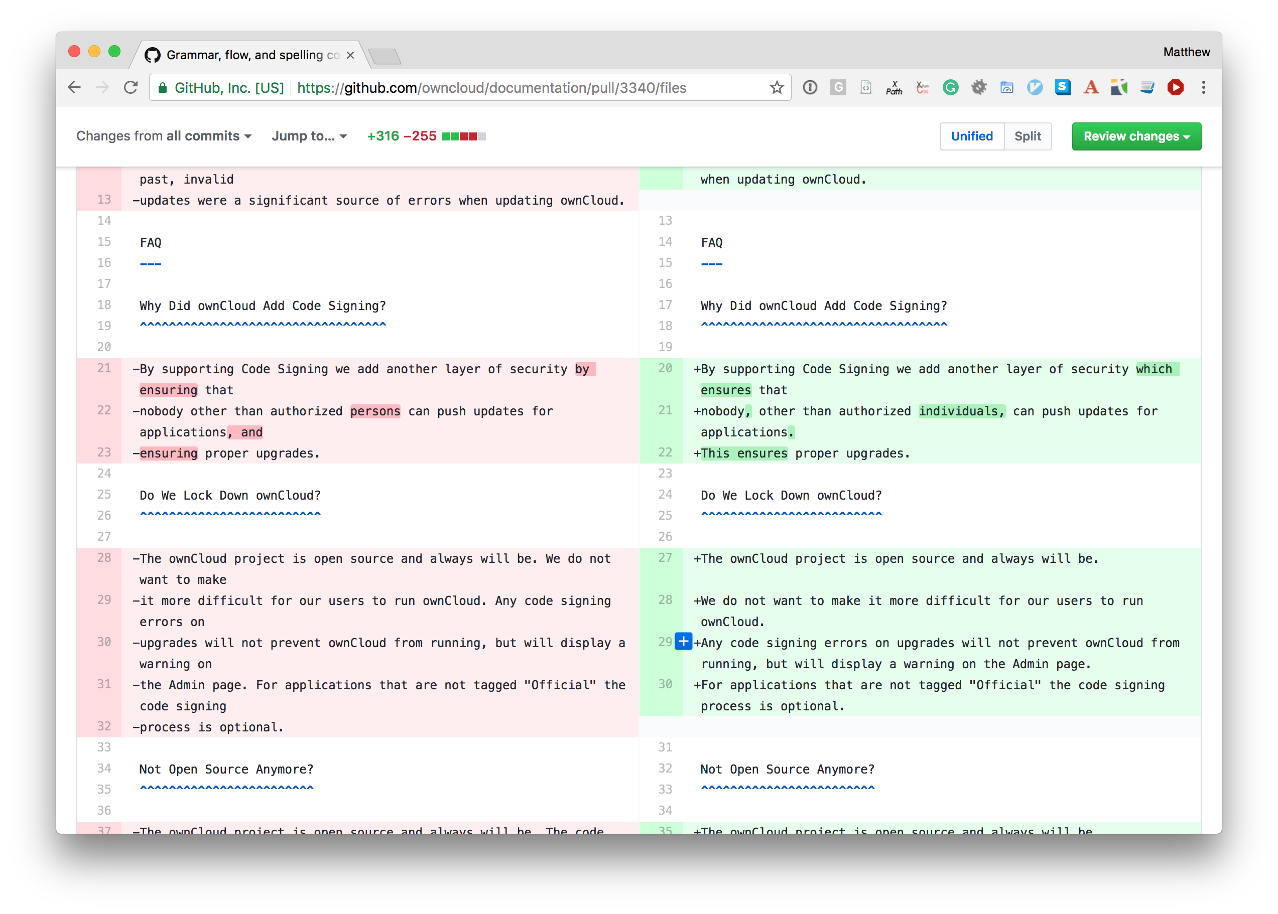
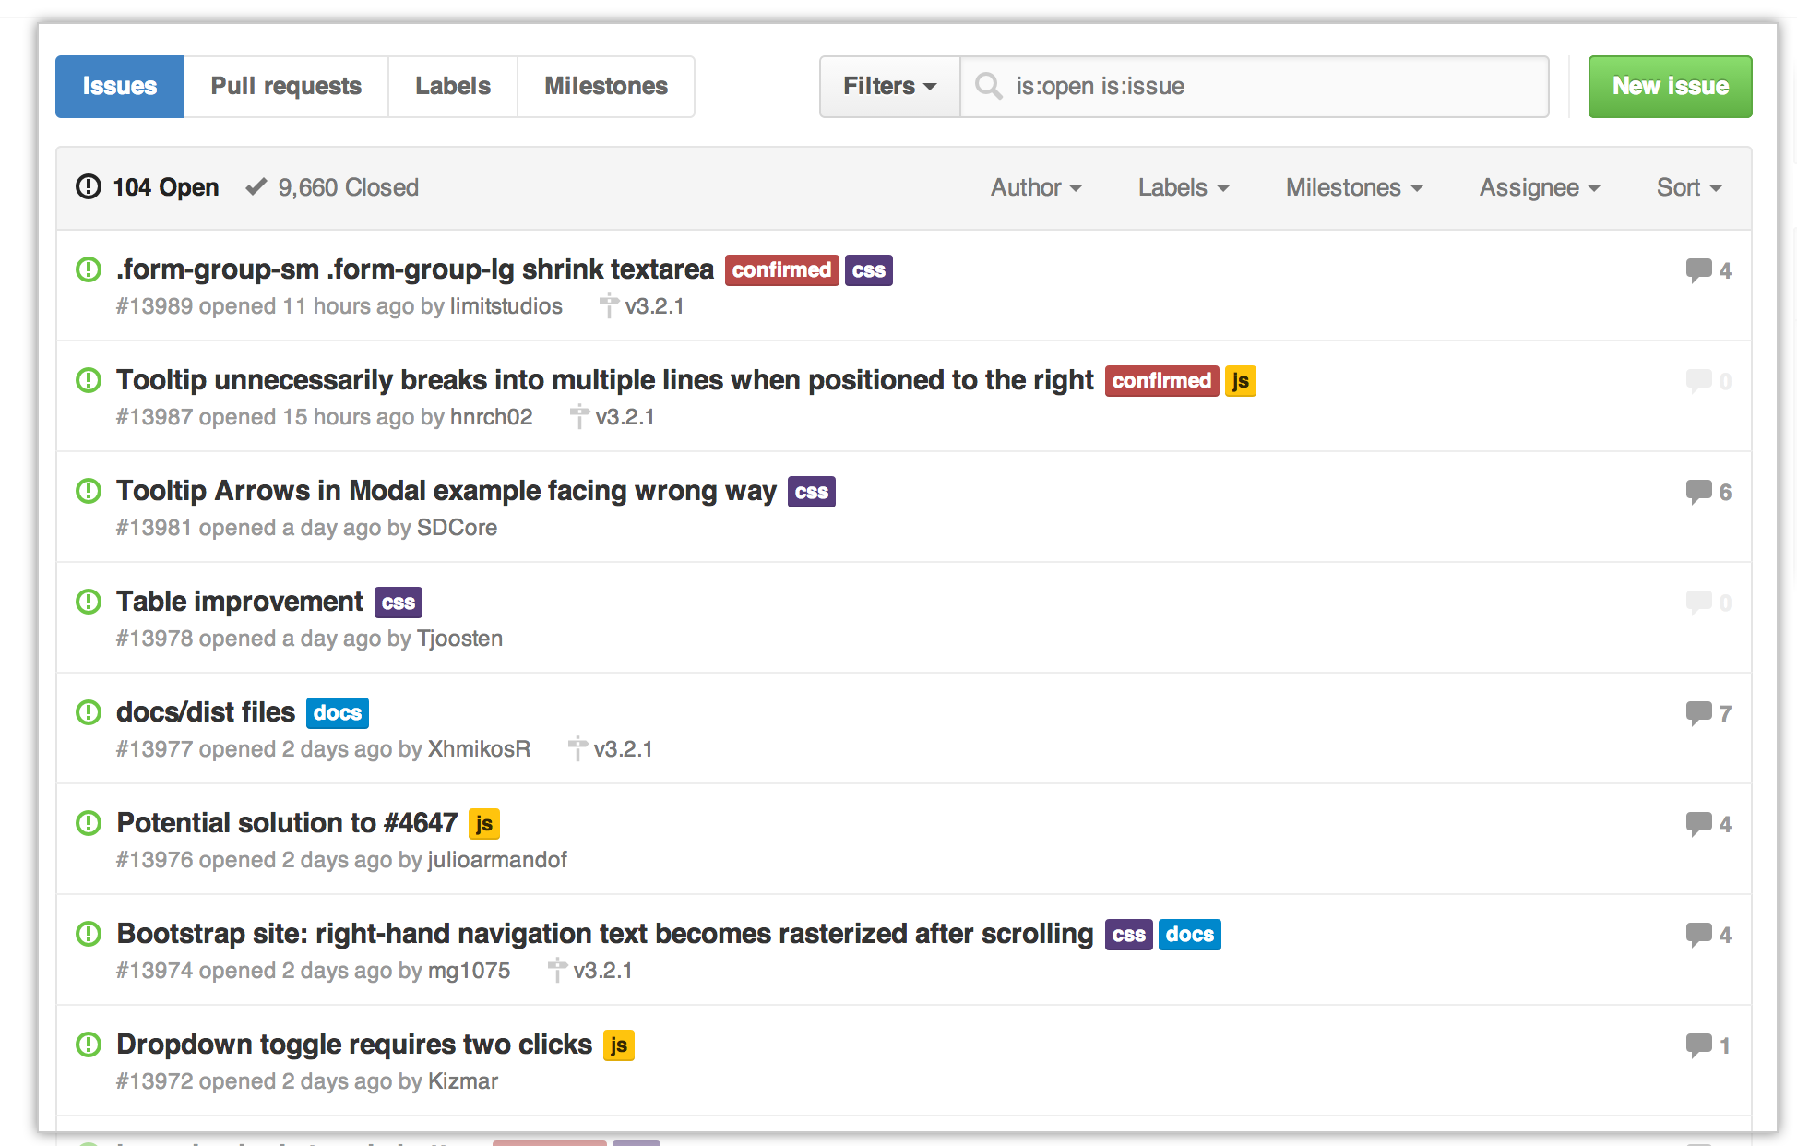
GitHub
Left figure
Right Figure

Slide 7

GitHub Demo

Slide 8

Email Demo

Slide 9
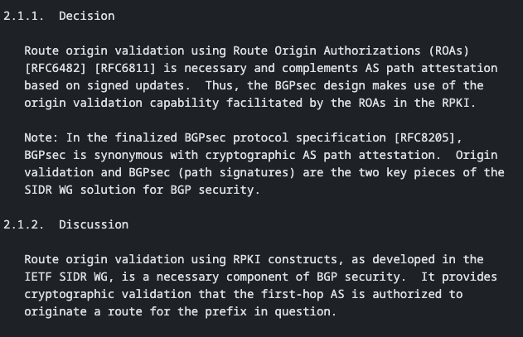
A snapshot of the dream data
RFC 8205
RFC 8374

Slide 10
Solutions
binary classification
Informaiton Retrieval

Slide 11
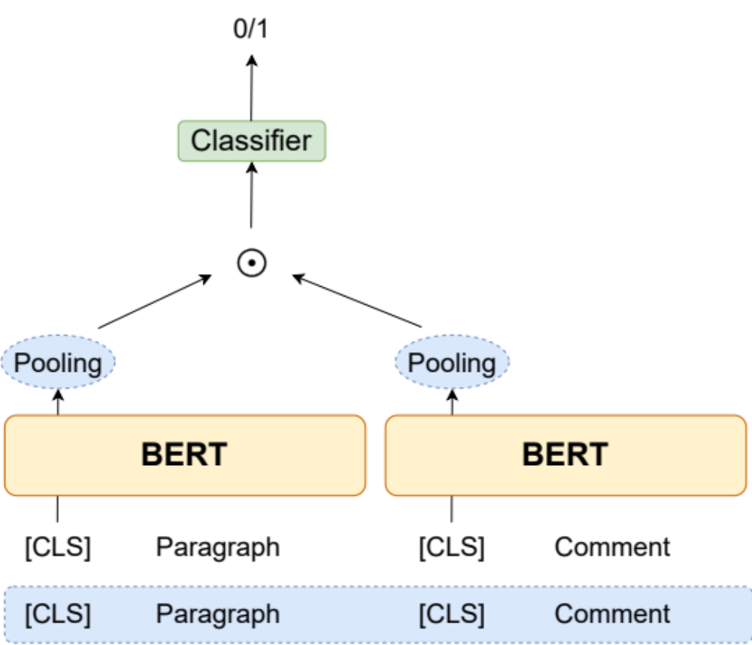
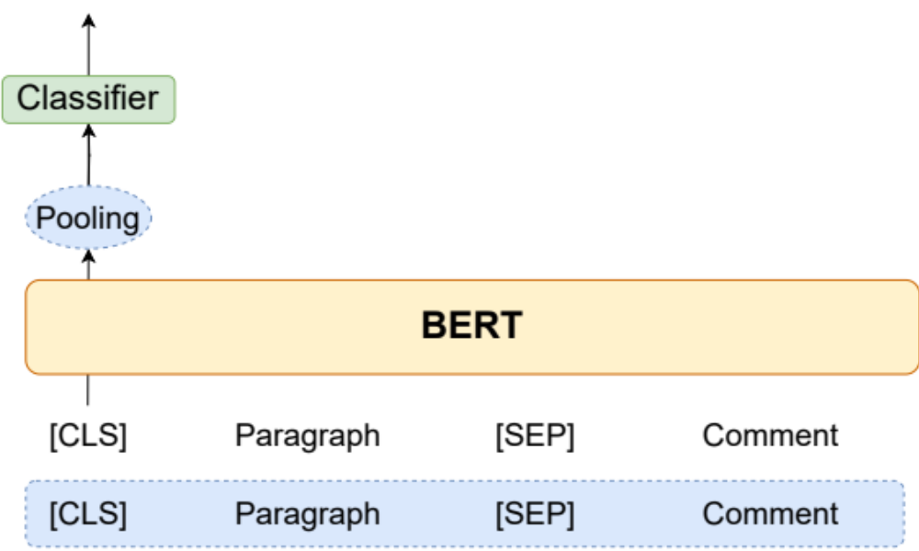
Classification
Tell me why

Slide 12
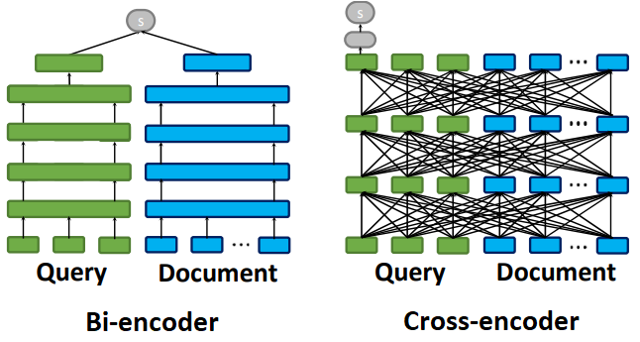
Information Retrieval
ColBert

Slide 13
Problems
We have difficulty to define the right task
We struggle to get good performance, compared with well-established benchmark dataset.

Slide 14
Call to Action: Share Your Expertise!
What is you impression on the data?
What do you think on those methods we’ve tried? Pros, cons?
How would you solve the task?
Are there emerging trends or technologies in NLP that we should explore?

Slide 15
Thank You!
Together, we can drive innovation and excellence in NLP.

