Slide 1

The Borderless Internet
Audun Jøsang
University of Oslo
Rethinking Territorial Jurisdiction
Nobel Symposium 2025

Slide 2


Plumbing and Appliances
The Internet as a communication infrastructure
(my talk)
The Internet as a platform infrastructure
(Uta Kohl’s talk)
Notes:
2

Slide 3
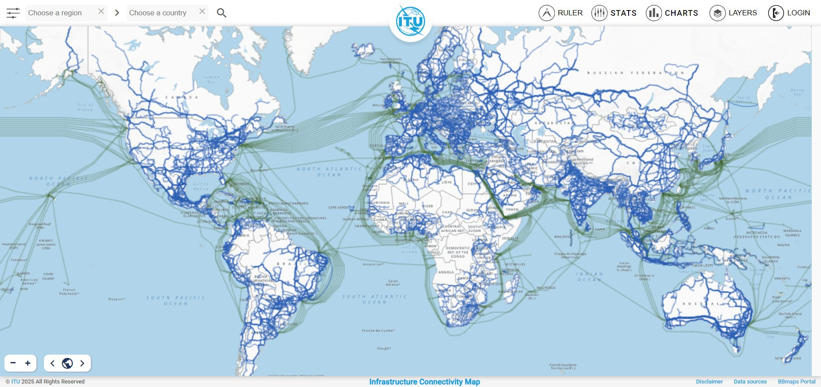
The Physical Internet https://bbmaps.itu.int/products

Slide 4
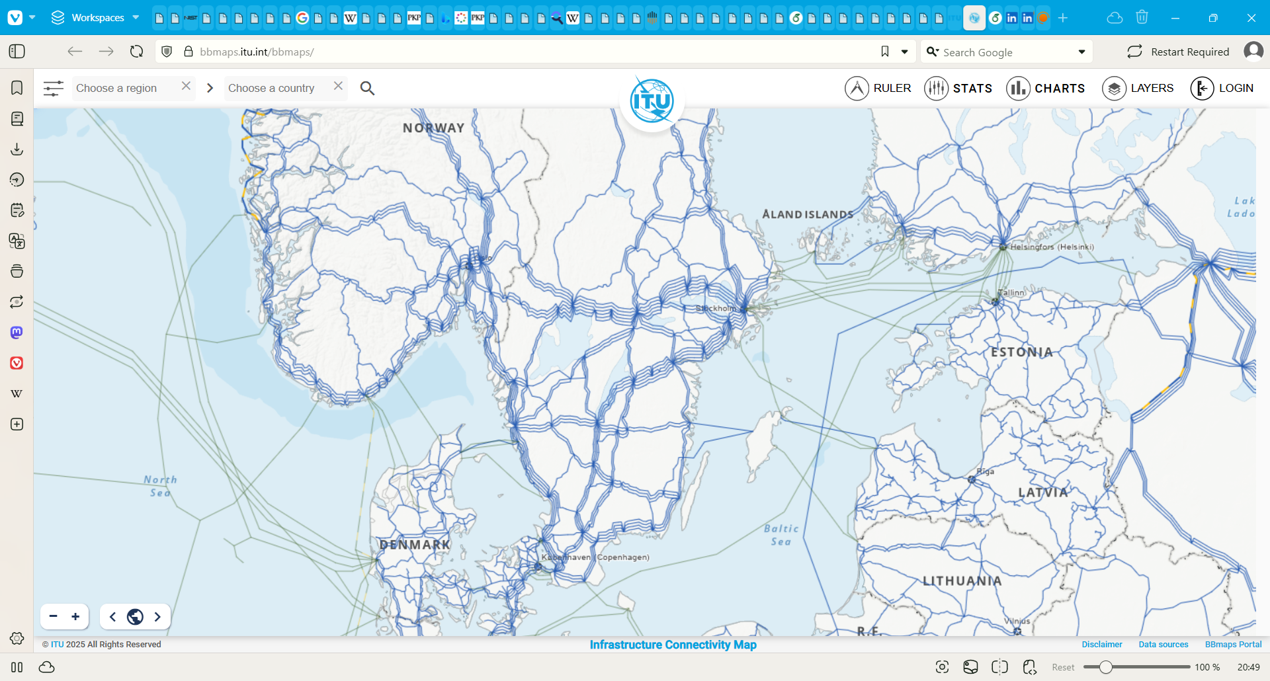
Internet in the Baltics

Slide 5
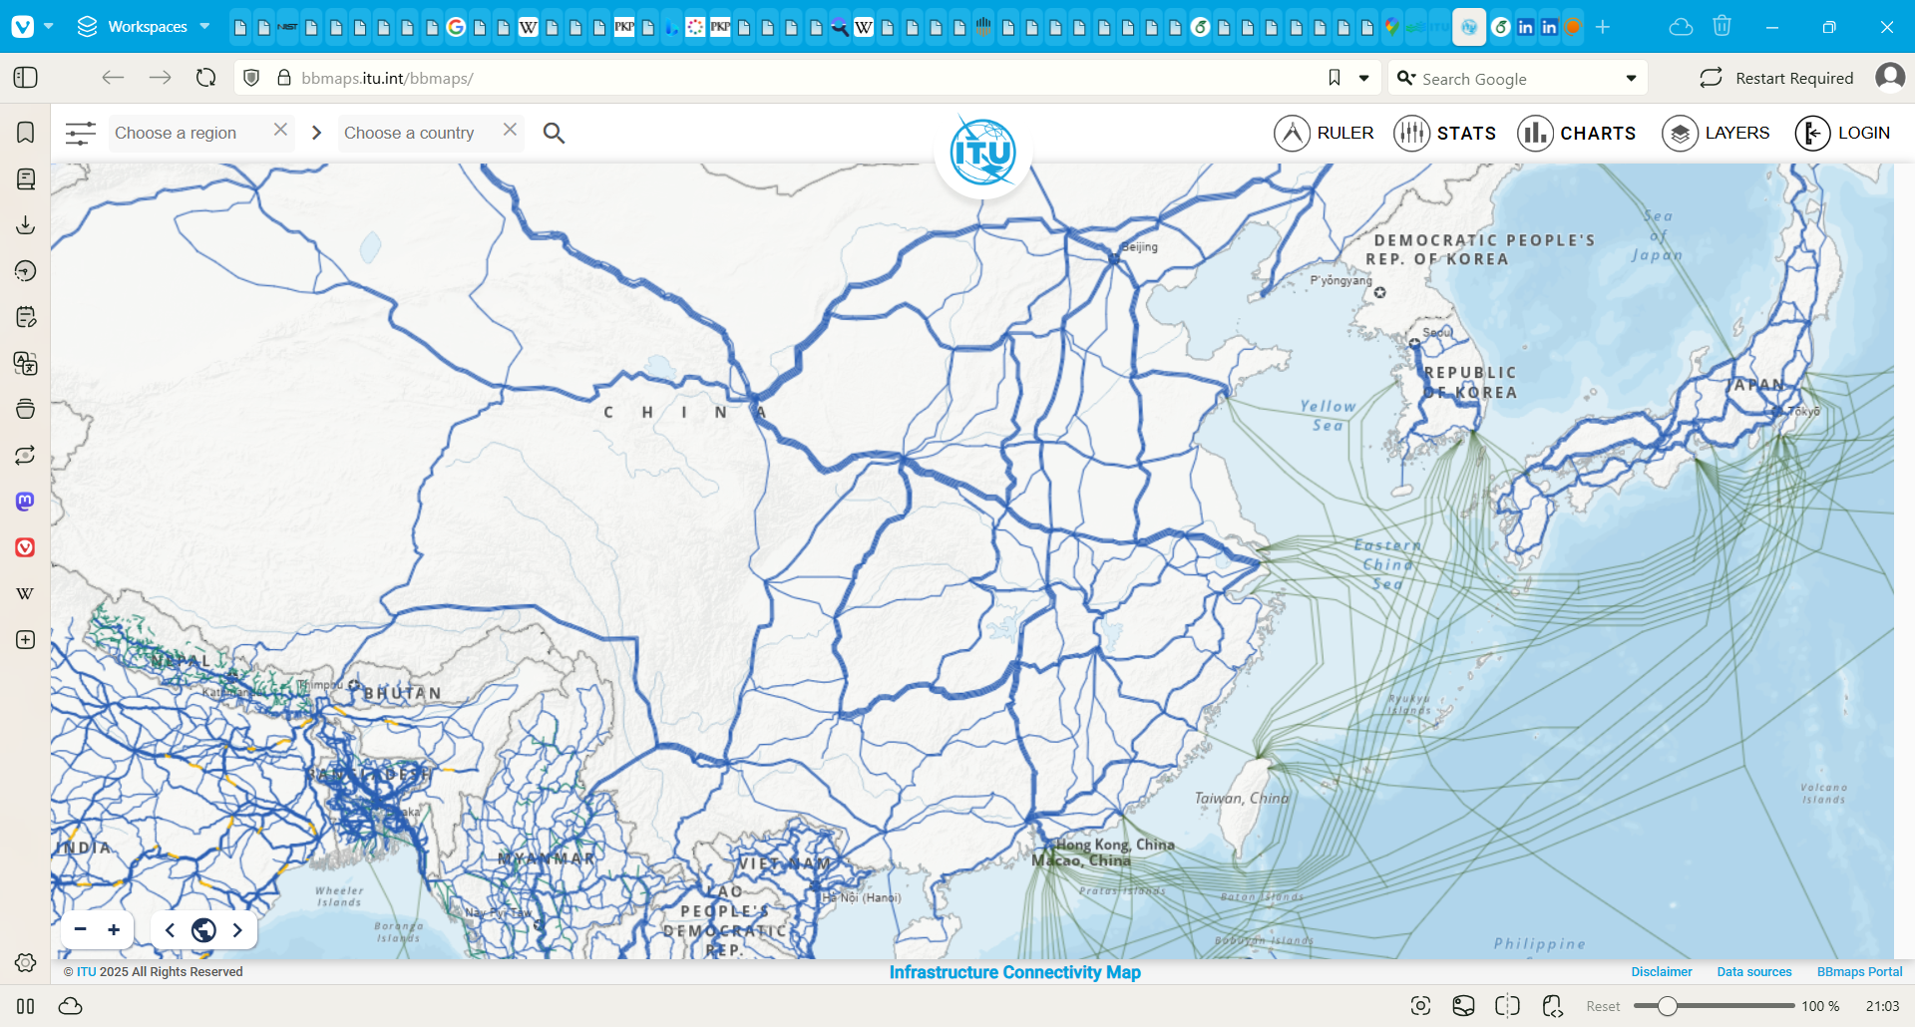
Internet in South-East Asia

Slide 6





Why not ITU?
Notes:
6

Slide 7
DNS: The Domain Name System
DNS root
.com
.org
.uk
. …
Top Level Domains (TLDs)
google
…
wikipedia
…
ac
co
gov
…
Domains
translate
…
en
…
ox
…
barclays
…
bristol
…
Subdomains
trinity
…
bank
…

Slide 8

Domain names and IP addresses
Domain names are virtual
IP addresses are physical
en.wikipedia.org
Translation
185.15.59.224
Internet
What is the IP address of the domain name en.wikipedia.org?
1
The IP address of the domain name en.wikipedia.org is 185.15.59.224.
2
DNS server
Retrieve the webpage of en.wikipedia.org at IP address 185.15.59.224.
Client
3
Here is the webpage of en.wikipedia.org.
4
Web server at 185.15.59.224

Slide 9
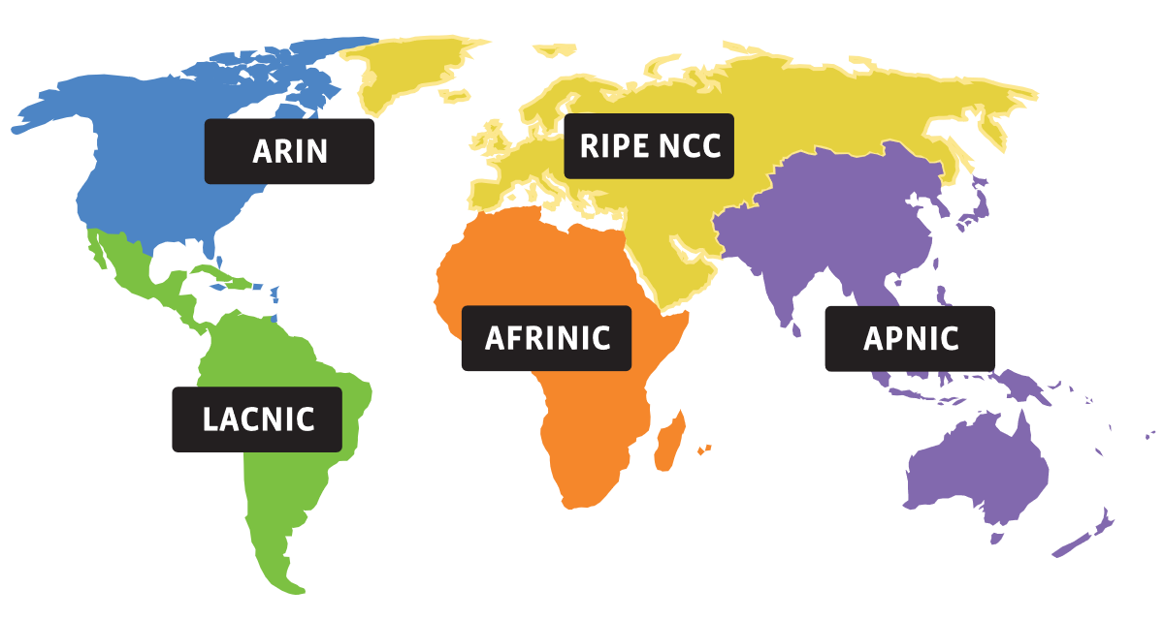
Assignment og IP address number ranges

Slide 10
IANA: Internet Assigned Numbers Authority
IANA
ARIN
North America
LACNIC
Latin America
RIPE NCC.
Eurasia
AFRINIC
Africa
APNIC
Asia Pacific
LIRs
LIRs
NIRs
LIRs
LIRs
LIRs
NIRs
End User Organizations
End User Organizations
End User Organizations
End User Organizations
End User Organizations

Slide 11
Tier 1 ISPs
(ASs)
NTT
Verizon
Full-mesh settlement-free peering
AT&T
Orange
Deutsche Telecom
Direction of settlement
Tier 2 ISPs
(ASs)
Korea Telecom
Vodafone
IXP
China Telecom
Turk Telecom
Singtel
British Telecom
Partial-mesh settlement-based peering
IXP
Telstra
Telenor
YouSee Denmark
Elisa Finland
Telia
Tier 3 ISPs
(ASs)
Internet customers

Slide 12
Internet routing
Internet router
Local switch/router
Autonomous System
Legend:
AS/ISP #1
a
b
c
Internet customer A
AS/ISP #2
AS/ISP #3
Internet customer B
d
a
a
Client
b
c
b
c
Ruptured cable
d
d
Server

Slide 13
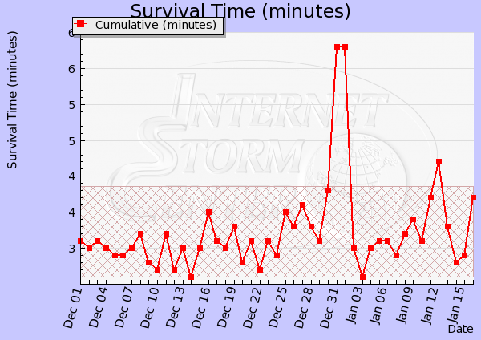
Internet Storm Center: https://www.dshield.org/survivaltime/

Slide 14
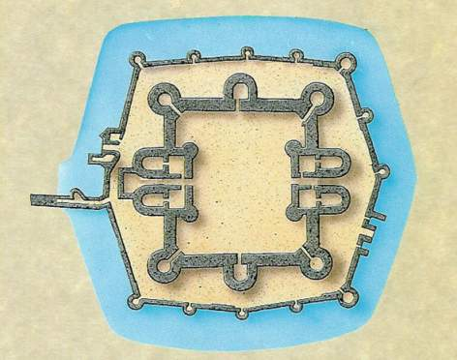







Computer Network Defence Paradigm
Outer segment
Inner segment
Lookout towers
Outer wall
Gateway and
External firewall
Web server
Email server
Server
DB
Gatekeeper
Inner wall
Internal firewall
Inner court
Normal access
Normal access
Outer court
Drawbridge
DNS server
Work station
Inner gate
Moat
IDS
IDS
Medieval castle
Computer network

Slide 15


Law enforcement: No law enforcement
Cyberattacker
Assets
Internet
Law enforcement
Nation state
Illegal material
Criminal

Slide 16

Law enforcement: Borders on the Internet
Cyberattacker
Assets
Internet
Law enforcement
Nation state
Illegal material
Criminal

Slide 17
Law enforcement: Global cybercrime regulation
Cybercriminal
Assets
Internet
Law enforcement
Law enforcement
Nation state
Illegal material
Criminal

Slide 18
End of presentation
Territorial Internet Jurisdiction
The Borderless Internet
18

