Slide 1
SCIS 2014 / IRIS 37
Sørup Herregaard, Ringsted, Denmark
10 – 13 August 2014

Slide 2
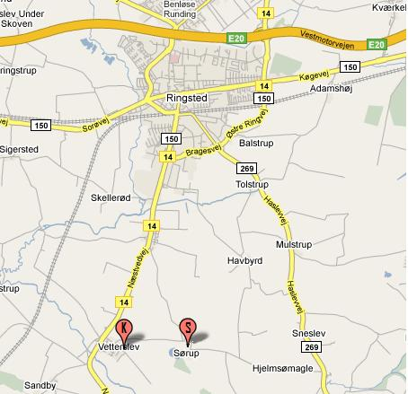
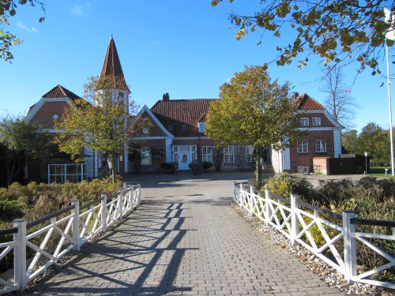
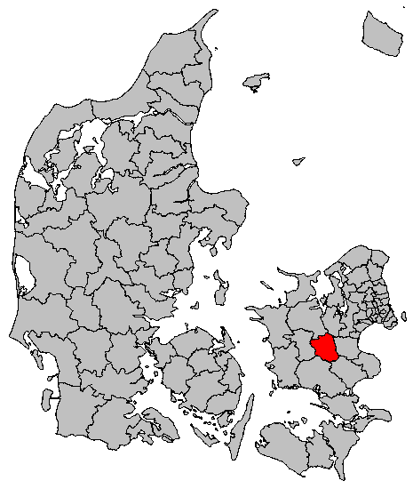
Sørup: Right in the Center of Zealand

Slide 3
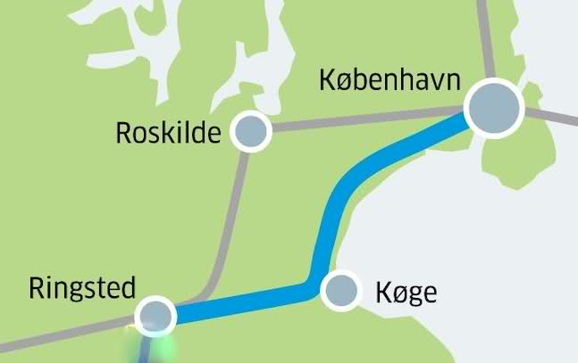
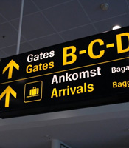

How to get there
To Ringsted by train (~1 hour)
Bus to Sørup from 10am to 1pm 10 August
Fly to CPH

Slide 4



Theme of Conference:
Designing Human Technologies

Slide 5
We have a Plan
Sunday 10 August | Monday 11 August | Tuesday 12 August | Wednesday 13 August
Lunch included at 12pm | SCIS in the morning | Famous Key Note | Young and upcoming Key Note
SCIS starts at 1pm | IRIS Working Groups during the day | IRIS Working Groups during the day | IRIS Working Groups until 11:30
First meeting in Working Groups late afernoon | IRIS Games in the afternoon | Conference Dinner | Ending IRIS at 12:30

Slide 6
SCIS: Call for Papers and what follows
February, 11, 2014:
Submissions due
March 11, 2014:
Editorial decisions sent to authors
April 1, 2014:
Submission of final versions
May 1, 2014:
Deadline for authors to register to the conference (with early bird fee)
May 1, 2014:
Notification of acceptance for SCIS
August 10-13, 2014:
SCIS/IRIS, Sørup Herregaard, Ringsted, Denmark

Slide 7
IRIS 38: Call for Papers and what follows
April 1, 2014:
Submissions due
April 28, 2014
Reviews due
May 9, 2014:
Deadline for authors to register to the conference (with early bird fee)
May 9, 2014:
Submission of final versions
August 10-13, 2014:
SCIS/IRIS, Sørup Herregaard, Ringsted, Denmark

Slide 8
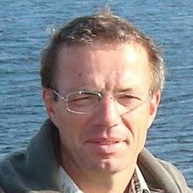
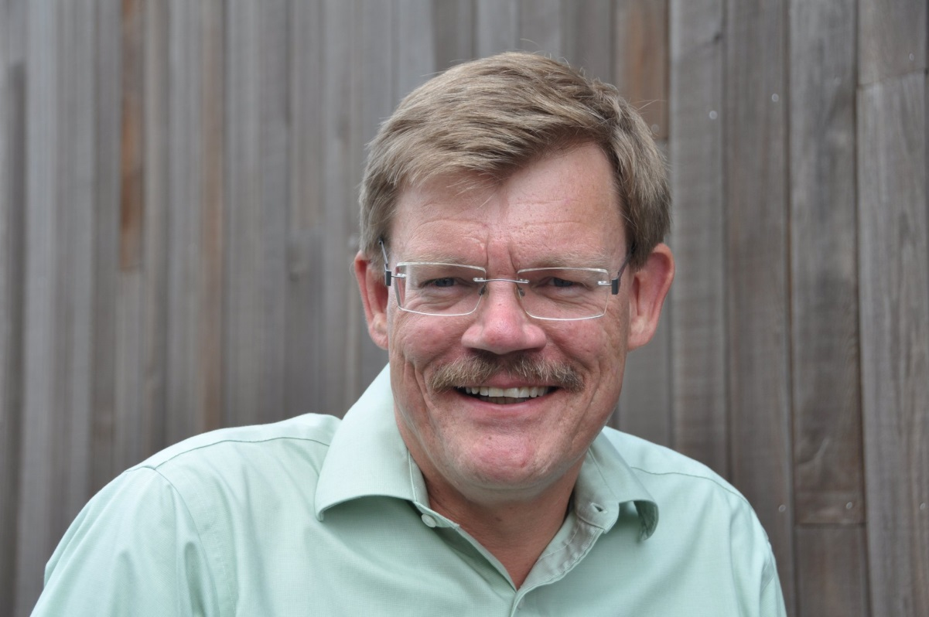
Doing the work: The Chairs
Jacob Nørbjerg, Ålborg U.
Jan Pries-Heje, Roskilde U.
Jacob Nørbjerg, CBS.

Slide 9
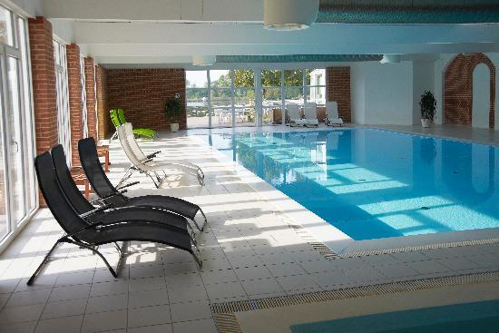
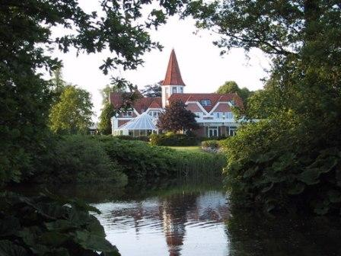

Sørup awaits you …

