Slide 1
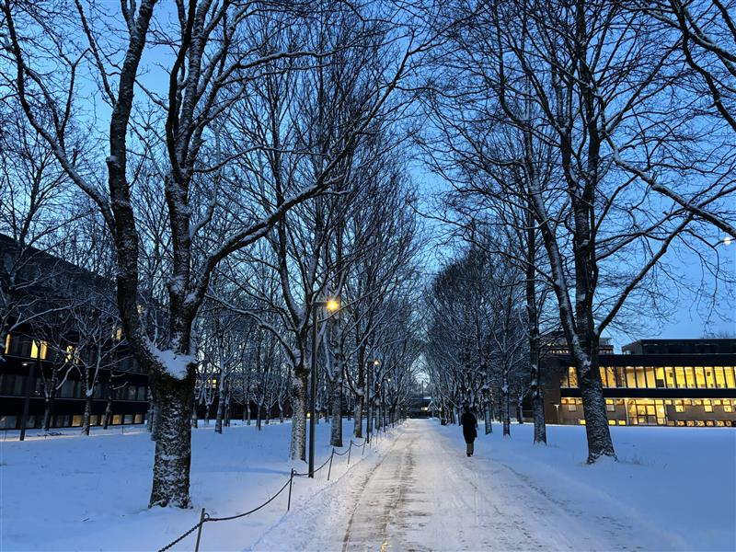
Remember that the university library is here to help!
Andri Spilker & Matthew Good
PhDs in Astrophysics & Informatics
University of Oslo library
How the university library can help you on the way

Slide 2
Remember that the university library is here to help!

Slide 3
Seminars to help you through your masters
Final master seminar
18th of March
Final checklist for delivering your master thesis
Final writing tips
Visit from professor?
How to present?
Publishing, conferences?
Writing seminar
9th and 10th of April 9-12
Structure your writing
Write-write-write (exercises, tips, motivation)
Copyright: what can you use?
Correct citations
You can influence what happens here!

Slide 4
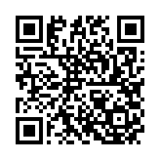
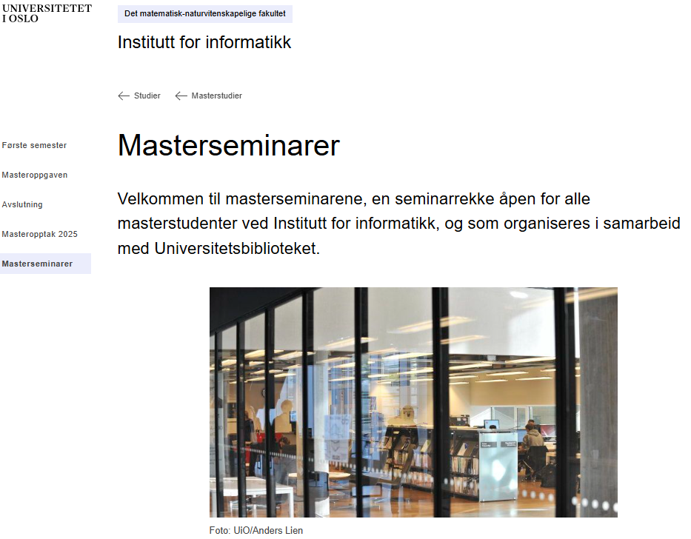
Check website for updates
https://www.mn.uio.no/ifi/studier/master/masterseminarer/

Slide 5
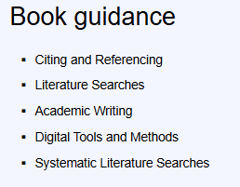
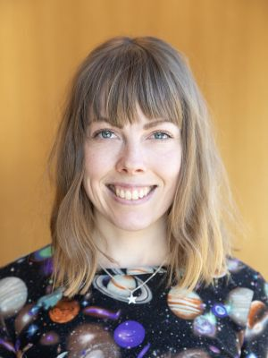
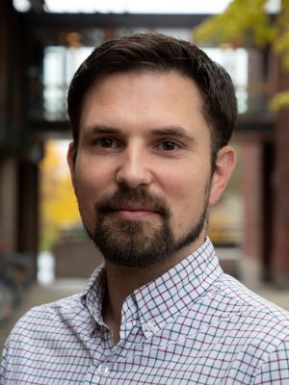
Ask us for help any time!
Andri Spilker Subject librarian informatics Informatics library Andri.spilker@ub.uio.no | Matthew Good Leading development of the Digital Scholarship Centre Matthew.good@ub.uio.no
https://www.ub.uio.no/english/using/guidance/

Slide 6
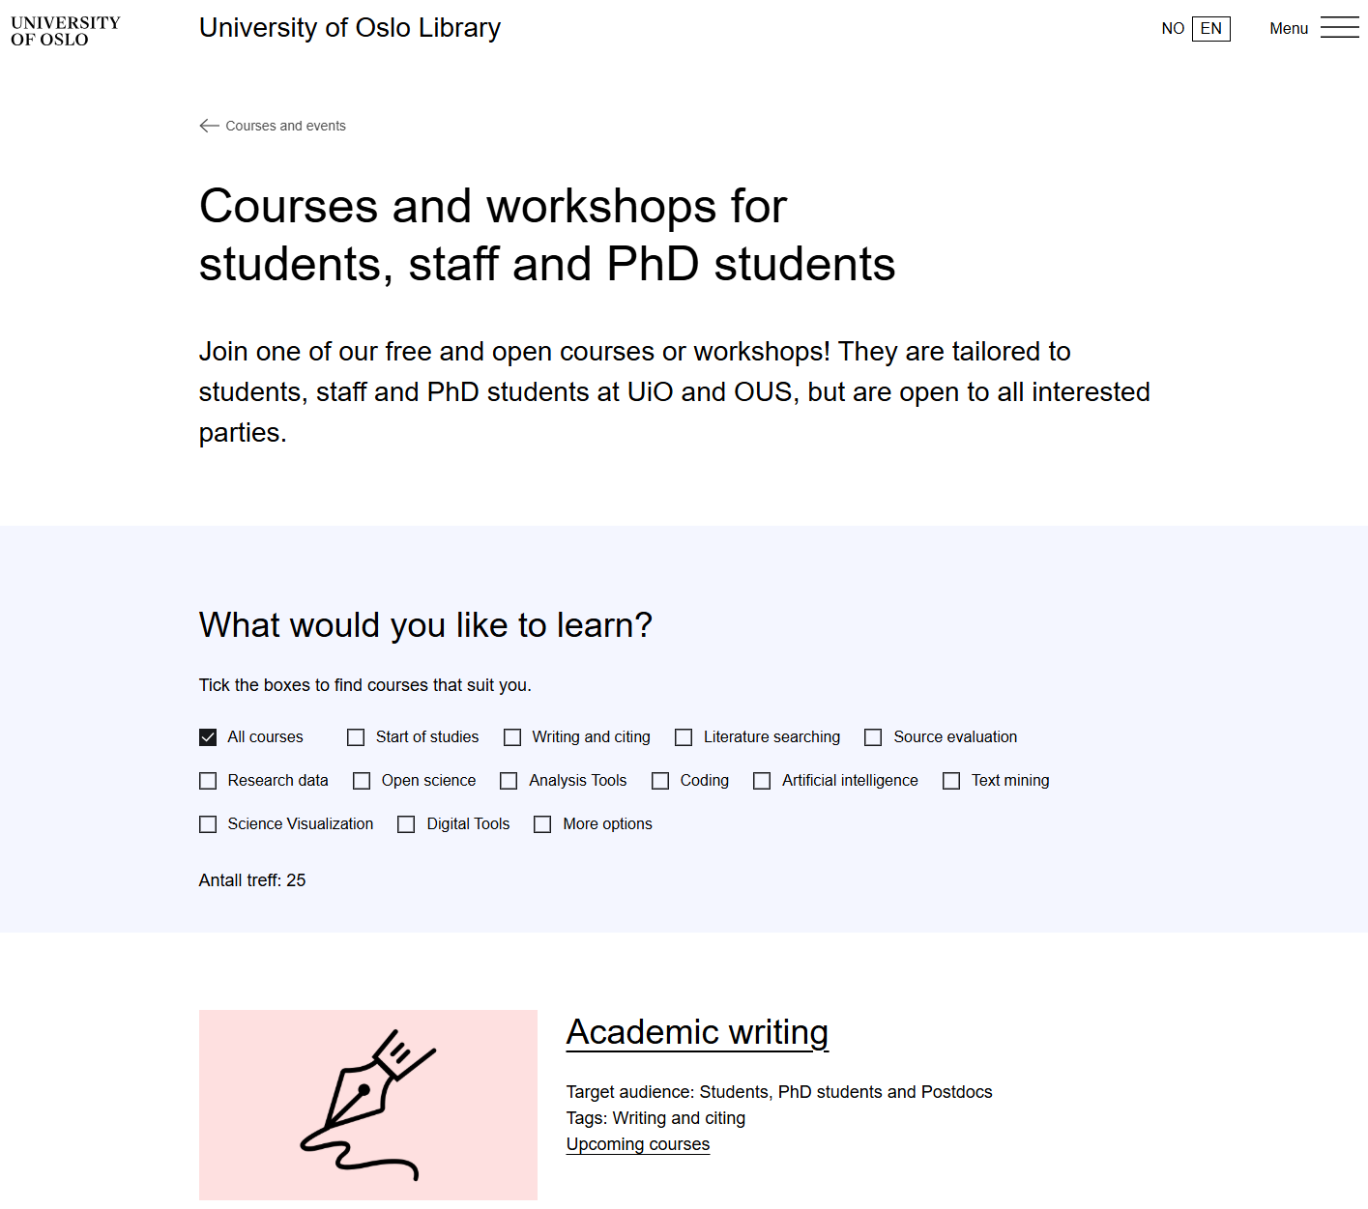
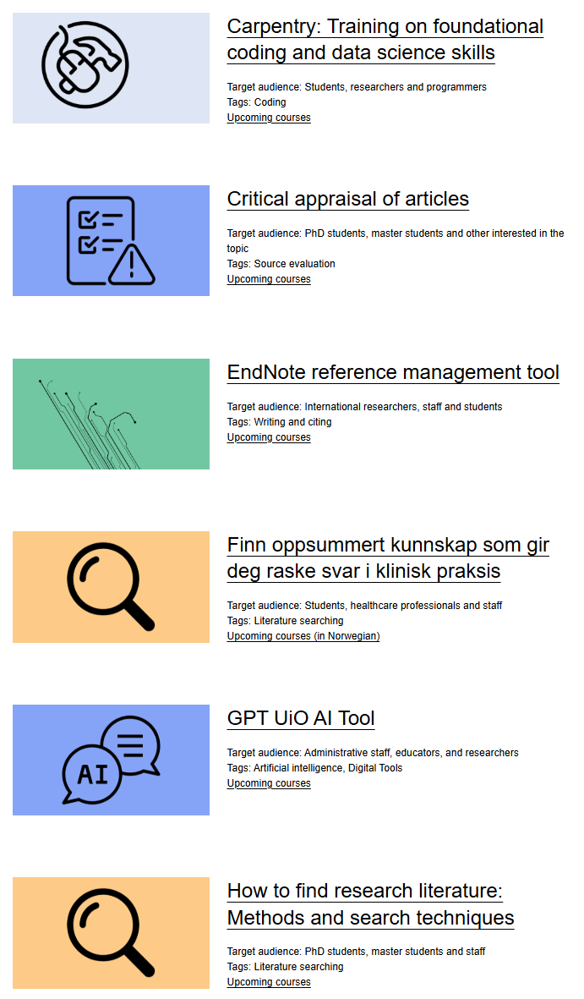
Notes:
LaTeX course!

Slide 7
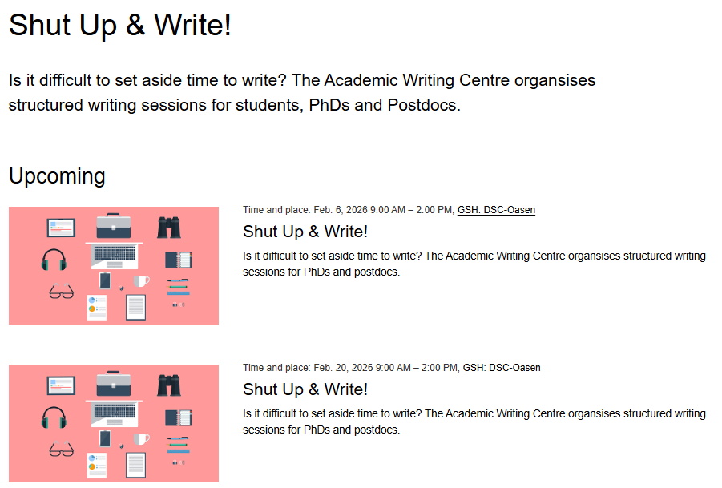

Slide 8
See you at the master seminars!
Final master seminar
18th of March
Final checklist for delivering your master thesis
Final writing tips
Visit from professor?
How to present?
Publishing, conferences?
Writing seminar
9th and 10th of April 9-12
Structure your writing
Write-write-write (exercises, tips, motivation)
Copyright: what can you use?
Correct citations
You can influence what happens here!

Slide 9
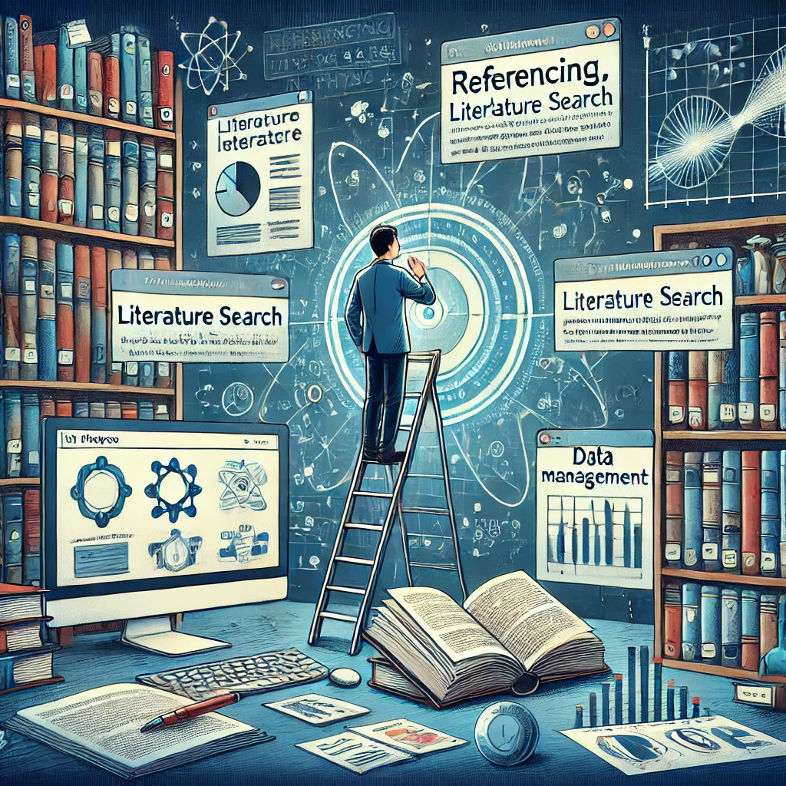
The university library: much more than books and study spaces!
We can help you with:
Finding and getting books and articles
Literature searching
Reference management
Data management
Open access publishing
Academic writing
Outreach and science communication: stages and podcasts
Research ethics and plagiarism
Visualisation
3D-printing
Different tools: LaTeX, Zotero, EndNote, R, UnixShell, Nvivo….
Image generated using ChatGPT by OpenAI
Notes:
We are much more than books and study spaces!

