Slide 1
Menneske-maskin:
Kvantitative metoder
Dag Sjøberg and Gunnar Bergersen

Slide 2
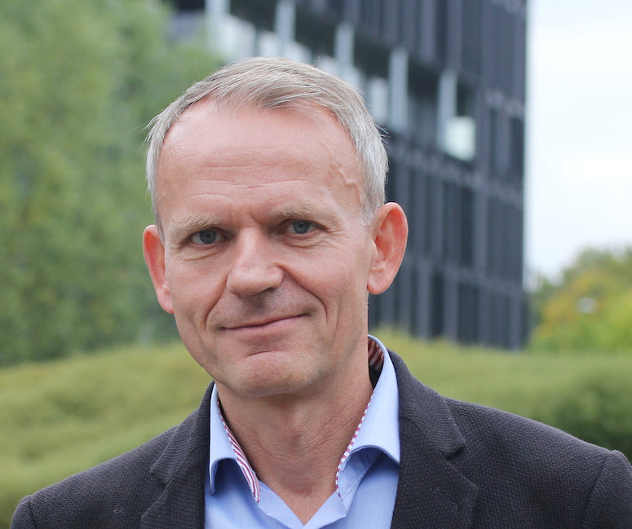
About Me
Current position: Professor at University of Oslo
  Software Process Improvement,
  Agile and Lean Methods, Software Quality,
  Empirical Research Methods
Education:
  MSc, University of Oslo
  PhD, University of Glasgow, Computing Science
Prior work experience
  National University Hospital (Rikshospitalet)
  SINTEF ICT
  Simula Research Laboratory
  Statistics Norway (SSB)
Startup
  Member of steering committee and co-owner of four startup companies
Notes:
Fikk ingen opplæring I metoder og datainnsamling da vi studerte her. I forrige årtusen.

Slide 3

About me
Current:
  Associate professor in Software Engineering
Education
  MSc (2001) and PhD (2015) from University of Oslo
  PhD thesis: “Measuring programming skill”
Prior work experience
  Programmer
  IT Project leader of two companies
  CEO of three companies and Chief Product Officer in Greps (skill testing of developers)

Slide 4
Research method = the way knowledge is created
Good method
Reliable knowledge
Poor method
Unreliable knowledge
(most extreme: fake news, lies)

Slide 5

“Vi mennesker har gjennom hundrevis av år utviklet metoder for å komme frem til sannheten. Naturvitenskapelig metode for å forstå den fysiske verden, juridisk metode som grunnlag i rettsvesenet, journalistisk metode i nyhetsmedier og så videre. Når vi får sannheten vår fra sosiale medier og KI-chatboter, øver vi inn metoden «tro på enkle budskap vi liker». Og vi ender opp med å bli groteskt enkle å villede.”
https://www.aftenposten.no/meninger/kommentar/i/pB60KV/trusselen-fra-ki-er-ikke-at-systemene-blir-superintelligente-men-at-vi-blir-superavhengige
Notes:
Si: Nesten det motsatte av vitenskapelig metode (scientific methods)

Slide 6
Typical pattern of informatics/computer science
Research Method
People/Actors
Activity
Products/artifacts
Quantitative and qualitative
End users
Use
Develop
End-user applications (apps, robots, public services, etc.)
Quantitative and qualitative
Developers
Use
Develop
Enabling technology
(machines, operating systems, infrastructure, programming and model-ling languages, methods, tools, models, etc.)
Computer scientists
Quantitative
Dag Sjøberg and Gunnar Bergersen

Slide 7
Writing a Master’s thesis
You may wish to
propose or develop a new X (process, method, technique, practice, language, tool, framework, algorithm, robot, etc.) that is supposed to be better than what exists,
find out whether an existing X is better than an existing Y, or
how to improve X
Thesis: A scientific statement
Master (or PhD thesis): A justification of that statement
Most Master’s theses would include some of this

Slide 8
What does it mean to be better?
  How much?
  How many?
  How large?
  How old?
  How long?
  How high?
  How warm?
  How thick, firm, etc.
Answers are measured in terms of quantitative data
Notes:
Mapping for example, colour, sound etc.

Slide 9

Quantitative data
Qualitative data
Data expresses quantity
Data expressed as numbers
Used in statistics
Data expresses quality in some sense
Data expressed as text, images and forms except numbers
Can obtain quantitative data indirectly if a mapping exists from quantitative to quality data
Not used in statistics
Mentimeter: What kind of data do you plan to collect for your thesis?
Notes:
Mapping for example, colour, sound etc.

Slide 10
Quantitative empirical methods
Experiments and surveys typically collect quantitative data
Therefore called “quantitative empirical methods”
Empirical means using evidence based on observation or experience rather than theory or pure logic

Slide 11
How to find out whether something is better?
Investigate what works best in practice, that is, perform
an empirical study
  Measurements/Statistics
  Experiment
  Survey: people are asked about their opinions
  Other studies:
    case studies, possibly using interviews
    action research
    ethnographic studies
    others

Slide 12
Mentimeter: What kind of research method do you plan to use for your thesis?

Slide 13
(Controlled) Experiment
Independent variables
(treatment)
Dependent variables
(outcome)
method, tool, technique, language, practice, etc.
time, quality, costs, etc.
Effect
Moderator
variables
(context)
An experiment is a cause-effect study, that is, an intervention (treatment) is introduced to observe its effects
Difference in the outcome is supposedly caused by the different treat-ments (or treatment compared with no treatment, that is, the control group)

Slide 14
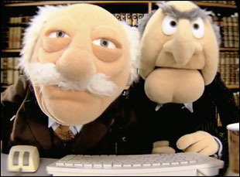
What is best?
Pair programming or solo programming
295 junior, intermediate and senior professional Java consultants
from 29 companies were paid to participate (one work-day)
99 individuals; 98 pairs
The pairs and individuals performed the same Java maintenance tasks on either:
  a ”simple” system (centralized control style), or
  a ”complex” system (delegated control style)
We measured:
  duration (elapsed time)
  effort (cost)
  quality (correctness) of their solutions

Slide 15
Experiment
Independent variables
(treatment)
Dependent variables
(outcome)
Pair programming versus
solo programming
duration, cost, quality
Effect
Moderator
variables
(expertise, complexity)

Slide 16
Results
Programmer Expertise | Task Complexity | Use PP? | Comments
Junior | Easy | Yes | Provided that increased quality is the main goal
 | Complex | Yes | Provided that increased quality is the main goal
Intermediate | Easy | No
 | Complex | Yes | Provided that increased quality is the main goal
Expert | Easy | No
 | Complex | No | Unless you are sure that the task is too complex to be solved satisfactorily even by solo seniors
One cannot state that pair programming is generally beneficial or not!
Notes:
However, remember what I said in the beginning, that: “Much research applies to groups of individuals or populations, and are not always relevant or valid for other situations.”
2. Organic food: Better on some things (bio diversity), but needs more area to produce the same.
Sandø example
I’m a secularist but: GOD is in the details

Slide 17
Other examples of experiment
Two algorithms may be compared regarding, for example:
  Their ability to solve a task
  Their performance (speed)
  Their energy consumption
  Their understandability

Slide 18

A/B testing
Background
  Historically used in marketing, design, games
  Data-driven product development & profitability tuning
  Assumption: ”We’re all wrong most of the time”
Typical use
  Fast release cycles
  Bottom-up and context dependent (for example,“I want to improve X for part Y”)
Notes:
Bottom up: Not typically from management

Slide 19
Requires
Two (or more) version to be compared (A, B, …)
At least one outcome variable (KPI or other metric or measure) to improve

Slide 20


Advantages
Experiments
Disadvantages
They are a well-established strategy, seen by many as the most ‘scientific’ approach
The only research strategy that can prove cause-effect relationships
Laboratory experiments permit high levels of precision in measuring outcomes and in analyzing data
Laboratory experiments often create artificial situations that are not comparable to real-world situations
Often difficult or impossible to control all the relevant variables
It is often difficult to recruit a representative sample of participants
Notes:
(e.g., with students at the university)

Slide 21
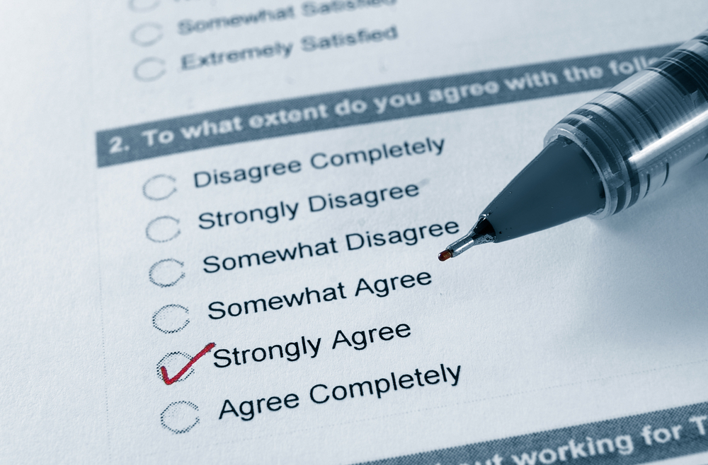
Surveys
Notes:
Resultatene derfor subjektive enn de vanlig ved bruk av andre forskningsmetoder

Slide 22
Common in society
Requires relatively few resources to include many people
Create statistics and test hypotheses over characteristics of the target group (the population being investigated)
Obtain information about people’s opinion about what, how much, how many, how and why or what people say they do
As opposed to case studies and ethnography, one does not observe
Notes:
Resultatene derfor subjektive enn de vanlig ved bruk av andre forskningsmetoder

Slide 23
Advantages
Disadvantages
They provide a wide an inclusive coverage of people or events
They can be administered from remote locations using mail, email or telephone
They can provide a lot of data in a short time at a reasonable cost
They can be quantitatively analysed
They can be replicated
They lack depth
They tend to focus on what can be counted or measured
They do not establish cause-effect
They cannot judge the accuracy or honesty of people’s responses, for example, by observing their body language

Slide 24
What do you plan to investigate in your thesis?

Slide 25
Hypothesis testing
Null hypothesis:
  ”there is no difference between the effect of treatments (experiments) or between groups (surveys)”
  ”there is no difference between solo and pair programming”
Notes:
Kan ta poweranalysis på tavla

Slide 26
P-value
If it’s very unlikely, for example < 5 % (significance level), that we had obtained the results that we actually got, if the null hypothesis were true, then we reject the null hypothesis and claim the alternative hypothesis (”there is a difference …”)
The likelihood that we obtained the results we did assumring the null hypothesis is true, is called the p-value (probability value)
One uses statistical methods to test null hypotheses
Notes:
Kan ta poweranalysis på tavla

Slide 27
How likely is 5 %?
Approximately the probability of exactly 8 heads in 10 tosses is
P(X=8) = (10 choose 8)/2¹⁰ = 45/1024 ≈ 0.044

Slide 28
Effect size
P-values is about how likely it is that there is a difference
Effect size is about how large the difference is
  Is the difference large enough to have any meaning in practice?
V.B. Kampenes, T. Dybå, J.E. Hannay and D.I.K. Sjøberg. A Systematic Review of Effect Size in Software Engineering Experiments, Information and Software Technology 49(11-12):1073-1086, 2007

Slide 29
Validity of empirical studies
Internal validity
  Is the difference that we observed between the groups that received the treatments actually caused by the treatments, or may there be other causes for the difference?
Construct validity
  If a complex concept is measured, does the measurements represent the concept in a satisfactory way? For example, is it OK to measure quality of a software system only in terms of number of bugs?
External validity
  Can we generalize the results we found; that is, is it likely that we would obtain the same results in other settings?
Statistical conclusion validity
  Is correct statistics used?
Notes:
Example: Prior experience in programming affect programming skill?
Gunnar: Reliability blir tema for alle i masteruke

Slide 30
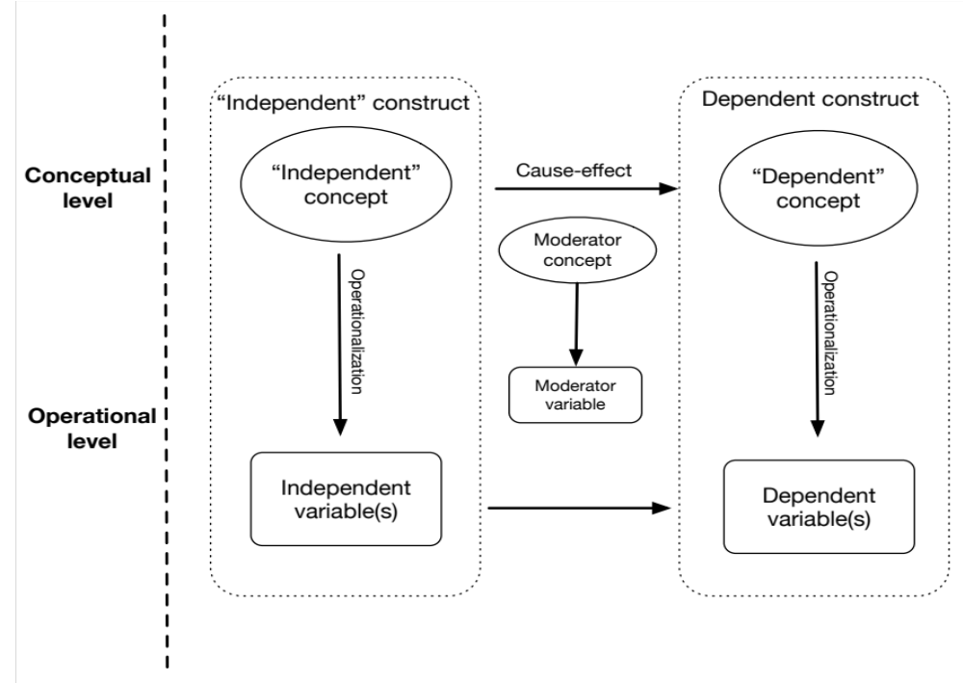
Construct validity →
Internal validity →
Measurements

Slide 31

Much literature on research methods

Slide 32
Good luck with your thesis work!

