Slide 1


Seating
PROSA: Programming and System Architecture
ISIK: Information Security
ROB: Robotics and Intelligent Systems
DESIGN: Informatics: Design, Use, Interaction
ENT: Entrepreneurship and Innovation Management
DIGHEL: Digitalization in the Health Sector
SPRÅK: Language Technology
CS: Computational Science
EIT: Electronics, Informatics and Technology
DIGØK: Digital Economics and Leadership
Foto: Jarli&Jordan/UiO

Slide 2

Welcome as a Master's student at the Department of Informatics!
Foto: UiO/Anders Lien

Slide 3

Today’s schedule
12:15 – 13:00 – Welcome to master's studies
Greetings from the head of education and important information.
13:15 – Orientation meeting for each program
You will be guided to the orientation meeting which take place
at our home ground Ole-Johan Dahls House.
14:30/16:00 – Something to eat and socializing
Academic questions? Ask them today in the orientation meeting.

Slide 4
Master weeks
 | Long thesis (60 ECTS) |  |  |  | Short thesis (30 ECTS)
4. sem | Thesis | Thesis | Thesis |  | Thesis | Thesis | Thesis
3. sem | Thesis | Thesis | Course |  | Course | Course | Course
2. sem | Thesis | Course | Course |  | Course | Course | Course
1. sem | Course | Course | Course |  | Course | Course | Course
 | 10 ECTS | 10 ECTS | 10 ECTS |  | 10 ECTS | 10 ECTS | 10 ECTS
Week 2
Week 1
Week 1: Introduction to being a Master student and a scientist.
Week 2: More about research methods and how to write a Master thesis.

Slide 5
What do we expect from you?
Attend these introductory weeks.
Read all relevant information on the web. http://www.mn.uio.no/ifi/english/studies/master/
Read your university email.
Follow all deadlines.
Study 40 hours per week.
Be active and participate.
Contact the student administration or your lecturer/supervisor in case of any problems.

Slide 6
Important deadlines​
13 August: Course registration
  Help with course registration tomorrow from 13:30
  Remaining courses (restplasser) available from 18 August at 9:00. First come first serve.​
  Absolute final deadline for signing up 1 September​
1 September: ​
  Paying your semester fee​
  Registering in StudentWeb​
  Applying for special examination arrangements
1 December:​
  Hand in Master plan Agreement ​
Notes:
Study plan agreement - This is where you select the courses to be included in your degree, and your supervisor. More information about this later in the semester. ​
QnA på torsdag for demonstration.
​
Special arrangments for. ​
Studiehverdagen​
Eksamen​
​

Slide 7
The student administration​
Contact information:
E-mail: studieinfo@ifi.uio.no
Remember to send from your student e-mail for verification purpose
Receptions in Ole Johan Dahls house
4th floor, Section B - study related support
Open: 09:00 – 15:00
Student Councelling
Vi offer drop-in study councelling on 4th floor from 12:00-15:00 on all weekdays
Notes:
Here to guide you if you need us. ​

Slide 8
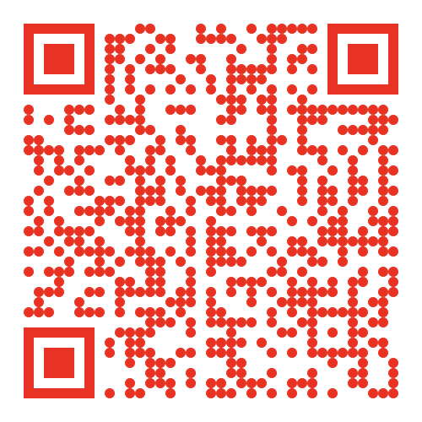
Information and tools​
Read program-, course– and semester pages. ​
Check student e-mail frequently​
My studies / Mine studier: Personal schedule, messages and managing studies:
"IT Help UiO" - If any problems with IT.
Being a master’s student at IFI : ​
Notes:
Sjekke semestersiden ofte for oppdateringer på undertvisning per emne, endringer oppmøte/digitalt osv.​
​
Go here for updated information, guiding you through your entire degree, from the very beginning, to handing in your thesis.​
​

Slide 9

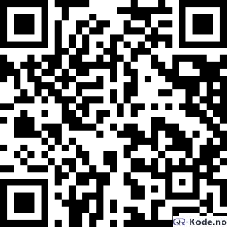
Speak Up-system for students
About which issues can you speak up?
Different ways of speaking up
What happens when you speak up?
Where you can get support
Notes:
About which issues can you speak up?
We strive for a safe and engaging learning environment and need feedback from you to improve. There are several factors that together create a good learning environment, and we strive to achieve safety, respect, as well as a good physical and psychological environment here at UiO. We therefor ask you to let us know when you are satisfied or when something needs improvement. We ask you in particular to give notice of serious, critical issues. It might be hard to decide with category your case belongs to. The most important is that you speak up, and the personnel receiving your case will take care of the rest.
2) Different ways of speaking up
Satisfied or dissatisfied? Feel free to say it directly to the person in question, to a manager or to the faculty's information center. You can also:
Tell your student representative.
Tell your faculty's learning environment contact.
Tell us by using our online form.
If you would like to speak up anonymously, you can contact the the ombud for students.
3) What happens when you speak up?
Who follow up on your case depends on the topic of you Speak up-case. Most cases goes to the Speak up-office at your faculty. Go to the overview of administrative procedures.
4) Where you can get advice and support
It is important to speak to someone if you have experienced something that doesn’t feel right. You can talk to Your faculty's learning environment contact
Your faculty's information centre
The ombud for students
SiO councelling
A university humanist or chaplain
JURK - Legal advice for women (Norwegian)
The ombud for equality and anti-discrimination (ldo.no)

Slide 10
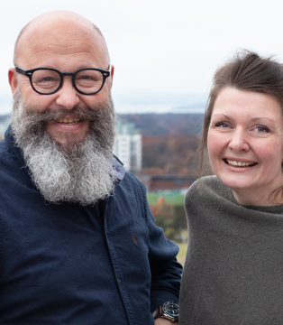
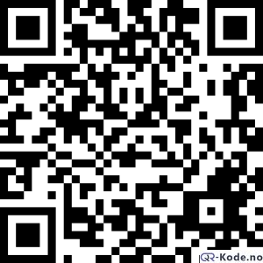
Forvei
Do you need someone to talk to? Get in touch with our counsellors Ilan or Linda!
A personal counselling program for all students admitted to a study program at the MN Faculty.
Book a counselling session online.

Slide 11

Student life​
SiO: student welfare organisation ​
  Health (GP, mental health) ​
  Sports ​
  Housing ​
  Kindergartens ​
  Student ID
Student organisations​ at IFI
Student bar: Escape – open all week

Slide 12

Attendance
https://nettskjema.no/a/640263

