Slide 1
Welcome to Digitalization in the health sector ☺

Slide 2
Agenda today
Round of introductions
Program overview
Information systems research group, courses we teach
Administrative information
Food and tour of the building

Slide 3
Round of introductions
Name
Background
Motivation for joining the program
For faculty; do you teach in this program? Are you a (potential) supervisor?

Slide 4
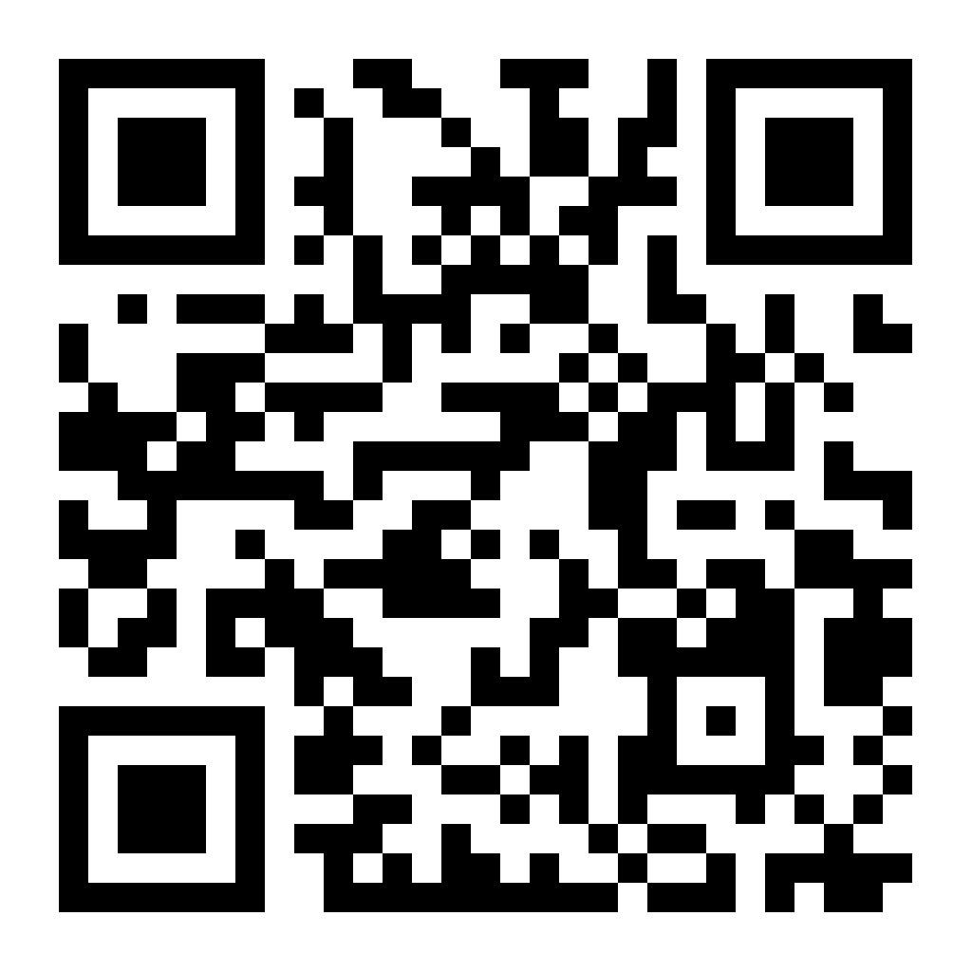
The program at a glance!
Fifth class of DIGHEL starting now. Around 20-30 students each year. LinkedIn-page: Digitalization in the Health Sector (DIGHEL)
Interdisciplinary ambitions (we also supervise students from other programs at IFI)
Two year, full time study.
Scan QR & join LinkedIn group!

Slide 5
Some expectations from us
Of the program:
  Graduate competent students in high demand
  Be well regarded and seen as relevant by students, government, and industry
Of the faculty
  Engage in digital health research projects
  Research-based education
  Identify relevant thesis projects with appropriate scope
Of the students
  Be present, and be engaged with fellow students and faculty
  Take an active role in improving the program
  Approach potential supervisors

Slide 6
Your expectations? Program, faculty, fellow students?
menti.com
Code: 22644723

Slide 7
How much time (per week) would you expect to dedicate to MSc work?
(That includes: study; research; exam preparation…)
Code: 3173 8295

Slide 8
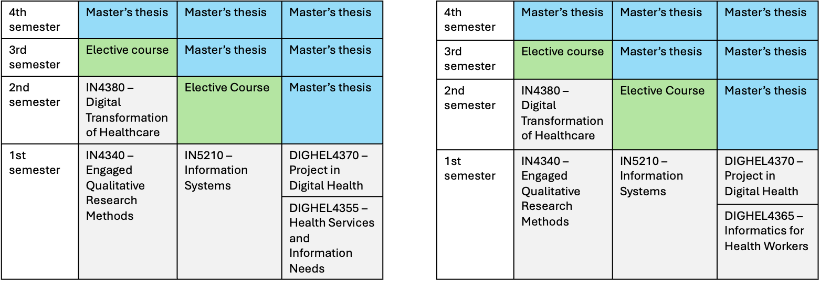
Program structure
Informatics background
Health background

Slide 9
On courses and thesis...
We don’t offer any courses on specific technology/applications
The master project usually offers opportunities to go into depth on this
Long master thesis; investigating and defining the problem, coming up with research design, is an important part of the work and learning. Things are seldom clear from the start!

Slide 10
Which courses to select this semester?
There are five compulsory courses, four of which run in the fall. We strongly recommend you to take these now:
IN5210 Information Systems (10 credits)
IN4340 Engaged qualitative research methods (10 credits)
Either
  DIGHEL4355 Health Services and Information needs (5 credits), or
  DIGHEL4365 Informatics for health workers (5 credits)
DIGHEL4370 Project in Digital Health (5 credits)

Slide 11
Which courses to select later?
IN4380 Digital Transformation of Healthcare (spring, compulsory)
Discuss elective courses with your supervisor

Slide 12
Research groups and
Master programs
Digital innovation
Design
DESIGN
DIGHEL
PROSA
Information systems

Slide 13
Information systems group
The Information Systems research group studies digitalisation in the public sector with an engaged and interventionist approach.
A sociotechnical focus on design, use, implementation, innovation, management, and governance of information technology in organizations.

Slide 14
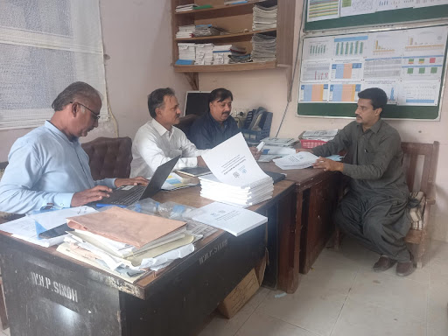
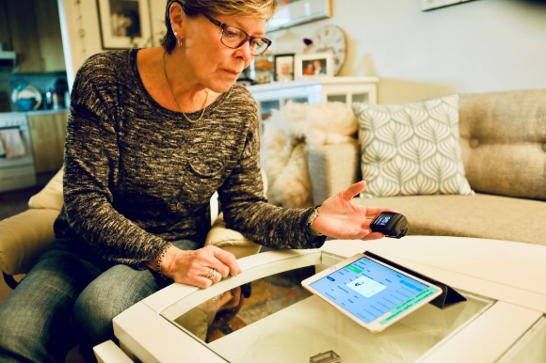
IS research focus
The interplay of digital technologies and associated processes, and organizations
  Datafication: the 'translation' of entities and processes into data and the consequences and challenges this has.
  Digitalisation governance and the organisation of systems design, innovation, and digitalisation processes.
  Digital platforms and infrastructures are networked forms of digital resources and processes designed and cultivated to enable innovation and distributed social value creation.
Main empirical areas
Global health: HISP-centre and dhis2
Digital health in Norway
Illustrasjonsfoto: Thomas Berg/Helsedirektoratet

Slide 15
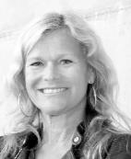
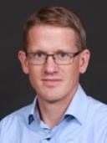
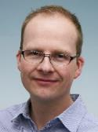
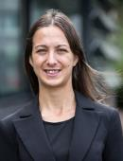

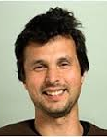
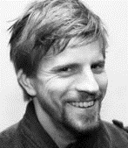
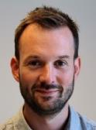
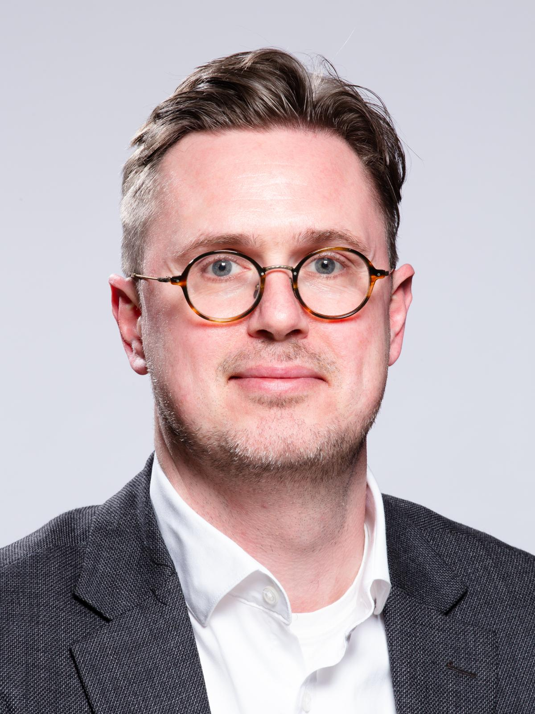
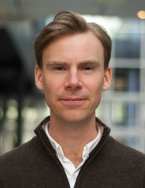
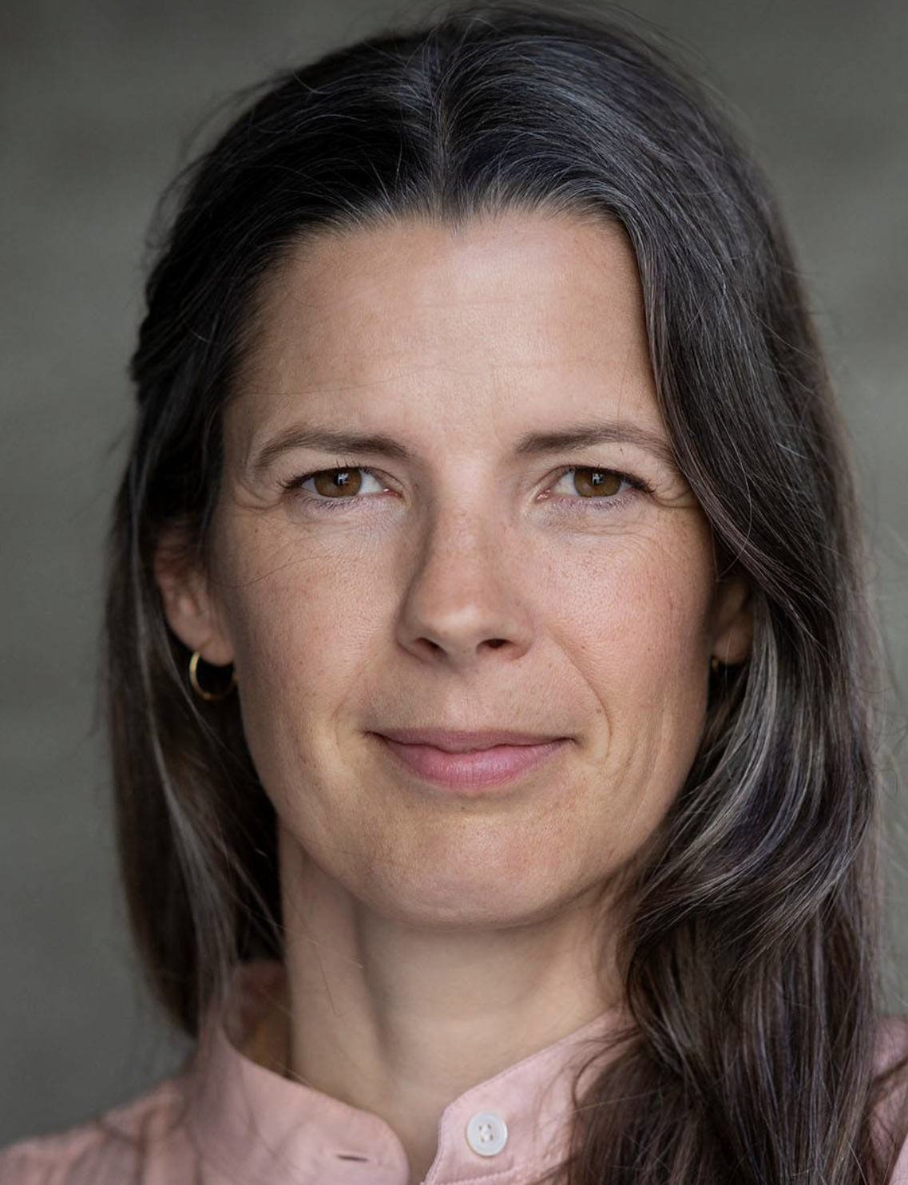
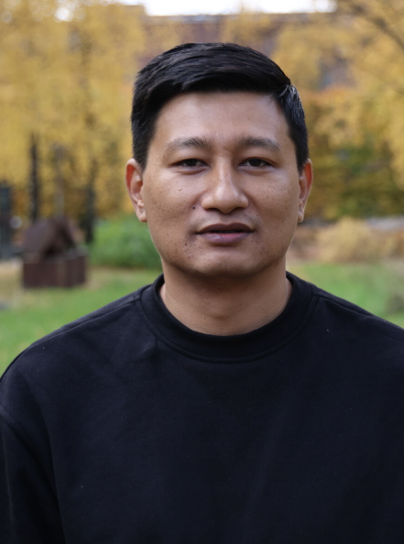
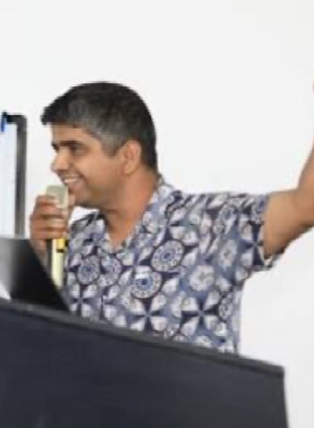
Faculties (potential supervisors)
Professors
Adjunct Professors
Kristin Braa
Petter Nielsen
Sune Müller
Silvia Masiero
Johan Sæbø
Eric Monteiro
Associate Professors
Postdocs
Terje Sanner
Alexander Kempton
Troels Mønsted
Magnus Li
Mari Kannelønning
Manish Baidya
Bipin Acharya
https://www.mn.uio.no/ifi/english/research/groups/is/

Slide 16

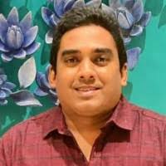
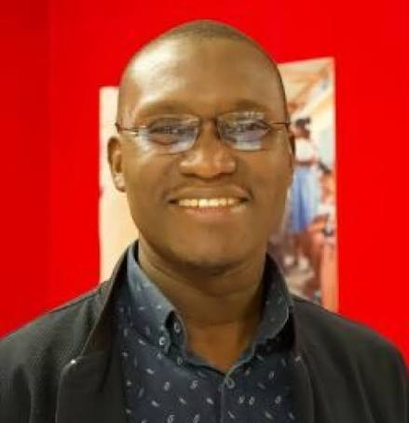

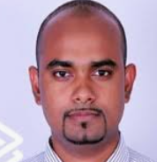
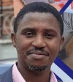
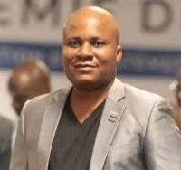
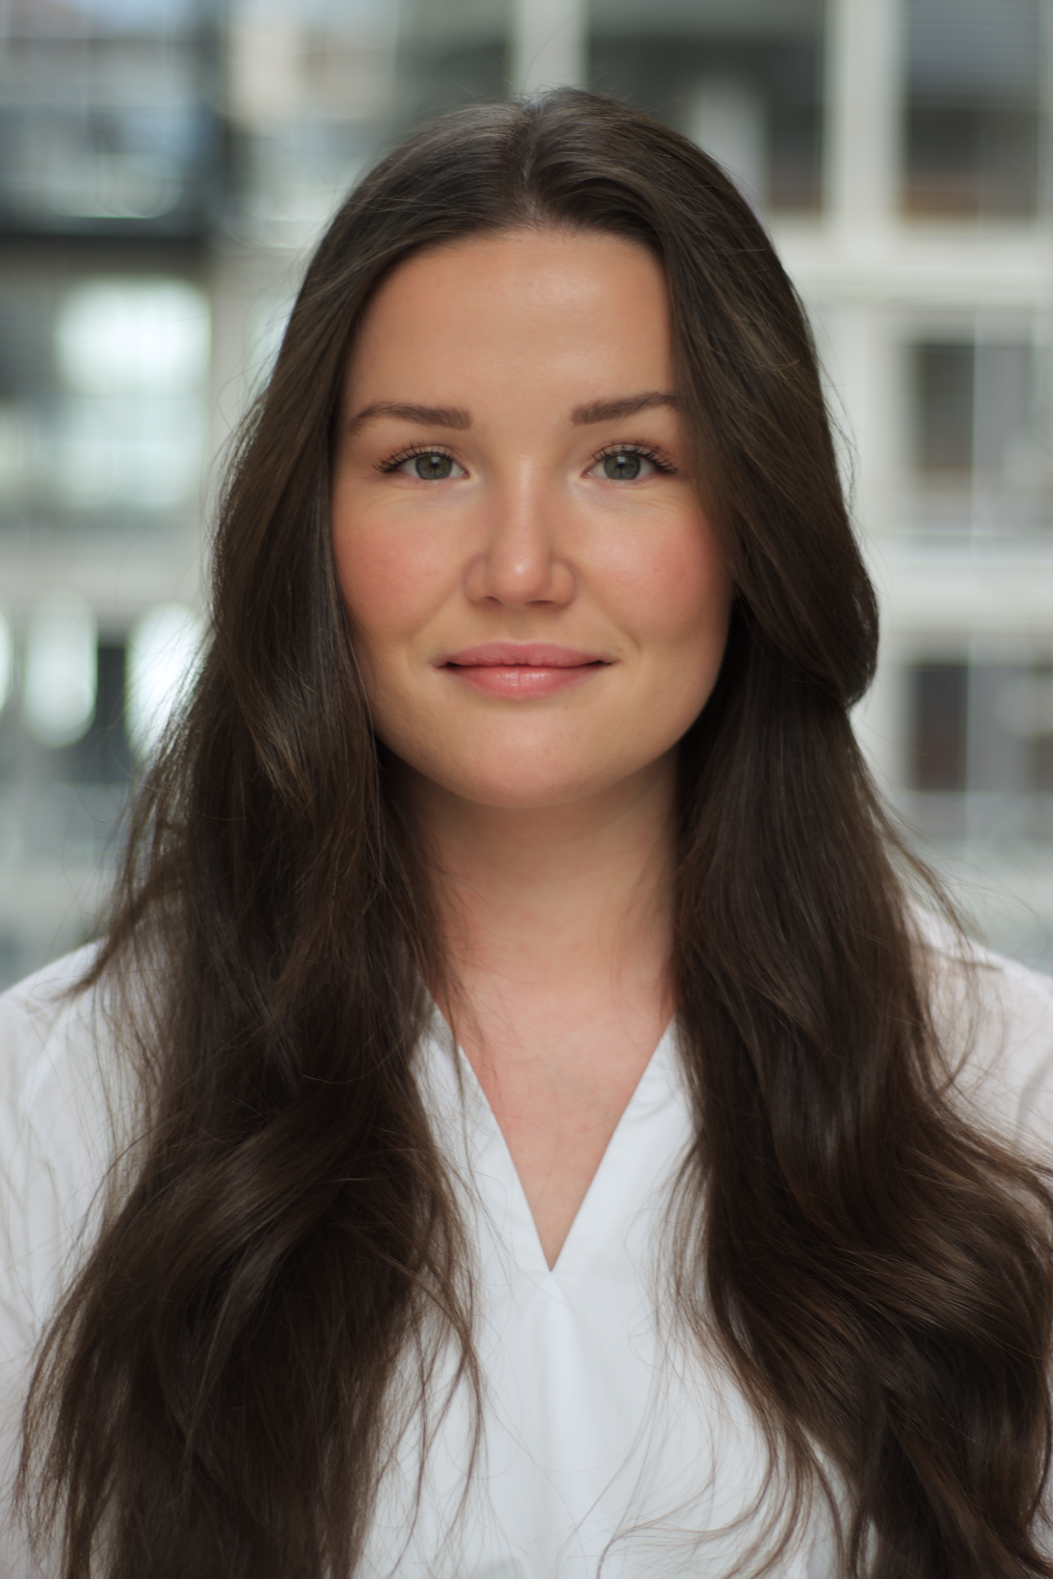
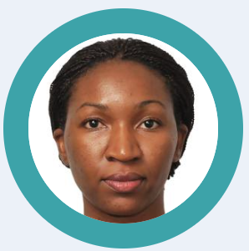
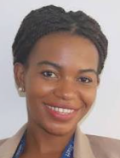
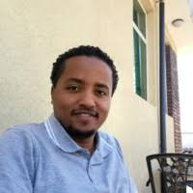
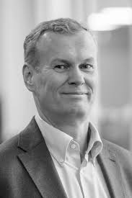



19 PhD candidates

Slide 17
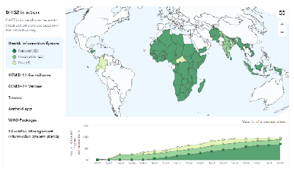
DHIS2
Supported as a Global Public Good
Open source, entirely free of licensing fees
Generic- supporting all use cases
Global footprint: used by 73 countries
Scalability: national scale in 60 countries
In-country ownership
Community-driven software roadmap
Read more on dhis2.org/in-action and facebook.com/dhis2
Global «footprint»
2.4 billion people
+ 60 NGO’s, 58 PEPFAR countries, 60+ PSI countries, 10 global organizations

Slide 18
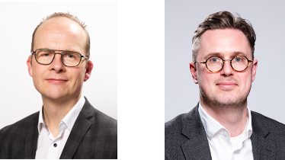
DIGHEL4355 Helsetjenester og Informasjonsbehov
Purpose of the course
To provide students with a background in informatics with a foundational understanding of health information management and information needs among health professionals.
Topics:
Basic categories of health services.
Information needs for clinical and administrative purposes.
The relation between clinical work, administration, research, and health politics in relation to information needs.
How information systems can be used to address challenges related to health information.
Ethical perspectives on health information.
Format
The course is organized as a 2-hour lecture and 2-hour seminar (80% compulsory attendance) per week.
Grading A-F based on 30-minute oral examination.
Course teacher
Sune Dueholm Müller (sunedm@ifi.uio.no)

Slide 19
DIGHEL4365 Informatics for health workers
Purpose of the course
To provide students with a background in health with a foundational understanding of programming and databases,
Topics:
Programming
  Algorithmic thinking
  Input-output
  Statements and loops
Databases
  How to efficiently store data
  How to find the right data
Format
2 hours lecture per week, for half of the semester
2 hours seminar per week (80% compulsory attendance)
2 individual assignments
Written digital exam
Course teachers
Johan Ivar Sæbø (johansa@ifi.uio.no)

Slide 20
DIGHEL4370 Project in Digital Health
Purpose of the course
To provide students with practical experience with identifying challenges related to information needs in a specific problem context and proposing digital solutions to meet these. In addition, the course will give student experience with working in interdisciplinary teams.
Topics:
Practical experience working in interdisciplinary teams.
Knowledge of and experience in applying key ICT development approaches
Practical experience in examining a use case and understanding information needs
Format
The course is organized as a 2-hour lecture and a 2-hour seminar per week.
Grading A-F based on oral group presentation
Course teacher
Troels Mønsted (monsted@ifi.uio.no)

Slide 21
IN5210 Information Systems
Broad introduction to IS research
  Steep learning curve - lots to read, discuss and learn
  Engaging and rewarding in terms of preparing for your master’s
Learning outcomes:
  Know as selection of IS theories and concepts
    How to discover them
    How they are made
    How to use them in own research
  Practice reading academic papers
  Practice academic writing
Topics reflect ongoing research in IS and DIN
https://www.uio.no/studier/emner/matnat/ifi/IN5210/h26/index.html

Slide 22
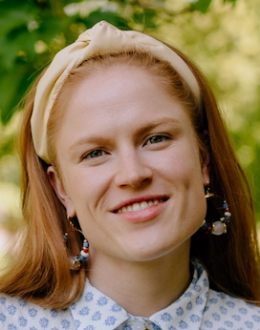
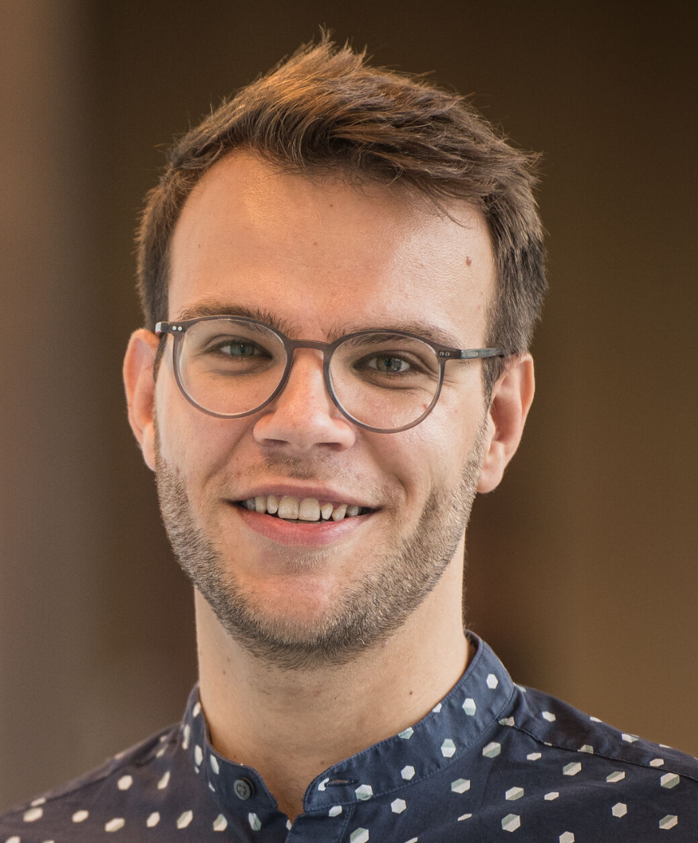
Structure
2+2 lectures per week 2 hours seminars per week
  Mandatory (80%) attendance including preparations (short assignments)
Essay (individual written home exam) + Oral (for some)
Petter Nielsen
pnielsen@ifi.uio.no
Geertruida Attwell geertrua@ifi.uio.no
Steffen Hornemann
shorn@ifi.uio.no

Slide 23
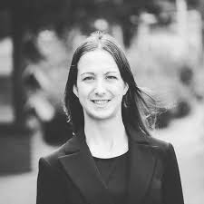
IN4340: Engaged Qualitative Research Methods
Introductory course to Qualitative Research Methods
Takes the stance of engaged research: a participatory form of research for studying complex real-world problems from the perspectives of key stakeholders
“Engaged” course by name and fact: not only weekly lectures, but also four applied sessions in which students deal with real-life fieldwork scenaria, applying the notions learned in class
Sharp focus on skills needed to develop your MSc thesis proposal and write your thesis
Assessment: 40% two home essays, 60% written exam
Course Teacher: Silvia Masiero
silvima@ifi.uio.no
https://www.uio.no/studier/emner/matnat/ifi/IN4340/index-eng.html

Slide 24
IN4380 Digital Transformation of Healthcare
Purpose of the course
Digital Transformation of Healthcare aims to develop students’ understanding of digital health in a global context and with a key focus on the Norwegian healthcare system.
After completing the course, students are able to identify key institutional, organizational, and (inter)personal challenges and opportunities related to digitalization of the health sector.
Themes:
The course is organized around four core themes:
Foundational concepts of digital health.
The institutional context for change.
Trends and emerging technologies in healthcare.
Change processes in digitalization of healthcare services.
During the course you will be introduced to a variety of theories and a range of empirical examples covering, for instance,electronic health records, digital health infrastructures, eHealth and telemedicine, and artificial intelligence.
Key info
10 ECTS
Grading A-F based on 30-minute oral examination
2-hour lecture + 2-hour seminar per week.
9 individual reflection notes during the course.
Course teachers
Sune Dueholm Müller (sunedm@ifi.uio.no)
Troels Mønsted (monsted@ifi.uio.no)

Slide 25

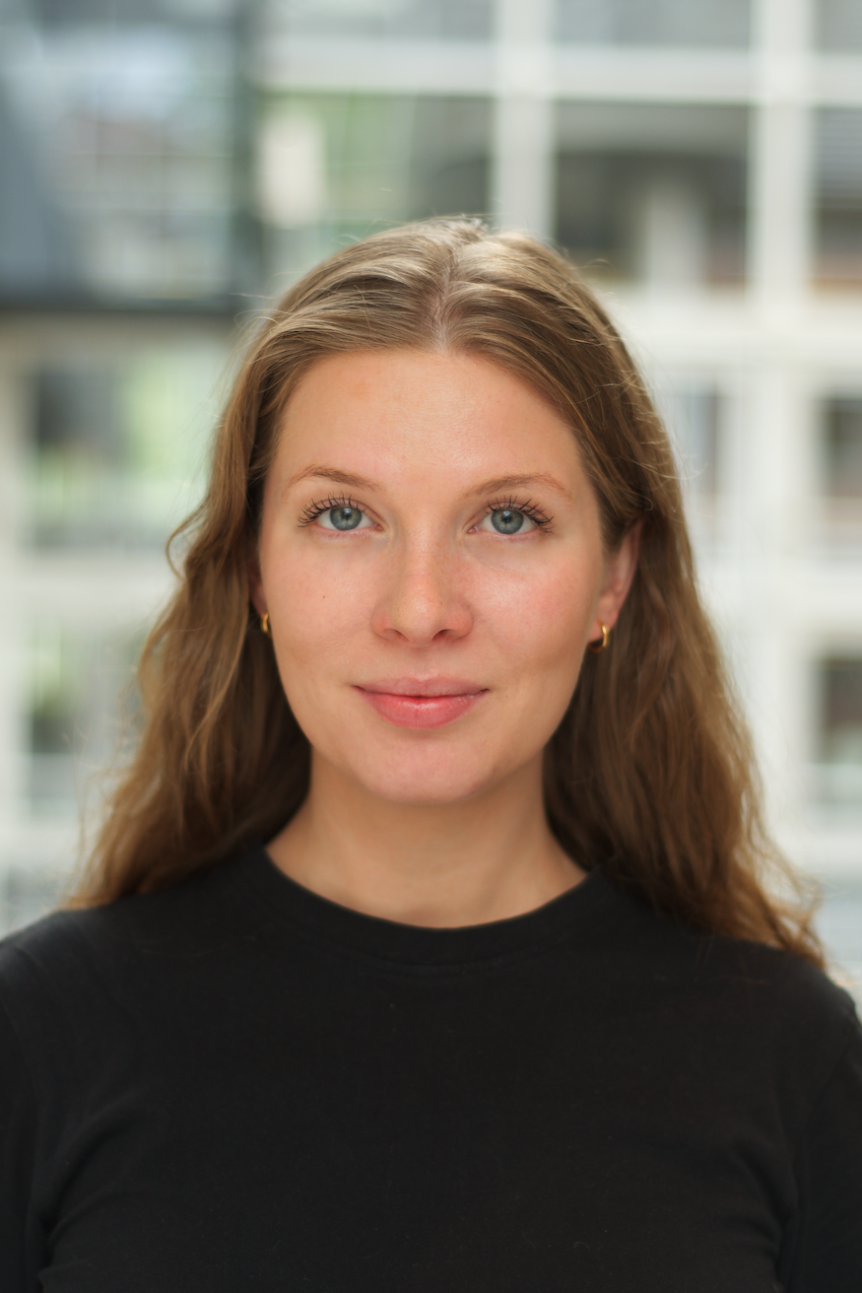
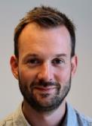
IN5320 - Development in Platform Ecosystems
Software platform represents an increasingly common way of organizing digital resources to support and promote design and innovation
This course is about the theory and practice of Development in Platform Ecosystems
  Governance of/in platform ecosystems
  Design and Innovation in platform ecosystems
  Software platform ecosystems
  Platforms in the public sector
Practical part of the course comprises exercises and mandatory assignments on the development of web-based applications for platforms (JavaScript, React)
A six-week project where students in groups design and develop a web-based application
Key info
10 ETC
Grading: A-F based on group work (85%) and individual midterm exam (15%)
Lectures with readings
Practical mandatory assignments
Group work
Contact
Terje Aksel Sanner (terjeasa@ifi.uio.no)
https://www.uio.no/studier/emner/matnat/ifi/IN5320/index.html
Terje Sanner
Johanne Thunes
Alexander Kempton

Slide 26
IN5370: ICTs and Global Inequalities
Intensive (four weeks: 1-25 September)
Home exam at the end of the course counts 100% of the final grade
Concerns understanding the relation between ICTs and socio-economic inequalities
Relevant in current times given the widespread diffusion of digitally-induced harm and injustice (stemming from ICTs including digital ID, biometric border controls, and data violence tools in and beyond the Global South)
We try to answer the question: are ICTs deepening socio-economic inequalities, and what can be done?
Course Teacher: Silvia Masiero
silvima@ifi.uio.no
https://www.uio.no/studier/emner/matnat/ifi/IN5370/index-eng.html

Slide 27
Master thesis
You are expected to pick your courses, the topic of your thesis and your supervisor during your first semester.
Available thesis topics will be presented on an information meeting in September.
In mid-October, a form will be made available where you submit up to 3 themes you would like to write about. You will then be assigned to a supervisor based on capacity and demand.
A long thesis (60 credits) should be completed over two or three semesters, but work should begin during the second semester
A long thesis should be approximately 100 (+/- 20) pages
Past theses can be found at duo.uio.no

Slide 28
Typical themes for master theses
Master’s theses topics generally revolve around design, use, implementation, innovation, management, and governance of information technology in organizations.
DHIS2 or other empirical contexts e.g., in Norway
May be descriptive and explanatory, e.g., case studies or constructive and interventionist, e.g., action research.
Examples from previous years:
Information sharing in welfare technology
Introduction of new sequencing technology for cancer research at Radiumhospitalet

Slide 29
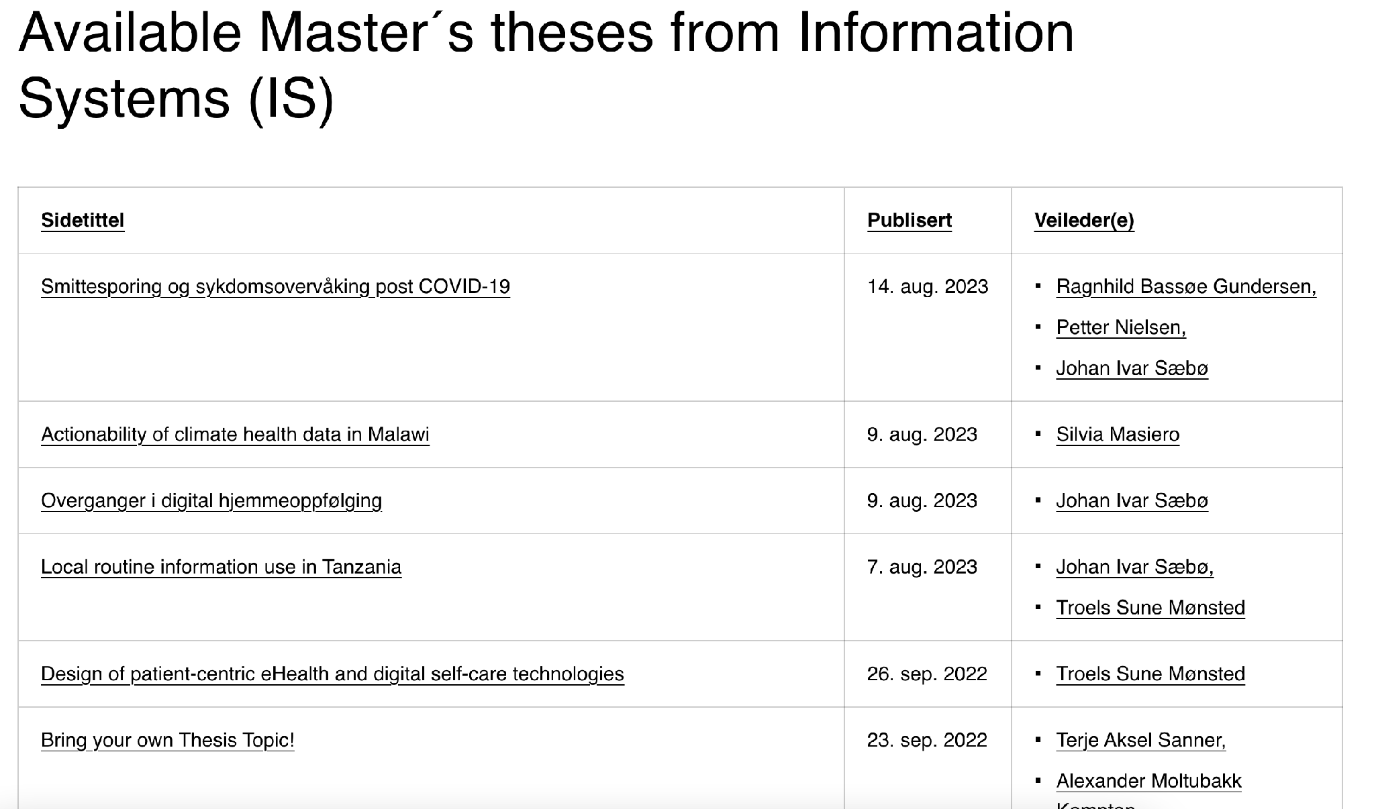
Master topics will become available soon
https://www.mn.uio.no/ifi/studier/masteroppgaver/is/

Slide 30
The master projects (to be updated)
More about the projects:
  https://www.mn.uio.no/ifi/studier/masteroppgaver/is/
More about the supervisors:
  https://www.mn.uio.no/ifi/english/research/groups/is/
Any questions: monsted@ifi.uio.no (or other potential supervisors)

Slide 31
Look forward to two splendid years together! ☺

