Slide 1
Information systems group
The Information Systems research group studies digitalisation in the public sector with an engaged and interventionist approach.
A sociotechnical focus on design, use, implementation, innovation, management, and governance of information technology in organizations.

Slide 2

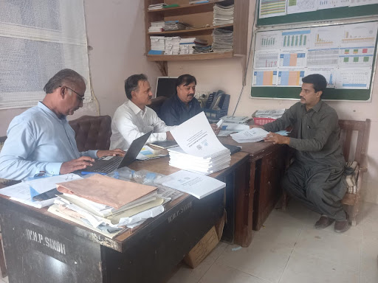
IS research focus
The interplay of digital technologies and associated processes, and organizations
  Datafication: the 'translation' of entities and processes into data and the consequences and challenges this has.
  Digitalisation governance and the organisation of systems design, innovation, and digitalisation processes.
  Digital platforms and infrastructures are networked forms of digital resources and processes designed and cultivated to enable innovation and distributed social value creation.
Global health: HISP-centre and dhis2
Digital health in Norway
Illustrasjonsfoto: Thomas Berg/Helsedirektoratet

Slide 3






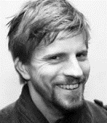




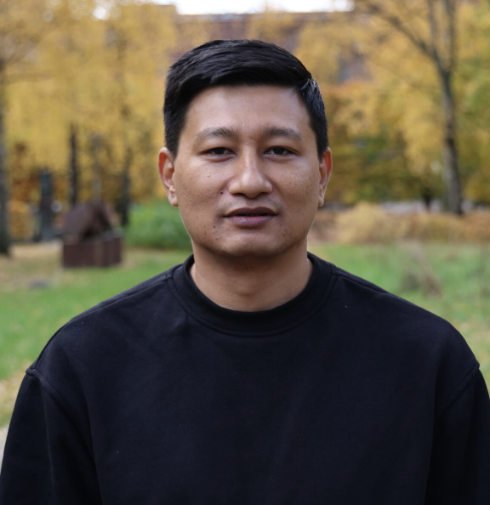

Faculties (potential supervisors)
Professors
Adjunct Professors
Kristin Braa
Petter Nielsen
Sune Müller
Silvia Masiero
Johan Sæbø
Eric Monteiro
Associate Professors
Postdocs
Terje Sanner
Alexander Kempton
Troels Mønsted
Magnus Li
Mari Kannelønning
Manish Baidya
Bipin Acharya
https://www.mn.uio.no/ifi/english/research/groups/is/

Slide 4
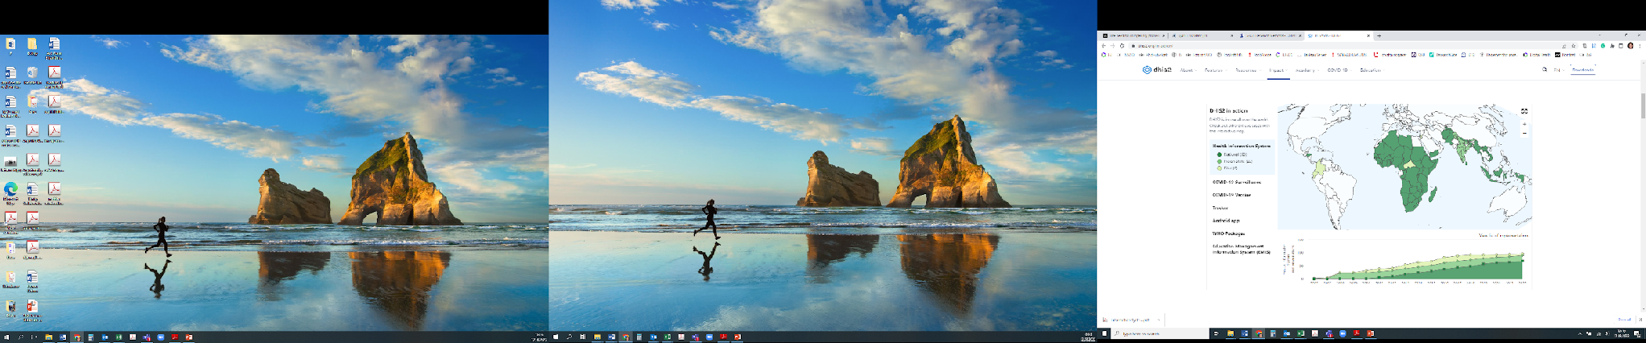
DHIS2
Supported as a Global Public Good
Open source, entirely free of licensing fees
Generic- supporting all use cases
Global footprint: used by 73 countries
Scalability: national scale in 60 countries
In-country ownership
Community-driven software roadmap
Read more on dhis2.org/in-action and facebook.com/dhis2
Global «footprint»
2.4 billion people
+ 60 NGO’s, 58 PEPFAR countries, 60+ PSI countries, 10 global organizations

Slide 5
IN5210 Information Systems
Broad introduction to IS research
  Steep learning curve - lots to read, discuss and learn
  Engaging and rewarding in terms of preparing for your master’s
Learning outcomes:
  Know as selection of IS theories and concepts
    How to discover them
    How they are made
    How to use them in own research
  Practice reading academic papers
  Practice academic writing
Topics reflect ongoing research in IS and DIN
https://www.uio.no/studier/emner/matnat/ifi/IN5210/h26/index.html

Slide 6

IN4340: Engaged Qualitative Research Methods
Introductory course to Qualitative Research Methods
Takes the stance of engaged research: a participatory form of research for studying complex real-world problems from the perspectives of key stakeholders
“Engaged” course by name and fact: not only weekly lectures, but also four applied sessions in which students deal with real-life fieldwork scenaria, applying the notions learned in class
Sharp focus on skills needed to develop your MSc thesis proposal and write your thesis
Assessment: 40% two home essays, 60% written exam
Course Teacher: Silvia Masiero
silvima@ifi.uio.no
https://www.uio.no/studier/emner/matnat/ifi/IN4340/index-eng.html

Slide 7


IN5320 - Development in Platform Ecosystems
Software platform represents an increasingly common way of organizing digital resources to support and promote design and innovation
This course is about the theory and practice of Development in Platform Ecosystems
  Governance of/in platform ecosystems
  Design and Innovation in platform ecosystems
  Software platform ecosystems
  Platforms in the public sector
Practical part of the course comprises exercises and mandatory assignments on the development of web-based applications for platforms (JavaScript, React)
A six-week project where students in groups design and develop a web-based application
Key info
10 ETC
Grading: A-F based on group work (85%) and individual midterm exam (15%)
Lectures with readings
Practical mandatory assignments
Group work
Contact
Terje Aksel Sanner (terjeasa@ifi.uio.no)
Terje Sanner
Alexander Kempton

Slide 8

Typical themes for master theses
Master’s theses topics generally revolve around design, use, implementation, innovation, management, and governance of information technology in organizations.
DHIS2 or other empirical contexts e.g., in Norway
May be descriptive and explanatory, e.g., case studies or constructive and interventionist, e.g., action research.

