Slide 1
Research groups in PROSA
Reliable systems (PSY) – 9th Floor
Networks and Distributed Systems (ND) – 4th Floor
Scientific Computing and Machine Learning (SCML) 4th Floor
Information Systems (IS) – Nemko
Data and Knowledge Management (DKM)– 8th Floor
Software Engineering (SE) – 10th Floor
Programming Technology (PT) – 10th Floor
Computing Education (ITU) – 10th Floor

Slide 2

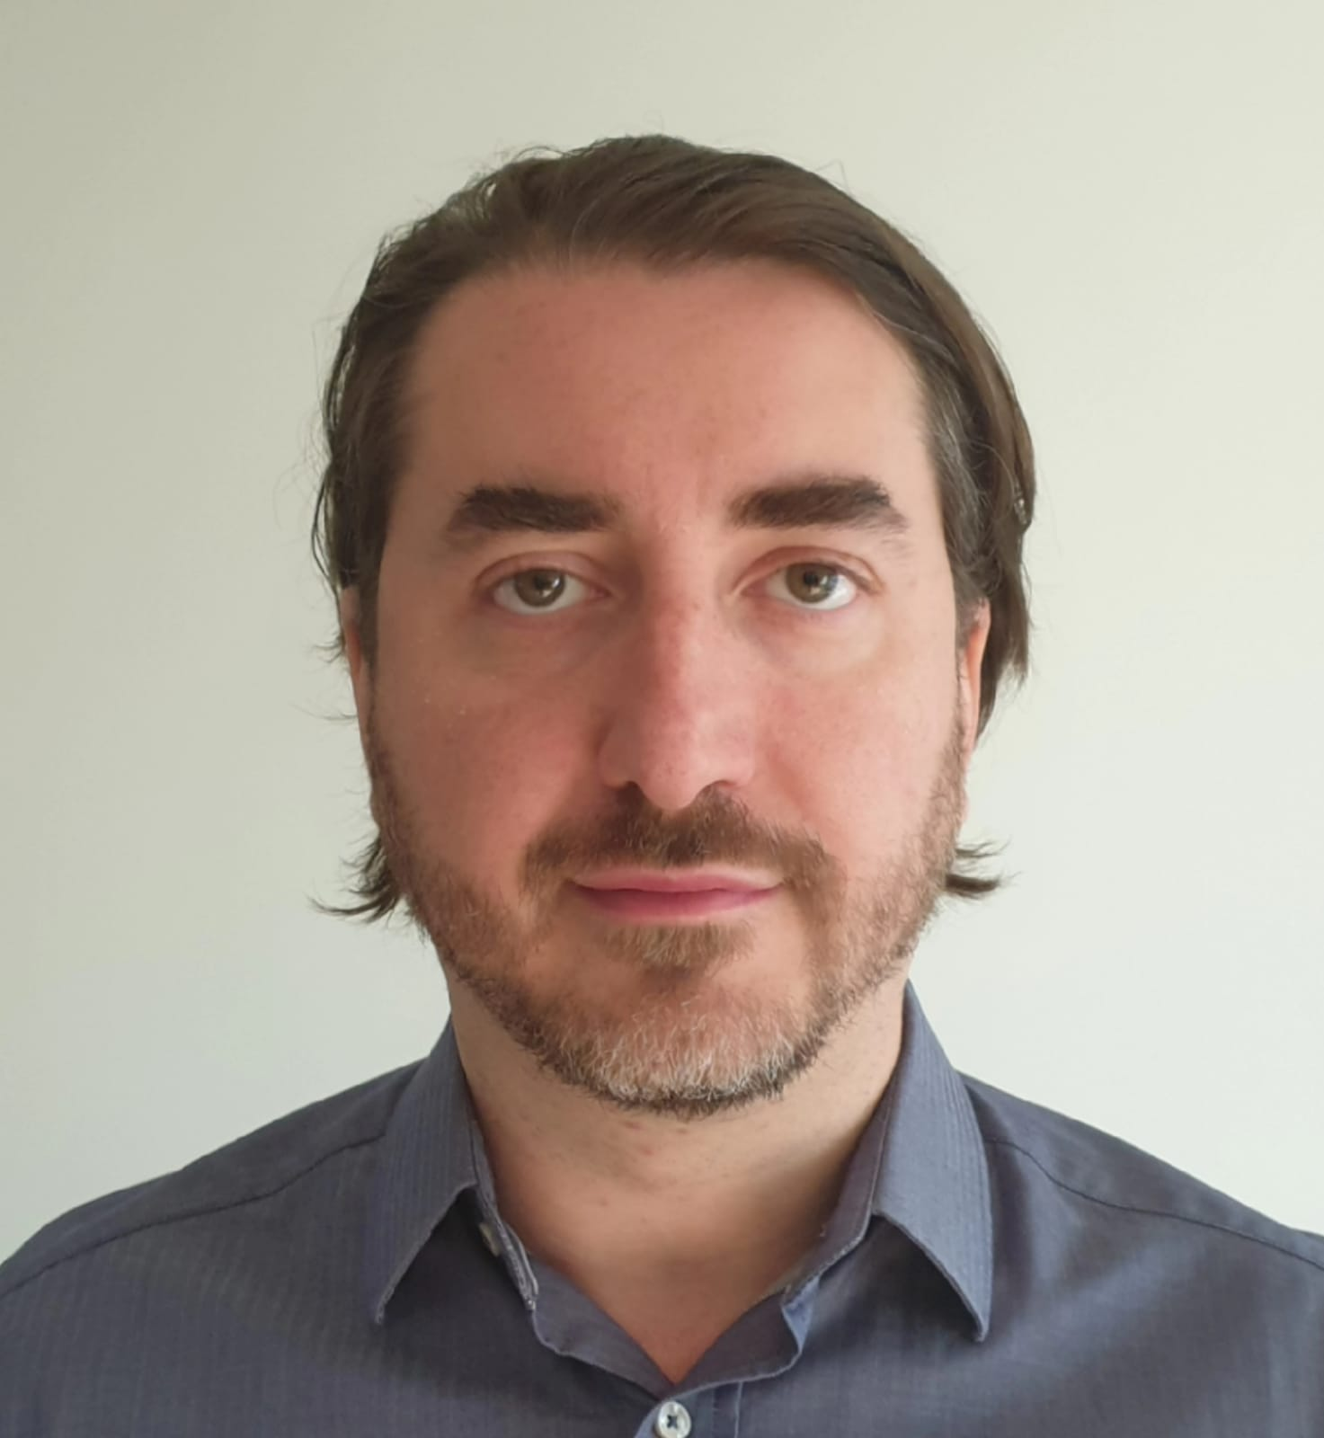

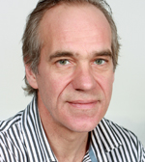
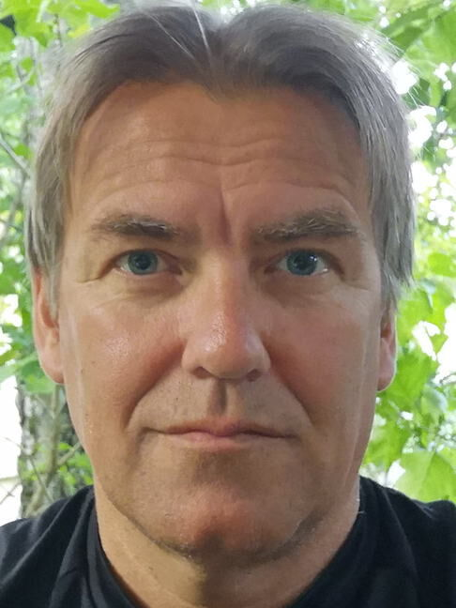

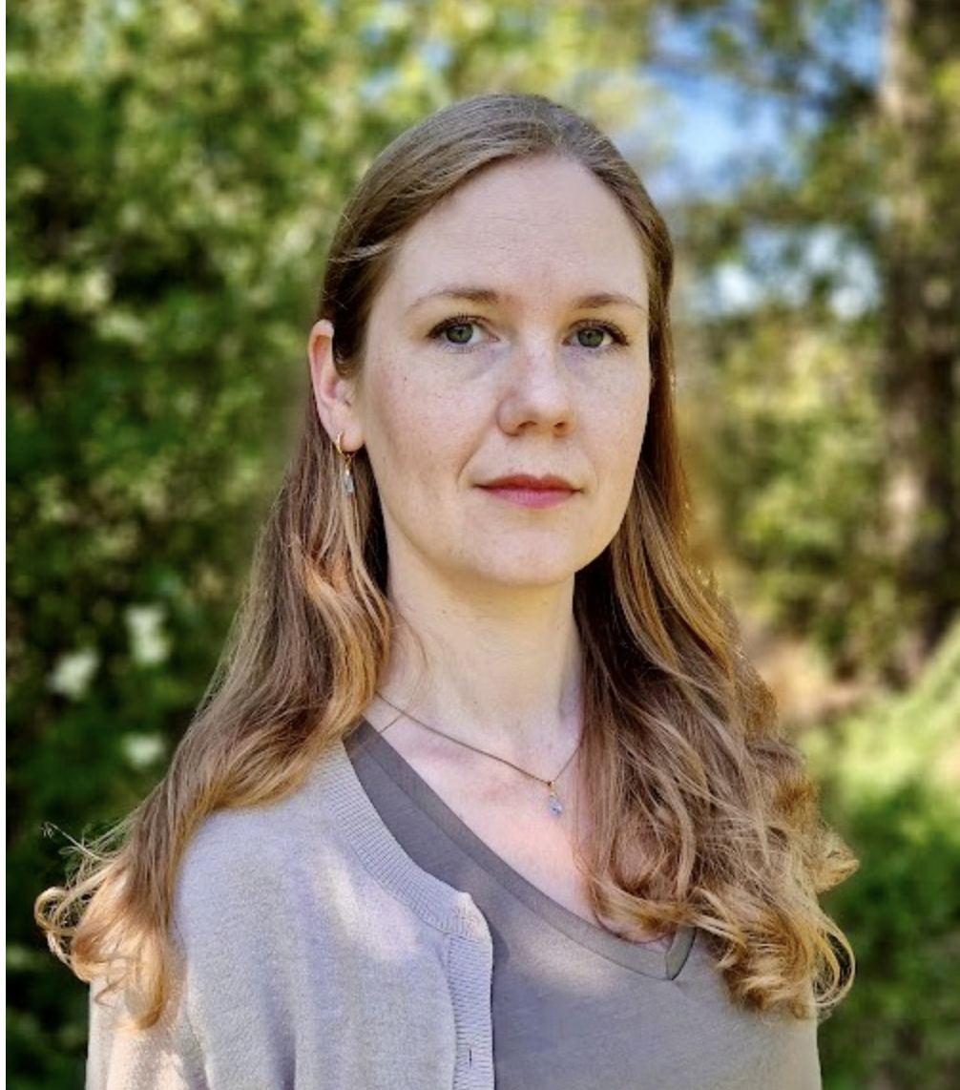
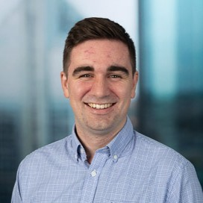
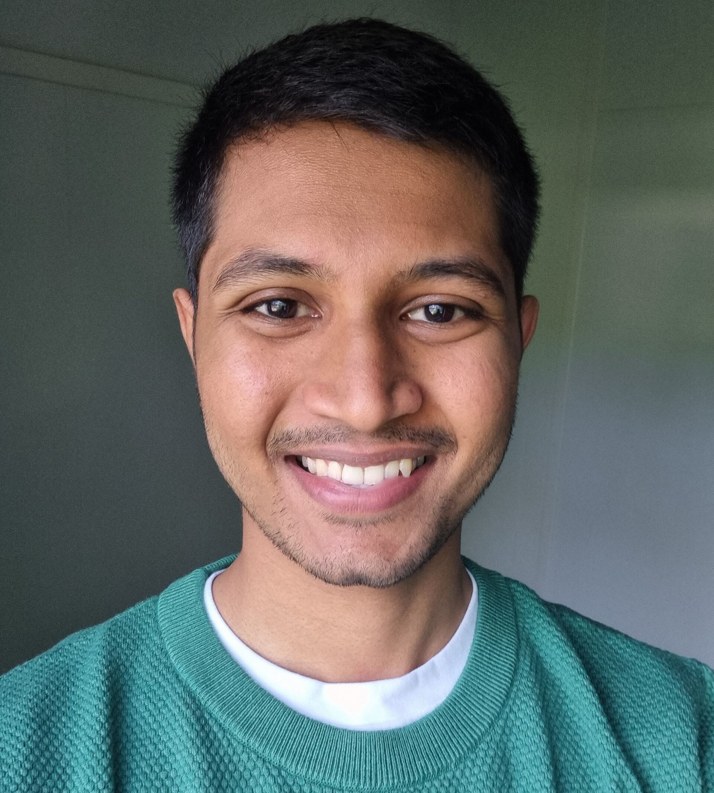


Software Engineering group
Located at the 10th floor

Slide 3
Software Engineering Group
Contact
  Antonio Martini – antonima@ifi.uio.no (group leader)
  Viktoria Stray – stray@ifi.uio.no
  Yngve Lindsjørn – ynglin@ifi.uio.no
  Gunnar Bergersen – gunnab@ifi.uio.no
  Marthe Berntzen – marthenb@ifi.uio.no
  Ketil Stølen – ketils@ifi.uio.no
  Steffen Almås - steffa@ifi.uio.no
  Karthik Shivanskar - karths@ifi.uio.no
  Jayeong Song - jayeongs@ifi.uio.no
  Marius Irgens - mariuir@ifi.uio.no

Slide 4
Software Engineering - SE
SE teaches and conducts research in a variety of topics in software engineering. The research is primary within the following areas:
Agile methods
Teamwork
System development
Technical debt
Software Architecture
Software testing
Evaluation of IT competences and skills
Software Process Improvement
Research methods in software engineering
AI for software engineering
Software engineering for AI
Software Visualization

Slide 5
Software Engineering (SE) - Master Courses
IN5140 – Smart processes and agile methods in software engineering (Autumn)
  The course will give a solid fundament for participating in and manage the software projects of an organization and for improving the way such projects are conducted. Focus on Process Improvement and agile methods.
IN4240 – Software Testing (Spring)
  This course covers fundamental concepts in software testing and specific areas such as: testing through the life cycle of a software system, static testing techniques, test design techniques, test management, testing tool support, testing user experiences, accessibility testing, exploratory testing, automated testing, test-driven development.
IN5130 – Unassailable IT-systems (Autumn)
  The techniques presented have for several years been used in design of real time systems and other distributed systems. We concentrate on systems of interacting actors and model such systems in UML. Sequence Diagrams of UML are the core notation for intuitive and formal description of interaction patterns.
(waiting acceptance) AISE – AI Software Engineering (Spring, Master)
  Learn how to build, deploy and integrate a trustworthy AI-powered application using AI agents. Learn how to choose the right technologies and make important decisions affecting sustainability, security, economy, sovereignty, etc.

