Slide 1
Master studies at ITS
Kaja Mosserud-Haavardsholm
Programme coordinator, ITS
kajaem@its.uio.no

Slide 2
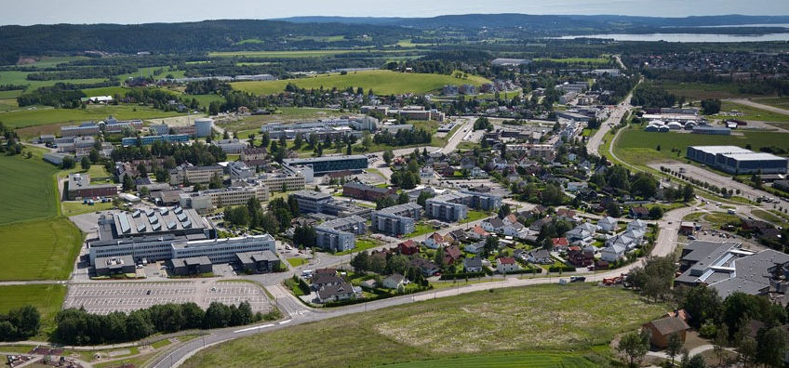
Department of Techology Systems, you say?
Based at Kjeller Research Park – where the Internet
first came to Europe
Foundation (started by UiO and
establishments at Kjeller)
for 30 years, now a department
at UiO
A handful of full-time researchers
Lecturers and supervisors with
main positions in industry or research establishments
Notes:
UNIK – owned by Universities and research establishments
8 full-time by end of 2018
Ca 50 professors and assosiated professors from collaborating companies
FFI - Norwegian Defence Research Establishment
IFE – Institute for energy technology
NORSAR
Justervesenet - Norwegian Metrology Service
NILU – Norwegian institute for air research
Telenor

Slide 3
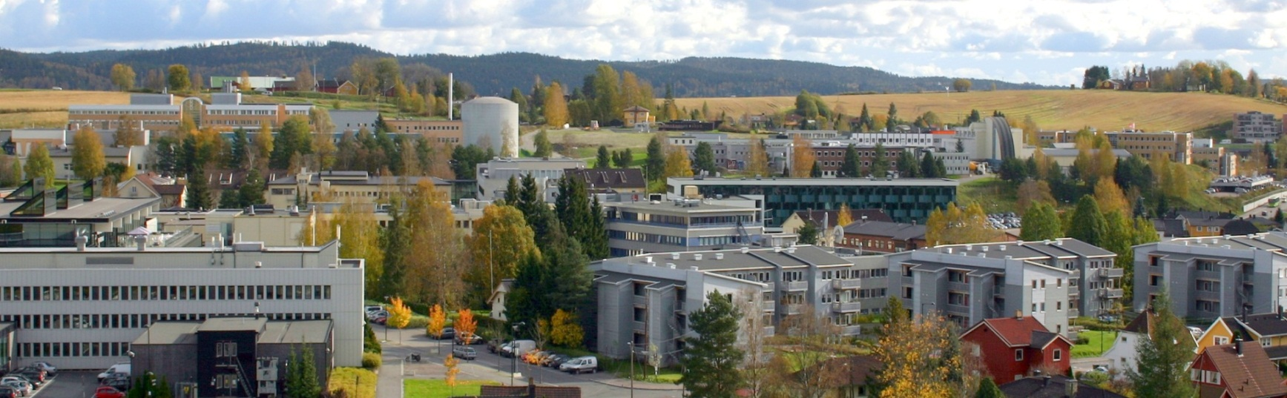


Kjeller Research Park
Thales
ABB
Telenor
Kongsberg-gr.
Akershus Energi
Rainpower
NILU
IFE
Kjeller innovasjon
FFI
NORSAR
Oslo Met
FLO/Kjeller
AIM Norway
Juster-vesenet

Slide 4














Teachers and supervisors from:

Slide 5
ITS
Goal: to take the knowledge and research available in the research park, and insert it into the University
~40+ courses for Master and PhD students taught by researchers from Kjeller Research Park and other research establishments
Supervisors for Master’s and PhD theses
Sections:
  Energy Systems (Master: renewable energy)
  Autonomous Systems and Sensor Technologies (Master: cybernetics)
  CENSSS, Centre for Space Sensors and Systems (Master: space systems)
Notes:
ITS = Department of Technology Systems
(Also 1 course open for BA students
Civil Protection – Samfunnssikkerhet - kommer

Slide 6

Courses at ITS
Autonomous Systems and Sensor Technologies
TEK4030 Control of manipulators and mobile robots
TEK4040 Mathematical modelling of dynamic systems
TEK4050 Stochastic systems
TEK5010 Multi-agent systems
TEK5020 Pattern Recognition
TEK5030 Computer Vision
TEK5040 Deep learning for autonomous systems
TEK5120 Modern service oriented architecture
TEK5600 Visualization of scientific data
Space Sensors and Systems
TEK4010 Optics and light
TEK5050 Detection of Optical and Infrared Radiation
TEK5130 Satellite Communications
TEK5140 Antennas and Radiowave Propagation
TEK5160 Radar remote sensing
Security and Cyber Physical systems
TEK4100 Signal Processing in Wireless Communication Systems
TEK4500 Introduction to Cryptography
TEK5110 Building Mobile and Wireless Networks
TEK5510 Security in operating systems and software
TEK5520 Information security in industrial sensor and mobile systems
TEK5530 Measurable Security for the Internet of Things
TEK5550 Advanced topics in cryptology
Energy Systems
TEK5300 Renewable energy: science and technology
TEK5310 Solar Cells
TEK5320 Battery Technology
TEK5330 Solar Energy Systems
TEK5340 Energy systems analysis: Modelling, methods and scenarios
TEK5350 Energy Markets and Regulation
TEK5370 Grid, smartgrid og IoT
TEK5380 Prosjekt innen fornybar energi
TEK5390 Hydrogenteknologi
TEK5410 Energy Markets and Regulation - Modelling and Analysis
TEK5420 Norway’s Energy Transitions: Policy Directions and Challenges
Photo by Christina @ wocintechchat.com on Unsplash
Notes:
All available on the UiO web page.

Slide 7
Courses at ITS
Autonomous Systems and Sensor Technologies
TEK4030 Control of manipulators and mobile robots
TEK4040 Mathematical modelling of dynamic systems
TEK4050 Stochastic systems
TEK5010 Multi-agent systems
TEK5020 Pattern Recognition
TEK5030 Computer Vision
TEK5040 Deep learning for autonomous systems
TEK5120 Modern service oriented architecture
TEK5600 Visualization of scientific data
Space Sensors and Systems
TEK4010 Optics and light
TEK5050 Detection of Optical and Infrared Radiation
TEK5130 Satellite Communications
TEK5140 Antennas and Radiowave Propagation
TEK5160 Radar remote sensing
Security and Cyber Physical systems
TEK4100 Signal Processing in Wireless Communication Systems
TEK4500 Introduction to Cryptography
TEK5110 Building Mobile and Wireless Networks
TEK5510 Security in operating systems and software
TEK5520 Information security in industrial sensor and mobile systems
TEK5530 Measurable Security for the Internet of Things
TEK5550 Advanced topics in cryptology
Energy Systems
TEK5300 Renewable energy: science and technology
TEK5310 Solar Cells
TEK5320 Battery Technology
TEK5330 Solar Energy Systems
TEK5340 Energy systems analysis: Modelling, methods and scenarios
TEK5350 Energy Markets and Regulation
TEK5370 Grid, smartgrid og IoT
TEK5380 Prosjekt innen fornybar energi
TEK5390 Hydrogenteknologi
TEK5410 Energy Markets and Regulation - Modelling and Analysis
TEK5420 Norway’s Energy Transitions: Policy Directions and Challenges
Photo by Christina @ wocintechchat.com on Unsplash
Notes:
All available on the UiO web page.

Slide 8
Courses at ITS
Autonomous Systems and Sensor Technologies
TEK4030 Control of manipulators and mobile robots
TEK4040 Mathematical modelling of dynamic systems
TEK4050 Stochastic systems
TEK5010 Multi-agent systems
TEK5020 Pattern Recognition
TEK5030 Computer Vision
TEK5040 Deep learning for autonomous systems
TEK5120 Modern service oriented architecture
TEK5600 Visualization of scientific data
Space Sensors and Systems
TEK4010 Optics and light
TEK5050 Detection of Optical and Infrared Radiation
TEK5130 Satellite Communications
TEK5140 Antennas and Radiowave Propagation
TEK5160 Radar remote sensing
Security and Cyber Physical systems
TEK4100 Signal Processing in Wireless Communication Systems
TEK4500 Introduction to Cryptography
TEK5110 Building Mobile and Wireless Networks
TEK5510 Security in operating systems and software
TEK5520 Information security in industrial sensor and mobile systems
TEK5530 Measurable Security for the Internet of Things
TEK5550 Advanced topics in cryptology
Energy Systems
TEK5300 Renewable energy: science and technology
TEK5310 Solar Cells
TEK5320 Battery Technology
TEK5330 Solar Energy Systems
TEK5340 Energy systems analysis: Modelling, methods and scenarios
TEK5350 Energy Markets and Regulation
TEK5370 Grid, smartgrid og IoT
TEK5380 Prosjekt innen fornybar energi
TEK5390 Hydrogenteknologi
TEK5410 Energy Markets and Regulation - Modelling and Analysis
TEK5420 Norway’s Energy Transitions: Policy Directions and Challenges
http://www.uio.no/studier/emner/matnat/its/
Photo by Christina @ wocintechchat.com on Unsplash
Notes:
All available on the UiO web page.

Slide 9
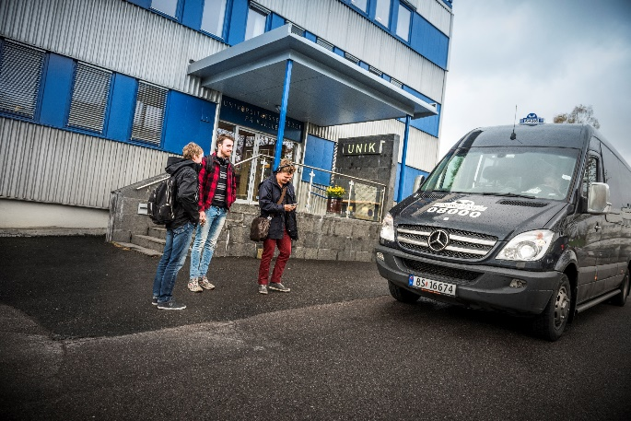
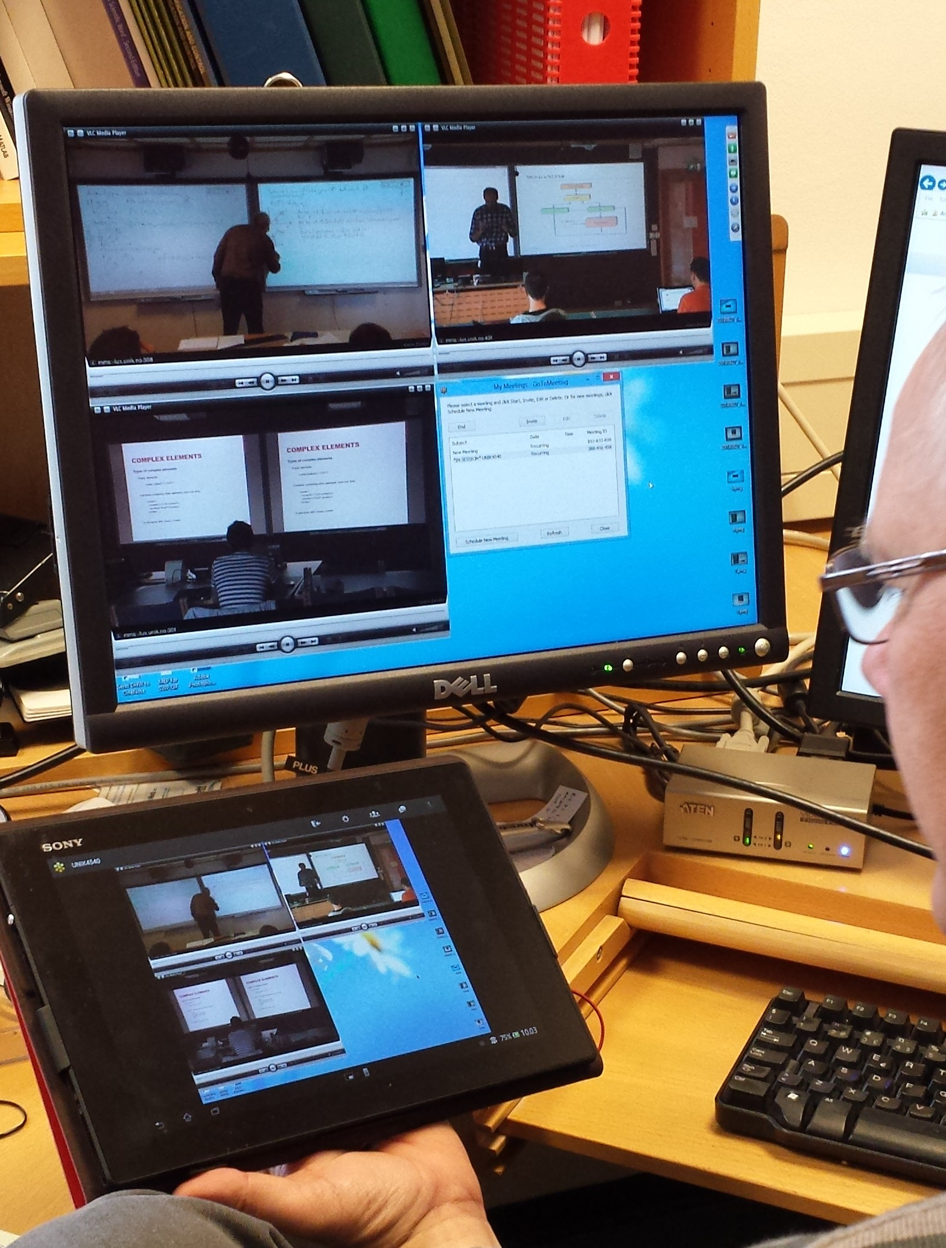
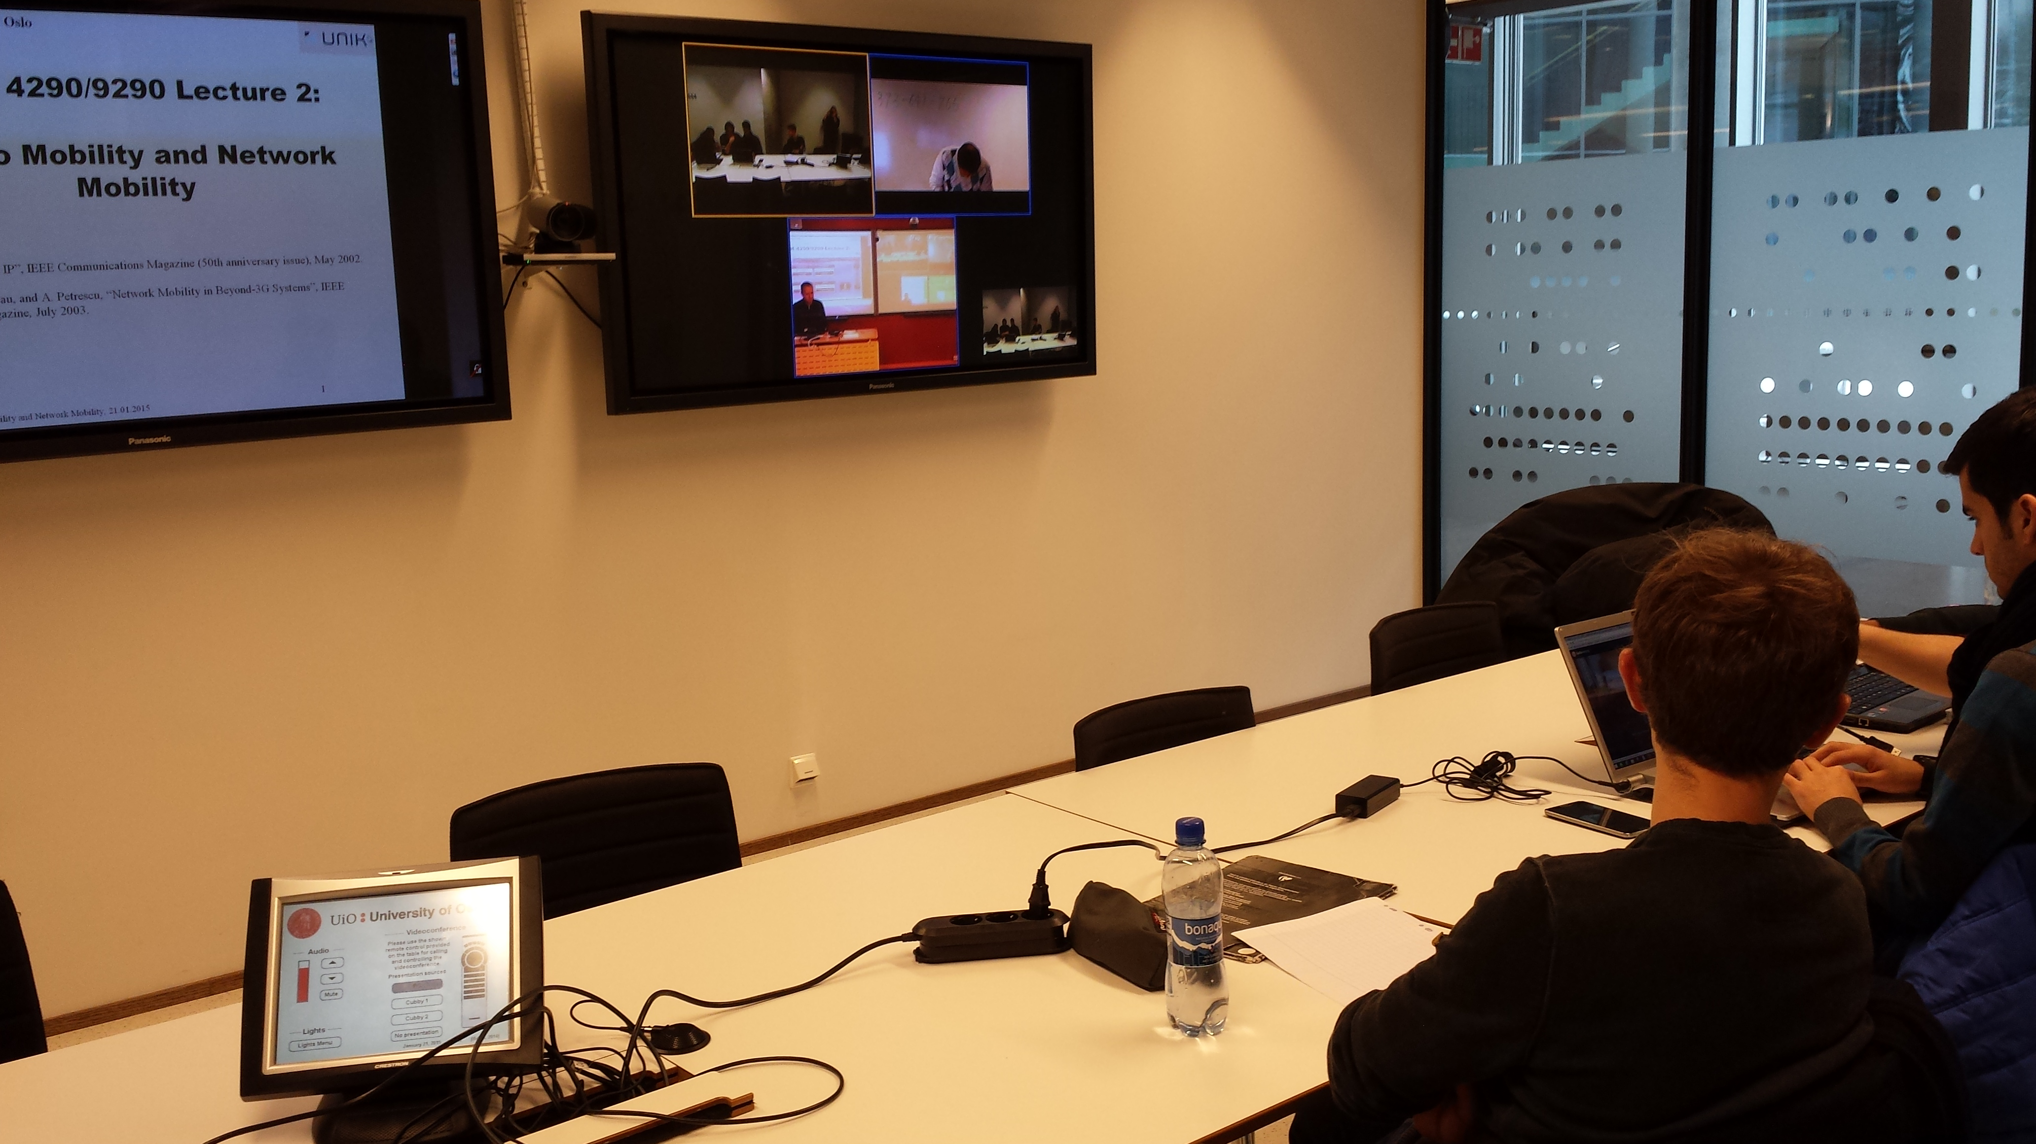
Attending courses at ITS
Two teaching sessions
  09:15-12:00 /13:15-16:00
Free bus from Blindern (OJD – Informatics building) to and from each session
Pre-pandemic: approx. 80% of our courses are
video transferred (streaming /
video conference)
Post-pandemic: more ☺

Slide 10
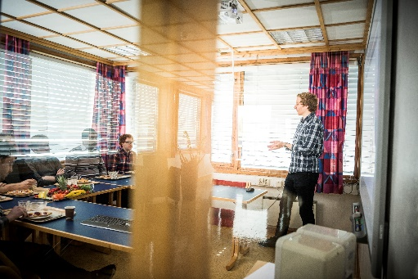

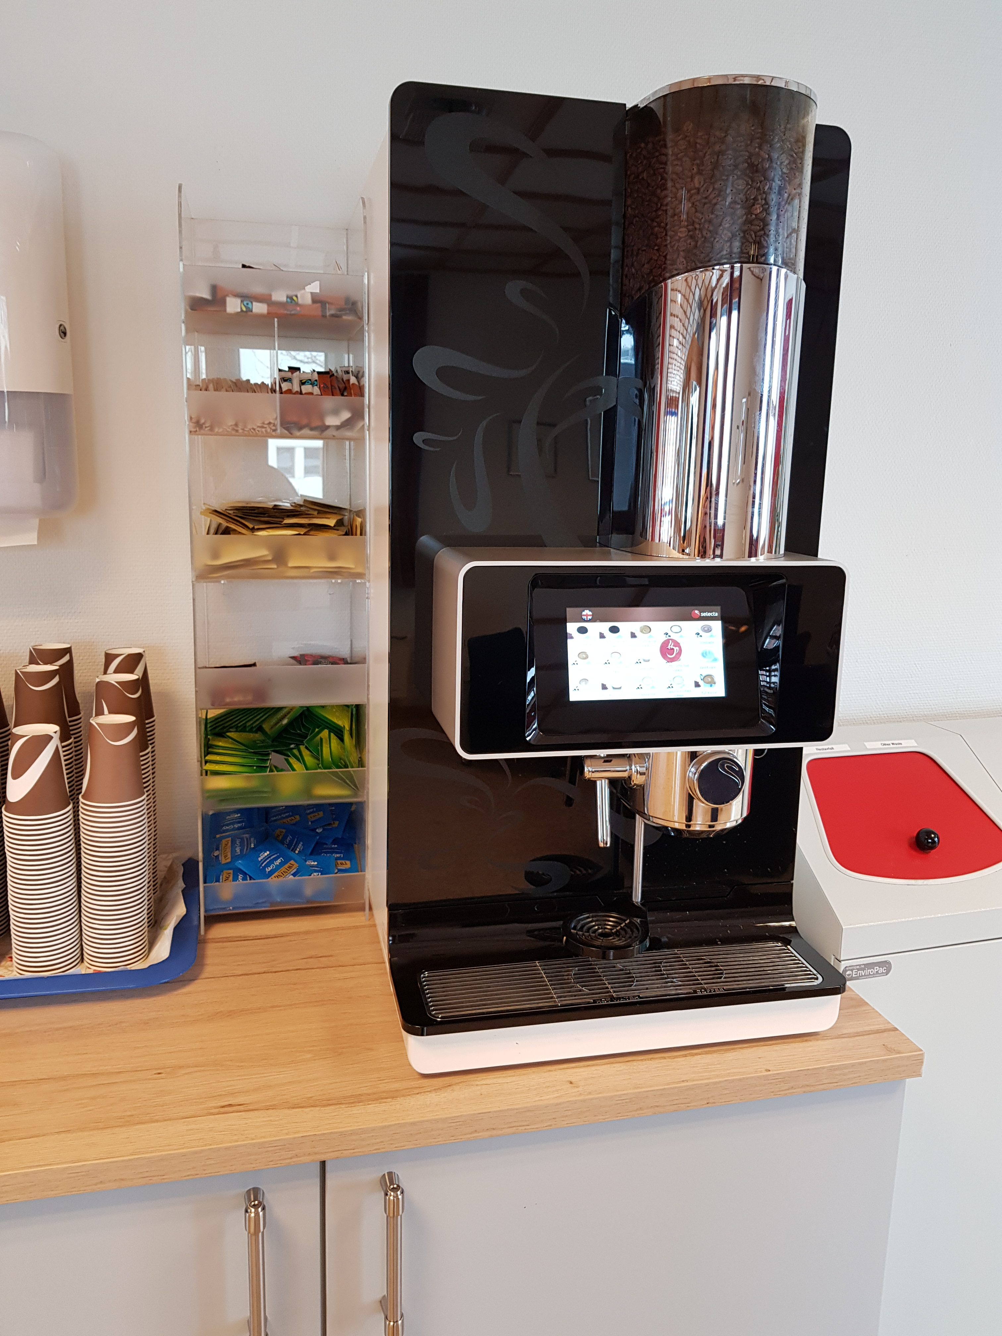


Contact
postmottak@its.uio.no / studieinfo@its.uio.no
facebook.com/itsuio
      @peopleofits
      www.mn.uio.no/its
WWW
Notes:
Or: come yell at me

Slide 11
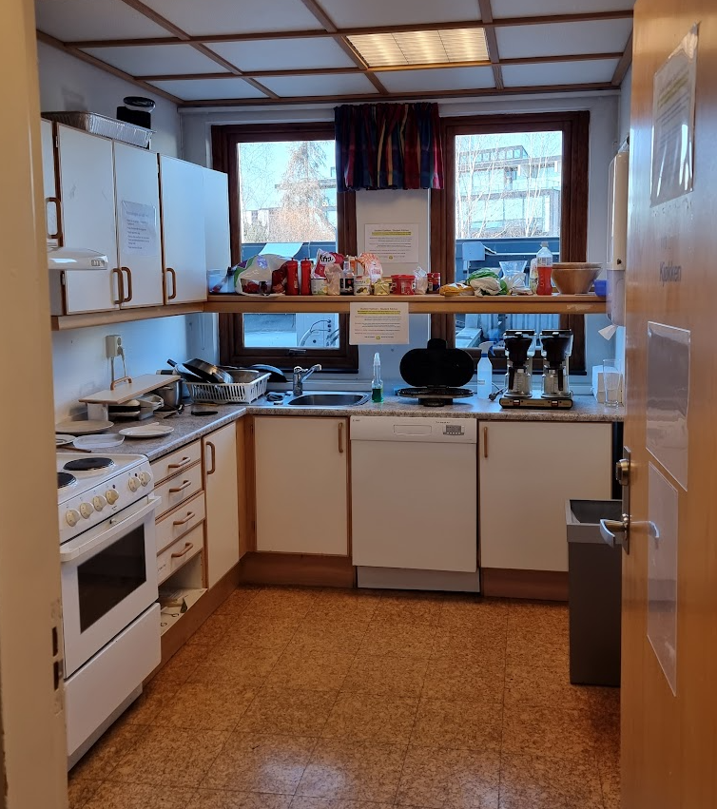
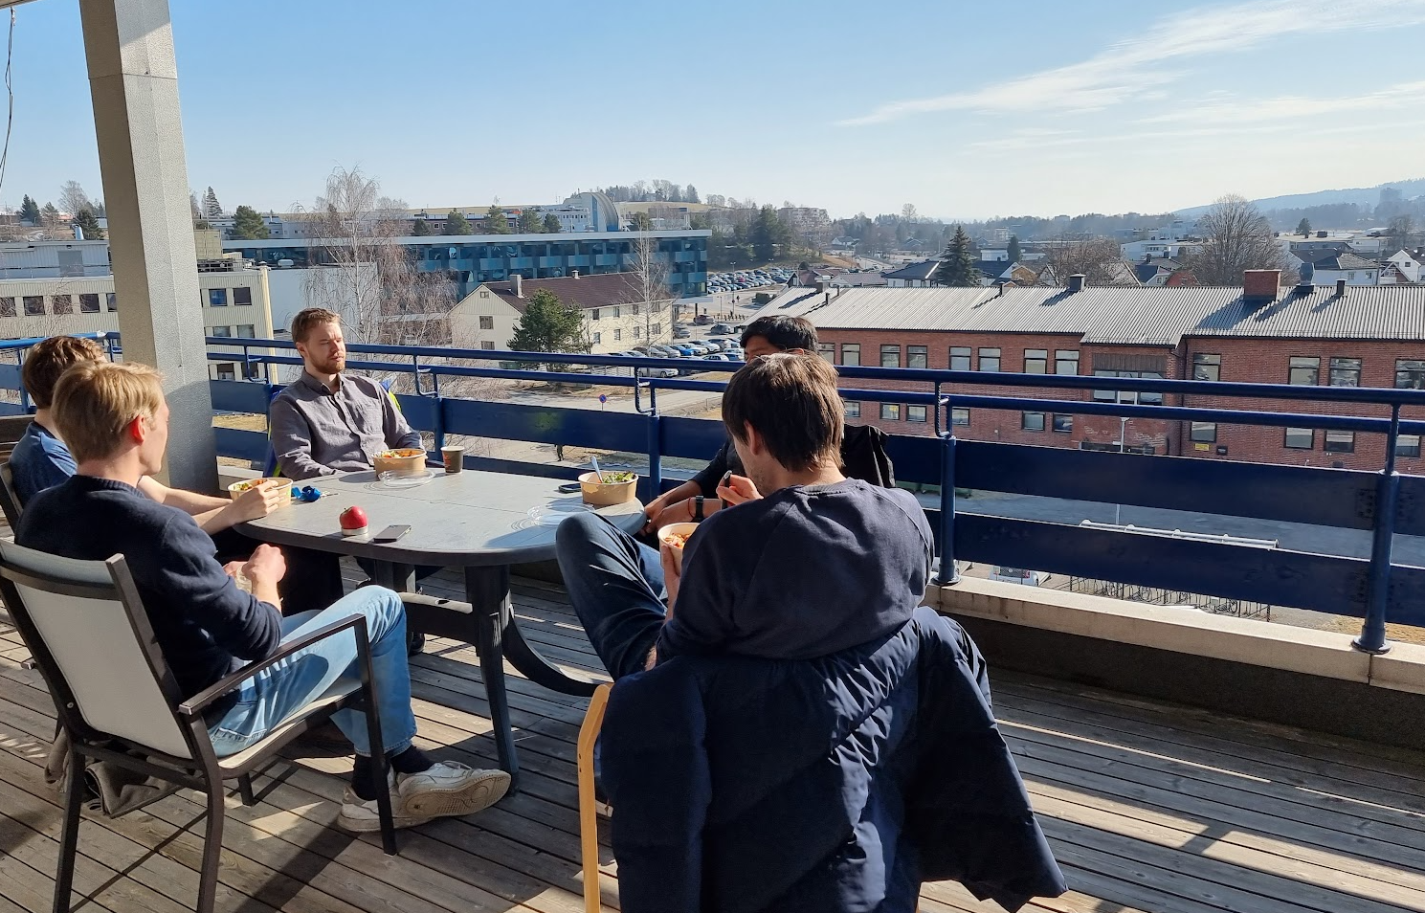
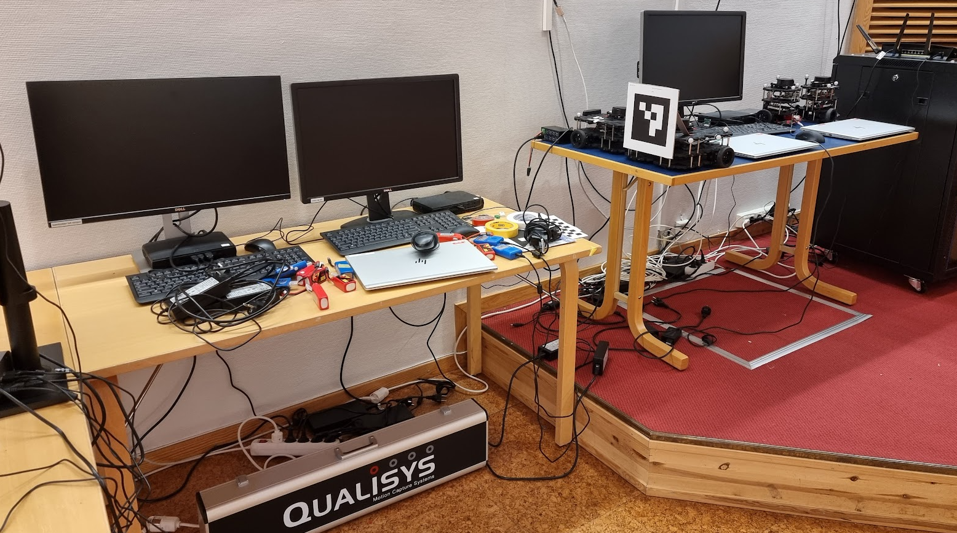
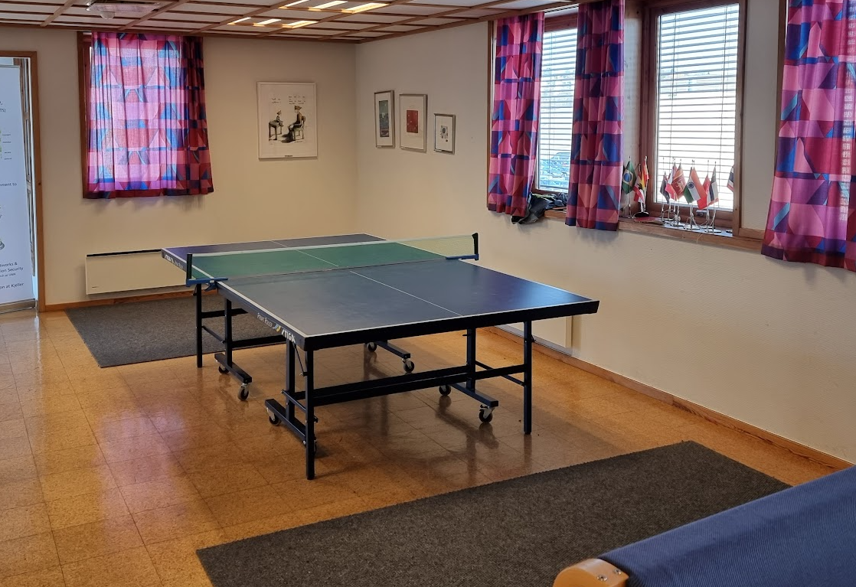
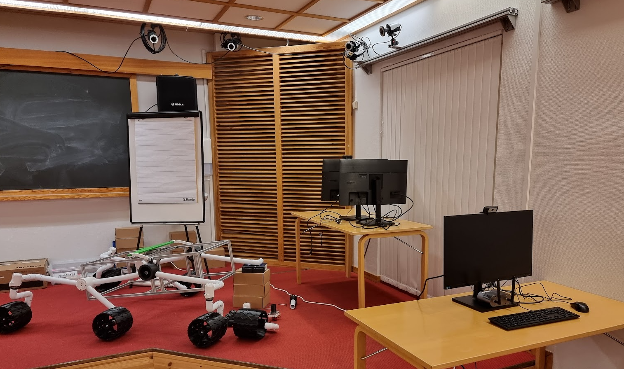
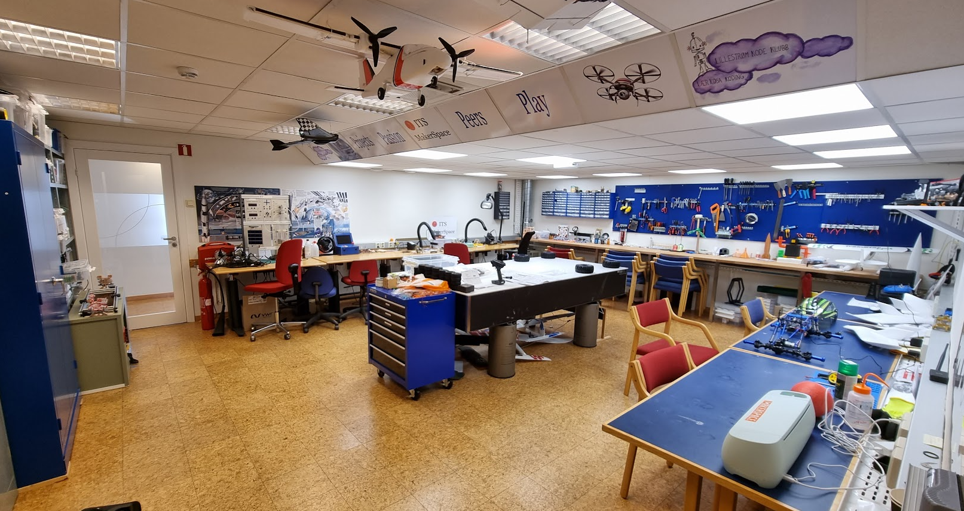
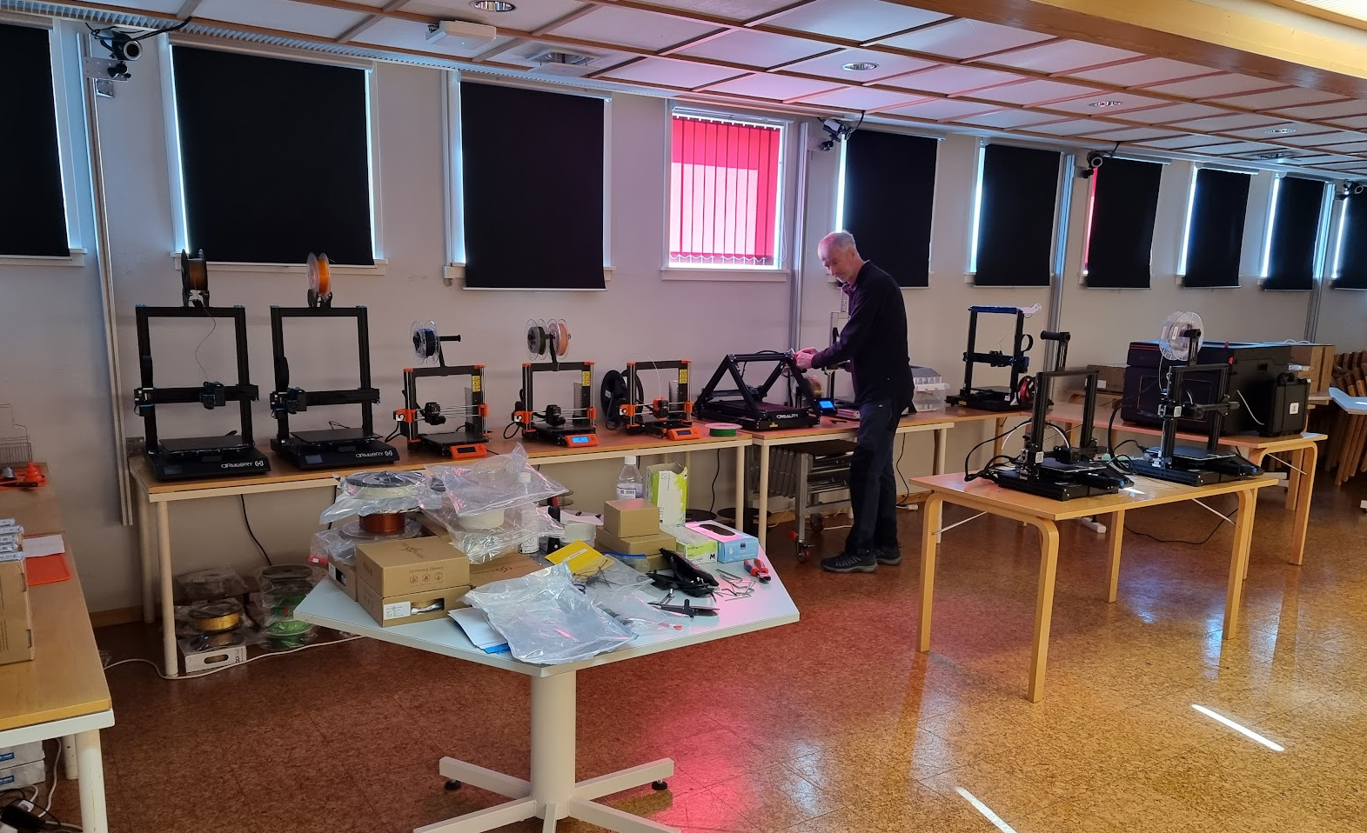
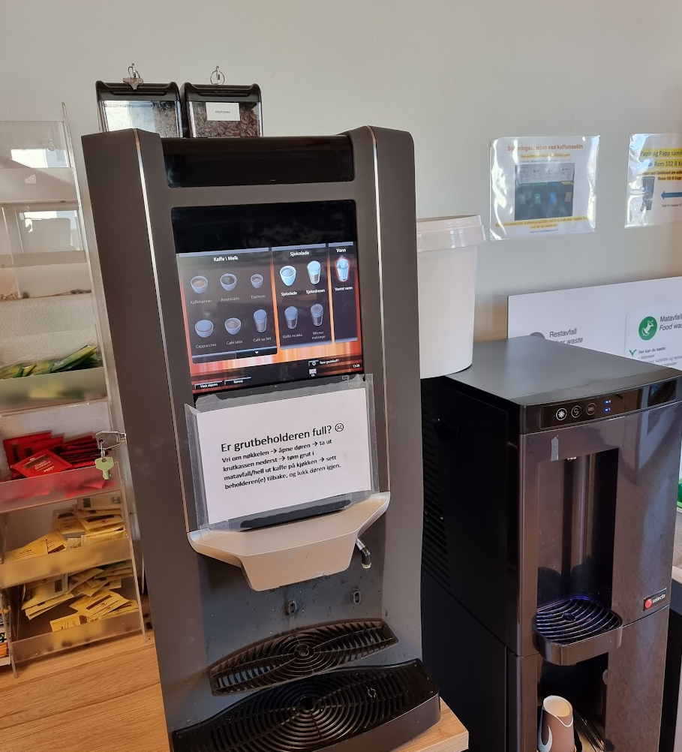
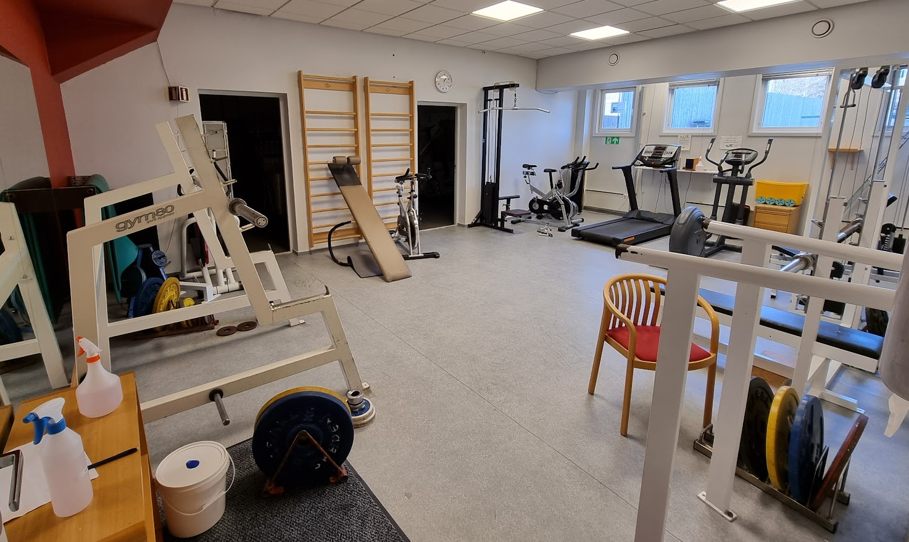
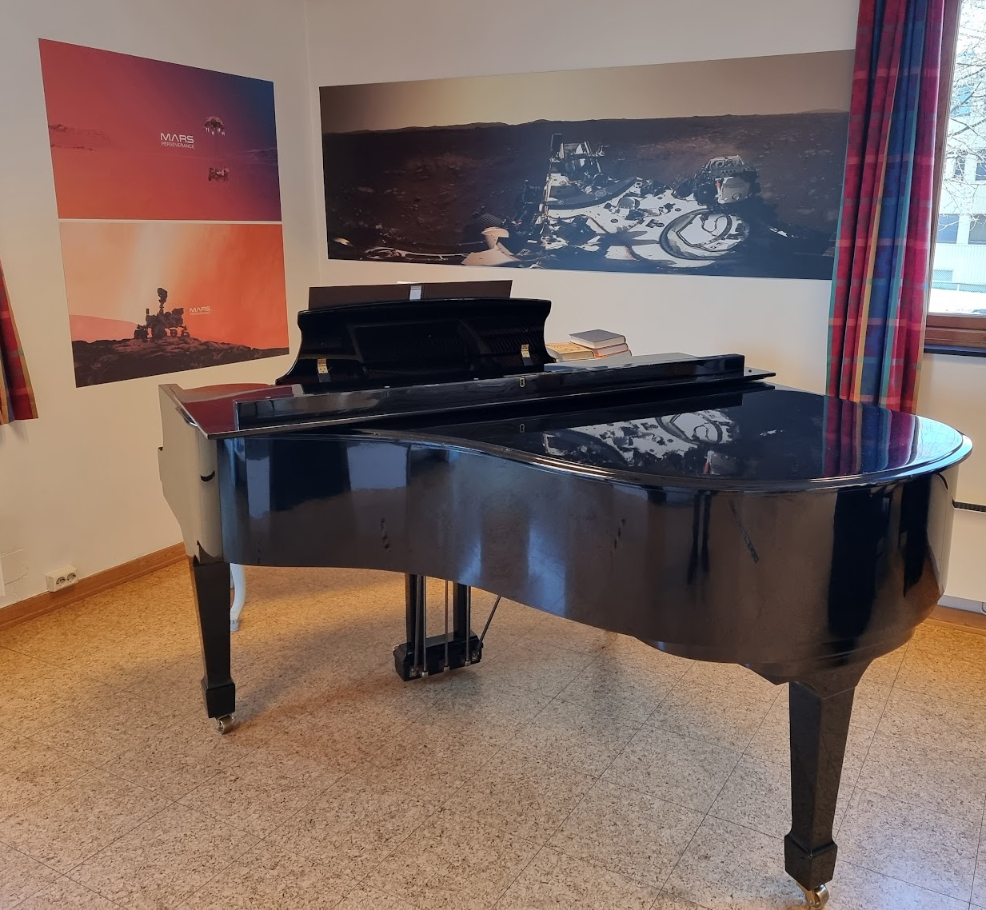
Student life at ITS

Slide 12
