Slide 1
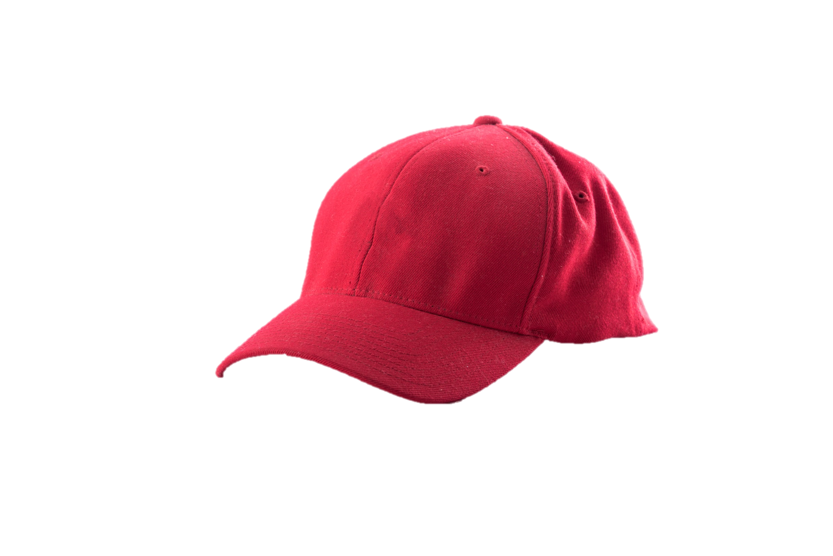
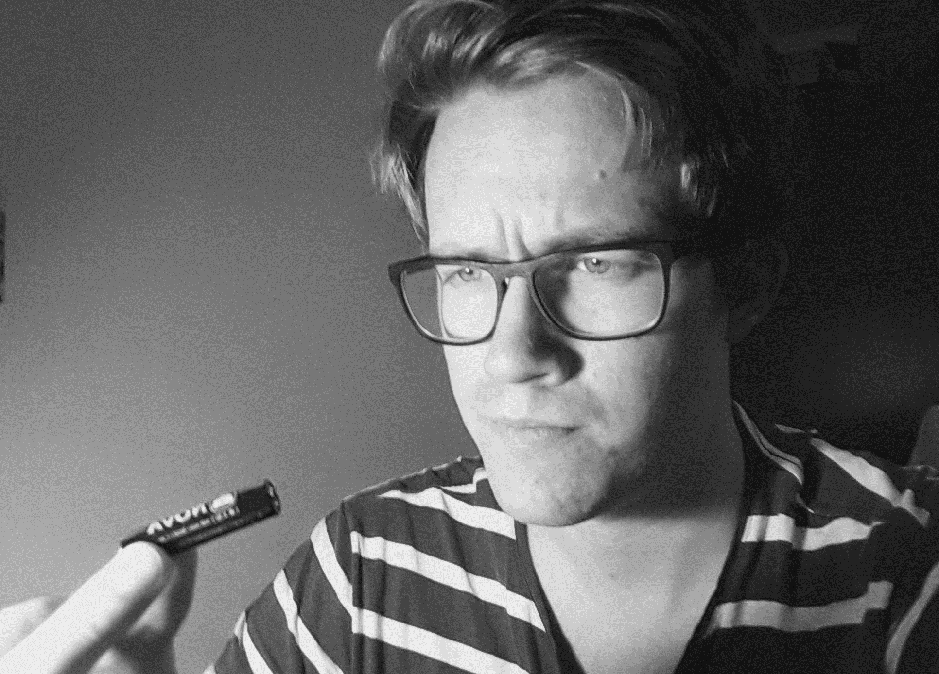
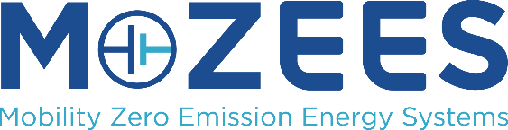
Halvor Høen Hval
Ph.d.-fellow
MAKE BATTERIES
SAFE AGAIN
Notes:
When people hear I work on batteries, they usually smile. That makes me happy. But then start complaining about their cell phone battery.

Slide 2
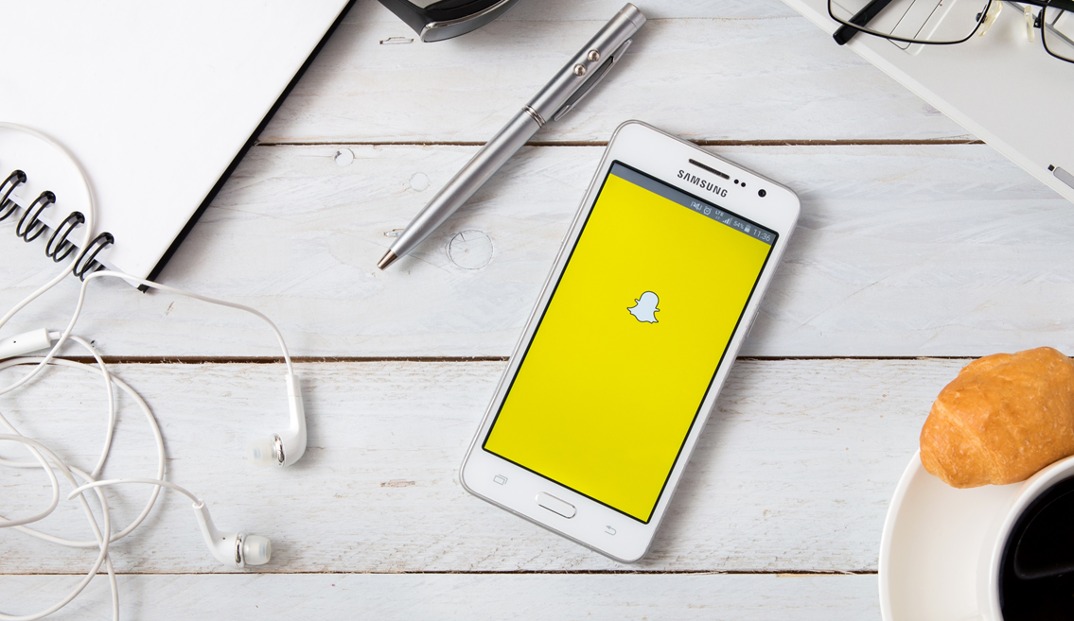
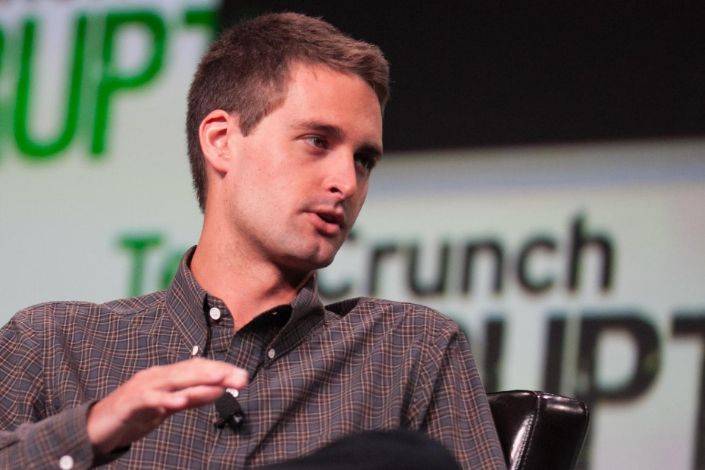
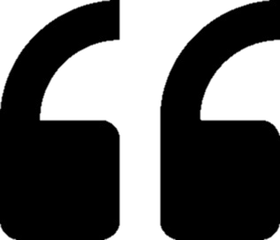
Photo: JD Lasica <https://flic.kr/p/fPS6qJ> , licence CC BY 2.0 <https://creativecommons.org/licenses/by/2.0>, no changes made
I keep hearing about battery innovation, but it never makes it to my phone.
- Evan Spiegel, co-founder of Snapchat
Notes:
This is not the motivation behind my research.

Slide 3
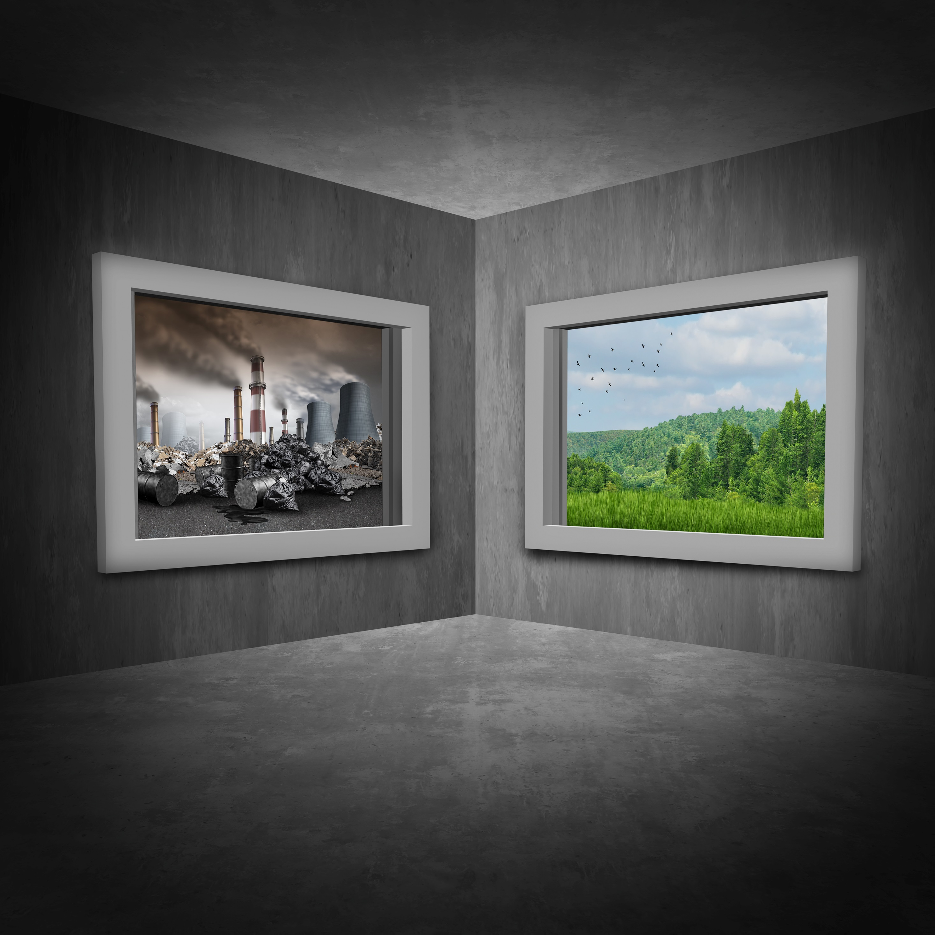
Notes:
Having a son
Excited, and worried
He and his descendants will have to pay the price for our selfish fossil fuel consumption.
(click)
We get more than enough energy from sunlight alone,
Renewable energy is cheaper than from fossile sources.
So WHY do we still burn them?
Accessibility.
Our energy consuption is not synchronized with sun, wind and waves.
Sunlight is weak when we are home from work
Cannot depend on sunshine and wind to drive
->Extra cost – the energy needs to be stored.
This is were batteries come in. Big batteries.

Slide 4
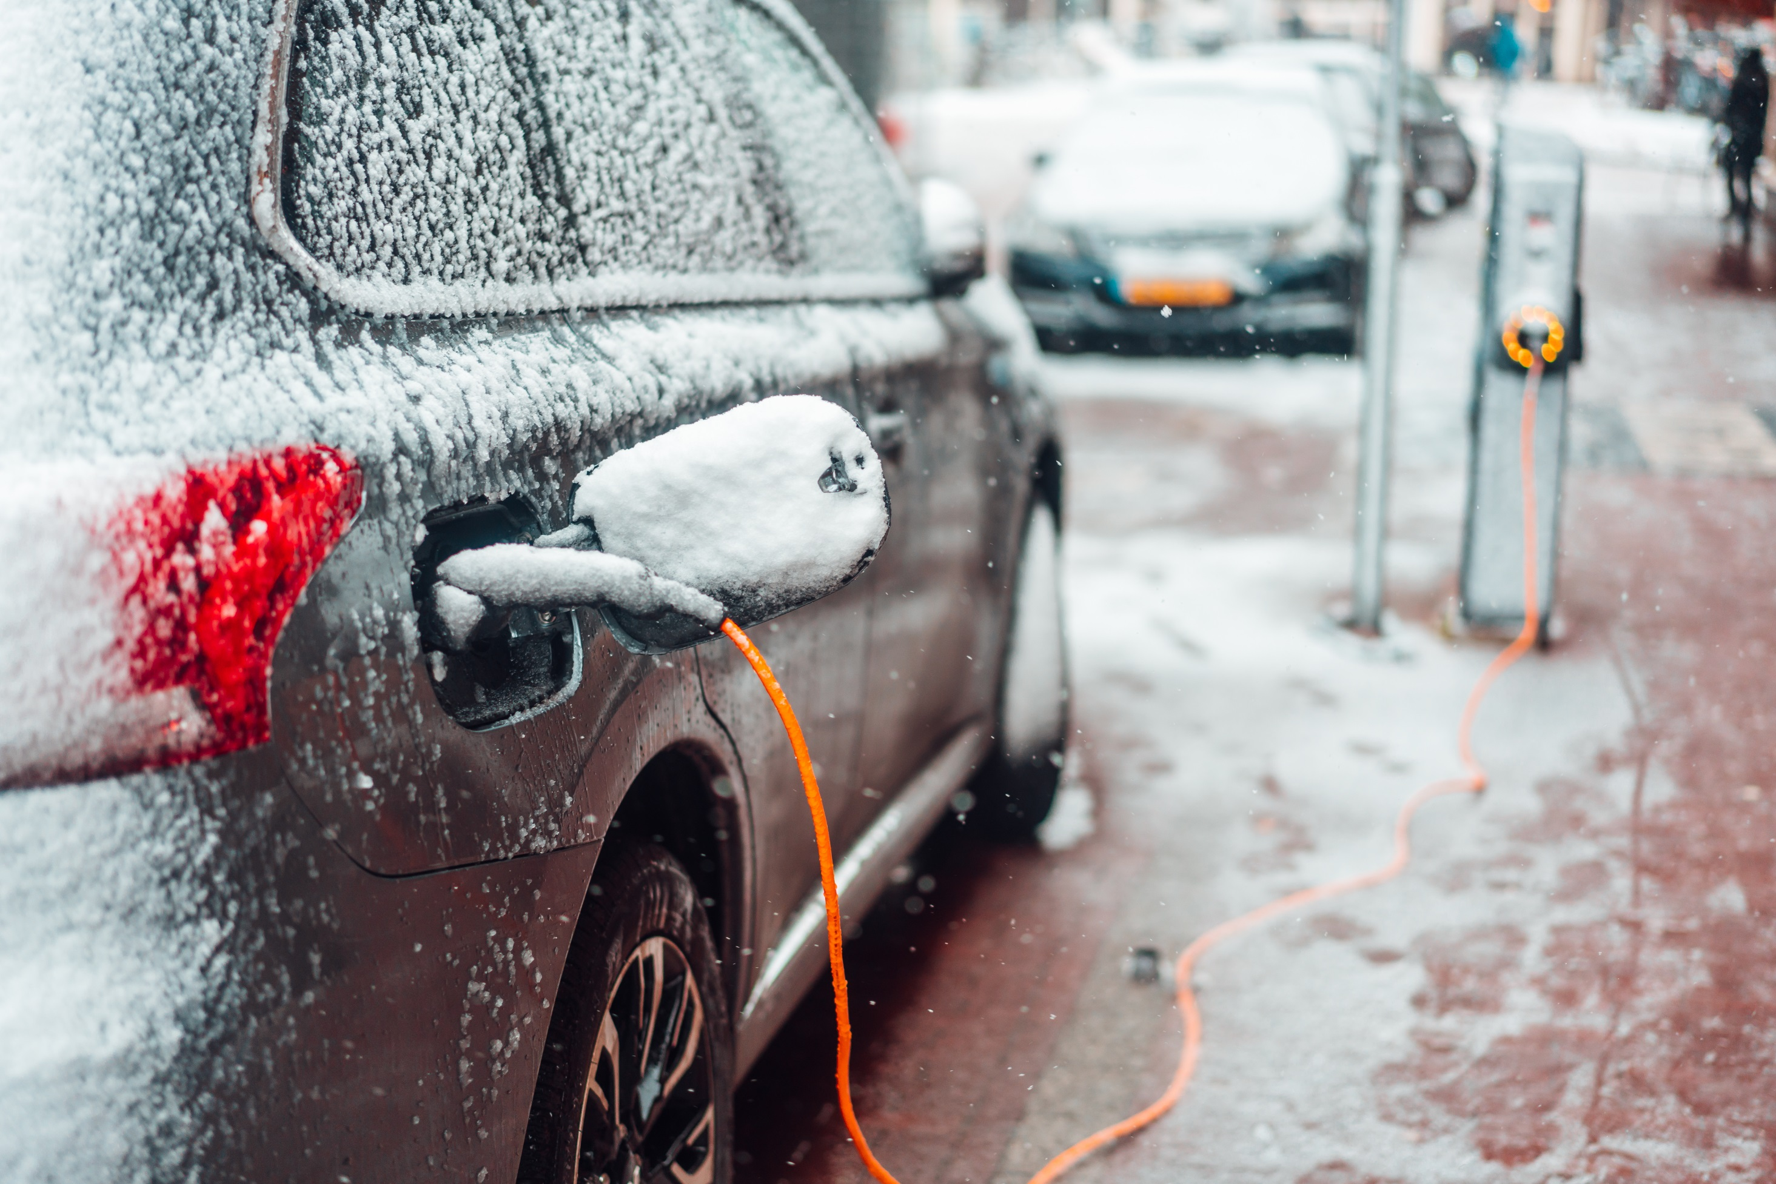
Notes:
In my research I consider battery materials for transportation
Safety is of uttermost importance.
Energy rich, and must withstand harsh conditions, such as large temp variations
Compromise between performance and safety is tricky
I wish to tweak is the electric potential.
I will make high-voltage cathodes.

Slide 5
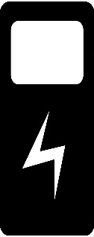
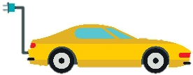
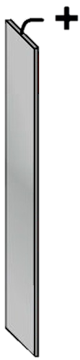

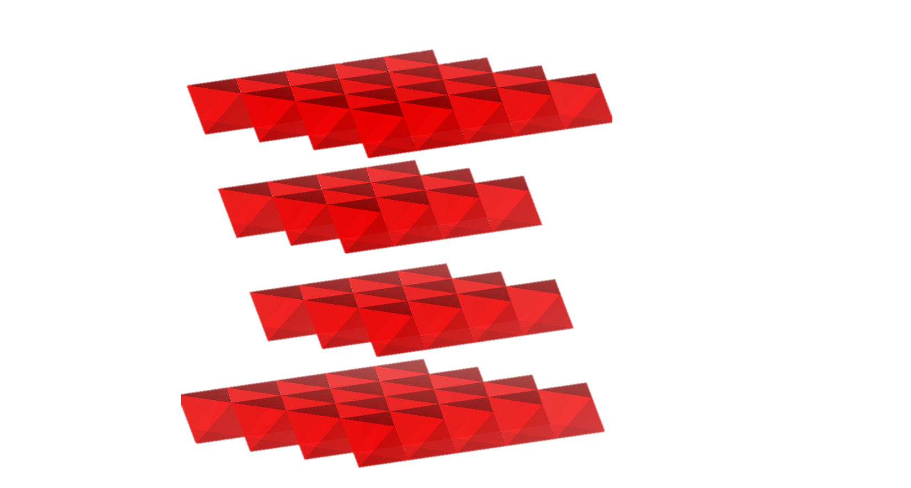
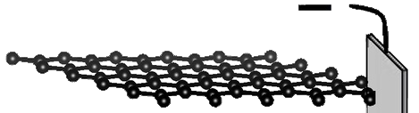
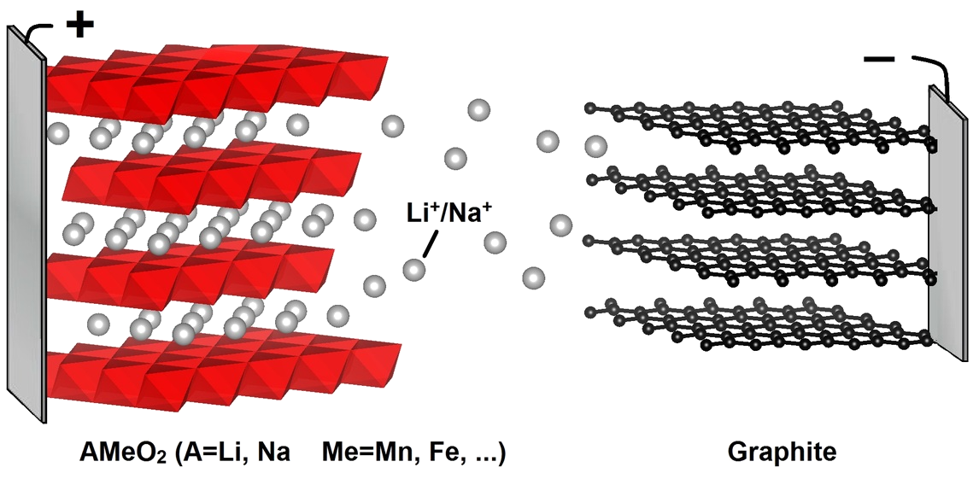
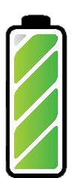
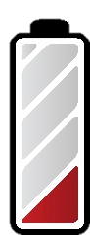
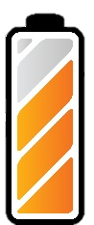
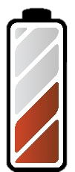
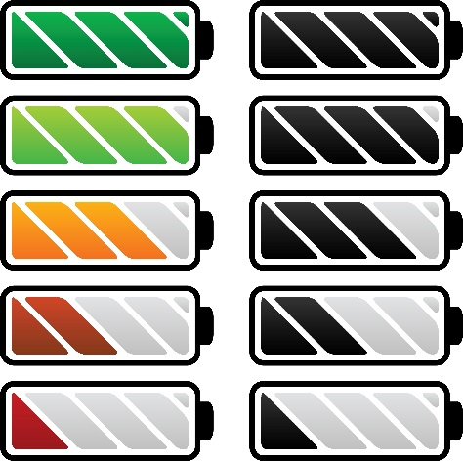

Slide 7
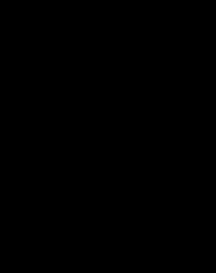
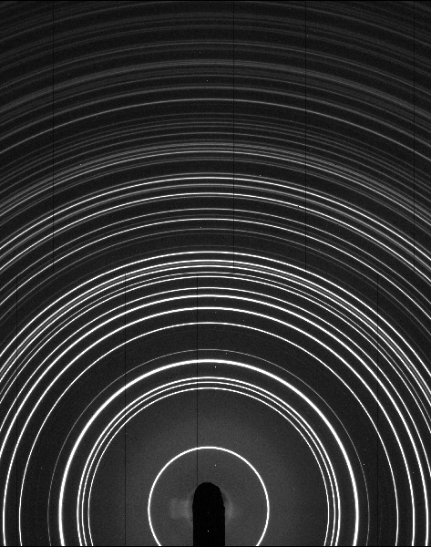
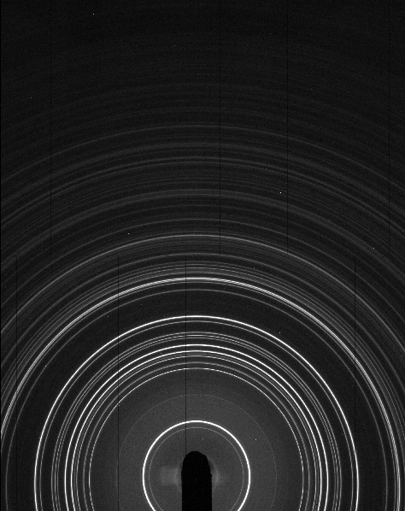
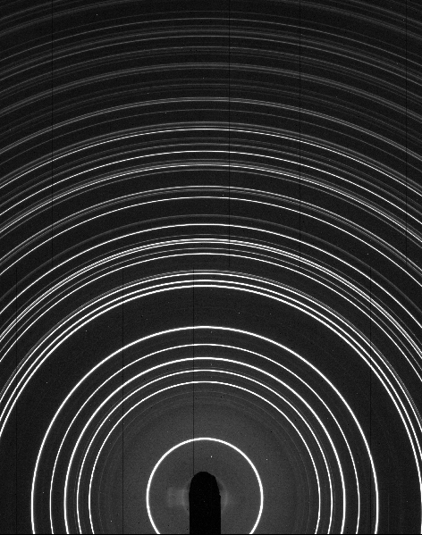
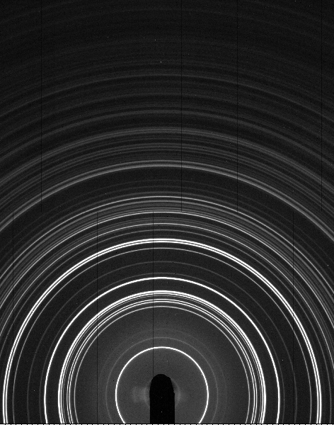
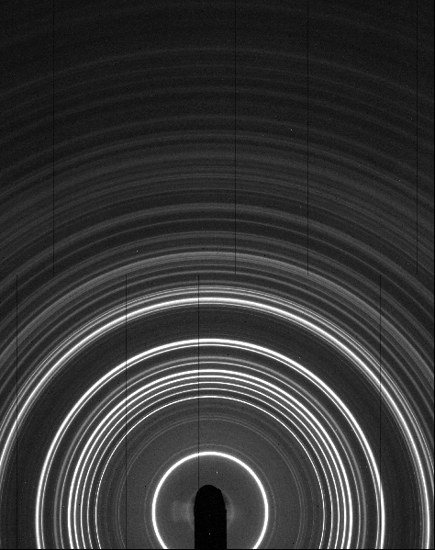

Slide 8
Notes:
I thought I would be more badass
Do not get my hands more dirty.
Reality kicked in, and I learned that to achieve something big, you’ve got to start small.
Thus i usually make cute coin cells like this when testing my materials. Then, I hope your batteries are charged – mine sure are! ‘Cause I’m not gonna to flip a coin and hope for the best – making big batteries safer is my contribution to make the world a greener and better place.

