Slide 1
University of Oslo NMR Center
Servicing the larger Oslo area with nmr science
Approximately 50-80 user accounts
8 (9) nmr spectrometers
Private companies are central
Automation is central
Chemistry Biology Biochemistry Material Science Medicine Veterinary Medicine Molecular Biology Pharmacy Police-Narcotics Industrial research and ??

Slide 2
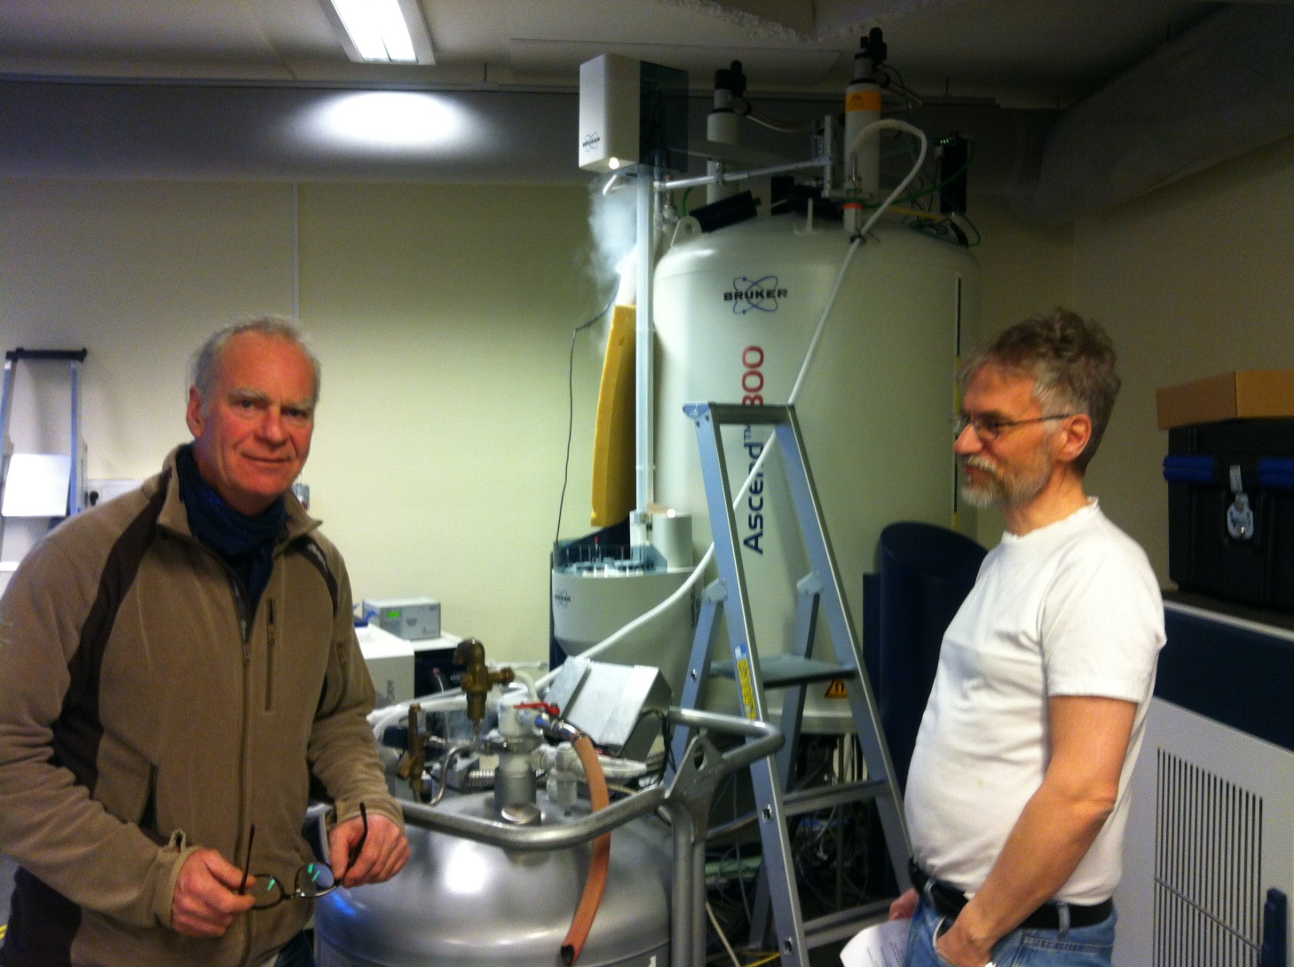
Dirk Petersen and Per Olav Kvernberg

Slide 3
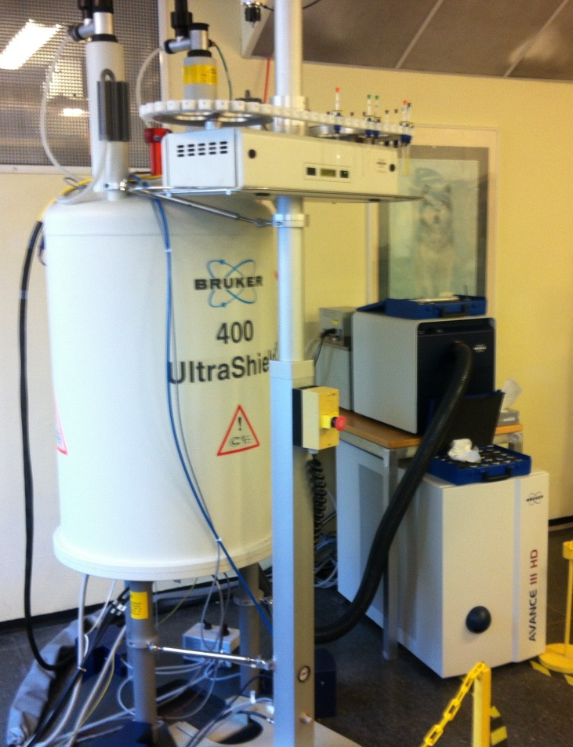
What are we Celebrating today? Bruker AVIIIHD800 and AVIIIHD400 UiO as Norwegian NMR Platform node

Slide 4
A fairly huge facility to run

Slide 5
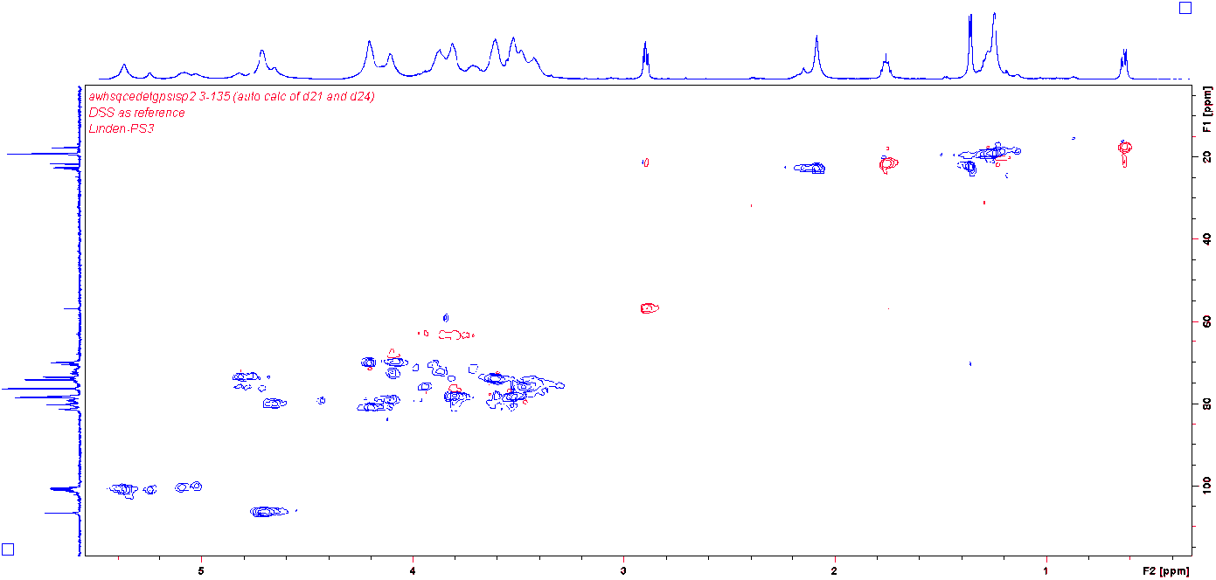
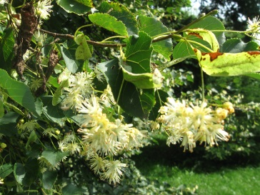
Recent 800 MHz results, part I
New ~1 x 10⁶ MW carbohydrate structure “solved” last week.
Yordan Georgiev, Bulgarian Academy of Sciences, Berit Smestad Paulsen, School of Pharmacy UiO, Alistair Wilkins, University of Waikato N. Z. and F. R. UiO

Slide 6
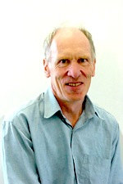
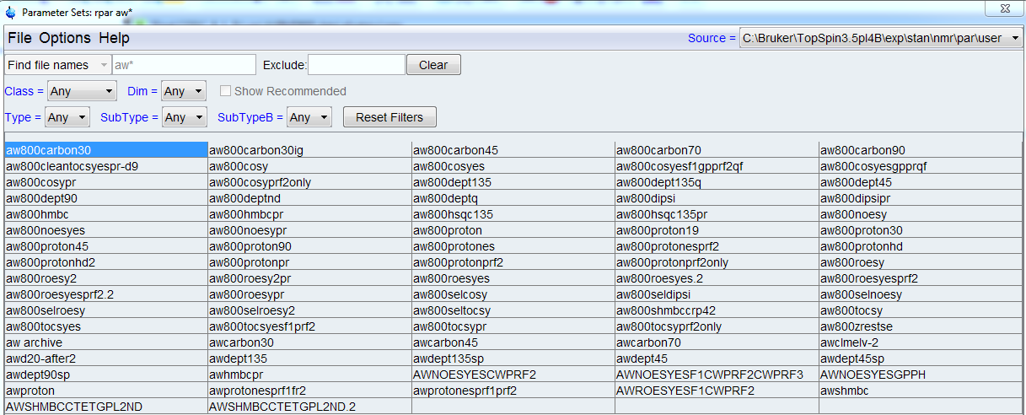
Recent 800 MHz results, part II
New solvent suppression parameter files and pulse programs made by Alistair Wilkins in N. Z. online to 800 MHz tested on small ~1000 MW toxins and the “1 x 10⁶ MW”

Slide 7
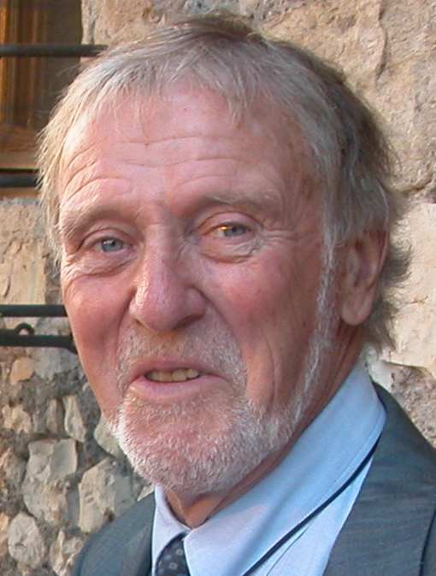
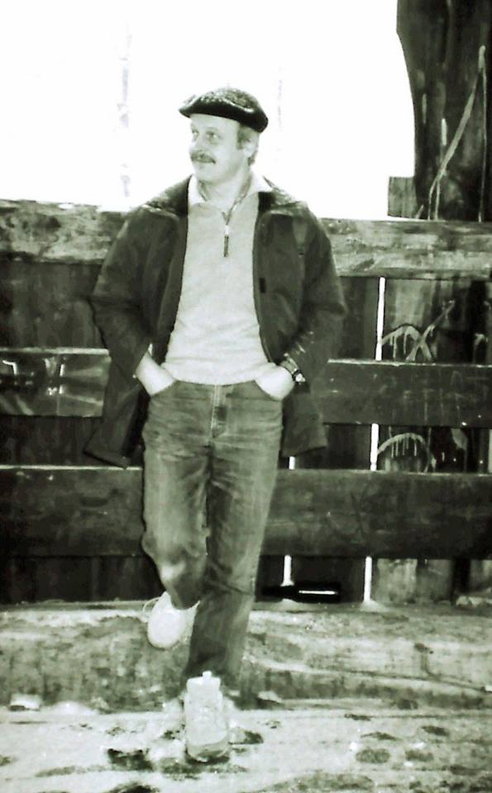
How did did it all start?
Per Kolsaker Detlef Moskau

Slide 8
Who else to thank?
Research Council of Norway (52 Mkr to NNP, 850 MHz UiB, 2 x 800 MHz NTNU and UiO)
Bruker Biospin (Larus Einarsson, Helena Kovacs, Jens Christian Madsen, Rainer Kümmerle, Göran Schömer and many more)
Department of Molecular Biology UiB (Øyvind Halskau Jr.)
Institute of Biotechnology NTNU (Finn Lillelund Aachmann)
Department of Chemistry UiB (Willy Nerdal)
Norwegian NMR Platform UiB (Jarl Underhaug)
Department of Chemistry UiO (1 MKr towards the 400 MHz)
Kaasa Malerfirma AS, VVS Engineering AS, Myhre Heis og Elektro AS, Bestotal AS, Datek AS, Building Maintenance UiO, Instrumentation Workshop at Department of Chemistry UiO

Slide 9
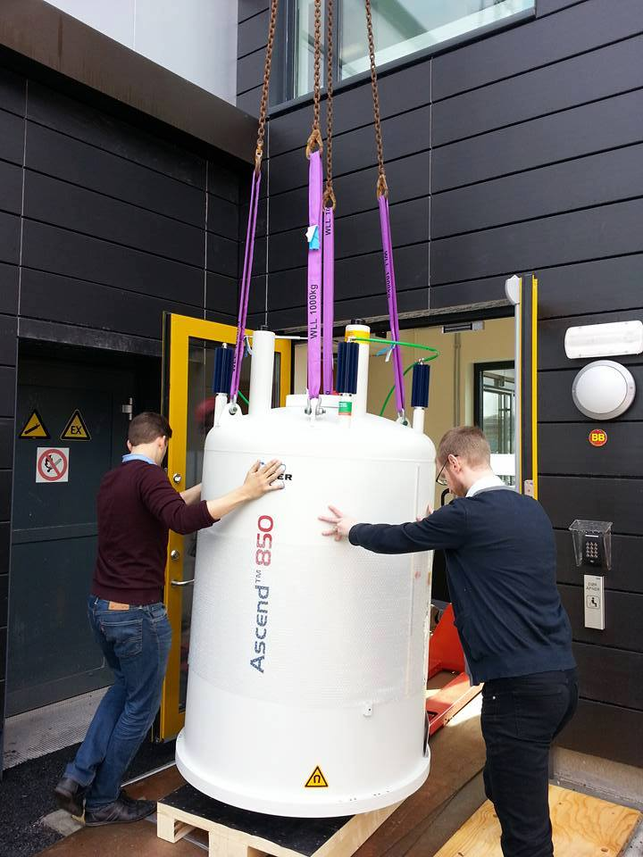
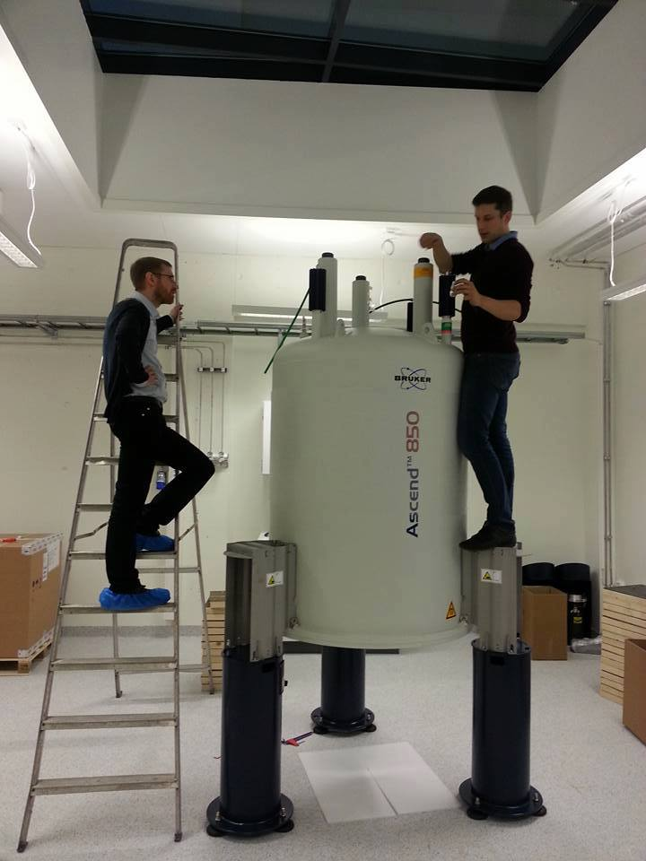
MR 2016 June 16. and 17. in Bergen
Lots of high class and fun MRI and NMR
Opening of the main NNP node

