Slide 1

Introduction to
Classification and labelling of mixtures
Wednesday 14. aug. 2019
09:15 – 14.00
Seminar room, Gleditcsh, Chemistry building
Karoline Fægri og Svein Tveit, Skolelaboratoriet i kjemi

Slide 2
Competence aims
Enable students to:
Be aware of the regulations that apply to classification and labelling of chemicals
Explain some fundamental concepts used in classification and labelling of hazardous substances and mixtures
Explain the elements of CLP hazard labelling
Label aquatic solutions of 2 mol/L NaOH,
15 % HCl, 9 % NH₃ and 0,2 mol/L CuSO₄
Notes:
Downstreams user?

Slide 3
Outline
Background information on CLP
Definitions and rules used in classification and labelling with CLP
Example - how to make a label
Exercise 1 & 2
More definitions and rules
Exercise 3
Even more definitions and rules
Exercise 4
How do we label chemicals at the university

Slide 4
Breaks
10.10 – 10.30
11.30 – 12.15 – lunch

Slide 5
Outline
Background information on CLP
Definitions and rules used in classification and labelling with CLP
Example – how to make a label
Exercise 1 & 2
More definitions and rules
Exercise 3
Even more definitions and rules
Exercise 4
How do we label chemicals at the university

Slide 6
Why is it important to classify and label chemicals?

Slide 7




HSE/HMS – authorities in Norway
 | Nature of hazards | Resposible authorities for HSE-laws and regulations
Health Helse | Health | Norwegian Labour Inspection Authority Arbeidstilsynet
Safety Sikkerhet | Physical | Norwegian Directorate for Civil Protection Direktoratet for samfunnssikkerhet og beredskap (DSB)
Environment Miljø | Environment | Norwegian Environment Agency Miljødirektoratet

Slide 8


About Regulation (EC) No 1272/2008 (CLP)
GHS | Global Harmonized System for classification and labelling of chemicals FNs globalt harmoniserte system for klassifisering og merking av kjemikalier
ECHA | European CHemicals Agency, responsible for implementing GHS in EU by establishing and updating an inventory for GHS substances Det europeiske kjemikaliebyrået ECHA har ansvar for å etablere og holde oppdatert et register over stoffers fareklassifisering og -merking.

Slide 9


About Regulation (EC) No 1272/2008 (CLP)
REACH | Regulation (EC) No 1907/2006 Registration, registrering Evaluation, vurdering Authorisation and Restriction, godkjenning og begrensning CHemicals, kjemikalier
CLP | Regulation (EC) No 1272/2008 Classification. klassifisering Labelling, merking Packaging of Substances and Mixtures, og emballering av stoffer og stoffblandinger

Slide 10

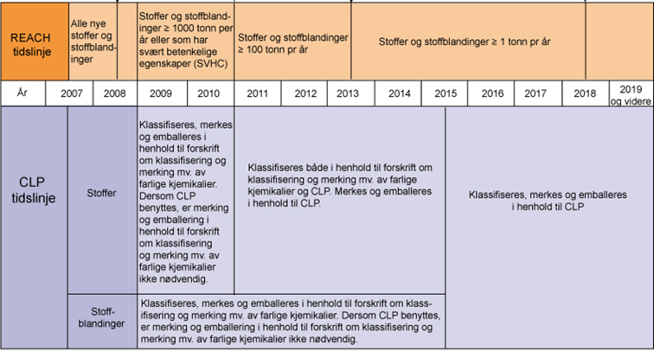
Timeline for implementing CLP
only CLP after
1. juni 2017
16. June 2012
CLP in Norway
1. December 2010
CLP in EU
Old labels and CLP until
1. June 2015
Kilde: http://www.miljodirektoratet.no/Global/dokumenter/tema/kjemikaler/reach_clp_tidslinje_800.jpg (august 2014)
Notes:
Forskrift om klassifisering, merking og emballering av stoffer og stoffblandinger (CLP) ble innført 16. juni 2012. Denne forskriften erstatter Forskrift om klassifisering, merking mv. av farlige kjemikalier (Merkeforskriften).
Skal sikre samme merking for lagring, omsetning og transport, over hele verden.

Slide 11
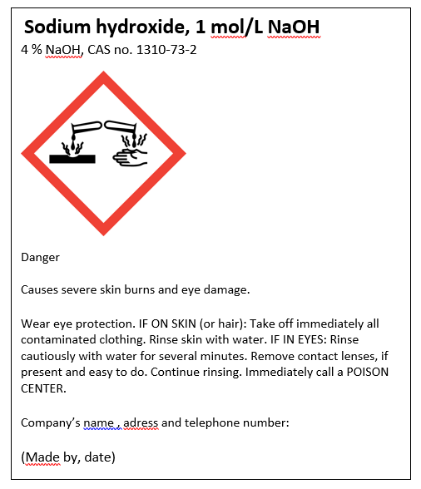
Hazard communication
Product identifier
Hazard pictogram
Signal word
Hazard statement
Precautionary
statement
Company identity

Slide 12
Product identifier
Name and identification number given in the Classification and Labelling Inventory
if not included in C&L Inventory
CAS number and IUPAC name

Slide 13

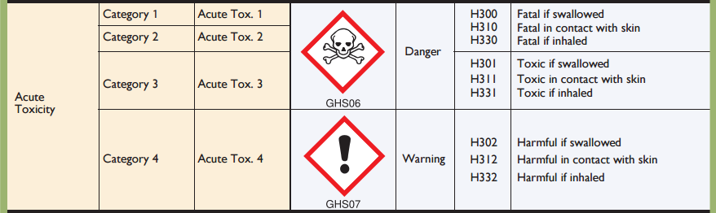
Hazard classes and categories (not part of labelling)

Slide 14

Hazard pictograms
Physical
Health
Environment

Slide 15
Signal words and hazard statements

Slide 16
Groups of hazard and precautionary statements
Code | hazard statements | Code | precautionary statements
H200-H299 | Physical | P100-P199 | General
H300-H399 | Health | P200-P299 | Prevention
H400-H499 | Environment | P300-P399 | Response
 |  | P400-P499 | Storage
 |  | P500-P599 | Disposal
EUH | only in the EU

Slide 17
Exercises – Classifying and making labels
Example: label 3 mol/L H₂SO₄ 1 L bottle

Slide 18
7664-93-9
7664-93-9
Classification
Label
Sulfuric acid, 3 mol/L H₂SO₄
CAS nr.
Notes:
Concentration: 3 mol/L * 82 g/mol = 246 g/L
In mass %: 246 g/L / 1170 g/L * 100% = 21 % (m/m

Slide 19
Exercises – Classifying and making labels
1a) Label for 2 mol/L NaOH
1b) (optional) Label for 5 mol/L HCOOH (density 1,05 g/mL)

Slide 20

Classification for acute or chronic aquatic hazard
L(E)C₅₀ from SDS
SECTION 12: Ecological information
12.1. Toxicity
Acute aquatic, fish: Value: x mg/l

Slide 21
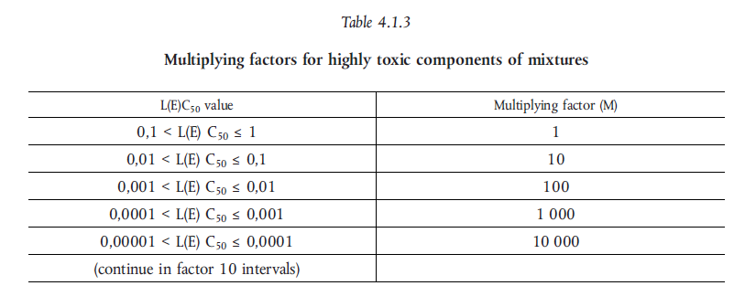
M - factor

Slide 22
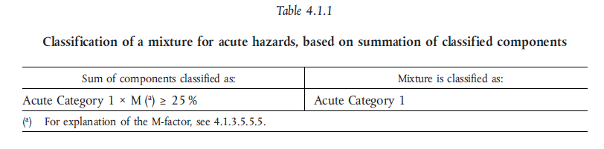
Classification – Aquatic acute

Slide 23
Exercises – Classifying and making labels
3a) Label for 9 % NH₃ in 1L bottle
3b) (optional) Label for 0,3 mol/L HNO₃

Slide 24
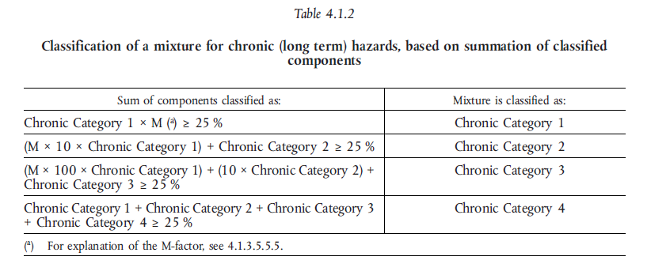
Classification – Aquatic chronic

Slide 25


Classification – Acute toxicity
ATE = Acute toxicity estimate

Slide 26
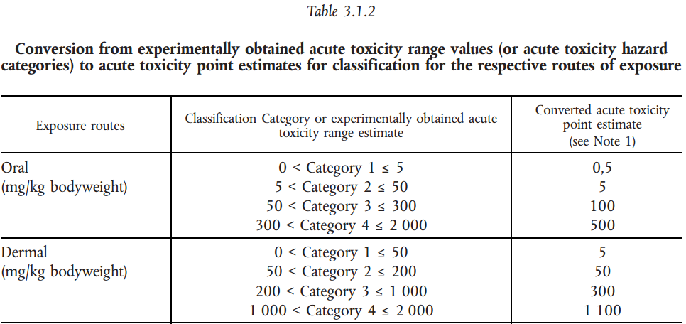

Acute toxicity
Example
A 5 % solution of a substance classified as acute tox. 3 – oral exposure
$${ATE}_{mix}=\frac{100∗ATE}{c}=\frac{100∗100}{5}=2000$$

Slide 27
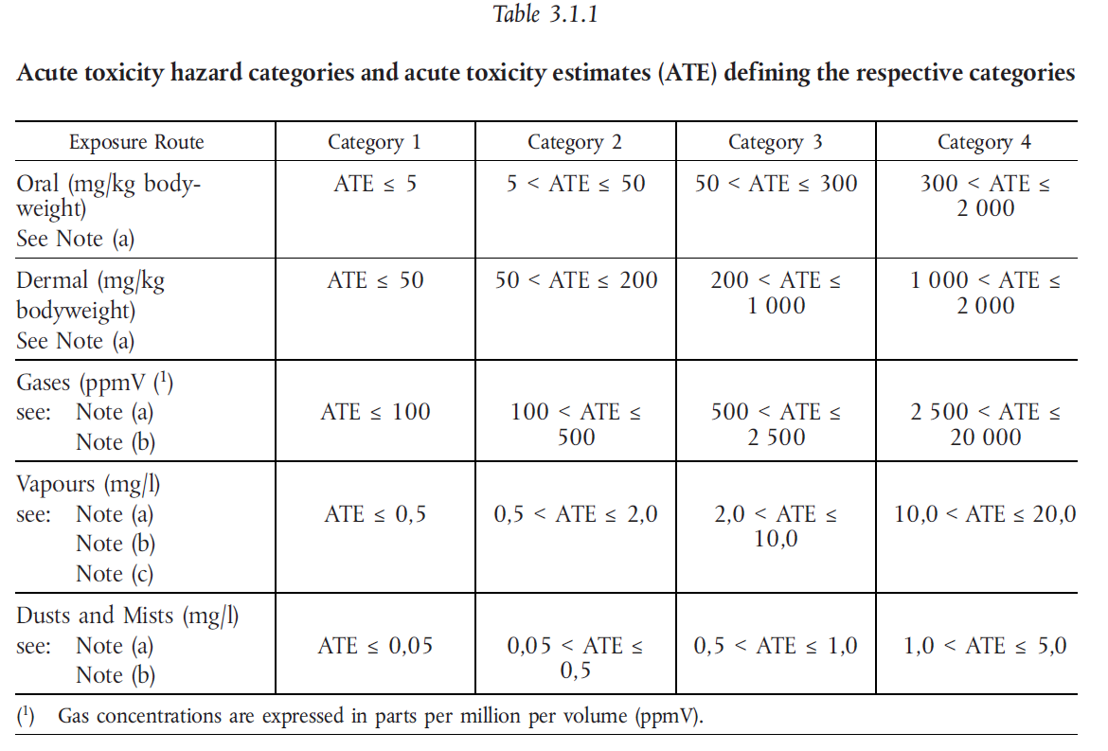

Slide 28
Acute toxicity
Example
A 5 % solution of a substance classified as acute tox. 3 – oral exposure
$${ATE}_{mix}=\frac{100∗ATE}{c}=\frac{100∗100}{5}=2000$$

Slide 29
Exercises – Classifying and making labels
4a) Label for 0,2 mol/L CuSO₄
4b) (optional) Label for 1 mol/L ZnCl₂

Slide 30
Harmonised classification
Harmonised classification (as provided in Annex VI to CLP), must always be used by a manufacturer
Harmonised classification normally applies to those properties of the highest concern
Where some, but not all hazard classes or differentiations within hazard classes have been harmonised, the remainder should be self-classified to complete the classification
Guidance on the Application of the CLP Criteria

Slide 31
Leads to different classification for the same mixture
Ammonia 25 % (Avantor)
Skin corrosion 1B
Aquatic acute, 1
STOT, SE, 3
Serious eyedamage, 1
Aquatic chronic, 2
Ammonia 25 % (Merck)
Skin corrosion, 1B
Aquatic acute, 1
STOT, SE, 3
Corrosive to metals, 1

Slide 32
CLP in scientific research
This Regulation (CLP) shall not apply to the following:
substances and mixtures for scientific research and development, which are not placed on the market, provided they are used under controlled conditions in accordance with Community workplace and environmental legislation.
http://eur-lex.europa.eu/LexUriServ/LexUriServ.do?uri=OJ:L:2008:353:0001:1355:en:PDF
Title 1, Article 1, 2d

Slide 33
How to label mixtures in your science lab
Mixtures that are to be use the same day do not require any labelling
Mixtures that are left over night requires a minimum labelling of:
  Name and molar concentration
  Hazard pictograms
  Hazard statements
  Highly relevant precautionairy statements

Slide 34
Evaluation
Plus, minus, delta

