Slide 1
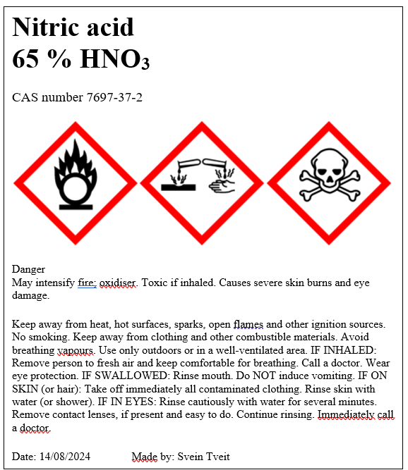
Classification and labelling of mixtures
An introduction
Svein Tveit
Research Section for Chemistry Education
Department of Chemistry

Slide 2

Who is attending the workshop?

Slide 3

Competence aims
Enable students to:
Be aware of the regulations that apply to classification and labelling of chemicals
Explain some fundamental concepts used in classification and labelling of hazardous substances and mixtures
Explain the elements of CLP hazard labelling
Label aquatic solutions of 2 mol/L NaOH,
2 % HCOOH, 0,1 mol/L ZnCl₂ and 2,0 mol/L ZnSO₄

Slide 4
Outline
Background information on CLP
Definitions and rules used in classification and labelling with CLP
Example 1 - how to make a label
Exercise 1 & 2
Example 2 - how to make a more difficult label, included more definitions and rules
Exercise 3a & 3b
How do we label chemicals at the university?
Lunch break approx. 11.45 – 12.30

Slide 5
Where to find the documents for this workshop?
Google “Seksjon for kjemididaktikk uio”
In the left menu, choose “kurs”
In the left menu, choose “tidligere kurs”
Under 2024 you will find the presentation, the checklist and a booklet with information and exercises.

Slide 6

Why is it important to classify and label chemicals?

Slide 7



HSE/HMS – authorities in Norway
 | Nature of hazards | Resposible authorities for HSE-laws and regulations
Health Helse | Health | Norwegian Labour Inspection Authority Arbeidstilsynet
Safety Sikkerhet | Physical | Norwegian Directorate for Civil Protection Direktoratet for samfunnssikkerhet og beredskap (DSB)
Environment Miljø | Environment | Norwegian Environment Agency Miljødirektoratet

Slide 8
European chemical legislation
GHS is a global harmonized system for classification and labelling of chemicals
European Chemicals Agency, ECHA, is responsible for implementing GHS in Europe by establishing and updating an inventory on GHS substances.
There are two cornerstones of chemical legislation in the EU:
Regulation (EC) 1907/2006 on Registration, Evaluation, Authorisation and Restriction of Chemicals – The REACH regulation.
Regulation (EC) 1272/2008 on Classification, Labelling and packaging of substances and mixtures – The CLP regulation
Norway as part of EØS is bound to EU chemical legislation and only CLP is used since 2017.

Slide 9
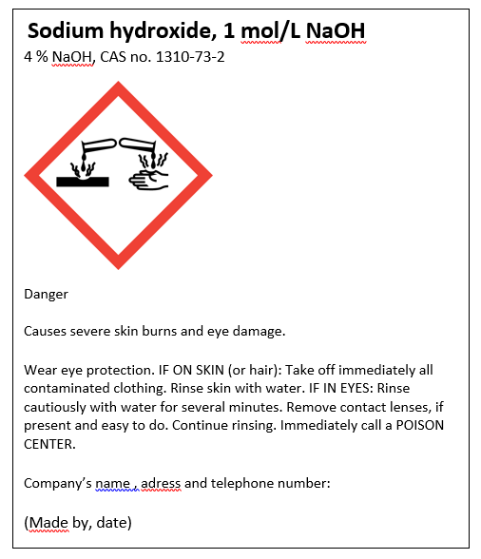
Hazard communication in CLP
Product identifier
Hazard pictogram
Signal word
Hazard statement(s)
Precautionary
Statements
Company identity

Slide 10
Product identifier
Name and identification number given in the Classification and Labelling Inventory
If not included in C&L Inventory use the CAS number and IUPAC name

Slide 11

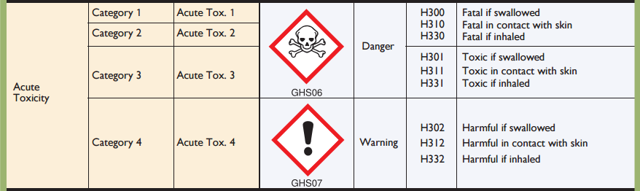
Hazard classes and categories (Not part of labelling)

Slide 12









Hazard pictograms
Physical
Environment
Health

Slide 13
Signal words and hazard statements

Slide 14
Groups of hazard and precautionary statements
Code | Hazard statements | Code | Precautionary statements
H200-H299 | Physical | P100-P199 | General
H300-H399 | Health | P200-P299 | Prevention
H400-H499 | Environment | P300-P399 | Response
 |  | P400-P499 | Storage
 |  | P500-P599 | Disposal

Slide 15
Example 1 – Classifying and making labels
Make a label for 3 mol/L H₂SO₄

Slide 16
Calculate approximately mass percentage concentration
M_{m} (H₂SO₄) = 98 g/mol
Calculate concentration in g/L:
3 mol/L ⋅ 98 g/mol = 294 g/L
We assumed that the density is 1000 g/L:
Mass % = 294 g/L / 1000 g/L * 100 % = 29,4 %

Slide 17
Exercise 1
Make a label for 2 mol/L NaOH

Slide 18
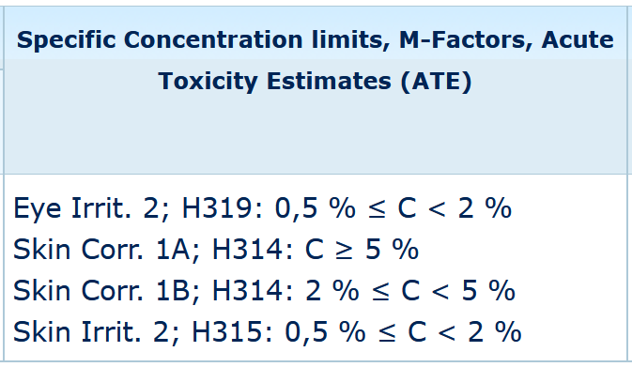
Severity of hazards decreases as concentration decreases
Pure sodium hydroxide is classified as Skin Corr. 1A
Solutions with a concentration of 5 % and more are also classified as Skin Corr. 1A.
Solutions with a concentration of 2 % or more, but less than 5 % is classified as Skin Corr 1 B.
What about solutions with concentrations below 2 %?

Slide 19
Exercise 2
Make a label for 2 % formic acid, HCOOH.

Slide 20
Example 2 – Classifying and making labels
Make a label for 1 mol/L CuSO₄

Slide 21
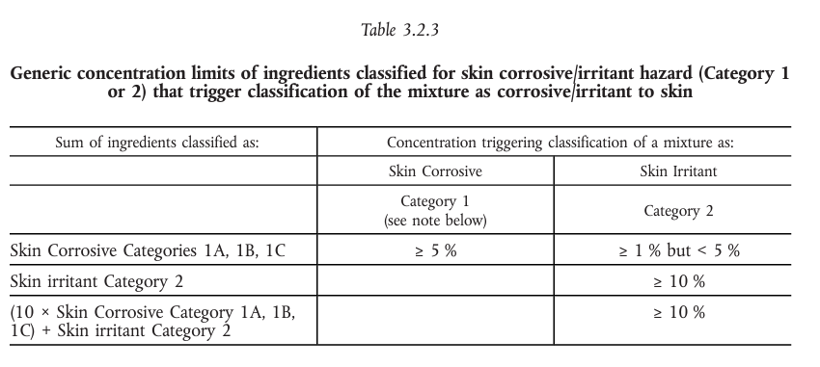
Generic concentration limits
When specific concentration limits are not given in C&L inventory, we have to use generic concentration limits.
Generic concentration limits for different hazard classes can be found in the CLP regulation.

Slide 22
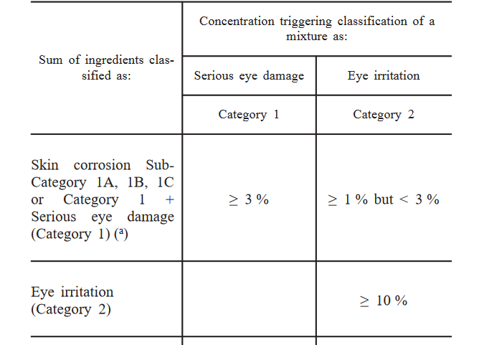
Generic concentration limits
When specific concentration limits are not given in C&L inventory, we have to use generic concentration limits.
Generic concentration limits for different hazard classes can be found in the CLP regulation.
Table 3.3.3

Slide 23
Classification for acute or chronic aquatic hazard
LC₅₀ , EC₅₀ or NOEC from SDS
SECTION 12: Ecological information
12.1. Toxicity
Values are given in mg/L

Slide 24
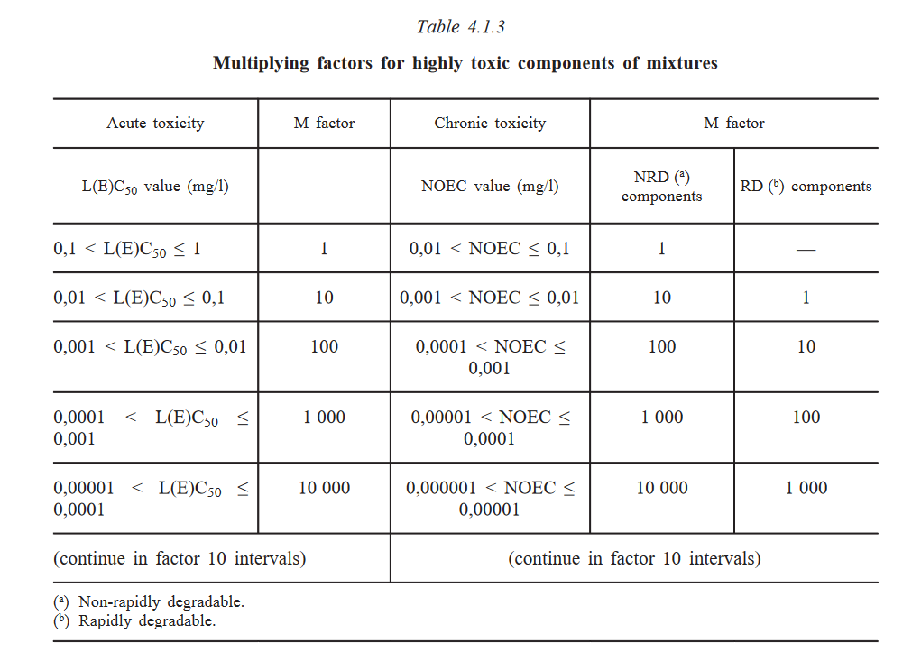
M - factor
The M-factor is a multiplying factor that takes into account the toxicity of a given chemical
The lower the LC₅₀ , EC₅₀ or NOEC is, the higher the M-factor

Slide 25
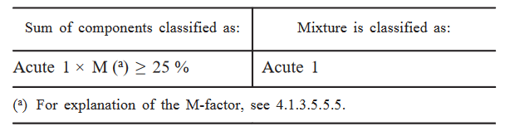
Classification – Aquatic acute
All components classified as Acute Category 1 are considered. If the sum of these components multiplied by their corresponding M-factors is equal to or greater than 25 % the whole mixture is classified as Acute Category 1.
Table 4.1.1

Slide 26
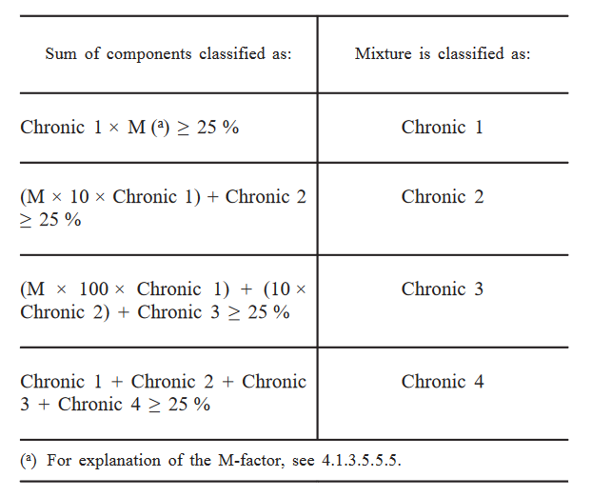
Classification – Aquatic chronic
Table 4.1.2
Aquatic chronic has several hazard categories.
If a chemical classified as Aquatic chronic 1 is diluted, we have to consider all categories
Notes:
First all components classified as Chronic Category 1 are considered. If the sum of these components
multiplied by their corresponding M-factors is equal to or greater than 25 % the mixture is classified as
Chronic Category 1. If the result of the calculation is a classification of the mixture as Chronic Category 1 the
classification procedure is completed.
In cases where the mixture is not classified as Chronic Category 1, classification of the mixture as Chronic
Category 2 is considered. A mixture is classified as Chronic Category 2 if 10 times the sum of all components
classified as Chronic Category 1 multiplied by their corresponding M-factors plus the sum of all components
classified as Chronic Category 2 is equal to or greater than 25 %. If the result of the calculation is
classification of the mixture as Chronic Category 2, the classification process is completed.

Slide 27
Classification – Acute toxicity
The Acute toxicity estimate, ATE, of a chemical is used to classify the acute toxicity of mixtures of that chemical.

Slide 28
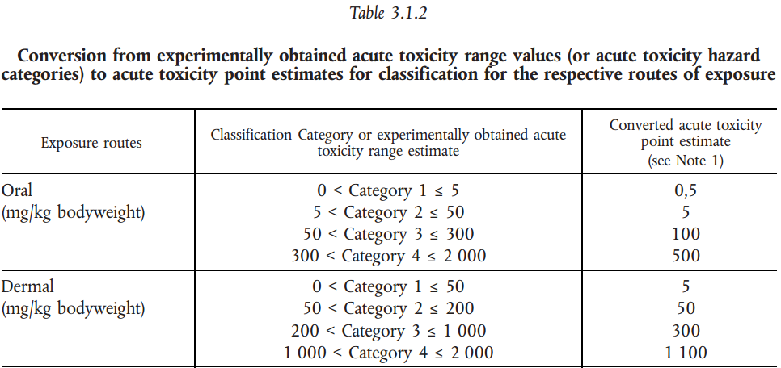
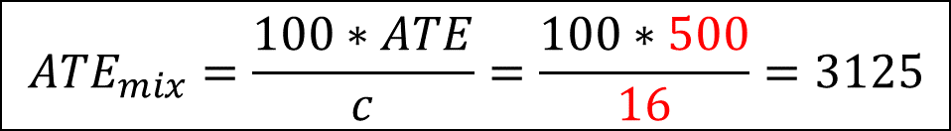
Example
A 16 % solution of a substance classified as acute tox. 4 – oral exposure
$${ATE}_{mix}=\frac{100∗ATE}{c}=\frac{100∗500}{16}=3125$$

Slide 29
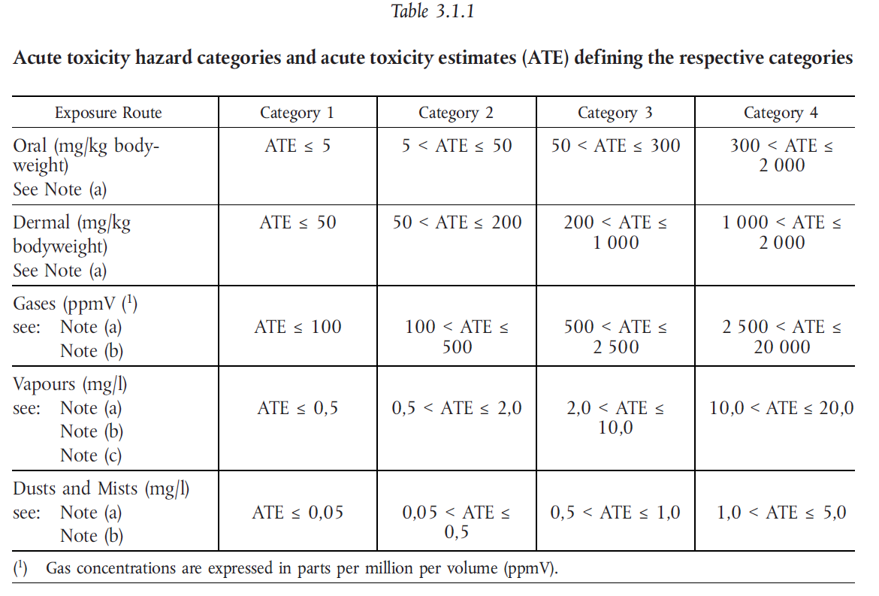

Slide 30
Exercise 3
3a) Make a label for 0,1 mol/L ZnCl₂
3b) Make a label for 2,0 mol/L ZnSO_{4 ,}CAUTION: Use Cas nr 7733-02-0 for zinc sulfate

Slide 31
Harmonised classification
Harmonised classification (as provided in Annex VI to CLP), must always be used by a manufacturer
Harmonised classification normally applies to those properties of the highest concern
Where some, but not all hazard classes or differentiations within hazard classes have been harmonised, the remainder should be self-classified to complete the classification
Guidance on the Application of the CLP Criteria

Slide 32
Leads to differ classification of the same chemical
Ammonia 25 % (Avantor)
Skin corrosion 1B
Aquatic acute, 1
STOT, SE, 3
Serious eyedamage, 1
Aquatic chronic, 2
Ammonia 25 % (Merck)
Skin corrosion, 1B
Aquatic acute, 1
STOT, SE, 3
Corrosive to metals, 1

Slide 33
CLP in scientific research
This Regulation (CLP) shall not apply to the following:
substances and mixtures for scientific research and development, which are not placed on the market, provided they are used under controlled conditions in accordance with Community workplace and environmental legislation.
http://eur-lex.europa.eu/LexUriServ/LexUriServ.do?uri=OJ:L:2008:353:0001:1355:en:PDF
Title 1, Article 1, 2d

Slide 34
How to label mixtures in your science lab
Mixtures that are to be use the same day do not require any labelling.
For mixtures that are stored, see point 8.4 in the HSE manual.

Slide 35

Evaluation

