Slide 1
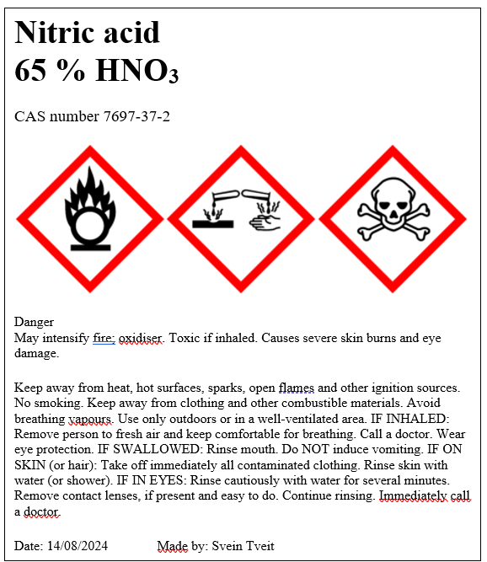
Creating labels for diluted solutions for use in chemistry research and education
Svein Tveit
Research Section for Chemistry Education
Department of Chemistry

Slide 2

Who is attending the workshop?

Slide 3

Aim of this workshop
Enable students to:
create labels for diluted solutions of some common chemicals used in chemistry education, based on harmonized CLP classification from ECHA CHEM.
Be aware of the regulations that apply to classification and labelling of chemicals
Explain some fundamental concepts used in classification and labelling of hazardous substances and mixtures
Familiarize with the elements of CLP hazard labelling

Slide 4
Outline
Before lunch: Create labels for diluted solutions of substances classified in the hazard classes Skin Corrosion/Irritation and Serious eye Damage/Eye irritation using specific and generic concentration limits.
After lunch: Create labels for diluted solutions of substances classified additionally in the hazard classes of Acute Toxicity (oral exposure), Aquatic Acute, and Aquatic Chronic
IMPORTANT: The labels are sufficient for educational use and use in research, but not for commercial use because downstream users have many more requirements, such as self classification for hazard classes with out a harmonized classification.

Slide 5
Where to find the documents for this workshop?
Google “Seksjon for kjemididaktikk uio”
In the left menu, choose “kurs”
In the left menu, choose “tidligere kurs”
Under 2025 you will find this presentation and a word file with a checklist, templates, links and detailed SOP’s for the exercises.

Slide 6

Why is it important to classify and label chemicals?

Slide 7



HSE/HMS – authorities in Norway
 | Nature of hazards | Resposible authorities for HSE-laws and regulations
Health Helse | Health | Norwegian Labour Inspection Authority Arbeidstilsynet
Safety Sikkerhet | Physical | Norwegian Directorate for Civil Protection Direktoratet for samfunnssikkerhet og beredskap (DSB)
Environment Miljø | Environment | Norwegian Environment Agency Miljødirektoratet

Slide 8
European chemical legislation
GHS is a global harmonized system for classification and labelling of chemicals
European Chemicals Agency, ECHA, is responsible for implementing GHS in Europe by establishing and updating an inventory on GHS substances.
There are two cornerstones of chemical legislation in the EU:
Regulation (EC) 1907/2006 on Registration, Evaluation, Authorization and Restriction of Chemicals – The REACH regulation.
Regulation (EC) 1272/2008 on Classification, Labelling and packaging of substances and mixtures – The CLP regulation
Norway as part of EØS is bound to EU chemical legislation and only CLP is used since 2017.

Slide 9
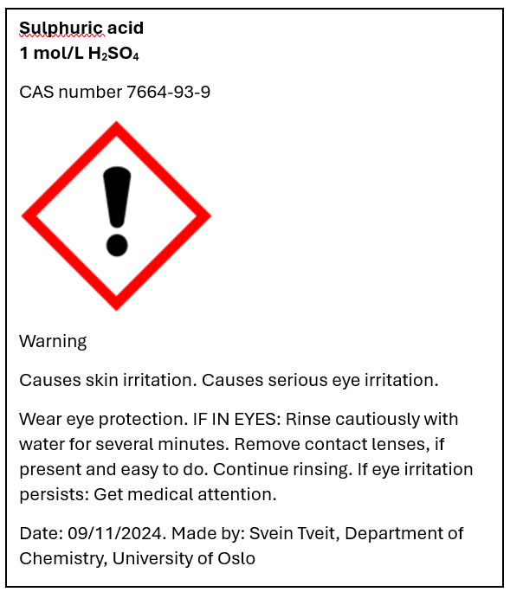
Hazard communication in CLP
Product identifier
Hazard pictogram
Signal word
Hazard statement(s)
Precautionary
Statements
Company identity

Slide 10
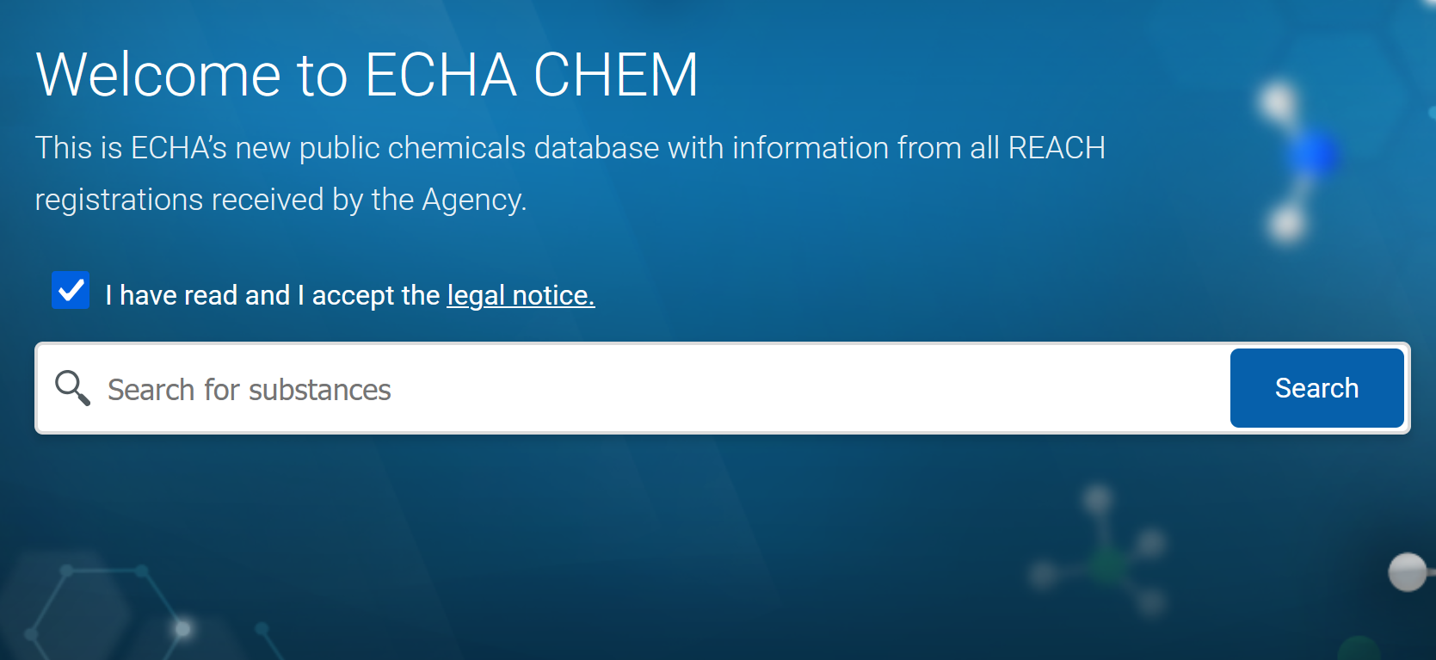
Product identifier
Name and identification number given in ECHA CHEM
If not included in ECHA CHEM use the CAS number and IUPAC name

Slide 11

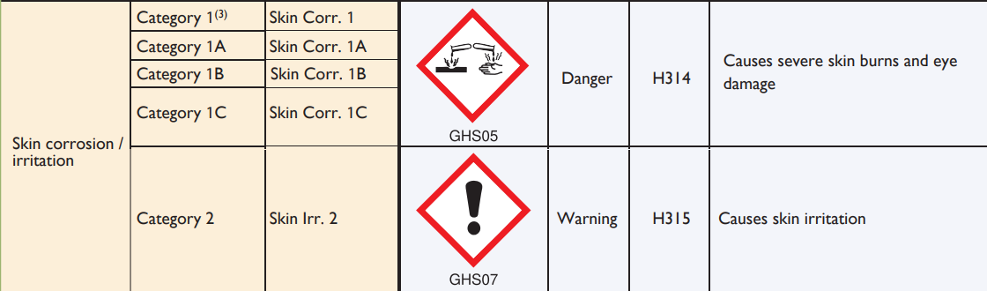
Hazard classes and categories (Not part of labelling)

Slide 12









Hazard pictograms
Physical
Environment
Health

Slide 13
Signal words and hazard statements

Slide 14
Groups of hazard and precautionary statements
Code | Hazard statements | Code | Precautionary statements
H200-H299 | Physical | P100-P199 | General
H300-H399 | Health | P200-P299 | Prevention
H400-H499 | Environment | P300-P399 | Response
 |  | P400-P499 | Storage
 |  | P500-P599 | Disposal

Slide 15
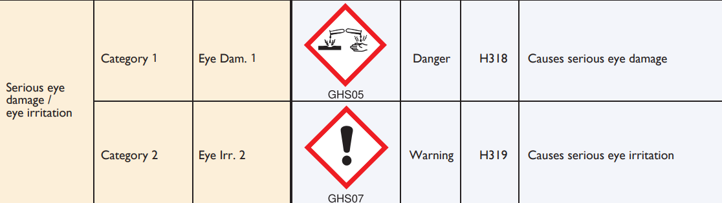
Skin corrosion/irritation and Serious eye damage /eye irritation

Slide 16
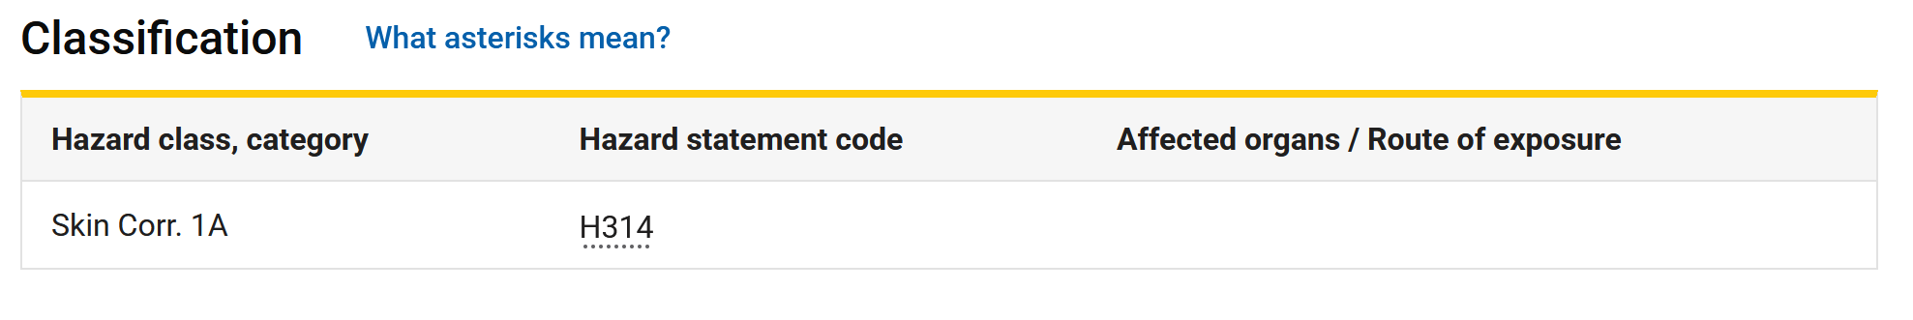
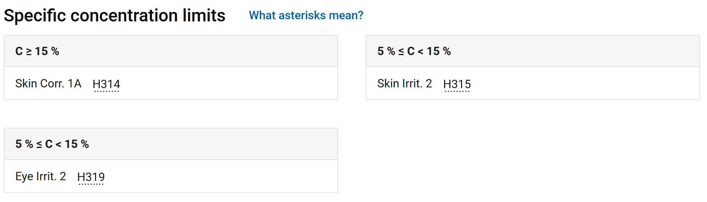
Specific concentration limits – ECHA CHEM
Harmonized classification of sulfuric acid

Slide 17
Example 1 – Classifying and create label
Create a label for 3 mol/L H₂SO₄

Slide 18
Calculate approximately mass percentage concentration
M_{m} (H₂SO₄) = 98 g/mol
Calculate concentration in g/L:
3 mol/L ⋅ 98 g/mol = 294 g/L
For simplicity we assumed that the density is 1000 g/L:
Mass % = 294 g/L / 1000 g/L * 100 % = 29,4 %
(If we consider the density, the mass % is: 294 g/L / 1170 g/L ⋅ 100 % = 25 % )

Slide 19
Exercise 1a
Create a label for 2 mol/L NaOH

Slide 20
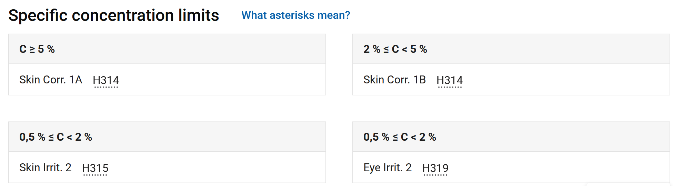
Severity of hazards decreases as concentration decreases
Pure sodium hydroxide is classified as Skin Corr. 1A
Solutions with a concentration of 5 % and more are also classified as Skin Corr. 1A.
Solutions with a concentration of 2 % or more, but less than 5 % is classified as Skin Corr 1 B.
What about solutions with concentrations below 2 %?

Slide 21
Exercise 1b
Make a label for 2 % formic acid, HCOOH.
Note: Be aware that there are two different harmonized classification for Formic acid. One in application and one for the future. You should now use the one that is in application.

Slide 22
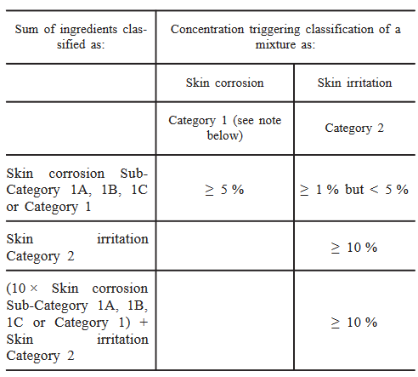
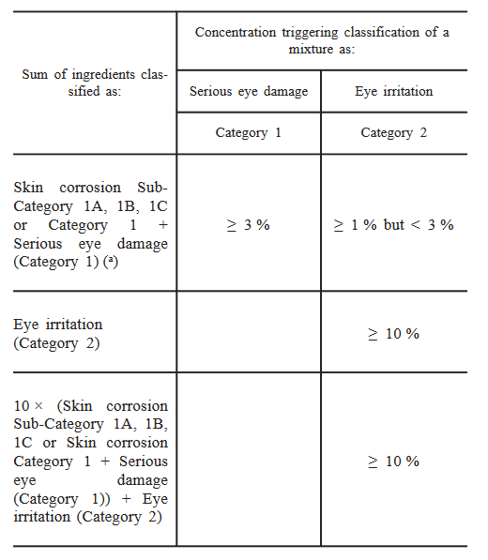
Generic concentration limits – CLP regulation
Table 3.2.3 (page 132 in clp)
Table 3.3.3 (page 138 in clp)
For strong acid and bases, pH should be used as criteria, see CLP regulation

Slide 23
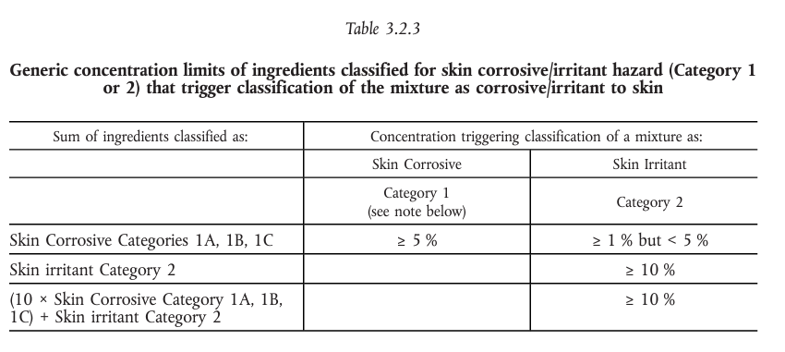
Using generic concentration limits
Example: A 3 % mixture of a substance classified as skin corr 1B.

Slide 24
Example 2 – Classifying and making labels
Create a label for 1 mol/L CuSO₄

Slide 25
Using generic concentration limits
16 % mixture classified as skin irrit 2 and eye irrit 2.

Slide 26
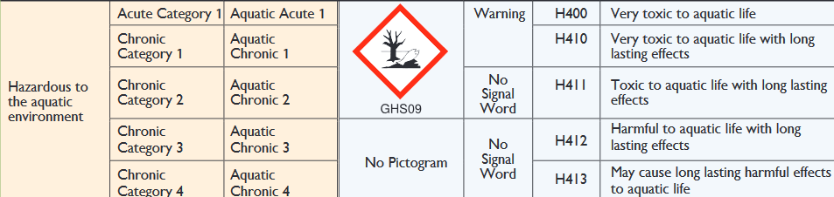
Hazardous to the aquatic environment
One category for aquatic acute and four categories for aquatic chronic

Slide 27
Classification for acute and/or chronic aquatic hazard
If not given in ECHA CHEM, a multiplication factor is found from LC₅₀ , EC₅₀ (acute hazard) or NOEC (chronic hazard) values in section 12 of the safety data sheet (SDS) and table 4.1.3 on page 206 in the CLP regulation (also on next slide)

Slide 28
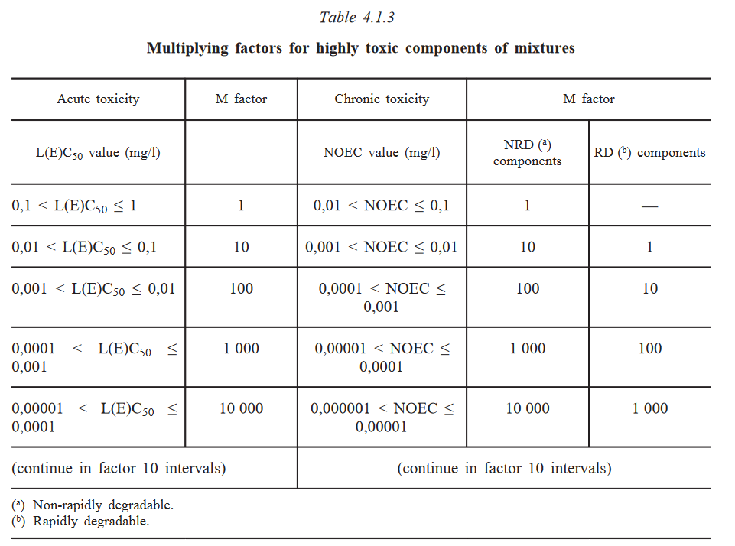

Slide 29
Classification for acute and/or chronic aquatic hazard
If not given in the C&L inventory, a multiplication factor is found from LC₅₀ , EC₅₀ (acute hazard) or NOEC (chronic hazard) values in section 12 of the safety data sheet (SDS) and table 4.1.3 on page 206 in the CLP regulation (also on next slide)
All components classified as Acute Category 1 are considered. If the sum of these components multiplied by their corresponding M-factors is equal to or greater than 25 % the whole mixture is classified as Acute Category 1.
All components classified as Chronic Category 1 are considered. If the sum of these components multiplied by their corresponding M-factors is equal to or greater than 25 % the whole mixture is classified as Acute Category 1. If not, we proceed according to table 4.1.2 on page 205 in the CLP regulation.

Slide 30
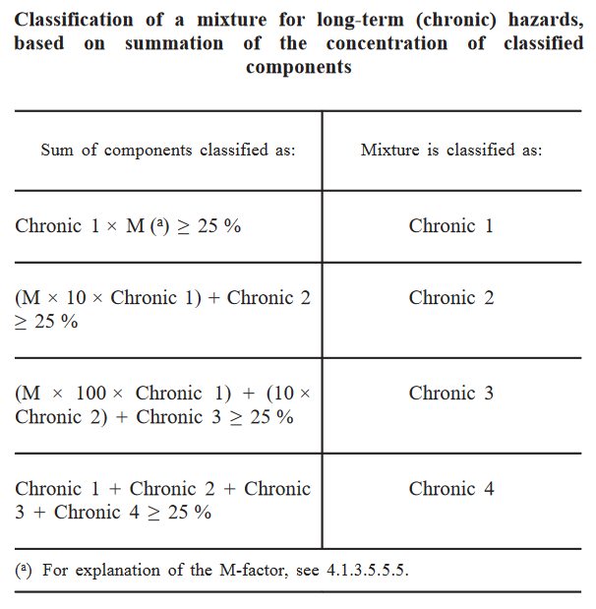

Slide 31
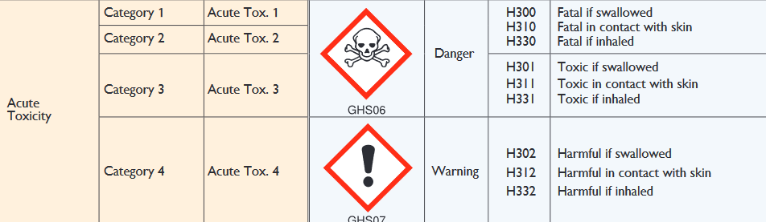
Acute toxicity
Divided into oral, dermal and inhalation and 4 categories
Acute toxicity estimate, ATE, is used to classify the acute toxicity of mixtures of that chemical.

Slide 32
Classification for acute toxicity
The acute toxicity estimate (ATE) for the classification of a
substance in a mixture is derived using:
— the LD 50 /LC 50 where available (section 11 in SDS),
— the appropriate conversion value from Table 3.1.2 (page 124 in the CLP regulation) that relates to the results of a range test, or
— the appropriate conversion value from Table 3.1.2 (page 124 in the CLP regulation) that relates to a classification category

Slide 33
Classification for acute toxicity
The acute toxicity estimate (ATE) for the classification of a
substance in a mixture is derived using:
— the LD 50 /LC 50 where available (section 11 in SDS),
— the appropriate conversion value from Table 3.1.2 (page 124 in the CLP regulation) that relates to the results of a range test, or
— the appropriate conversion value from Table 3.1.2 (page 124 in the CLP regulation) that relates to a classification category

Slide 34
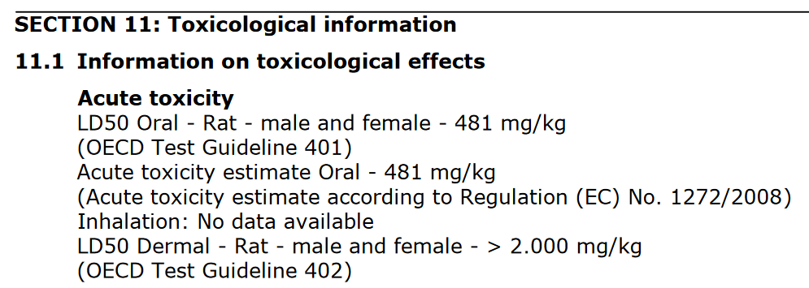
From section 11 in Safety data sheet (CuSO₄)

Slide 35
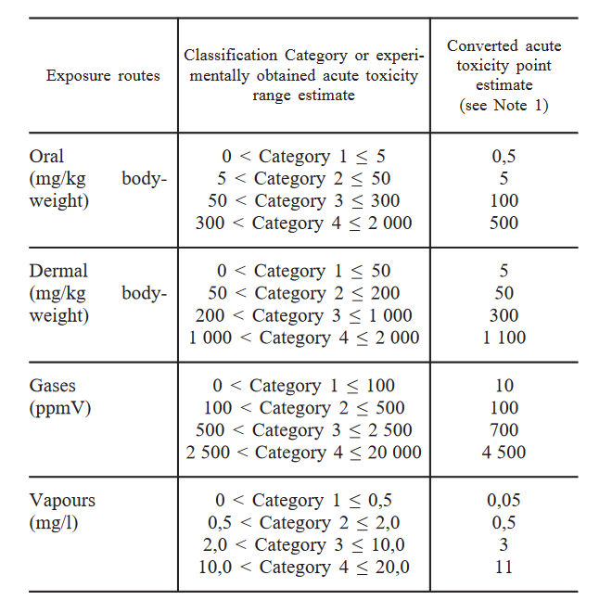
Table 3.1.2

Slide 36

Then we calculate the ATE of the mixture
Formula is found on page 123 in the CLP regulation
$${ATE}_{mix}=\frac{100∗ATE}{c}=\frac{100∗481}{16}=3006$$

Slide 37
Exercise 2
2a) Make a label for 0,1 mol/L ZnCl₂
2b) Make a label for 2,0 mol/L ZnSO_{4 ,} (Use Cas nr 7733-02-0 for zinc sulfate)

Slide 38
Harmonised classification
Harmonised classification (as provided in Annex VI to CLP), must always be used by a manufacturer
Harmonised classification normally applies to those properties of the highest concern
Where some, but not all hazard classes or differentiations within hazard classes have been harmonised, the remainder should be self-classified to complete the classification
Guidance on the Application of the CLP Criteria

Slide 39
Leads to different classification of the same chemical
Ammonia 25 % (Avantor)
Skin corrosion 1B
Aquatic acute, 1
STOT, SE, 3
Serious eyedamage, 1
Aquatic chronic, 2
Ammonia 25 % (Merck)
Skin corrosion, 1B
Aquatic acute, 1
STOT, SE, 3
Corrosive to metals, 1

Slide 40
CLP in scientific research
This Regulation (CLP) shall not apply to the following:
substances and mixtures for scientific research and development, which are not placed on the market, provided they are used under controlled conditions in accordance with Community workplace and environmental legislation.
http://eur-lex.europa.eu/LexUriServ/LexUriServ.do?uri=OJ:L:2008:353:0001:1355:en:PDF
Title 1, Article 1, 2d

Slide 41
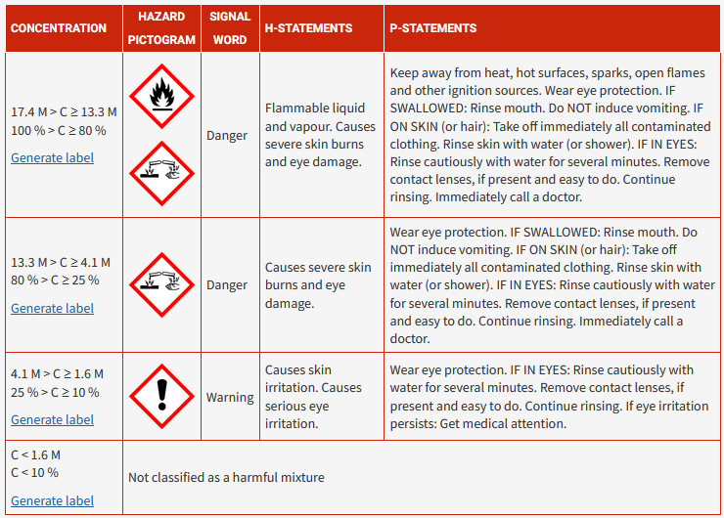
Online label generator for some common chemicals
The chesse.org website is developed to help teachers handle the chemical safety work
The website has a label generator for some common acid, bases and solution of salts.

Slide 42

Evaluation
https://nettskjema.no/a/536750

