Slide 1
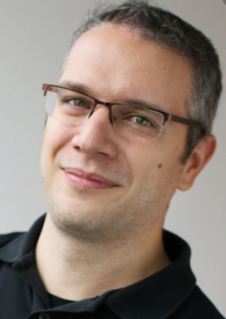
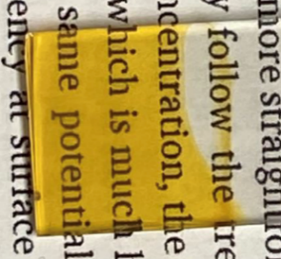
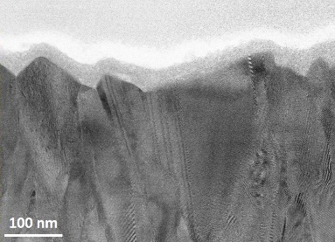
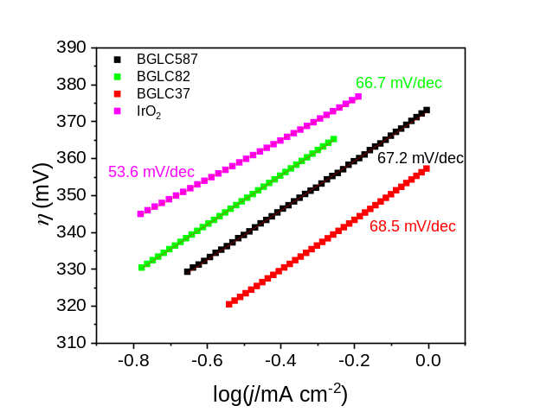
B.Sc. and M.Sc. projects related to photoelectrochemistry (PEC) as part of the Group for Electrochemistry
(Leader Prof. Truls Norby, truls.norby@kjemi.uio.no)
(contact: athanasios.chatzitakis@smn.uio.no, A. ‘’Sakis’’ Chatzitakis)
Solar light + light absorbing materials + electrochemistry = Sustainable fuels
1. Tantalum nitride (Ta₃N₅) films on glass and integration in tandem photovoltaic (PV) structures for water electrolysis with solar light. (Kjemi, MENA)
Aim: This project combines synthesis of thin films of photoabsorbing materials and their integration in PV devices for water electrolysis driven by sunlight.
Learning: • Basic and advanced (photo)electrochemistry.
• Electrical measurements of solar cells.
• Synthesis and structural characterisation of thin films of Ta₃N₅ and integrations with PV.
• Team work.
This is how your film looks in powerful microspcopes
Observed with Transmission Electron Microscopy (TEM)
Your basic and advanced electrochemical characterization will look like this. You will find a lot new information about your material
Your samples will look like that

Slide 2
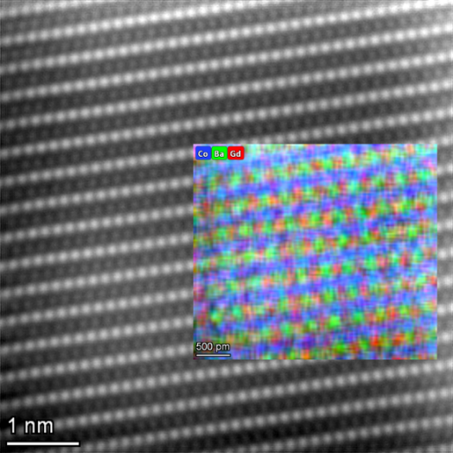
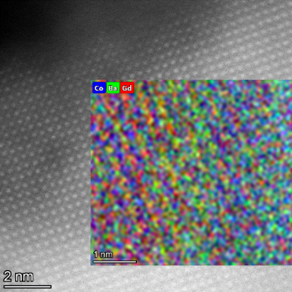
2. Study of the structural evolution of perovskite-based catalysts during water electrolysis. (MENA, Kjemi)
Aim: This project combines synthesis and electrochemical characterization of advanced catalyst materials for the oxygen evolution reaction. These materials are essential for our main purpose to produce sustainable fuels. This is a mechanistic study regarding the degradation of catalysts during water electrolysis. This can be coupled with theory and calculations and it will be in collaboration with more from the group.
Learning: • Basic and advanced electrochemistry. Stability and mechanistic studies.
• Synthesis and structural characterisation of powders.
• Team work.
Atomic resolution of the crystal structure…
…reveals the severe degradation
How and why this nicely crystalline materials becomes amorphous?

Slide 3
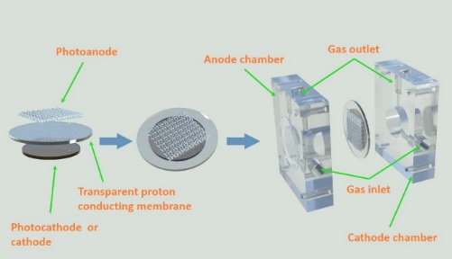
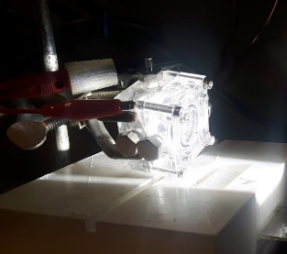
3. Solid state PhotoElectrochemical cells for CO₂ reduction in the gas phase. (MENA)
Aim: This project combines synthesis and electrochemical characterization of advanced catalyst materials for CO₂ reduction and recycling to useful chemicals. These materials and processes are essential for our main purpose to produce sustainable fuels. This is a fundamental study for CO₂ reduction, combining cell engineering. This can be coupled with theory and calculations and it will be in collaboration with more from the SMN group.
Learning: • Basic and advanced (photo)electrochemistry. Gas phase operation.
• Mass spectrometry.
• Synthesis and structural characterisation of films and powders.
• Engineering of gas phase photoelectrochemical cells.
• Team work.
Nanostructured materials for high surface area
catalysis
Cell performance for CO₂ reduction
and recycling
Ready for some engineering?

