Slide 1

Computational modelling of the biomechanics in the central nervous system
– Chiari and syringomyelia
Kent-Andre Mardal
Dept. of Mathematics,
University of Oslo /
Center of Biomedical Computing,
Simula Research Laboratory

Slide 2
Outline
Grand Challenge: mechanical remodeling (plasticity) of the central nervous system (as a function of time, age or pathological condition)
Why the Chiari malformation is a good starting point and why we believe it is mechanically driven
The computational problems are complicated:
- transition
- poro-visco-elastic deformations
- coupling between the viscous and porous flow
Some comments about the missing pieces of the puzzle

Slide 3


Remodeling occur as we age
Ventricular volume increase
Grey matter thickness decrease
Changes in folding
Tissue stiffens
Permeability decreases
CSF flow changes

Slide 4
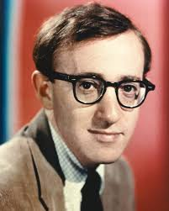

There are individual differences

Slide 5
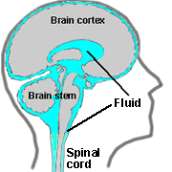
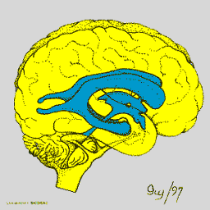
Small volume changes may lead to large pressure changes in the brain
The brain, its arteries and veins pulsate during the cardiac cycle volume changes are ~ 1 ml/s
The skull is rigid and changes in volumes causes pressure pulsation
The cerebrospinal fluid (water) compensates pressure pulsation by oscillating between the cranium and cervical cavities

Slide 6
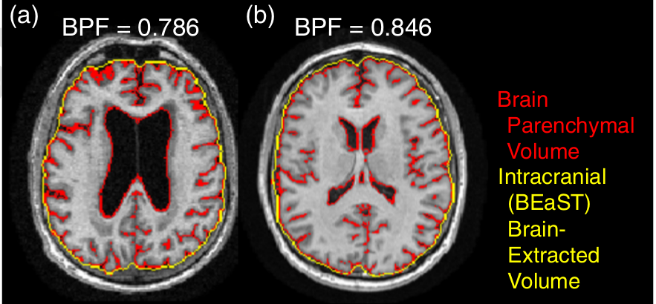
Alzheimer disease / Normal pressure hydrocephalus
Ventricular volume increase
Permability and stiffness changes
Accumulation of plaque (amyloid-beta protein)
Hyperkinetic flow
Abnormal intracranial pressure pulsation

Slide 7
Some examples of mechanically driven remodeling (Mechanotransduction):
Examples of mechanotransduction:
Bone grows under stress
Arteries grow stiff (the wall thickens) under high blood pressure
Arteries expand radially under high flow velocities (high shear)
Little is known about the biomechanical remodeling of tissue in the
central nervous system
(although we know that there is a general shrinkage, stiffening and
reduction of porosity as we age)

Slide 8
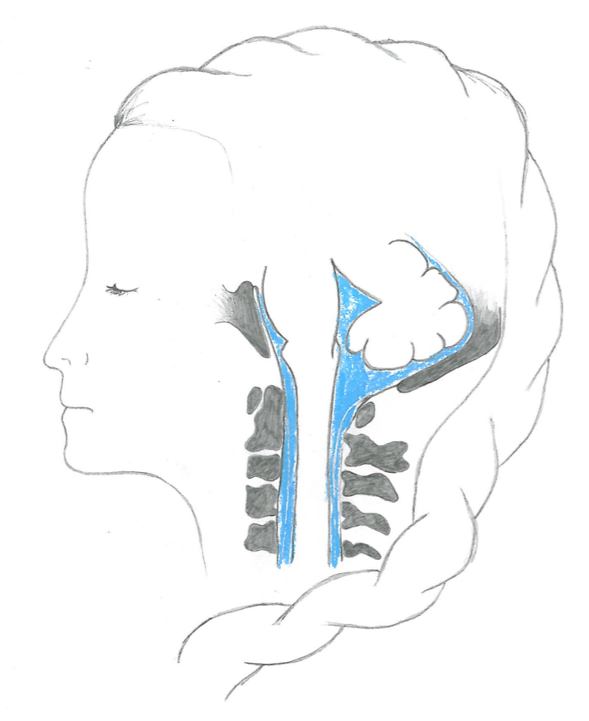
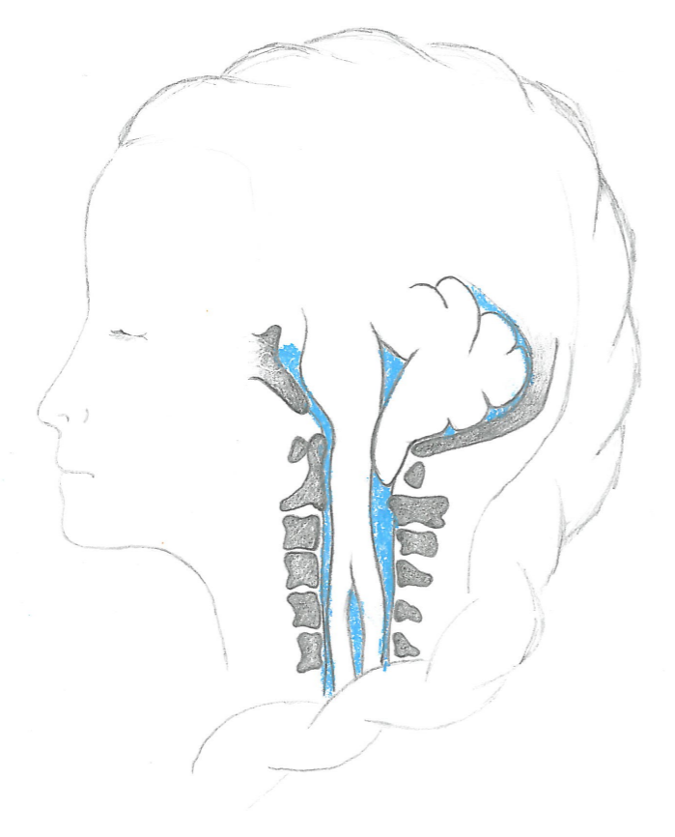
Chiari I is a medical condition where part of the brain is displaced into the spinal canal
Obstruction
Abnormal pressure and flow
Cyst formation
Notes:
Ok, but why are we interested in CSF flow in the spinal canal?
To the left you see the little brain and spinal cord in a healthy person. To the right you see a Chiari patient, where the cerebellum or little brain is displaced into the spinal canal and thus obstructing the blue CSF space. This abnormal anatomy disturbs the pulsatile flow and pressure environment and causes a wide range of symptoms such as severe head aches, sleep appnea and paralyses. Additionally, many Chiari patients develop fluid filled cysts within the spinal cord tissue (point).
The exact relation between Chiari I and spinal cord cyst is not known, but prevailing theories state that abnormal anatomy causes increased pressure gradients in the CSF space and that fluid flows from the CSF space into the tissue where it accumulates and eventually forms a cyst. It takes long for the cyst to form, so we look at small effects that adds up over time!
To treat these patients a decompression surgery is performed where parts of the bone is removed. This gives more space around the cerebellum and pain relief –moreover, the cysts often resolves.

Slide 9
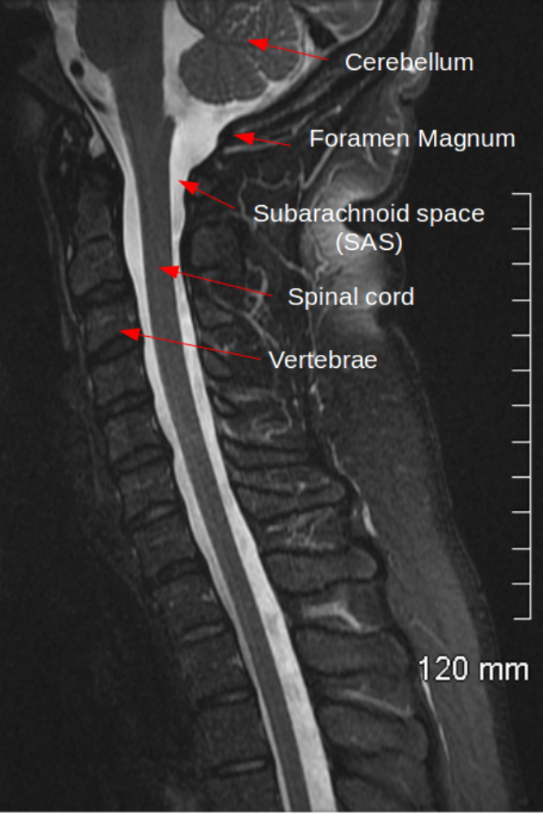
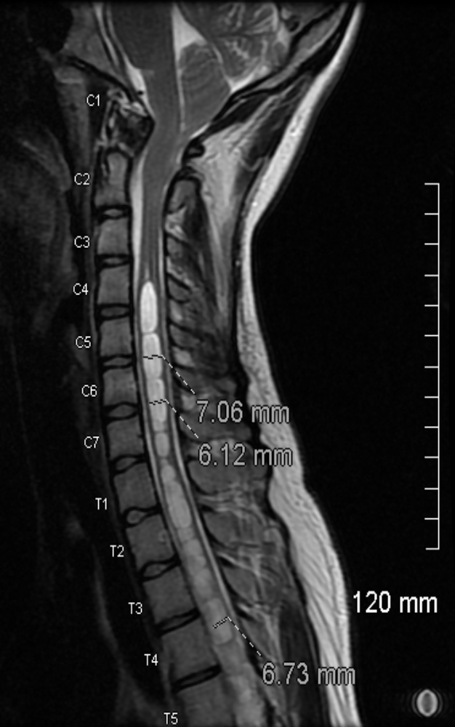
A healthy person and a Chiari patient with syrinxes
Prevalence of Chiari ~ almost 1% according to some studies, but numbers
vary and the condition appears to be under-diagnosed

Slide 10
Chiari Symptoms
-Difficulty driving _ Difficulty negotiating steps,Pressure / pain in the neck _ Pressure / pain behind the eyes (soreness in the eyeballs) _ Back pain _ Neck spasms _ Insomnia _ Ringing in ears (like the tone heard in a hearing test) _ Swaying _ Pain when changing position _ Tingling / crawling feeling on scalp _ Intolerance to loud / confusing sounds _ Decreased sensitivity to temperature _ Pain & tension along ear / eye / jawline _ Difficulty swallowing / lump in throat / sore throat / swollen lymph nodes _ Drooling _ Spontaneous vertigo _ Hand tremors _ Poor blood circulation / cold hands & feet _ Sinus / mucous problems _ Sleep apnea _ Decreased muscle tone _ Pressure in ears / ears feel stopped up _ Nausea _ Difficulty reading / focusing on text _ Depth perception problems _ Burning sensation in extremities / shoulder blades _ Menstrual problems / severe cramping during period _ Fluid-like sound in ears (like water running) _ Loss of sexual interest / lack of sensation in pelvic area _ Pulling sensation while sitting / standing _ Intense itchiness w/profuse sweating _ Slurred speech _ Gag reflex problems / lack of gag reflex _ Pressure / tightness in chest _ Loss of bladder control _ Frequent urination _ Dehydration / excessive thirst _ Electric like burning sensations _ Unequal pupil size _ Loss of taste _ Popping / cracking sounds in neck or upper back when stretching _ Dizziness _ Loss of smell / problems with sense of smell _ Dry skin and lips _ Sudden / abrupt changes in blood pressure due to awkward position of head _ Hiccups associated with drinking carbonated beverages _ Skin problems Other: migraines, oscillopsia, lump in throat, colour blindness, albinism, visual floaters, astigmatism, thinning hair, hear heartbeat in ears, throat closes when lying flat, vomit in sleep, swollen face, low body temperature, low blood pressure, legs feel heavy, "strangling" feeling, "floating" sensation, thickening of finger joints.
Headache (esp. if daily or at lower back of head)
Painful tension in neck
Fatigue
Migraines
Dizziness
Visual disturbances / loss of vision / spots in vision / double vision / seeing spots or "halos" / nystagmus
Tingling / numbness in the extremities
General imbalance / clumsiness
Memory loss
Restricted movement
Intolerance to bright light / difficulty adjusting to light change
Vertigo from position change or sudden standing
Poor / degraded motor skills
Sleep apnea

Slide 11

Cavalier King Charles Spaniel (about 50% have syringomyelia)

Slide 12
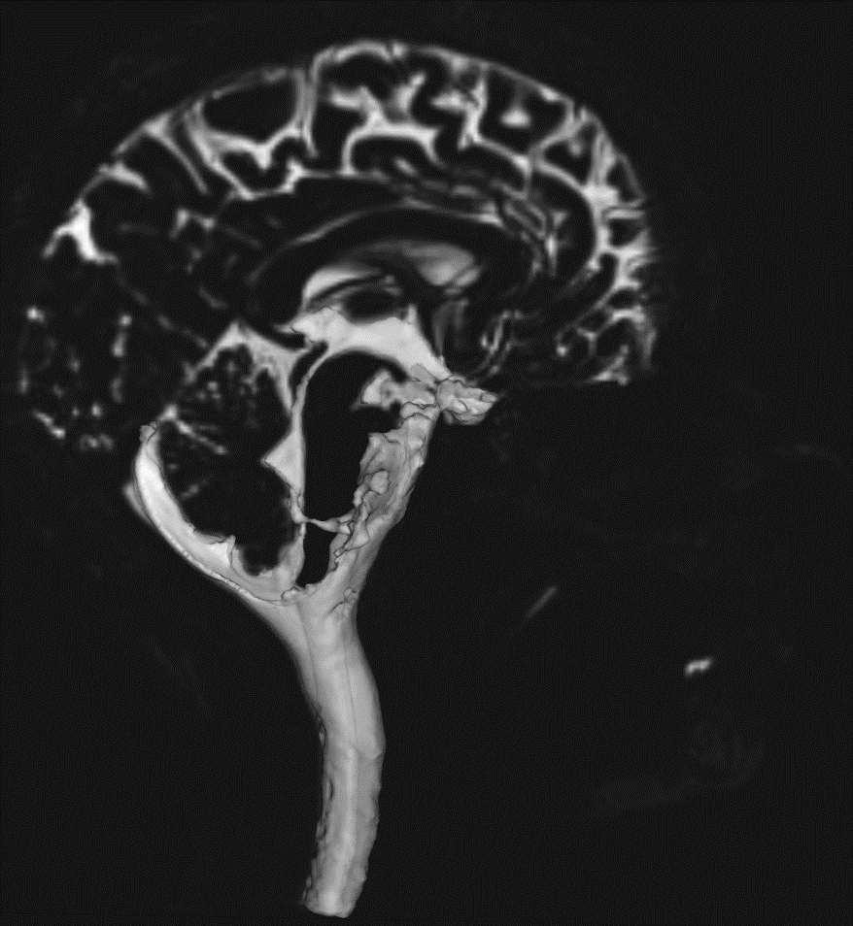
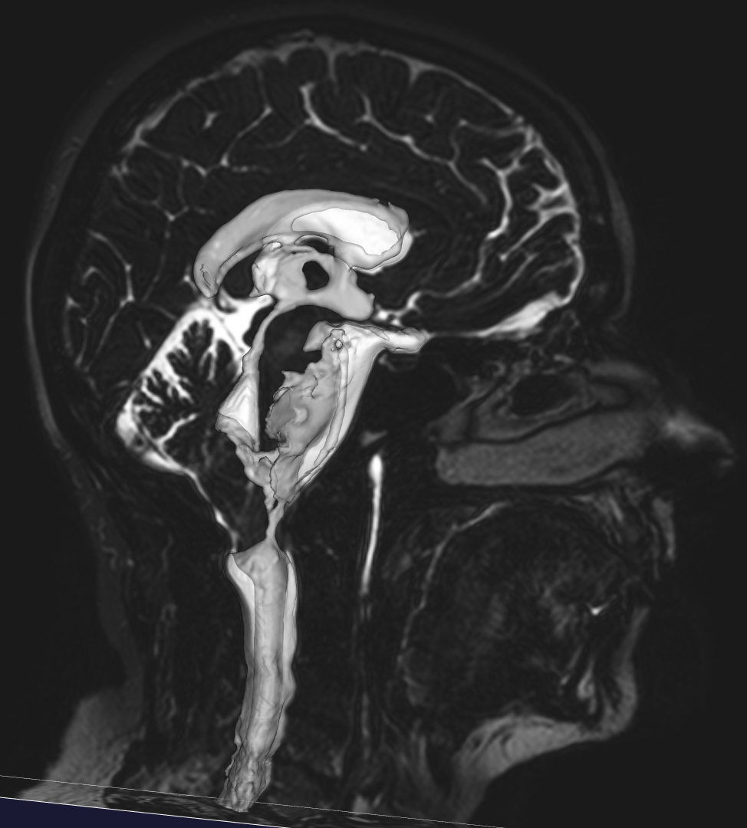
We reconstruct the SAS and ventricles from MR-images using the level set method (VMTK)
Volunteer 1
Patient 4

Slide 13
The Cerebrospinal fluid flow is ´hyperkinetic´-- with abnormally high velocities and pressure gradients
Cerebrospinal fluid is basically water
(and so is the extra-cellular fluid)
Reynolds number ~ 100-500
Womersly number ~ 1-5
Structures of mm scale
The complete compartment is around 1m long
Around 1 cm^3 flows up and down per second
Driven by the pulsation of brain, arteries and veins
Interacts with tissue – rigid motion, deformation and porous media flow

Slide 14
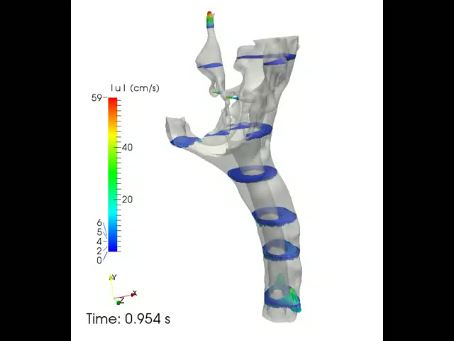
We simulated pulsatile flow through the 4th ventricle and CSF space in one control and two Chiari patients
By Karen Støverud
Control
Notes:
Here you see the velocity at different cross-section in the control patient. In general the flow is quite uniform –apart from in the aqueduct.
We also see that the duration of downwards directed flow, that is systole, is shorter with higher magnitude than upwards directed flow, that is diastole.

Slide 15
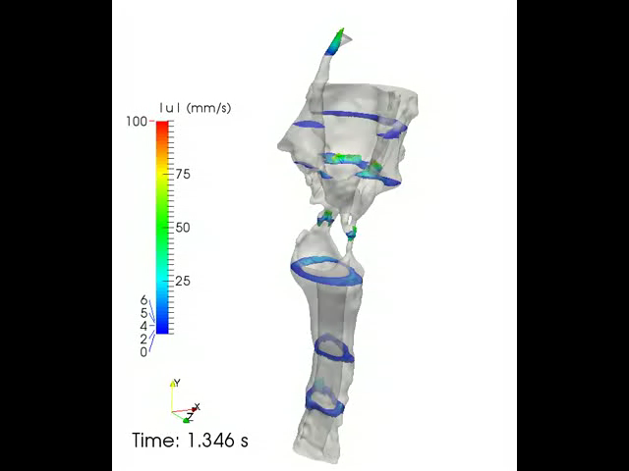
We simulated pulsatile flow through the 4th ventricle and CSF space in one control and two Chiari patients
By Karen Støverud
Patient with severe Chiari malformation
Notes:
Here you see the velocity pattern in the patient with the most severe obstruction. The flow pattern is now more complex with large flow jets extending well below and above the narrow channels connecting the cranial and cervical CSF space.

Slide 16
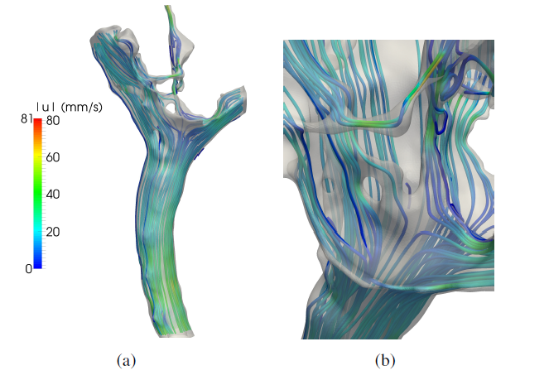
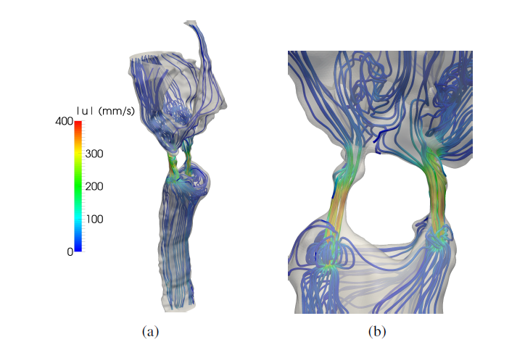
Main results from CFD simulations
Healthy
Pressure drop : 2-3 as high in Chiari patients
Velocities were up to 15 times higher
Flux almost the same
Phase difference between patients and normals
Not healthy

Slide 17
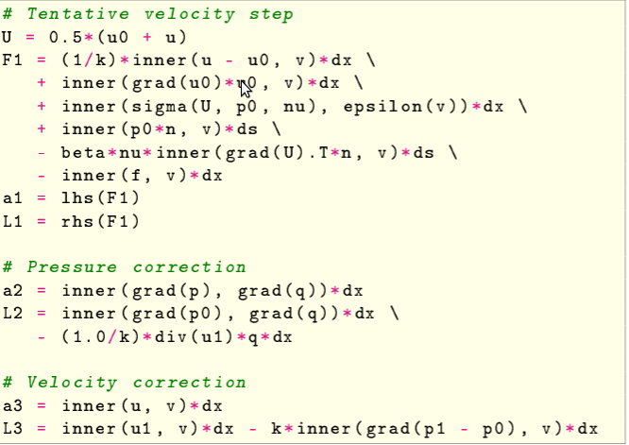

Software: FEniCS + VMTK
Simulator implemented in FEniCS
(can be found at bitbucket.org/cbcflow)
Incremental pressure correction scheme
The simulator is as efficient as can be!
Current simulation: ~ 20 M cells, 10 K time steps per second

Slide 18
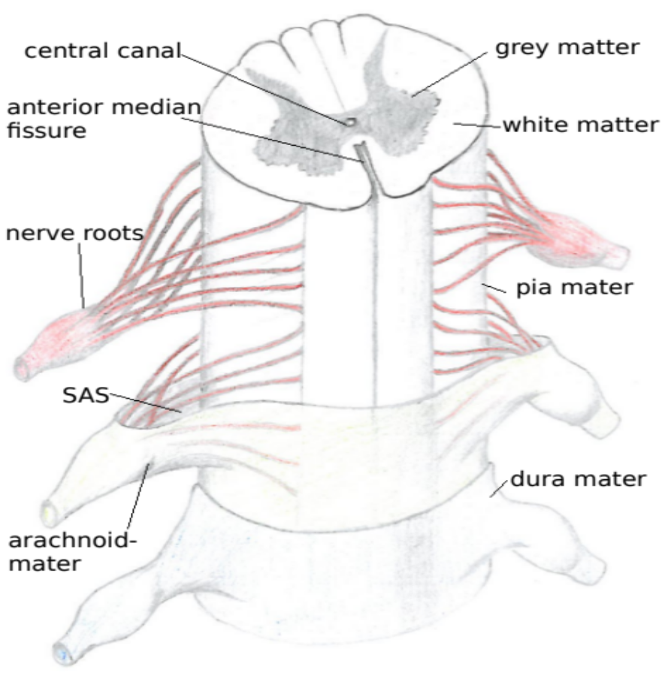
Adding complexity …… the tissue of the spinal cord

Slide 19
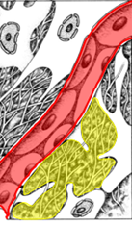
The tissue of the central nervous system is modeled as a poro-elastic medium
Solid
Cells
Vasculature
Fluid
Interstitial space
Notes:
We model the brain as a poro-elastic medium. Here to the left is a schematic drawing of the tissue –consisting of cells and capillaries –separated by interstitial fluid. In the figure to the right you see how the tissue is represented in the model. The cells and vasculature make up the solid phase, saturated with interstitial fluid.
This is a simplified model, but it has been shown to represent many relevant processes such as diffusion with a high precision.
So a bit more about brain tissue on the microscale.
We model the spinal cord as a poro-elastic medium. The human body is a sophisticated system, so we need to do some simplification. Here to the left a schematic drawing of the tissue is shown –consisting of cells and capillaries –surrounded by interstitial fluid. In the figure to the right you see how the tissue is represented in the model. The cells and vasculature make up the solid phase, saturated with interstitial fluid. Both the solid phase and fluid phase are assumed to be incompressible –but still the mixture is compressible.
This is a simplified model, but it has been shown to represent many relevant processes such as diffusion with a high precision.
Now we are ready to create a computational model of the spinal cord.

Slide 20
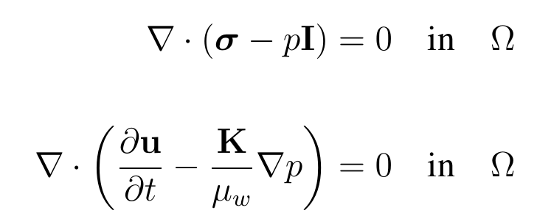
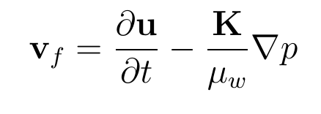
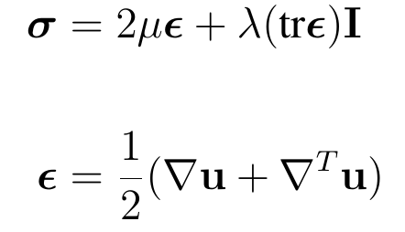
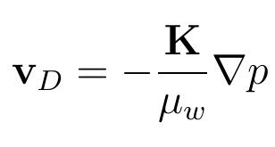
The Biot equations for incompressible solid and fluid phase
Volume balance:
Momentum balance:
Stress tensor:
Strain tensor:
Notes:
The equations for an incompressible fluid and solid phase are displayed –here referred to as the biot equations, just as you have seen earlier in the presentation. First you have the volume balance then the momentum balance where we assume linear elasticity for the solid matrix. The primary variables are pressure (p) and displacement (u). Additionally, we calculate the total fluid velocity and velocity relative to the solid. The first term in the fluid velocity represents the solid velocity –think of squeezing a sponge and how that induces flow. The second term is Darcy’s law.
Finally, we have several parameters and to simulate an open segment of the central canal we assign a higher permeability here. The other parameters, lame and fluid viscosity are kept constant.

Slide 21
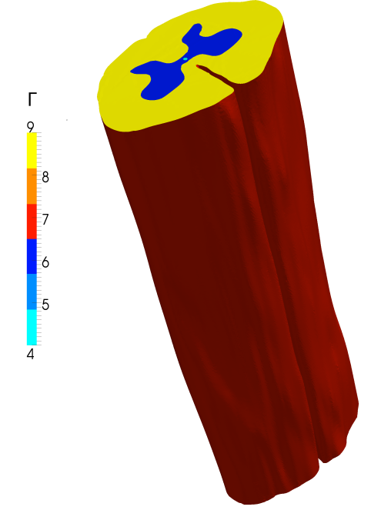
Significant features of the spinal cord
Is poro-elasticity needed or is elasticity sufficient?
Is the distinction between white and grey matter needed?
What about the central canal?
Or the median fissure?
Or the pia membrane?
Or the uncertainties in Lame parameters, anisotropic permeability, permeability etc?

Slide 22
Discretization
Linear finite elements with stabilization
Up to 3 M cells
Up to 10 K time steps per second
Around 22 CPU years due to direct solvers (all models + grid convergence etc)
Need better preconditioners ...

Slide 23
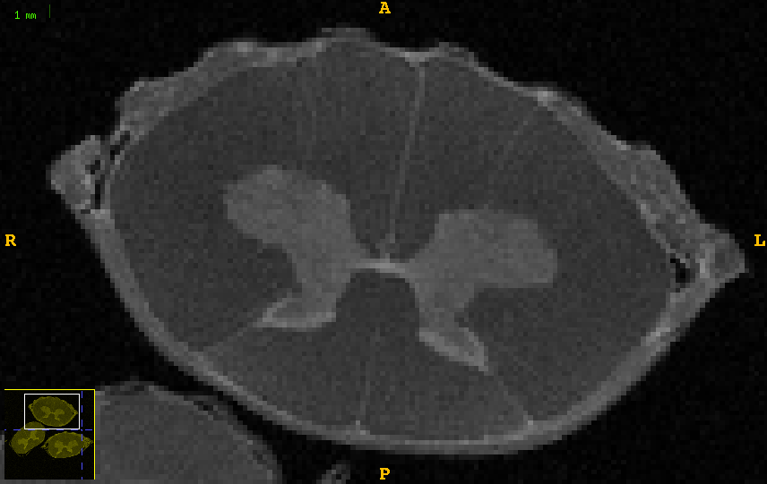
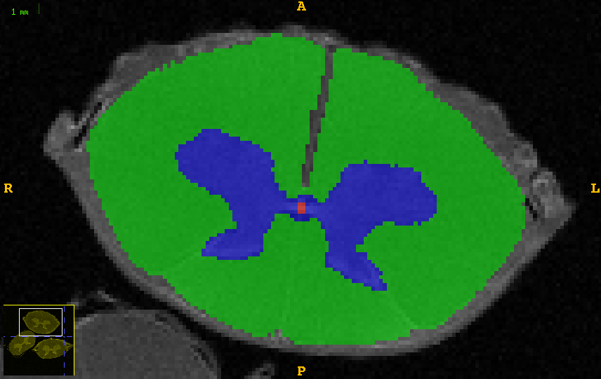

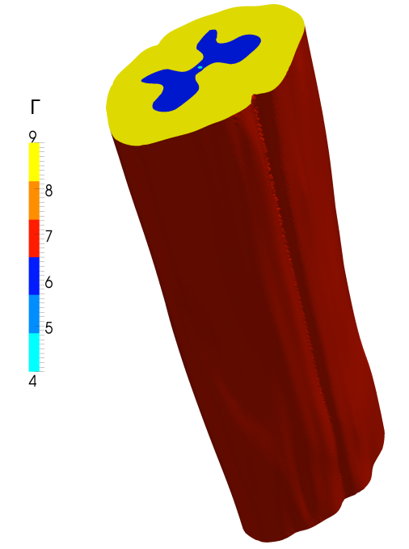
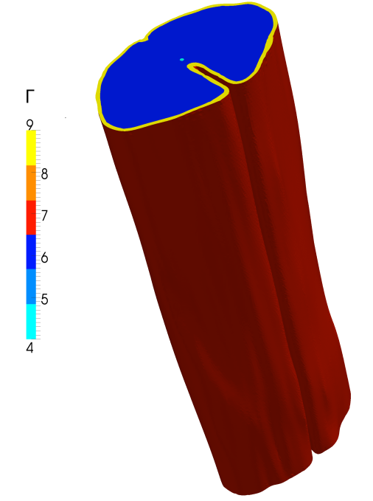
We create a geometry of the spinal cord based on DT-images of a sheep spinal cord
Notes:
We create a geometic model of the spinal cord from diffusion tensor images of a sheep cadaver. Here you see an axial plane from the image stack, where grey matter is brighter than white matter. In the very center of the image you see a bright spot –that’s a fluid filled channel called the central canal. In adults this is mostly occluded but in the following we’ll look at the effect of a partially open central canal. Now we segment these images–distinguishing between grey (blue) and white (green) matter and the central canal. Finally we generate a 3D model from the segmented images –which we will use to study the mechanics of the spinal cord.
The model to the left is the reference model, distinguishing grey and white matter, the central canal and including the median fissure. In the model in the middle we do not include the median fissure, and in the model to the left we have segmented out the pia mater –a thin membrane coating the spinal cord. The elasticity parameters for the spinal cord is uncertain, but mechanical testing suggests that the pia is substantially stiffer than the spinal cord tissue. Arachnoiditis patients often develop syrinxes. We tested how stiffening and thickening of the pia, as may be seen in arachnoiditis patients, affect pressure and interstitial fluid velocity.

Slide 24
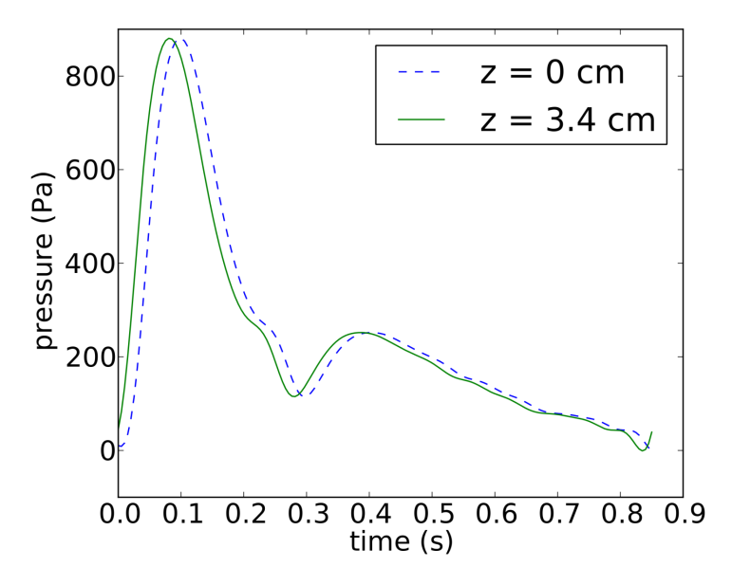
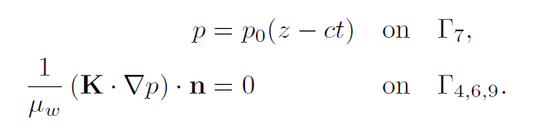
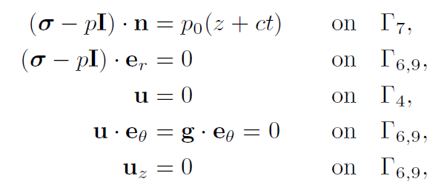
We apply a pressure wave based on in vivo measurement along the walls of the geometry
Volume balance:
Momentum balance:
Notes:
Along the walls of the geometry we apply a prescribed pore pressure and normal stress calculated from pressure measurements in a Chiari patient, the pressure vs time at the top and bottom of the geometry can be seen in the line plot to the left.
At the top and bottom boundary u is set to zero in the central canal and the z component and rotational component theta is set to zero in the blue and yellow region.
Note that the theta component is set to zero in a weak sense applying nitsche’s method.

Slide 25
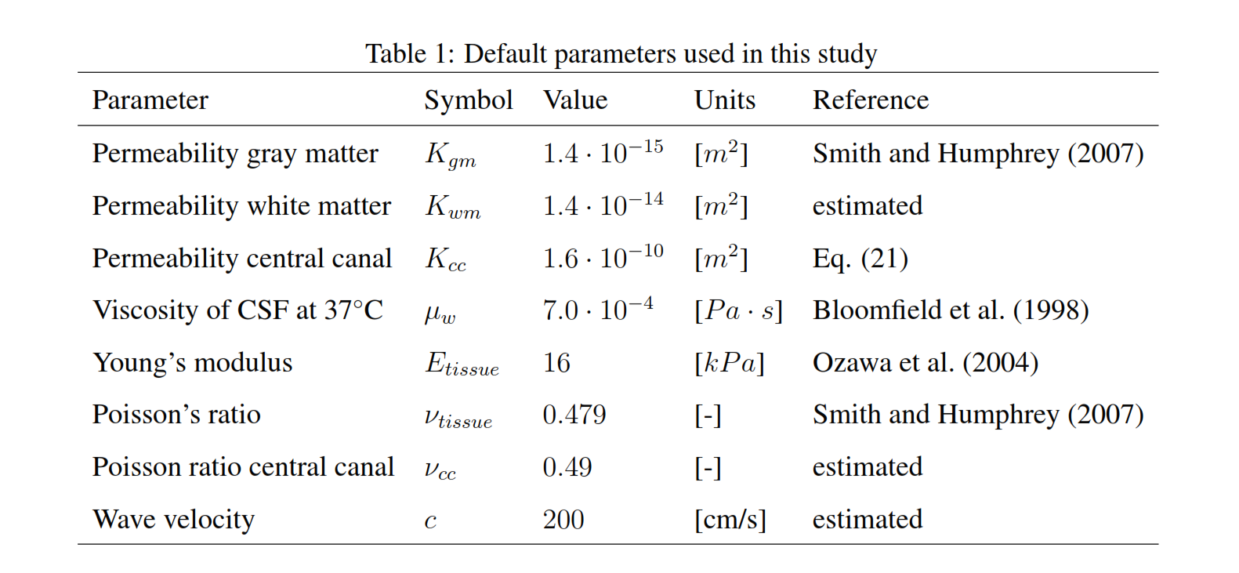
Default parameters

Slide 26
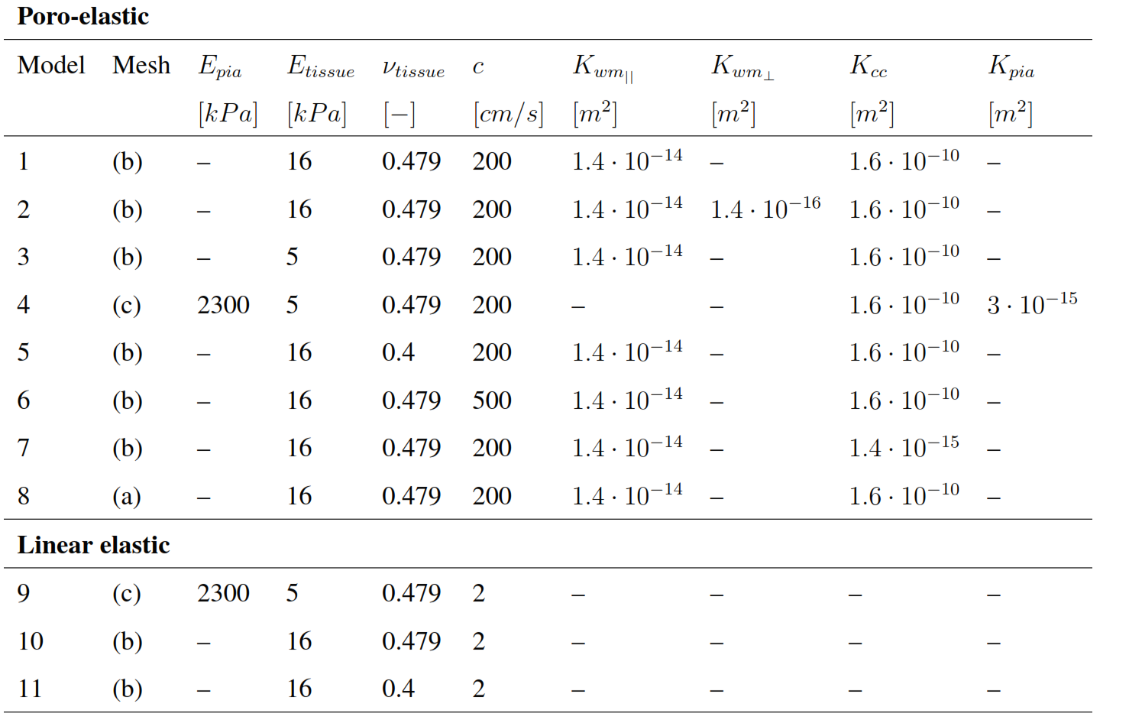
Variations of parameters

Slide 27
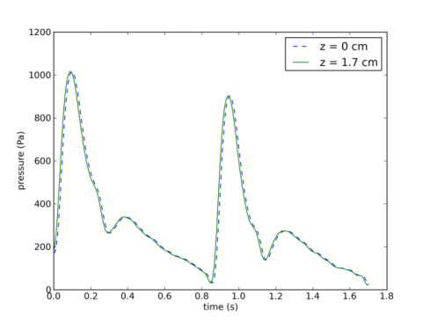
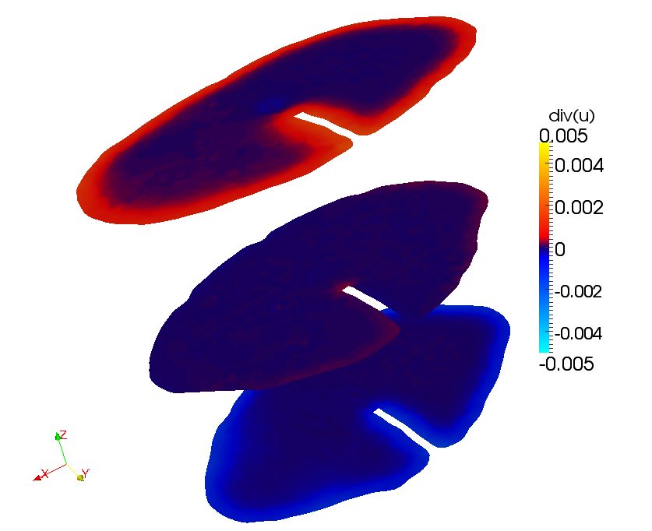
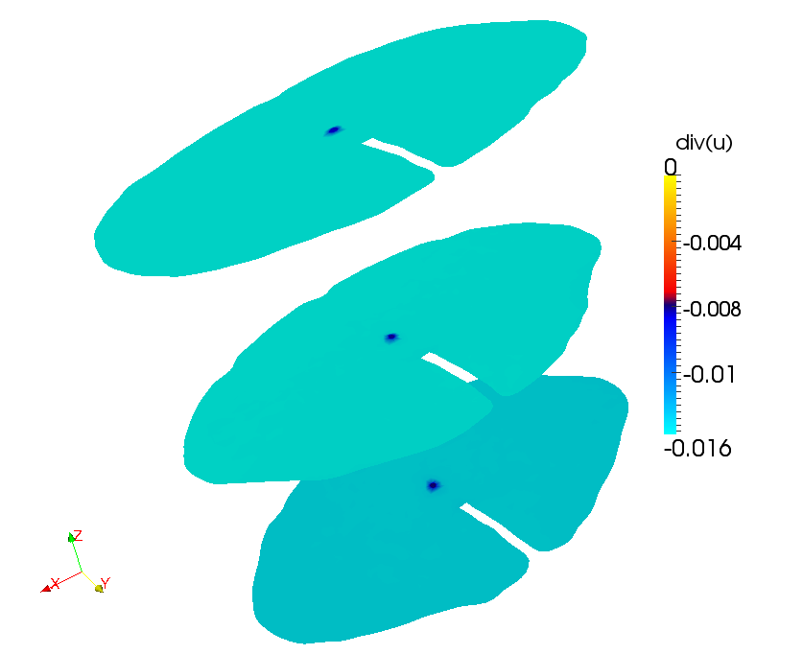
The spinal cord tissue is compressed by the pressure wave
Poro-elasticity
Linear elasticity
Notes:
Here you see plots of the divergence of the displacement for the poroelastic model to the left and linear elastic to the right –as the pressure is increasing –see red line.
This quantity is of interest because a dilatation of the tissue may indicate edema –which might eventually form a cyst.
In general the tissue is compressed by the pressure wave and in the case of linear elasticity this holds for every point in the geometry at this given point in time. However, for the poroelastic case (klikk) the tissue dilates close to boundary in regions of high pressure. Thus an increased fluid pressure may cause swelling of the tissue.
Since we do not compute pressure and do not have a fluid phase in the linear elasticity model we can obviously not look at pressure and fluid velocity. So the remaining results are only for Biot.

Slide 28
Snapshot of pressure in the spinal card
Sharp gradients associated with the boundary
Radial pressure gradients
Central canal display almost no variation in z-direction (because of incompressibility of water)

Slide 29
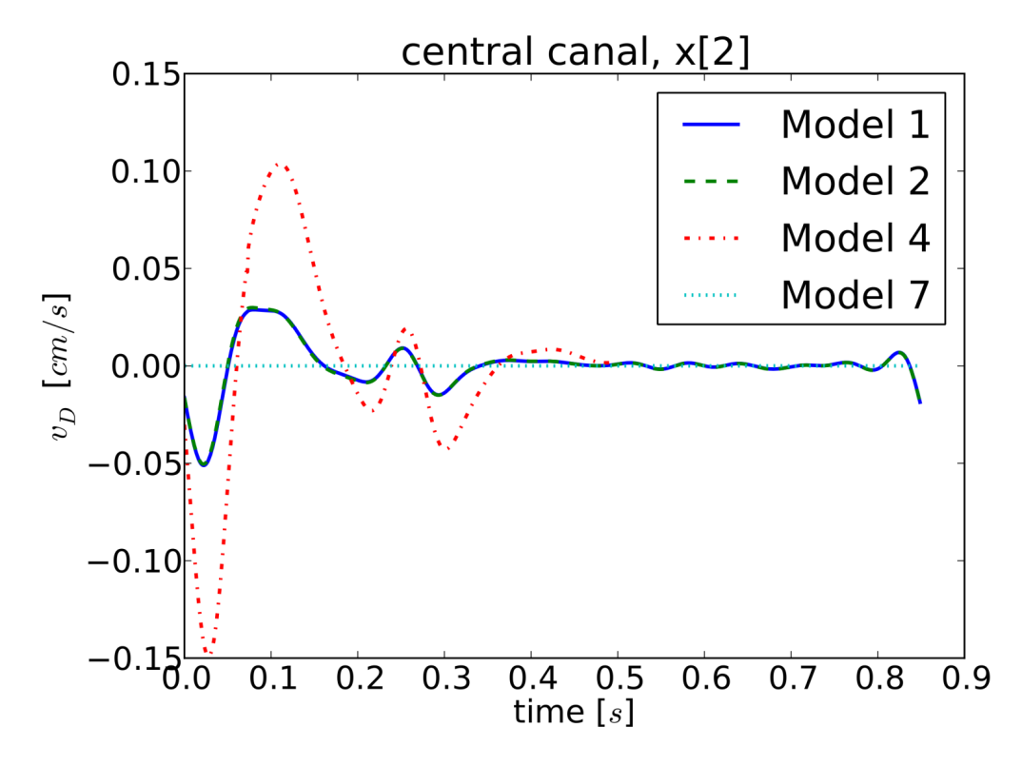
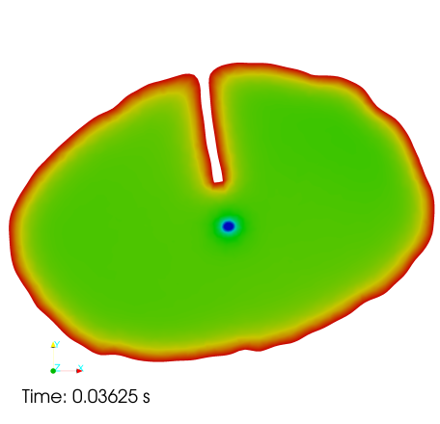
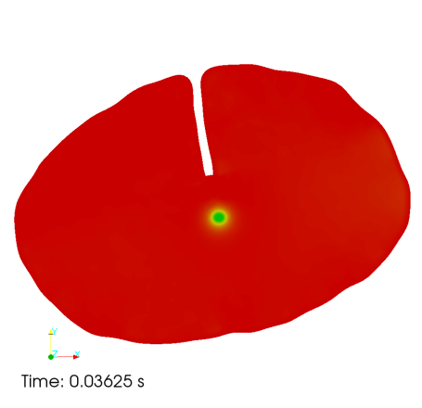
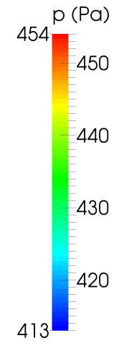
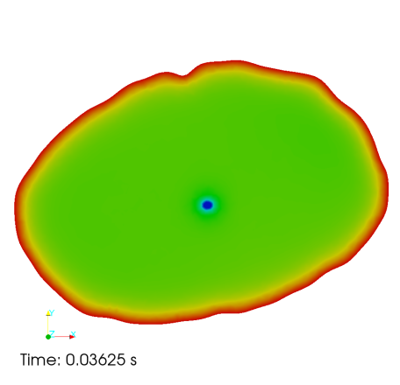
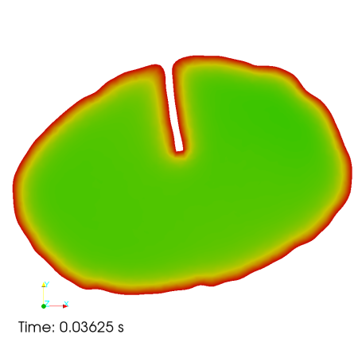
A stiff and thick pia and central canal affects the centripetal pressure gradient and fluid velocity
Reference
Stiff pia
Without fissure
No central canal
Increased flow Syrinx formation
Notes:
The pressure gradient from the wall towards the center is smaller for a stiff pia and without a central canal, while the fissure do not have a major impact on the centripetal pressure.
Finally, here is a plot of the interstitial fluid velocity in the central canal as a function of time. An open segment of the central canal causes enhanced fluid flow in the central canal compared to the surrounding tissue (blue vs turquoise line). And a stiff and thick pia results in 3 times higher velocities in the central canal than in the models with a homogenous Young’s modulus.
The increased fluid flow may play a role in syrinx formation.
(These factors are therefore important to include in future models.)

Slide 30
Summary of findings (so far…)
We have a reasonable understanding of the pulsating flow
Flow pattern distinguish healthy from pathological conditions (so does anatomical considerations)
Different established models for grey/white matter mechanics show quantitatively different behaviour -- which one should we use ???
We now have (or are close to having) the computational means to perform simulations of the human brain from a mechanical perspective
Life is complex -> “realistic” computational models tend to grow BIG
(a couple of cm of spinal cord -> 2 M cells)

Slide 31
Open Questions ??
What are the proper values of the permeability, elasticity ?
How much do this values vary between individuals, species, age, pathologies etc?
What laws govern the remodeling of the central nervous system?
The coupling to the electrophysiologi
Mouse / rat modeling is easier, perhaps a good starting point

Slide 32
Acknowledgement
Karen Støverud, Simula Research Laboratory
Victor Haughton, University Hospital of Wisconsin
Per Krisitan Eide, University Hosptial of Oslo
Geir Ringstad, University Hospital of Oslo
Marie Rognes, Simula Research Laboratory
Kartik Jain, University of Siegen
Hans Petter Langtangen, Simula Laboratory
(Karen Helene Støverud - Relation between the Chiari I malformation and syringomyelia from a mechanical perspective, PhD thesis, UiO, 2014)

