Slide 1
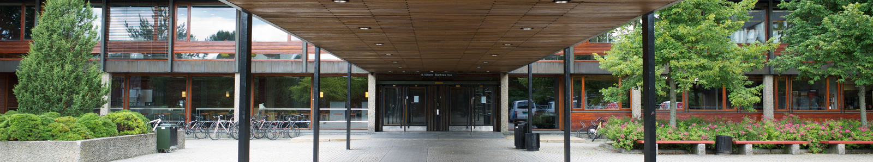
The Science Library
Library of Medicine and Science
Your ultimate resource centre for learning, research, collaboration and development
Photo by Simen Kjellin

Slide 2
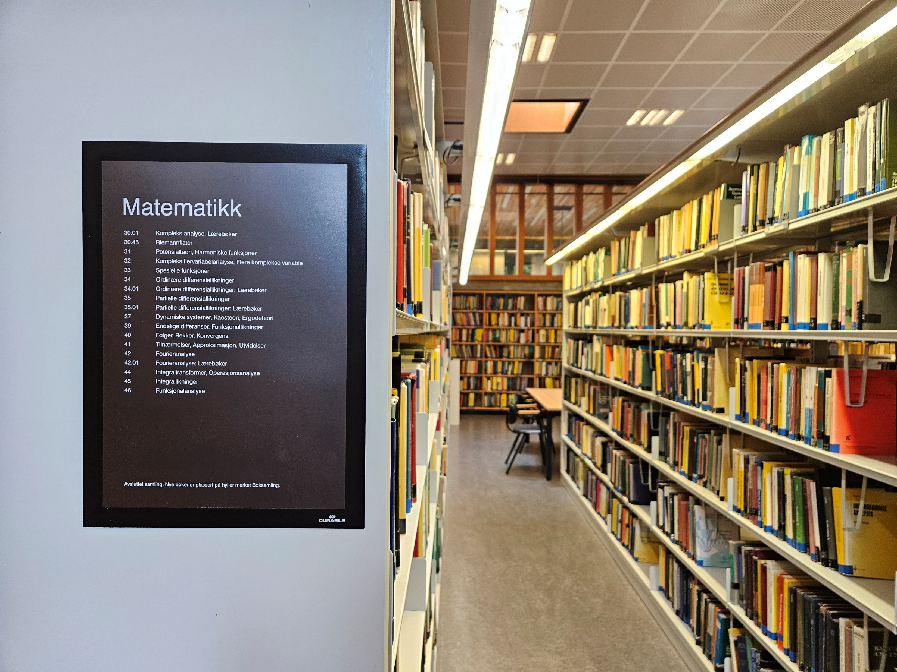
What is the Science Library?
Norway’s largest research library in the natural sciences!
Astrophysics
Biological sciences
Chemistry
Computer science
Geosciences
Mathematics
Pharmacy
Physics
Notes:
Realfagsbiblioteket - Titan.uio.no

Slide 3
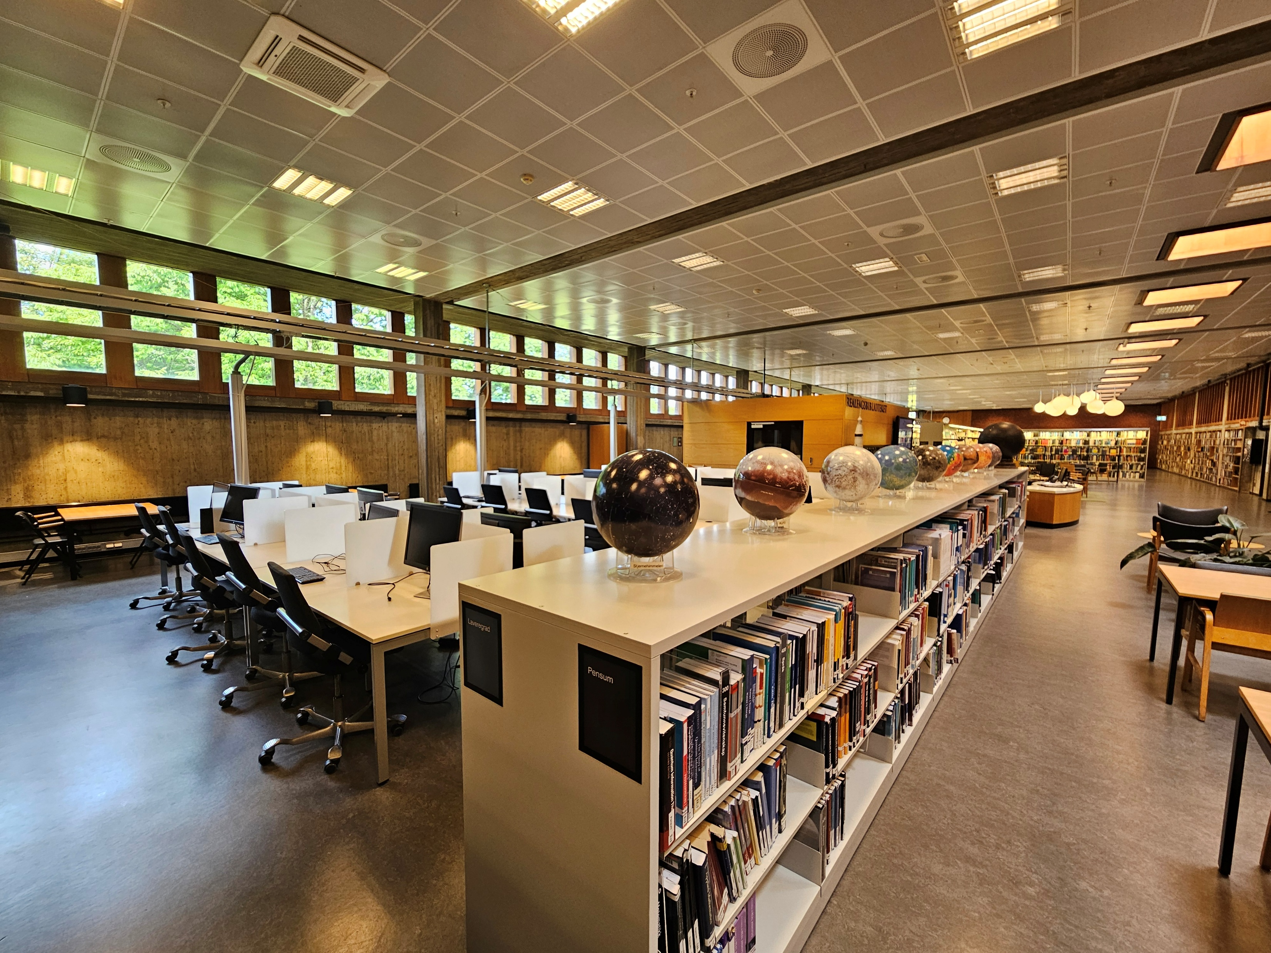
Why use the Science Library as a master’s student?
Because you will find lots of resources and tools to support your studies and research
A great place for studying and collaboration
Access to printed and digital literature and resources
(Personalized) guidance in studies and research
Discover new interests
Develop new research skills you can apply to your thesis and beyond
Notes:
Realfagsbiblioteket - Titan.uio.no

Slide 4
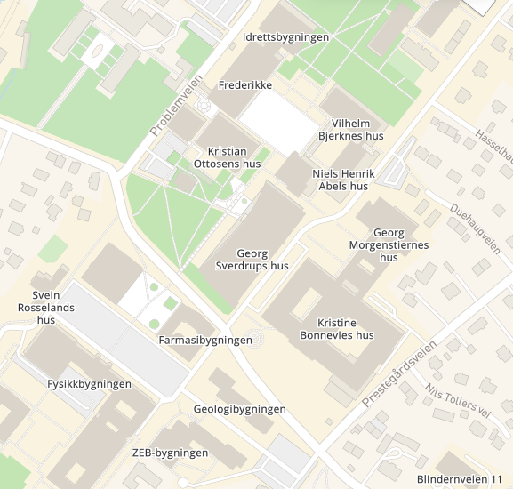
Where & when to visit the Science Library?
Physical address:
Vilhelm Bjerknes hus (VB)
Moltke Moes vei 35
The Science Library
Opening hours: (check the website)
Staffed:
Mon – Fri: 10 – 16
With UiO-card + code:
Mon – Fri: 8 – 22
Sat – Sun: 8 – 18
Korridor 2. etasje
Math institute
Website:
www.ub.uio.no www.ub.uio.no/fag/matematikk

Slide 5
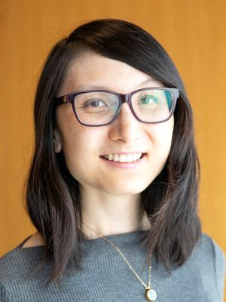
Questions / requests for the Science Library: Who to contact?
Yutong Shan
Senior academic librarian
Subject specialist in mathematics & geosciences
PhD in astrophysics
yutong.shan@ub.uio.no
realfagsbiblioteket@ub.uio.no

Slide 6
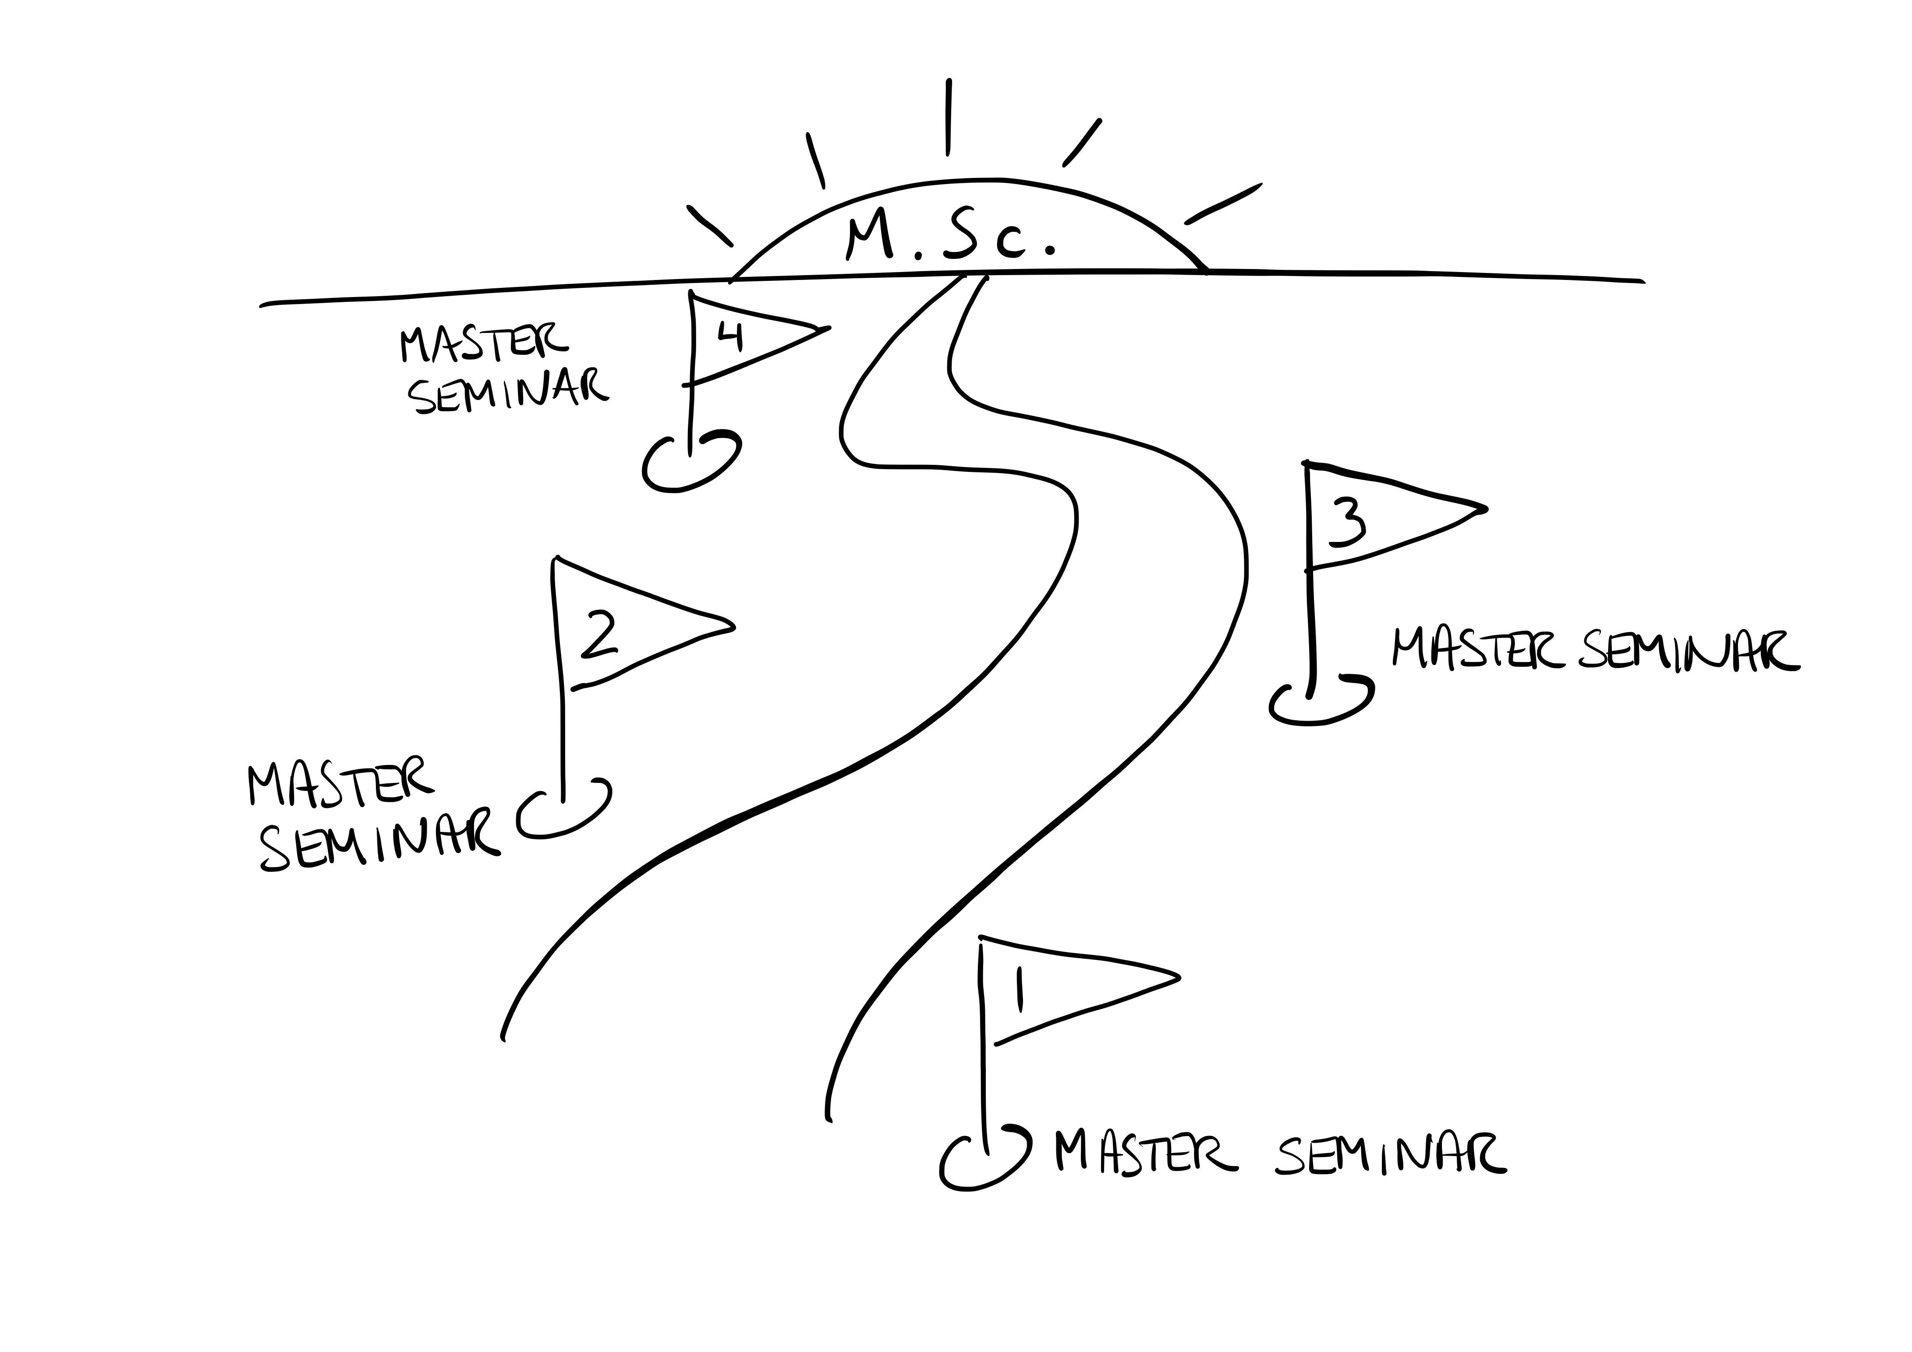
Master seminar series in Mathematics
You can influence what happens here!
Fall 2026
Stay tuned: info coming soon!
Notes:
One important task of subject librarians is that we teach the students how to write their masters thesis
Optional, but strongly recommend to attend to get the most out of your masters studies and make the best thesis possible!
You will learn the skills relevant for each stage of your masters studies as you go along
The first seminar will be in the fall. You will receive more information in a few weeks

Slide 7

Getting started with
LaTeX & Overleaf
For new master’s students
in physics and mathematics
Andri Spilker & Yutong Shan
Senior academic librarians for physics & mathematics
UiO Science Library
Time: Thursday 13 August 2026, 12:00 – 14:00
Location: Tidsrommet, Physics Building (Floor 1)
https://www.mn.uio.no/fysikk/english/studies/master/welcomeweek/latex-course.html

