Slide 1


Welcome meeting
Master students
The Department of Mathematics
Please register your
attendance by
using this QR code

Slide 2
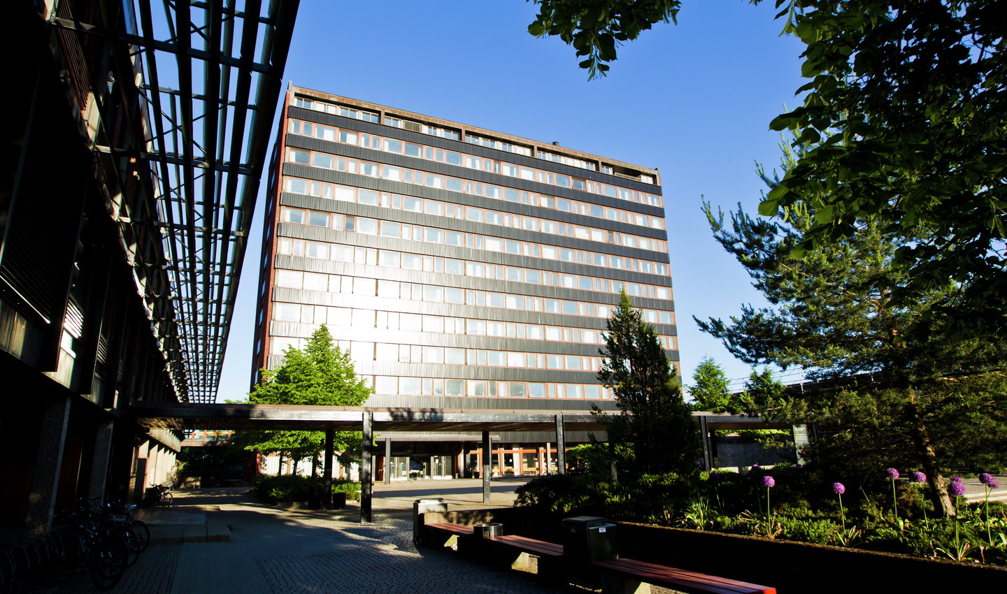
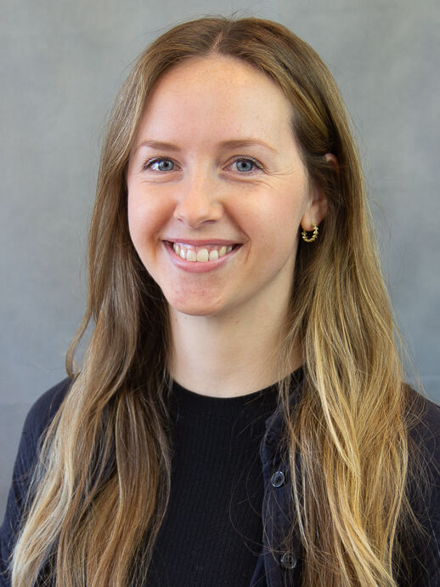
The student administration
Offices at the 7th floor of NHA
Administrative programme coordinator for master
programmes: Nora Sunde
Questions about anything adminsitrative:
  E-mail us from your student e-mail, including:
    your name, study programme and student number
studieinfo@math.uio.no
Niels Henrik Abels hus (NHA)
Nora Sunde

Slide 3
General and important information
All you need to know about your studies:
https://www.mn.uio.no/math/studier/programmer/master/index.html
Planning not to follow regular progression?
  Imortant! Contact the student administration: studieinfo@math.uio.no
  Application deadline: september 1st.
  NB: documented needs for part-time/reduced progression
Remember to log into your UiO e-mail and check it frequently

Slide 4
Important deadlines
August 13th:
  Deadline to sign up for courses in your programme with priority as a programme student
September 1st:
  Final deadline to register in Studentweb
  Final deadline to pay the semester fee
  Final deadline to sign up for courses in general
December 1st (or Sept. 1st):
  Deadline for submitting the master’s plan agreement
  (Deadline for submitting the master’s plan agreement if you plan on including master’s courses completed prior to admission)

Slide 5
The master’s plan agreement
What is a master’s plan agreement?
  A formal written agreement that works as a contract between you, your supervisor and the Department
Outlining your study plan and planned progression
  Who is your supervisor(s)
  Theoretical curriculum (courses)
  Thesis (long thesis of 60 ECTS or short thesis of 30 ECTS)
What elective courses to choose?
  A contact person on your study programme may assist you with choosing relevant elective courses this first semester.
  See also your programme web page

Slide 6
Speak up! / Si fra - systemet
About which issues can you speak up?
What you appreciate and would like UiO to do more of.
Bad aspects of your physical or social learning environment.
Harmful, dangerous, unethical or criminal offenses.
Bullying or sexual harassment.
https://www.uio.no/om/hms/si-fra/
https://www.uio.no/english/about/hse/speak-up/index.html

Slide 7

Study start survey 2026
Help UiO learn more about our new master’s students
The survey only takes a couple of minutes to complete ☺

Slide 8
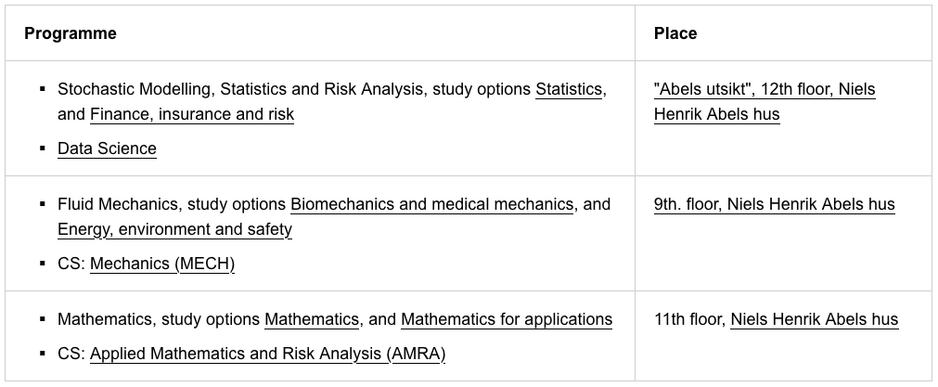
Luch and more information about the programmes

