Slide 1
Career course #thinkcareer 12 November 2021
Welcome!

Slide 2
Choose a box
ACADEMIA RESEARCHER | ACADEMIA NON-RESEARCHER
NON-ACADEMIA RESEARCHER | NON-ACADEMIA NON-RESEARCHER

Slide 3
Some general results for Norwegian phd candidates
where do they go and what do they do when they finish their degree?
Sources NIFU 2017:10 and NIFU 2020:19

Slide 4
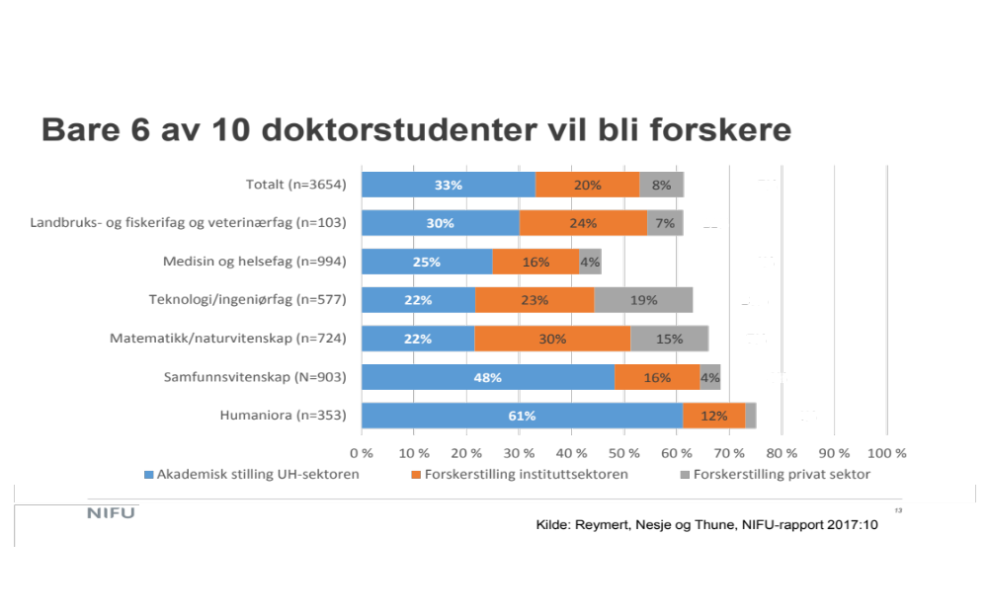

Slide 5
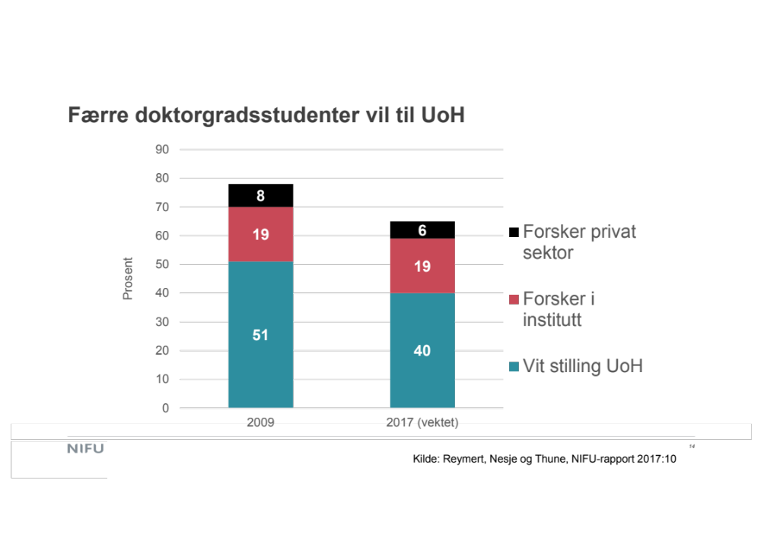
12 November 2021

Slide 6
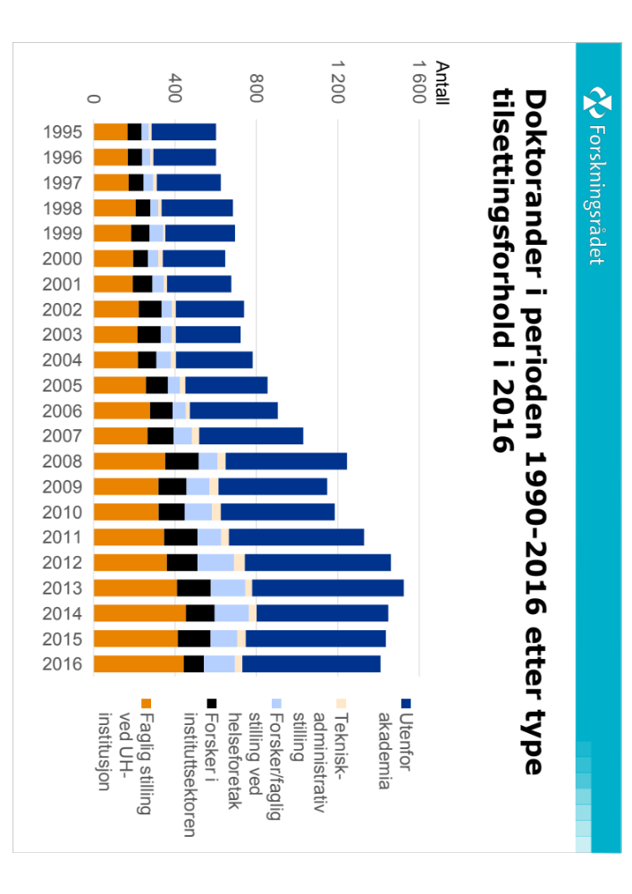

Slide 7
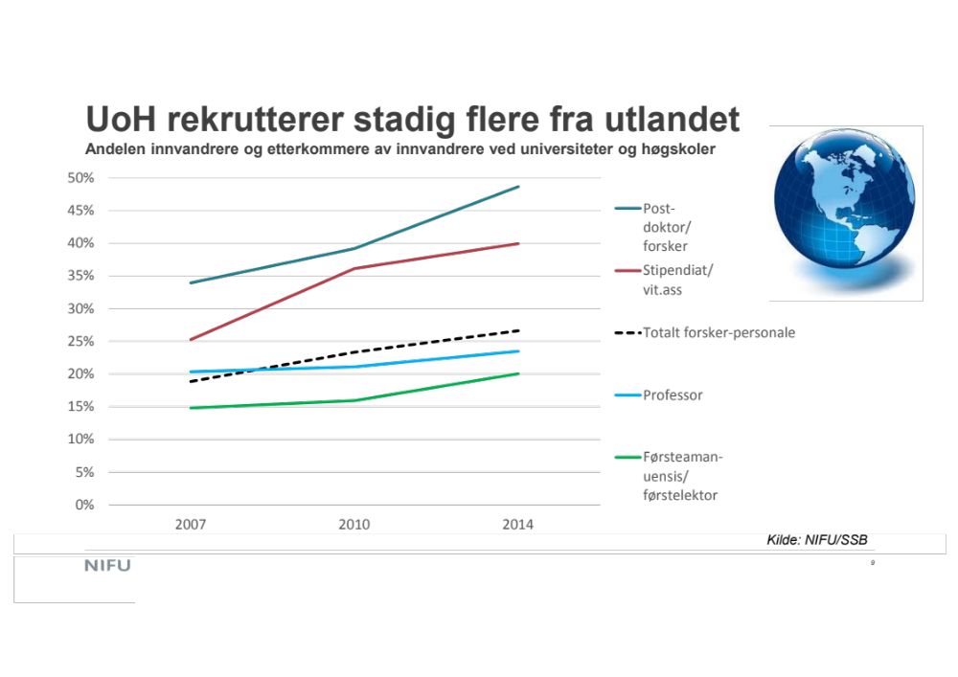

Slide 8
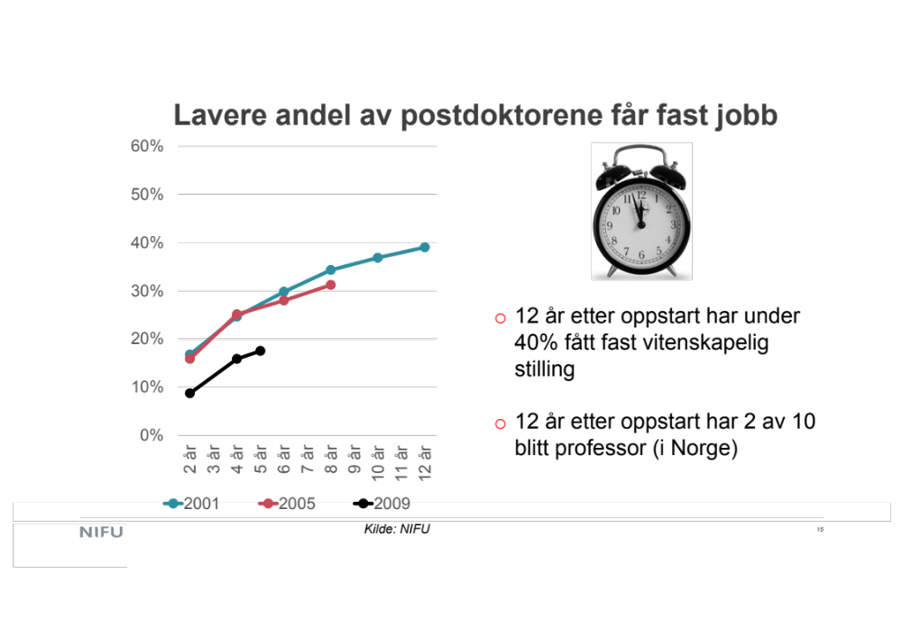

Slide 9
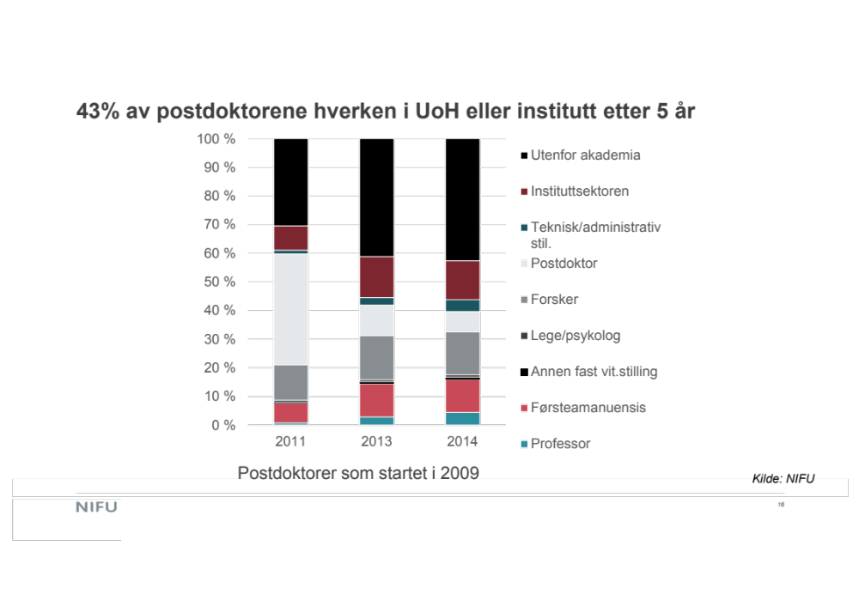

Slide 10
Other «fun facts»
Temporary employment after phd in academia is the most common reason to choose a career outside academia.
Phds in academia have lower salary (on average) than Phds in other sectors. (Largest gap in mathematics and natural sciences).
Female PhDs have lower salary than male PhDs (regardless of sector).
Phds work more hours.

Slide 11
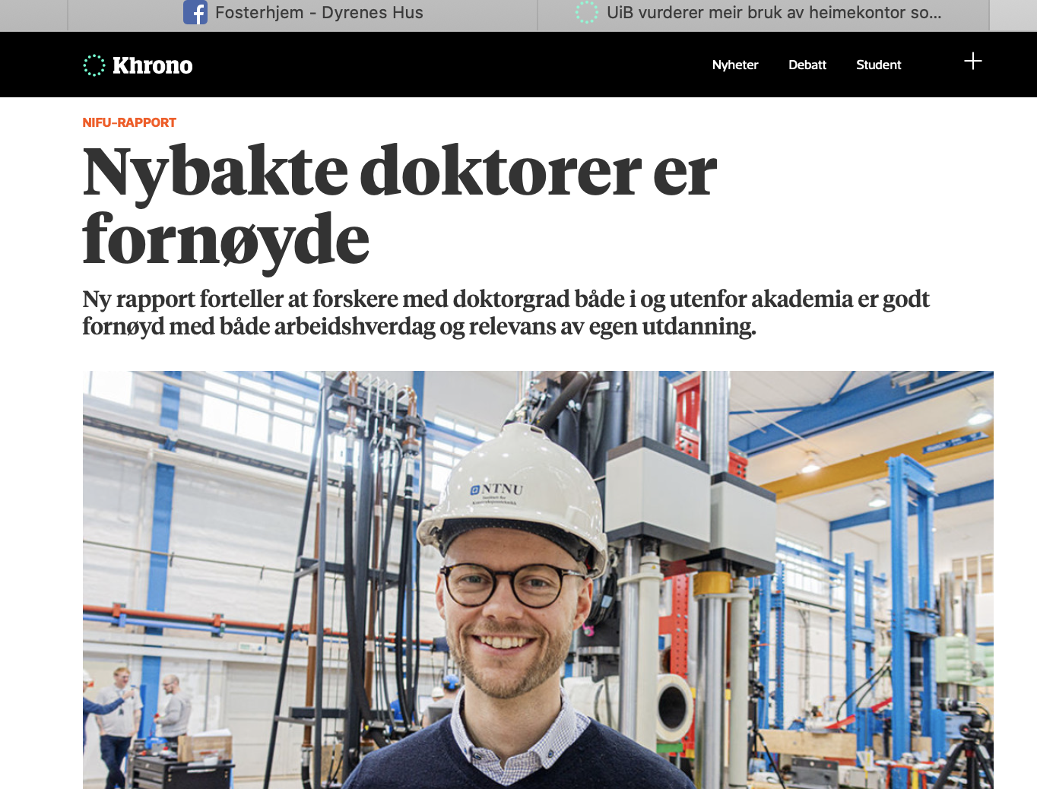
...but still, they are happy!

Slide 12
...but still, they are happy!
They are happy with
  Being in a permanent position
  Being able to contribute to society in a postive way
  Having the possibility to use their competence
  The responsibility and independence in their position.
  ...but to a less degree about their salary...

Slide 13
What about our own alumni?
Survey – finished in 2018
We contacted all PhDs graduating from our Department year 2000 ->
54% responded

Slide 14
Most important results
More than half of the respondees got a job before they finished their degree. (And less than 10% spent more than 6 months getting a job.)
Most have permanent jobs (85%)
They think their employers are aware of the content of their education
The education they got at UiO was useful

Slide 15
Our phd-alumni divided into boxes
ACADEMIA RESEARCHER 33 % | ACADEMIA NON-RESEARCHER 10%
NON-ACADEMIA RESEARCHER 21% | NON-ACADEMIA NON-RESEARCHER 36%

Slide 16
Respondees from what subject area?

Slide 17
where do they work?

Slide 21
How important are the following job characteristics for you?
less ← Importance → more
Professional challenges (95%)
Possibility of learning and personal development (92%)
Independent work (91%)
Flexible working hours (86%)
Control over your own work pace (86%)
Varied work tasks (79%)
Doing something useful for society (70%)
Collaboration with others (67%)
Good career opportunities (58%)
Recognition from leaders and colleagues (53%)
Opportunity to make international career (38%)
High income (33%)
Possibility of influencing community development (30%)
numbers in parenthese: sum of the numbers of replies of "important" and "very important"

Slide 22
To which extent do you agree with the following statements?
My studies helped me develop my ability for analytical thinking (91%)
My studies trained me for the process of collecting and processing complex information (83 %)
My studies helped develop my writing abilities (79%)
My studies gave me skills/competency that meets the demans of my professional life (74%)
My studies prepared me in the use of computer as a work tool (65%)
My studies gave me a good practice in oral preparation (60%)
number in parentese: sum of replies in the categories "agree" and "totally agree"
less ← agree → more

Slide 23
Advice from our phd-alumni I
Oral presentation skills and writing abilities are crucial for a successful career
Be aware that industry is often far behind theoretically but not necessarily when it comes to solving practical problems, which could often be the main issue for a new graduate.
They should for sure get internationally connected.
.. how to better at negotiating salary.
Learn to program!
A solid basis in statistics is useful for almost every professional area.

Slide 24
Advice from our phd-alumni II
Most of the work you have to do yourself. If you want to improve your writing or ability to present your work, you have to ask for advise, not sit around and wait for someone (your supervisor) to discover your weaknesses (it's a bit hard to call it weakness, but anyway) and help you out.
PhD students need to know about their job opportunities in industry and get prepared for such jobs as well and not just for the very limited number of permanent academic jobs. Tell them about the number of faculty jobs available vs. number of phds and postdocs!

