Slide 1
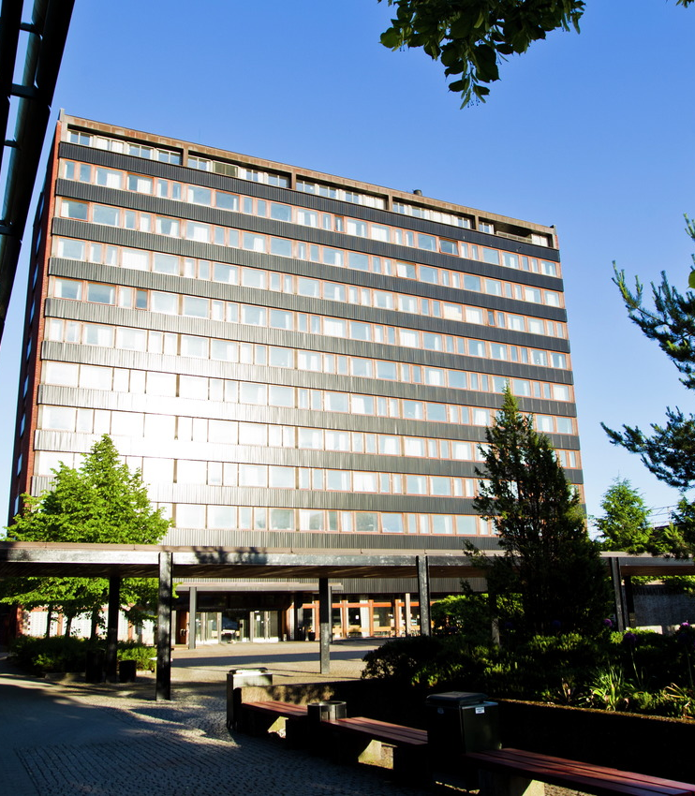
Think Career
Jørgen Vold Rennemo
Associate Professor
Department of Mathematics

Slide 2
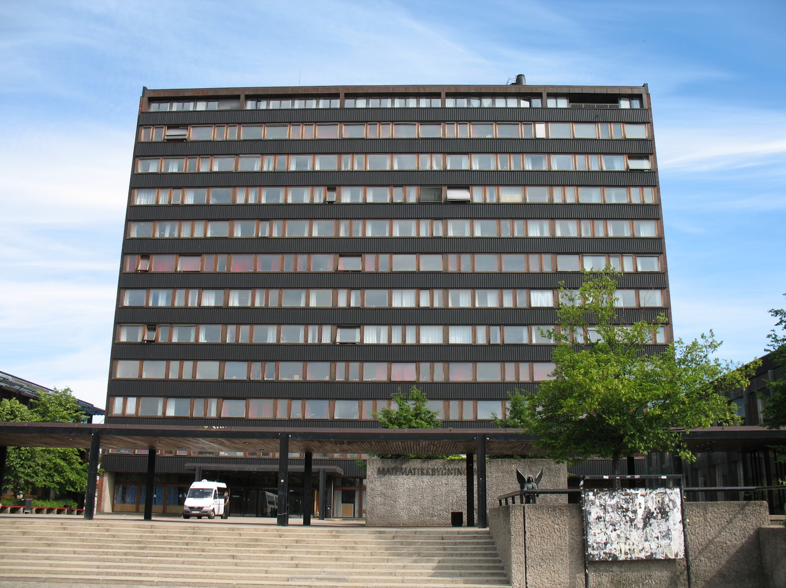
2010: BSc/MSc degree here →

Slide 3
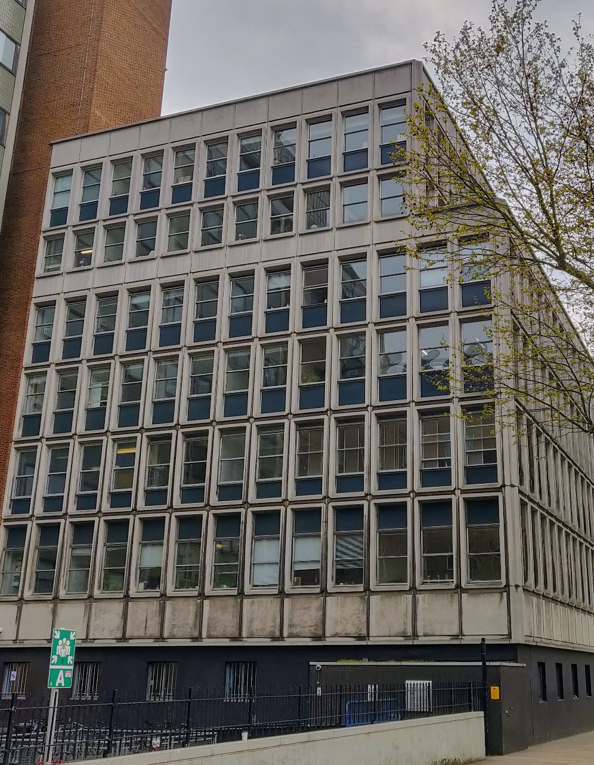
2011-2015: PhD (Imperial College London) →
Thesis in algebraic geometry on
The homological projective dual of Sym^2 P(V)

Slide 4
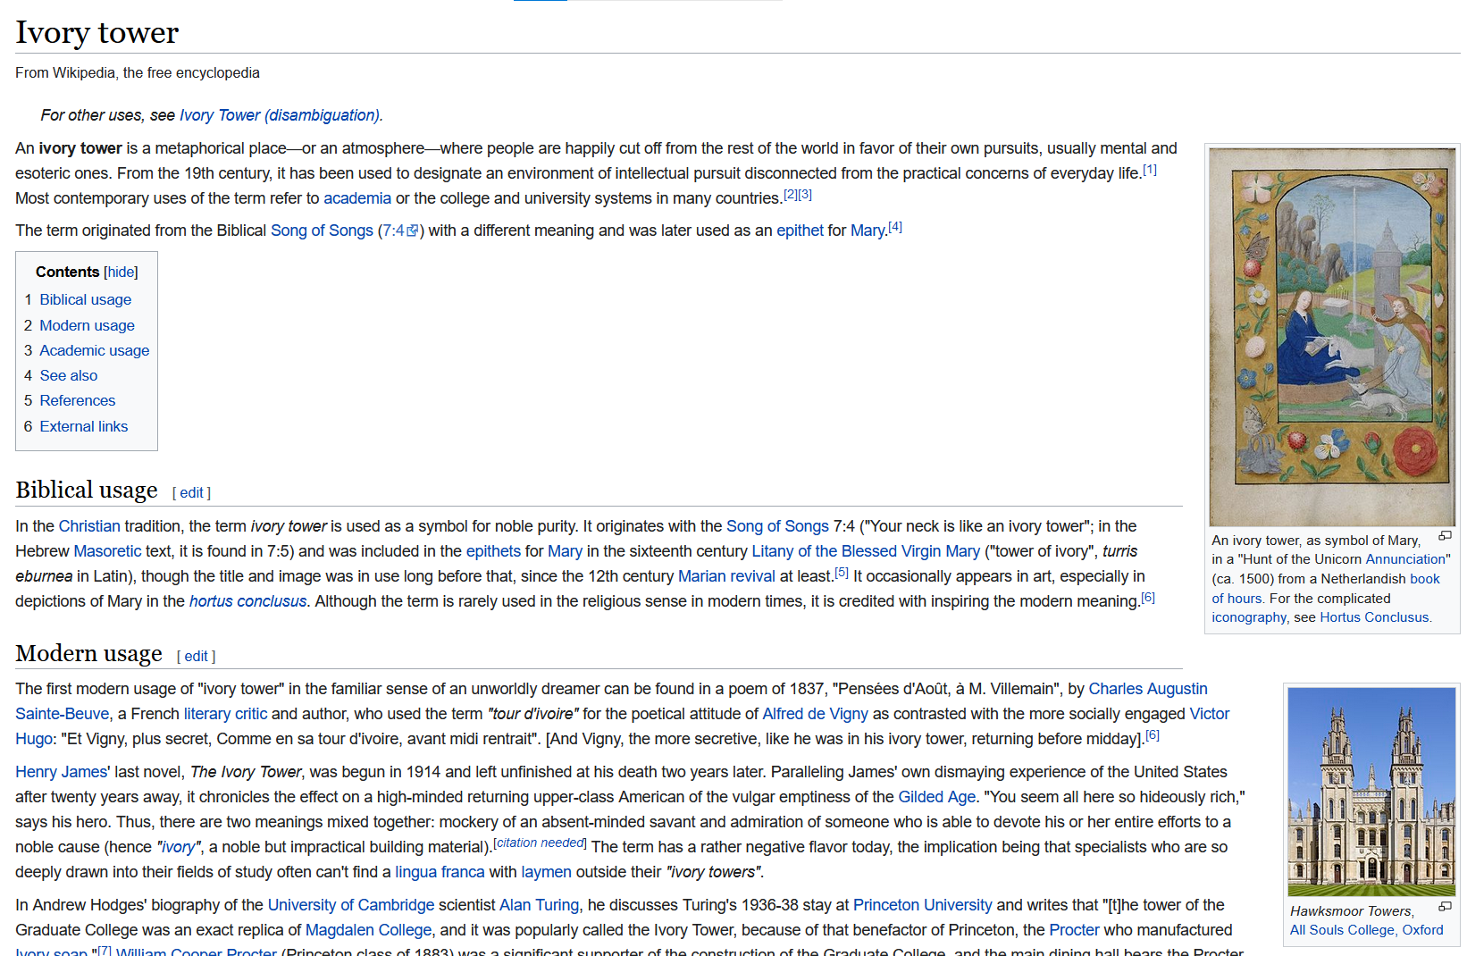

Slide 5
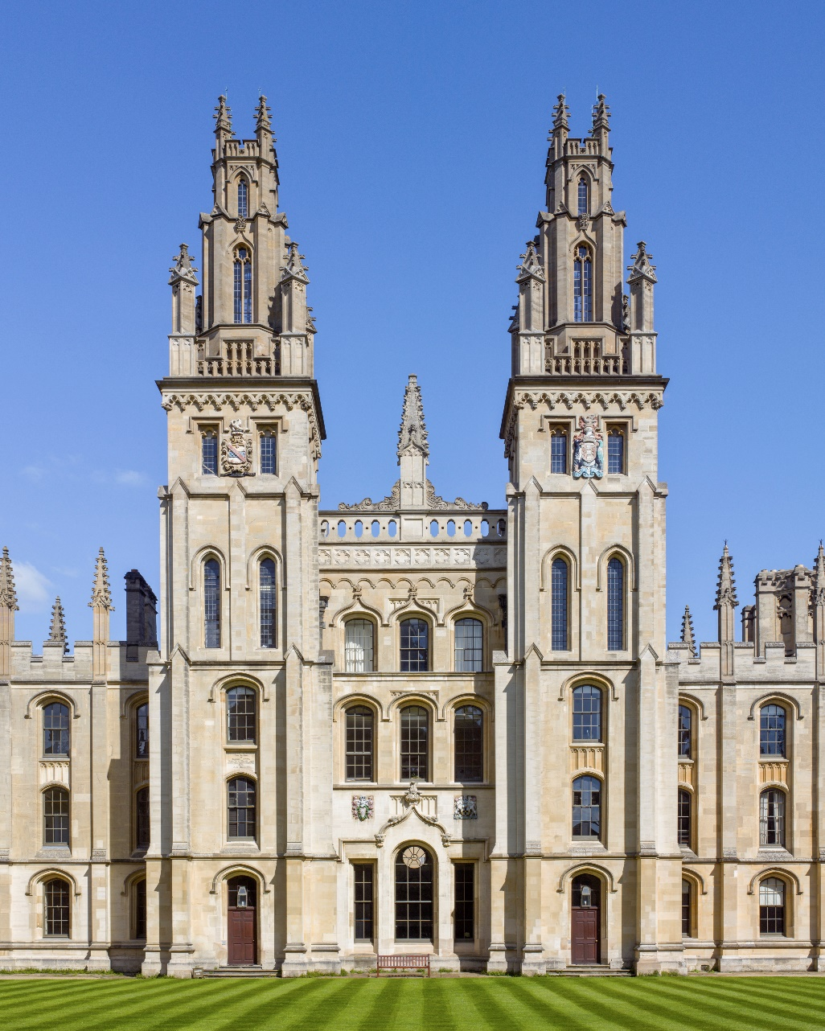
2015-2017: Postdoc (Oxford) →

Slide 6
2017-2020: Postdoc →

Slide 7
2021-???: Associate professor →

Slide 8
“My career plan”
Goal: Get to do mathematics research
Strategy: Do mathematics research
Find a result, prove it, write it down, share it
The postdoc cycle
Apply for many jobs, get rejected for many jobs
Apply for several grants, get rejected for several grants

Slide 9
Academic job applications
CV/publication list
Reference letters
Research statement
Interviews: They happen.

Slide 10
Research grants
Asking some grant agency for funding for 2-4 years
“Create your own position”
Difficult, time consuming, competitive
High reward

Slide 11
Best career tip
Travel(?)

