Slide 1
SMR
Stochastic Modelling, Statistics and Risk Analysis
Direction FFR
Frank Proske
Professor
Risk and Stochastics

Slide 2
FFR – Finans, Forsikring og Risiko
Risk: an event or action that may adversely affect an organization’s ability to achieve its goals and execute its strategies.
Risks generated from the environment or from human activities are everywhere and we must learn to take care of.
It is a daily challenge for those working in finance, insurance, energy or reliability engineering.
A good understanding of risk (measurement and management) is very important in decision making processes.

Slide 3
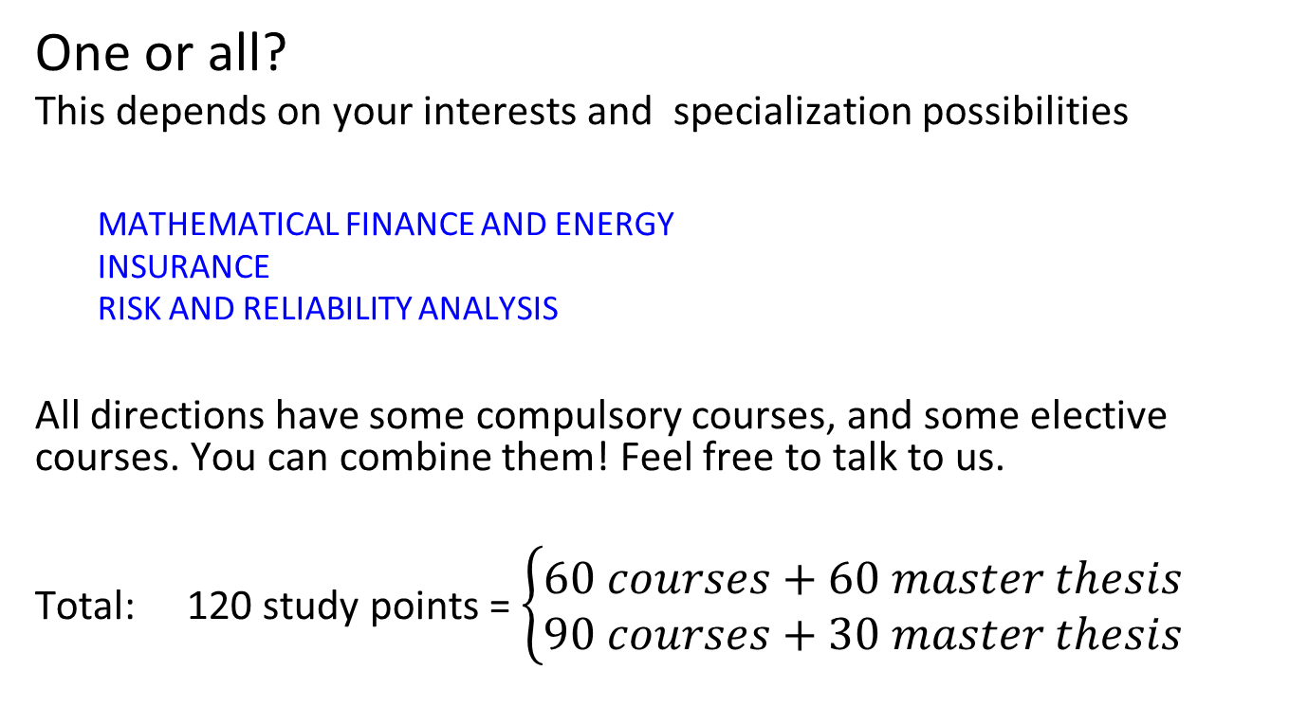
Structure: 3 specializations
One or all?
This depends on your interests and specialization possibilities
  MATHEMATICAL FINANCE AND ENERGY
  INSURANCE
  RISK AND RELIABILITY ANALYSIS
All directions have some compulsory courses, and some elective courses. You can combine them! Feel free to talk to us.
Total: 120 study points = $\left\{\begin{aligned}60 courses+60 master thesis \\ 90 courses+30 master thesis\end{aligned}\right.$

Slide 4
Mathematical Courses
MAT4720 Stochastic Analysis and Stochastic Differential Equations
MAT4710 Probability Theory
MAT4790 Stochastic Filtering
MAT4740 Malliavin Calculus and Applications to Finance
STK4550 Extreme Value Statistics and large Deviations
MAT4760 Advanced Mathematical Methods in Finance
Courses in Functional Analysis, Partial Differential Equations and Machine Learning

Slide 5
Finance & Energy Courses
STK-MAT4700 Introduction to Mathematical Finance and Investment Theory
MAT4770 Stochastic Modelling in Energy and Commodity Markets
MAT4750 Mathematical Finance: Modelling and Risk Management
STK4530 Interest Rate Modelling via SPDEs

Slide 6
Insurance
STK4505 Problems and Methods in Actuarial Science
STK4540 Non-Life Insurance Mathematics
STK4500 Life Insurance and Finance

Slide 7
Risk and Reliability
STK4405 Introduction to Risk and Reliability Analysis
STK4400 Risk and Reliability Analysis

Slide 8
Master thesis
Finance and Insurance: financial derivatives, bonds and interest rates, and model analysis.
Commodity markets, energy markets, freight markets.
Environmental risk factors into market prices.
Risk measures and monetary risk evaluations.
Insurance: Solvency II.
Reservoir production, performance, reliability of components.
Modeling, hedging, optimization.
Numerical methods (stochastic and deterministic).
Machine learning and applications
Background
Mathematics: statistics, probability, stochastic analysis, stochastic control – all can be covered with courses at master level with a background in math and statistics from bachelor.

Slide 9
Long or short master thesis?
Your choice!!
In FFR it is important to get a good background.
If you have 90 points on courses, then you get directly into the exciting part of the master’s thesis (30 points).
If you only have 60 points on courses, then you have to work harder to get into the heart of the thesis.
Both must be well written and skillful to obtain top marks.
Both can lead to exciting jobs and also a doctorate!

Slide 10
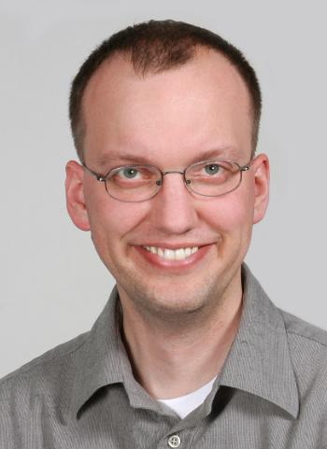

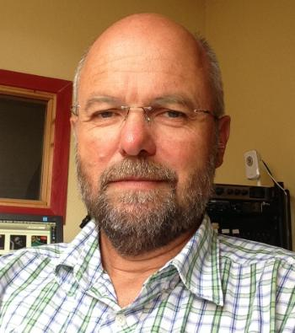
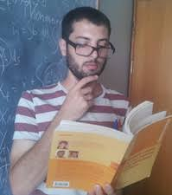

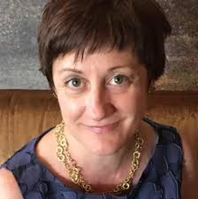
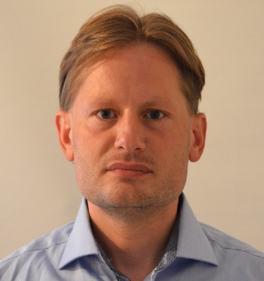
Supervisors
Finance, energy, risk measurement, risk management, control theory, probability theory, stochastic analysis statistics, reliability analysis, numerical methods ...
SECTION 3 – Risk and Stochastics

Slide 11
Examples
Machine learning techniques in interest rate modelling. Mathias Kristiansen. Consultant at KPMG. (Ortiz-Latorre)
Dynamic risk measures generated by time-changed BSDEs with jumps. Siyu Zhou. Data Scientist at Telia Norge. (Di Nunno)

Slide 12
Examples
A functional approach to forward rate modelling. Kim André Arnstsen. Pricing Actuary at Codan Norway. (Benth)
Prospective Reserves of Life Insurance Policies under the Heath-Jarrow-Morton Framework. Åsmund Hausken Sande. PhD student in our section. (Baños)

Slide 13
Examples
Unit-Linked Insurance Policies in the Presence of Credit Risk. Håkon Nortvedt. Actuary at Fremtind Forsikring (Proske)
Optimizing bivariate reinsurance with dependent risks. Xiaofei Li. (Huseby)

Slide 14
Risk and Stochastics
7 professors, 3 postdocs, 6 Phd students.
From various nationalities.
International collaborations: United Kingdom, France, USA, Austria, Germany, Ukraine, Spain…
Various ongoing research projects
  SCROLLER: A stochastic control approach to machine learning with applications to environmental risk
  STORM: Stochastics for time-space Risk models.
  SPATUS: Spatial-temporal uncertainty in energy systems.
STAR Seminars: Bi-weekly seminar with national and international speakers.

