Slide 1
Handling nervousness
Elina Melteig

Slide 2
What we fear the most
From The book of lists
Giving a speech in public
Heights
Insects
Financial losses
Deep water
Illnesses
Death

Slide 3
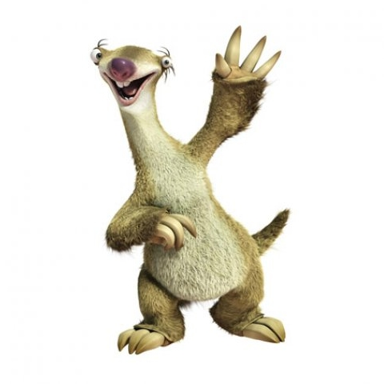
In the animal world, attracting
attention can be lethal

Slide 4
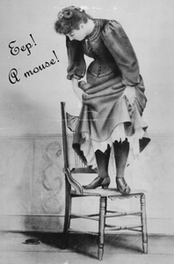
Nervousness is natural, but not always rational
you can learn to handle it

Slide 5
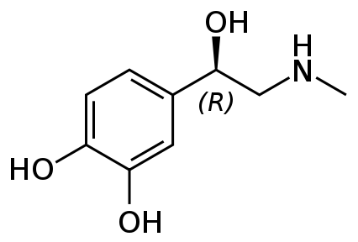
Adrenaline
(epinephrine)
The positive stress hormone
Sweating
Facial flushing
Dilated pupils
Muscle contraction
Dry trout
Increased respiratory rate
Increased heart rate
Fight-or-flight
This is good news!

Slide 6
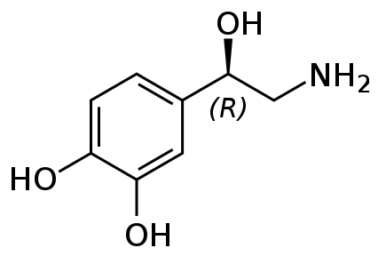
Noradrenaline
(norepinephrine)
The negative stress hormone
Cold-sweating
Turning pale
Small pupils
Paralysis
Voice loss
Hyperventilation
Galloping heart rate
This is bad news!

Slide 7
Our aim
Keep tension at the adrenaline level
by learning you to trust your basic skills (know that you know!)

Slide 8
reduced nervousness
more challenging tasks
confidence
better skills
more training

Slide 9
Lack of progress is due to lack of:
motivation
feedback
insight
into own performance
courage to face the demons

Slide 10
Your peers
Your friends will think you look stupid and boring
Learn the basic skills, and they will not!

Slide 11
Authorities
Your supervisors / superiors are present. They will regret accepting you as a student / employing you
Your leaders have been trough the same thing before and know how hard it is. They, in particular, will appreciate a good presentation

Slide 12
Scientific level
Some people in the room will know a lot more about the topic than you and will be very critical
Evaluate criticism as good advice. Thank them for their support.
Don’t try to impress anyone by giving a talk that is too complicated

Slide 13
Preparations
You have not had time to prepare properly. You will get a blackout
Be prepared! (you owe it to your audience)
Practice first on your own and then in front of a smaller group

Slide 14
Questions
You will get questions you cannot answer, or there will be none
Learn how to deal with questions
At meetings, the chair should always ask at least one question

Slide 15
The room
The lecture hall will be big and scary, or crowded and difficult
Familiarize yourself with the room before you go on stage. Resolve any problems or questions you might have with the organizer well in advance

Slide 16
Technical problems
The PC will not work, it will be impossible to upload the presentation, PowerPoint problems
Bring presentation on two USB-sticks, know PowerPoint, rehearse!
The blackboard/whiteboard is always an alternative, keep notes

Slide 17
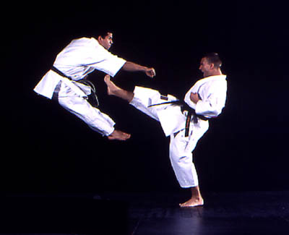
Mastering skills

Slide 18
White belt –
the inexperienced
Never or rarely makes presentations
Actively avoids doing so
Dislikes taking the word, even in small groups

Slide 19
Yellow belt –
the occasional
Not paralyzed by the prospect of giving a presentation, but does no volunteer
Not familiar with basic skills
Usually fails to thrill the audience

Slide 20
Blue belt –
the more experienced
Has given a fair number of presentations with some success
Familiar with the basic skills
Always well prepared

Slide 21
Brown belt –
the willing
Often gives presentations
Confident, clever and experienced
Involves, engages and adapts to the audience
Handles questions professionally

Slide 22
Black belt –
the professional
Black
Giving presentations is part of the job
Appreciates the attention of the audience
Handles high stress levels
Uses all techniques (including humor) efficiently

Slide 23
Black belt –
10th dan
Black
The unique performer
Improvises if required
Enjoys the adrenaline kick from giving the audience a great experience

Slide 24
Artist
10
Bad news: Practice in itself will not take you into the “advanced” zone
Good news: Just by knowing the Basic skills, you will never be in the “beginner” zone
Beginner

Slide 25
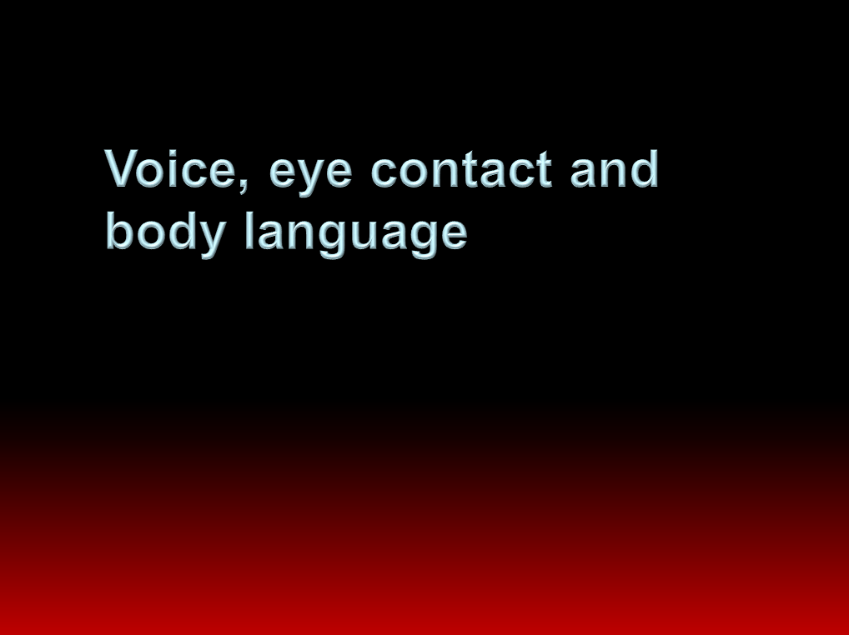
Use your voice and body
Belongs to the basic skills, but try a little bit more of everything

Slide 26

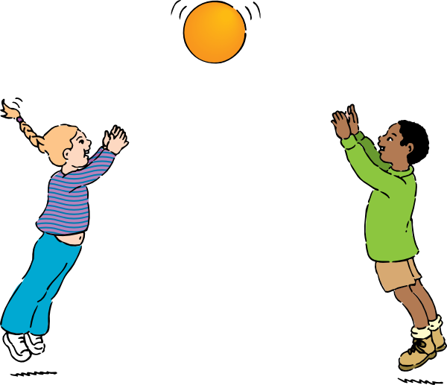

Involve your audience
Don’t do all the talking!
Make it interactive if appropriate
Ask questions
Share the stage

Slide 27

monologue
dialogue, questions
What lecture style maximizes learning outcome?

Slide 28
Use gadgets and demos
Use demos to visualize essential components of your talk
Must be relevant to the topic

Slide 29
Use humor
Excellent if nicely executed
Embarrassing if not
Who can you have fun with?
Yourself
and your own group

Slide 30
Be personal
Relate your topic to recognizable everyday events or objects
Share experience and interest

Slide 31
Position
Eye contact
Facial expression
Tics
Hands
Footwork
Body language
Voice
Breaks
Moves
Summary:
Your toolbox

Slide 32
Position
Eye contact
Facial expression
Tics
Hands
Footwork
Body language
Voice
Breaks
Moves
Involve
Be personal
(Humor)
Push limits
Summary:
Your toolbox

Slide 33
Exercise 3 (3 min)
Present a scientific topic to an audience of 1st year bachelor students.
in which you are personal, involve the audience and break your comfort zone

Slide 34
Next week
Exercise 4: Make PowerPoint presentation of:
- Master project
KJM2010/2020 project
Other research project
Focus: structure, comprehensibility. 4 min.
Save as .pdf and bring handout with six slides printed on each page (NO file upload)

Slide 35
Bonus material!!!
The power of pictures
Do not write too much
Pathos, ethos and logos
Dumb it down

Slide 36
My expectations:
Photo: University of Portsmouth
Notes:
Verdens sterkeste bio-materiale: snegle-tenner!!!
Sterkere enn spindelvev!!! Den har det på tunga, for å si det sånn!
Vi kjenner dem som albuesnegl (Limpet = patella vulgata)
Tenner av et komplisert mineralprotein..

Slide 37
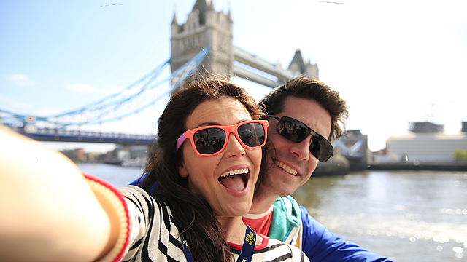
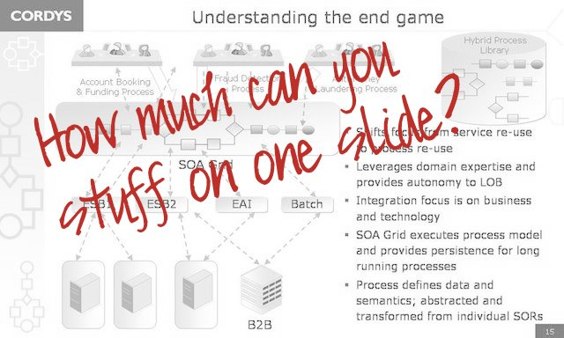
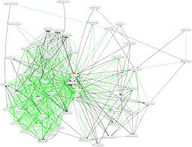
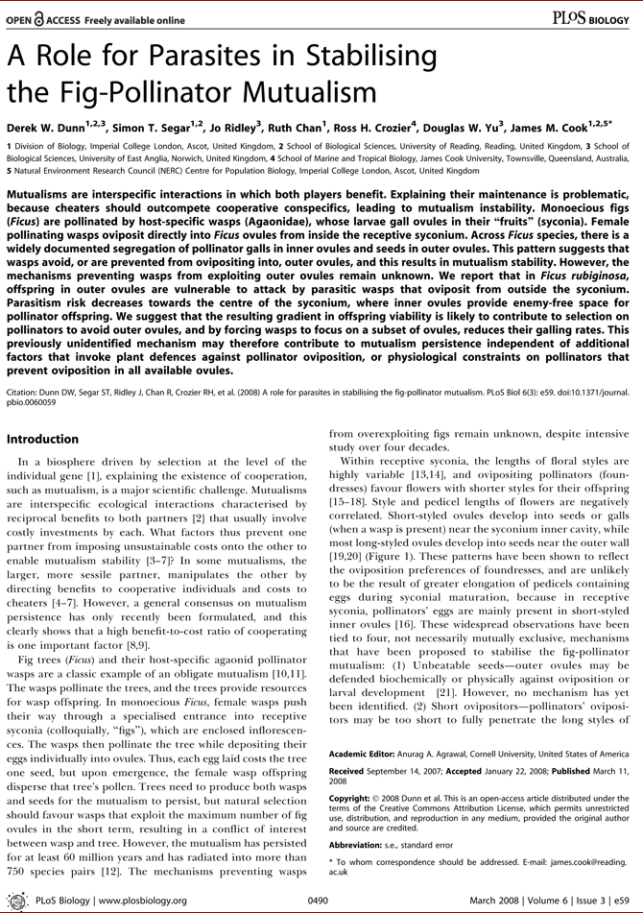
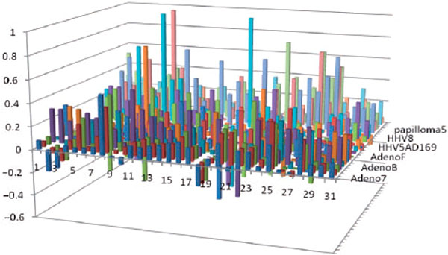
Notes:
THIS is ugly!
Too much information
Can´t see the graph
You may end up saying: 1) No time to explain this OR 2) this is too complicated... Then you have managed to both vaste your audiences time and insult them...
ALWAYS EXPLAIN YOUR GRAPHS!

Slide 38
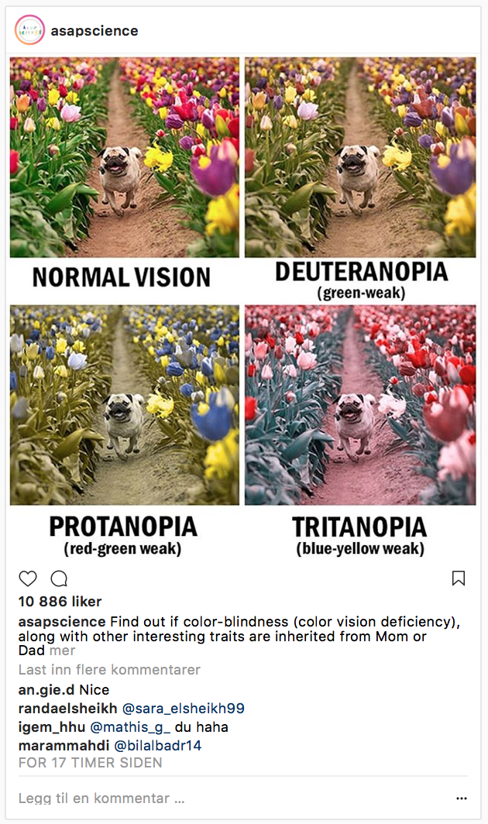
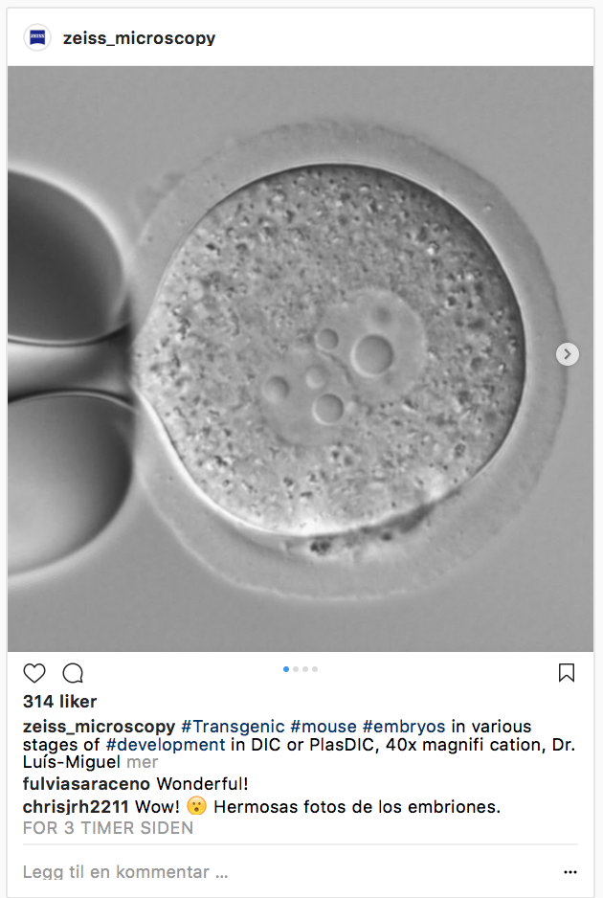
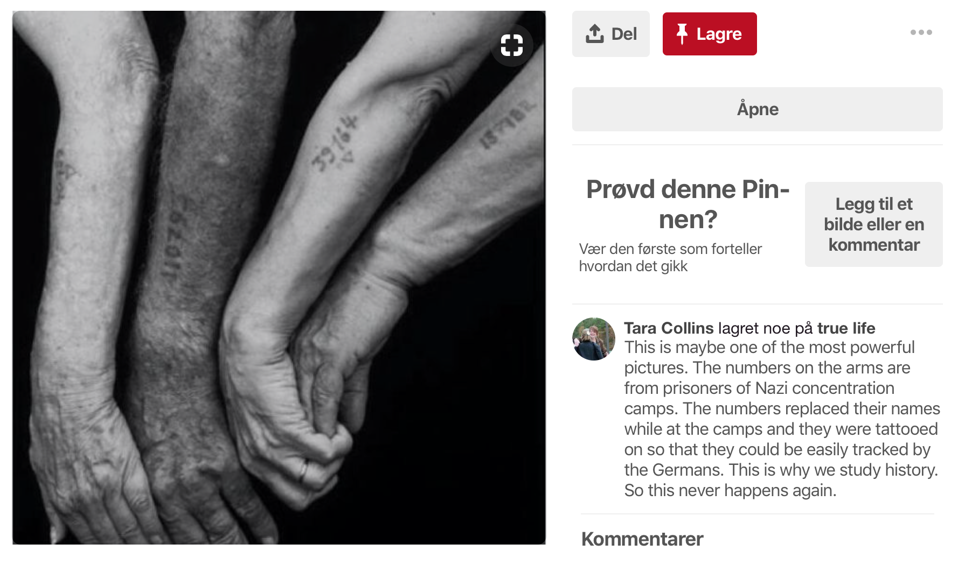
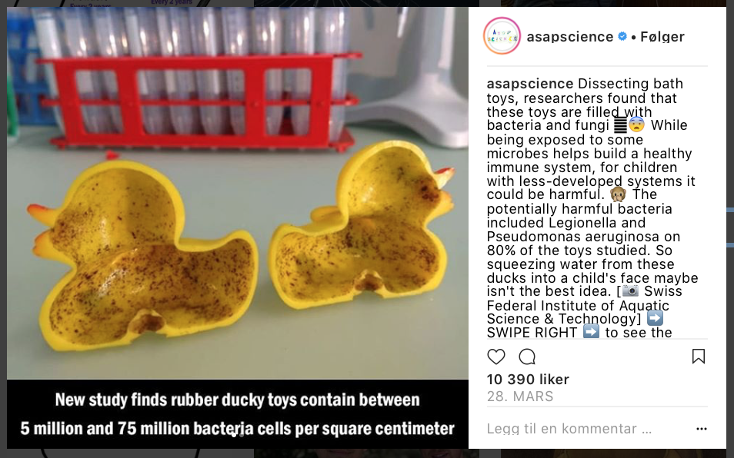
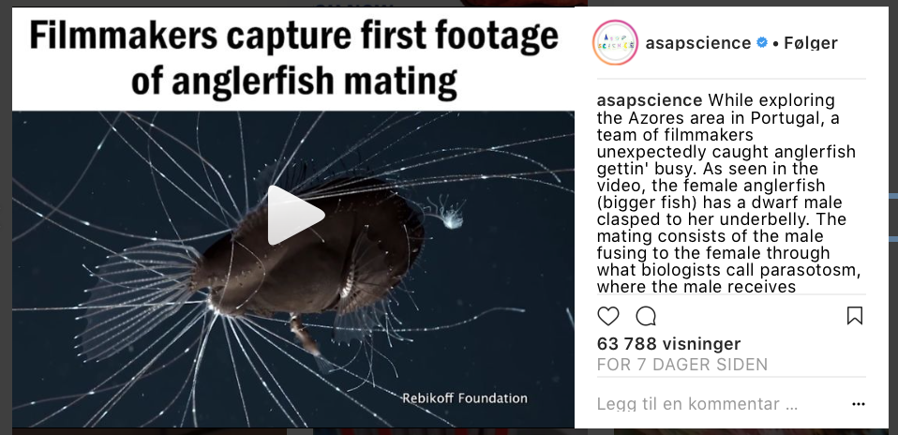
Illustrations, images and movies
Notes:
Images can be a thousand words
Funny
Tell your science
Wake emotions
Get your Ethos!
Illustrations – LOGOS?

Slide 39
Presentations and posters
En powerpointpresentasjon er ikke copy paste av det du har tenkt å si. Det som skjer da er at de som sitter i salen blir sittende å lese teksten i stedet for å høre på hva du faktisk sier. I tillegg blir du ofte bundet av teksten. Det er utrolig irriterende hvis du for eksempel glemmer å si noe om et av punktene eller hopper over noe fordi du innser at du ikke har tid. Selv om vi mennesker forteller mange historier gjennom tekst, så er det ikke derfor vi har presentasjoner. Vi har presentasjoner for å LYTTE. Hvis du har kommet så langt har du antagelig ikke hørt etter hva jeg har sagt. Slutt å lese nå. Jeg mener det!
Notes:
Too much text is distracting...
The presentation is not meant to be your notes!
Makes it harder to actuallt listen!

Slide 40
For how long will you stare at such a text?
Yes... It is visible...no it´s not pretty!
Notes:
Visibility?
Colours
Shadows
Animations
Size of the text

Slide 41

Mastering PATHOS ETHOS AND LOGOS

Slide 42
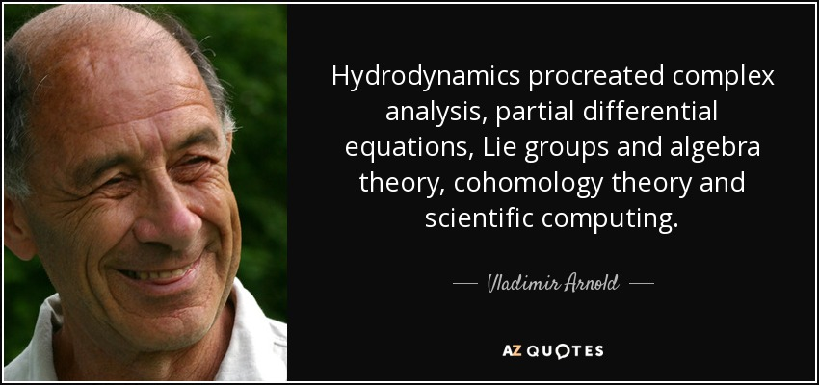
Avoid too technical language
Notes:
Lix-reknare!
Too technical... According to your audience?
Abreviations
Unexplained figures

Slide 43
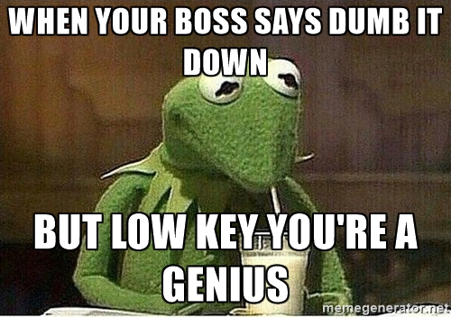
Notes:
NB!!!! DO NOT INSULT YOUR AUDIENCE!!!
It´s too complicated for you...
I don´t have time to explain this... Then why did you add it?
Presentations that were clearly meant for another audience

Slide 44
Next week
Exercise 4: Make PowerPoint presentation of:
- Master project
KJM2010/2020 project
Other research project
Focus: structure, comprehensibility. 4 min.
Save as .pdf and bring handout with six slides printed on each page (NO file upload)

