Slide 1

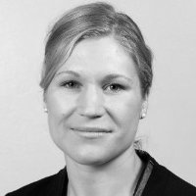
Scientific presentation techniques
Lecture 10: Slide design
Elina Melteig
Notes:
1: Ask the audience
- what is a nice slide?
- what is a bad slide?
AGENDA
Agree on check points for a nice presentation

Slide 2
Storyline
Results (and methods)
Hypothesis
Why?
Conclusion
Scenario
Notes:
To make a good presentation you need to know what to say...
Create a story: Beginning, middle, end
Scenario/context (preferably with an anecdote/personal or something that evokes emotions)
Why do we want to study something?
Hypothesis
Methods and timelines (with visuals to clerify)
Results.... Explainable graph (only the most important datapoints). (If you need to add extra slides, do that after the last slide..)
Conclusion? End?

Slide 3
Layout – creating your identity
Text
Background
Illustration and animation
Identity
Notes:
NB!
Dull is okay... Depending on the situation
YOU DO NOT NEED TO STAND OUT!
Identity and background: No slides but note: The layout says something about who you are and this can illustrate a point!
Text?
Background!!!

Slide 4
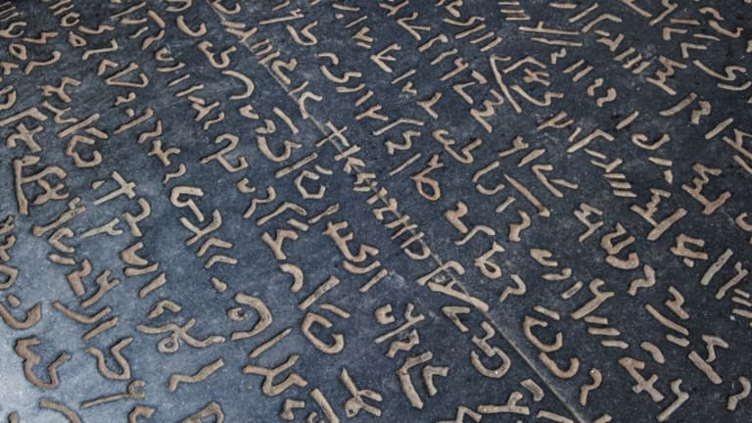
Text
Notes:
Use readable text
Not too crazy colours, contrasts,
WHY use text? It was created to convey messages across distances or «saved» in time, and as mental notes

Slide 5
For how long will you stare at such a text?
Yes... It is visible...no it´s not pretty!
Notes:
Visibility?
Colours
Shadows
Animations
Size of the text

Slide 6
En powerpointpresentasjon er ikke copy paste av det du har tenkt å si. Det som skjer da er at de som sitter i salen blir sittende å lese teksten i stedet for å høre på hva du faktisk sier. I tillegg blir du ofte bundet av teksten. Det er utrolig irriterende hvis du for eksempel glemmer å si noe om et av punktene eller hopper over noe fordi du innser at du ikke har tid. Selv om vi mennesker forteller mange historier gjennom tekst, så er det ikke derfor vi har presentasjoner. Vi har presentasjoner for å LYTTE. Hvis du har kommet så langt har du antagelig ikke hørt etter hva jeg har sagt. Slutt å lese nå. Jeg mener det!
Notes:
Too much text takes the attention away from the audience.

Slide 7
Animations
Problem: You want to show a document or a web page that is too large to fit on your screen if demands on text size etc. are to be fulfilled (or nearly so)
Notes:
NO go... No animations unless it actually underlines your message... Use with care...
But it also has some benefits! Explore the possibilities!
Consider: Can you use other tools, such as PREZI? A warning... To much side to side and zooming can make people dizzy!

Slide 8
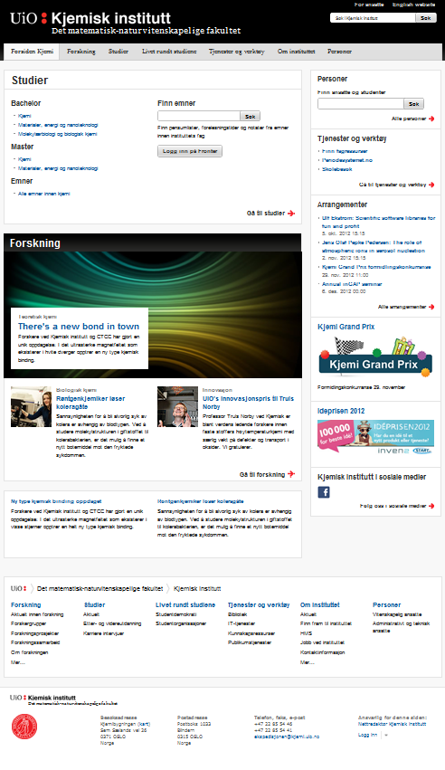
Notes:
NB! Means that technically a poster could be presented this way

Slide 10
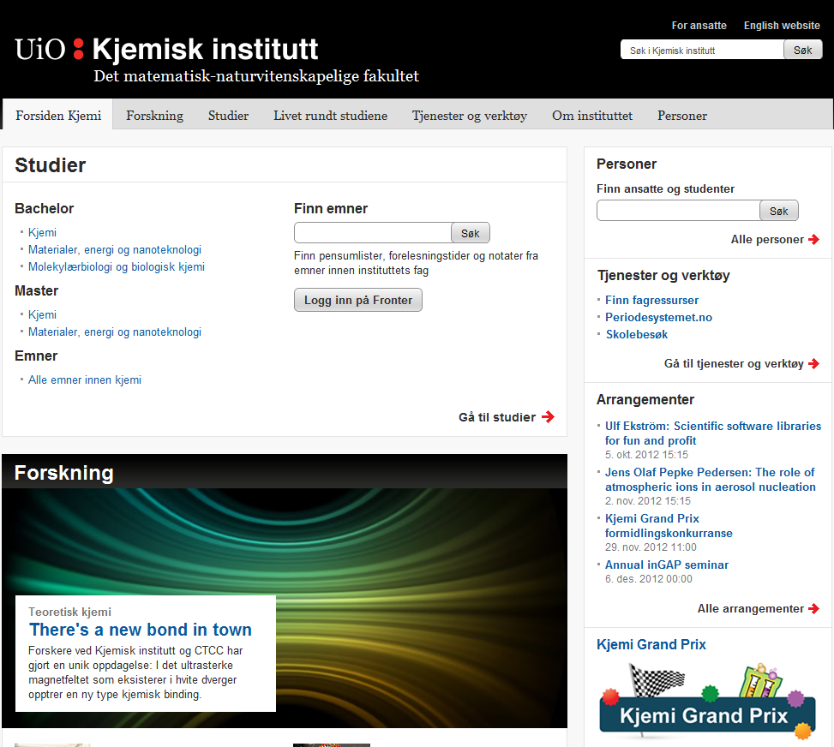

Slide 11
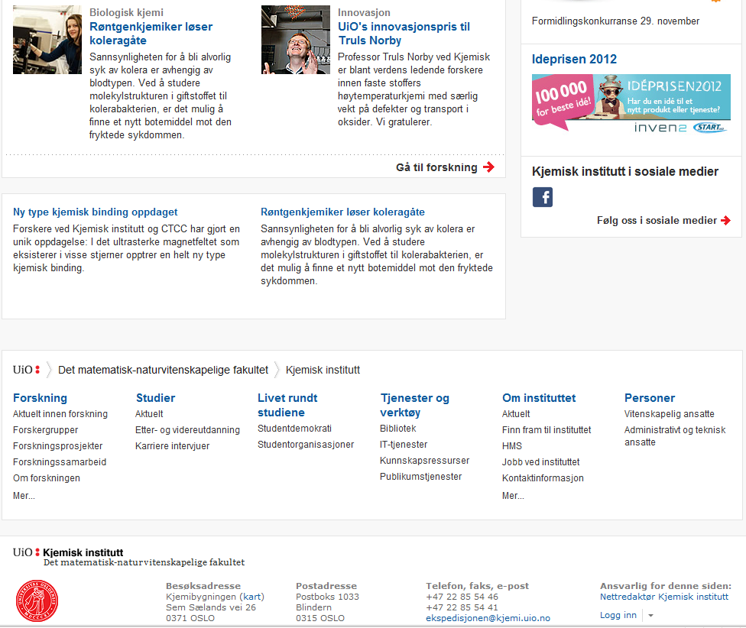

Slide 12
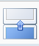
slow

Slide 14

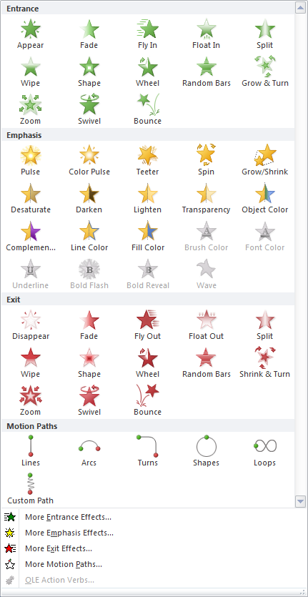
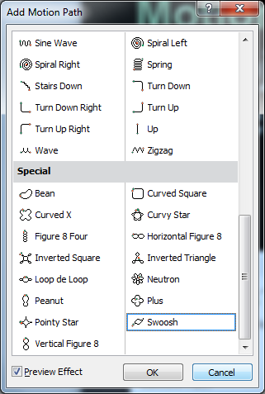
Motion paths
for objects on screen
or to bring them in
Can be very useful in illustrating processes

Slide 15
N₂ (105 K)
cooling unit
collimator
CCD detector
beam stop
X-ray source
head
goniometer

Slide 16
N₂ (105 K)
cooling unit
collimator
CCD detector
beam stop
X-ray source
head
goniometer

Slide 17
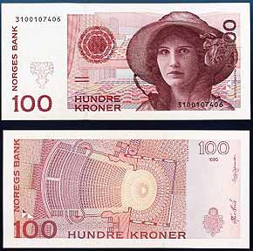
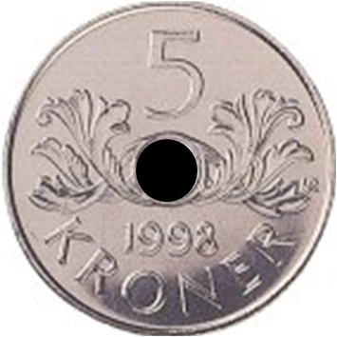
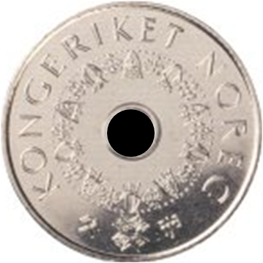

Slide 18
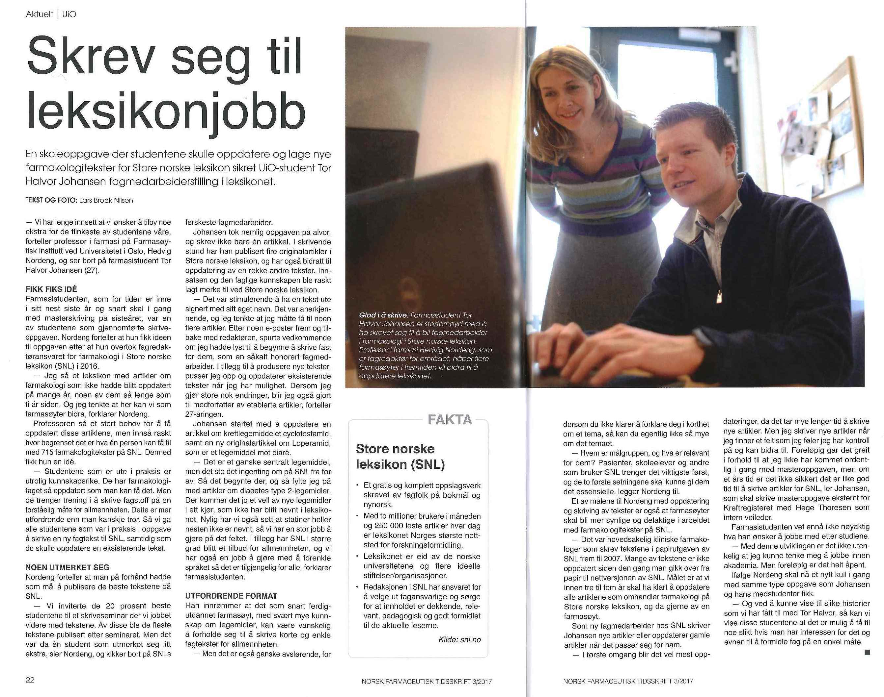
Figures and images
www.uio.no
Notes:
ONE figure pr. Slide!
Readable? Size/colours?
Does the audience know the abbreviations?
Do you explain what you see?

Slide 19
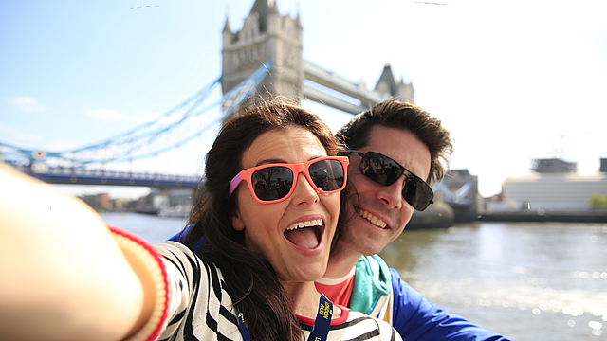
Notes:
Today, much of our storytelling has become exeedingly visual. Like selfies... Or snapchat instead of a text message. Or simply talking to each other... A picture says more than a thousand words?
If you use visuals:
Do you need it? What is the point?
Does it underline your point? (No CAT photos unless you need it!)
Is it simple enough to understand?
Does it look good?

Slide 20
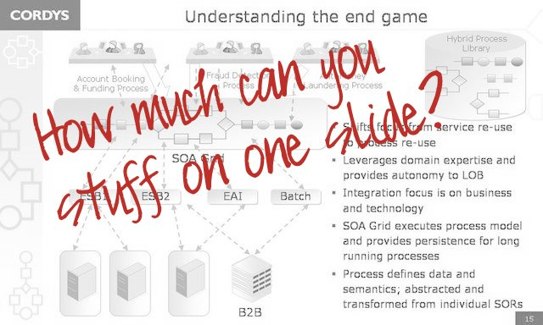
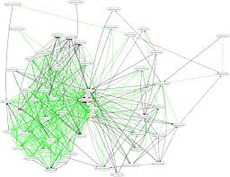
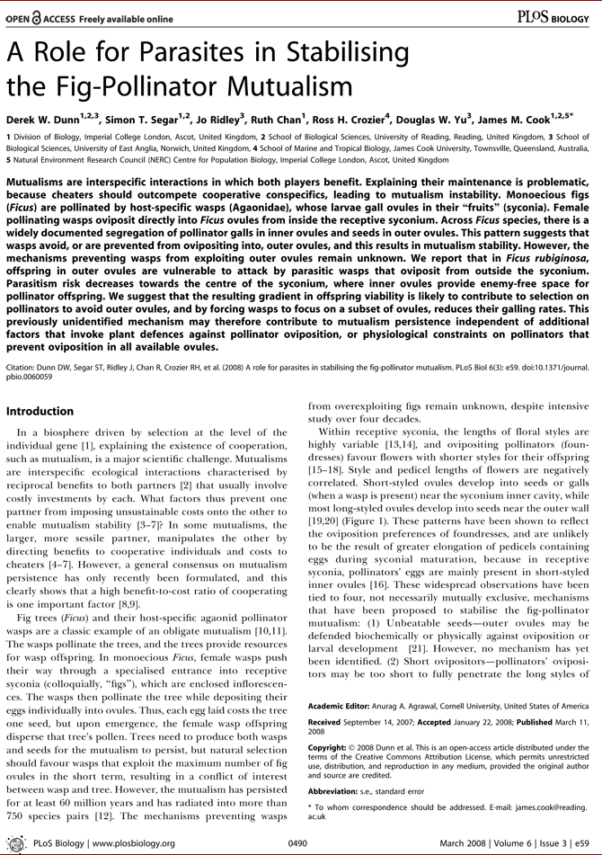
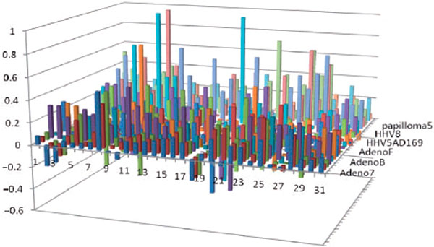
Notes:
THIS is ugly!
Too much information
Can´t see the graph
You may end up saying: 1) No time to explain this OR 2) this is too complicated... Then you have managed to both vaste your audiences time and insult them...
ALWAYS EXPLAIN YOUR GRAPHS!

Slide 21



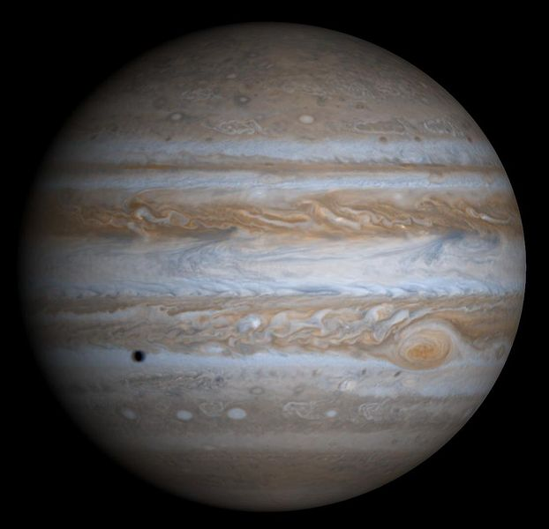
Jupiter
The largest planet in the solar system
Diameter 143 000 km
Big red spot in the atmosphere
More than 50 moons
No more than five focus points in a single slide
UiO 11.10.2017 Carl Henrik Gørbitz, Department of Chemistry, University of Oslo
Notes:
From CHs lecture...
I would say 3 key points!!!!

Slide 22
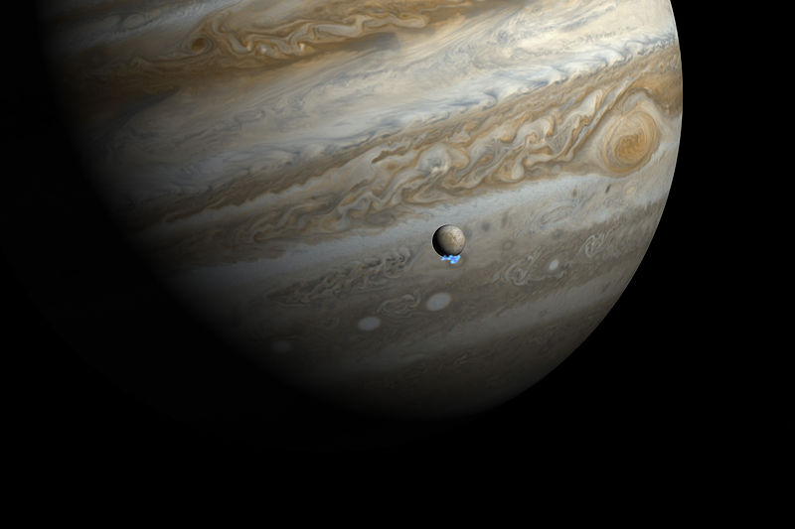
Jupiter

Slide 23
Notes:
Number of deaths during a boring presentation....
Explain the graph: What makes it interesting?
Keep in mind that this should be the «cliff-hangers» of your story! Did you make it or not?

Slide 24
Exercise 6
Work in groups of three.
Study the research presentation files and discuss where animations would have been appropriate and suggest how they could be executed

Slide 25
Next week
Poster design med Pål Gustav Widerberg
Personal coaching on Monday, Tuesday and Wednesday in preparation for video recordings in two weeks.

